Slide 1
Fantasy Football Recommendation System
Keith Landry

Slide 2
Predicting Fantasy Points
Matchups are important
Predict fantasy points by player against specific team
Only use current year data
Bootstrapping allows for distribution of predicted scores

Slide 3
Week 10 QB Predictions

Slide 4

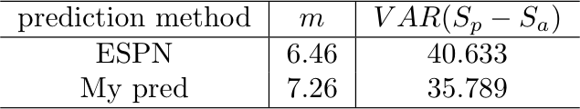
Accuracy (Playing Quarterbacks)

Slide 5
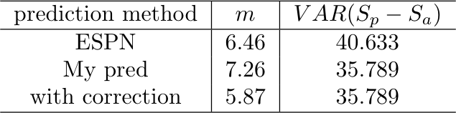
Systematic Error in Pred
Historically, predicted scores have been lower than actual scores across the board
In QB case this shift is about 4 fantasy points

Slide 6
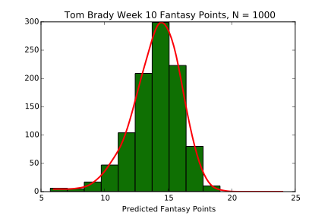
Probability of Winning Matchup
Prediction gives distribution of possible scores
Monte Carlo Simulation
See how scores of correlated players distort the score probability distributions
Not enough data to treat individual player combination

Slide 7
Improvements
Add weighting to cost function to emphasize recent games.
Handle Injured Players/replacements

Slide 8


Learning Procedure
Weekly player data scraped from fftoday.com
Construct 3 matricies
Cost Function Minimized
Regularization term and alpha are allowed to vary in cross validation
Bootstrapping performed

Slide 10
Tom Brady Week 10 Distribution

Slide 11
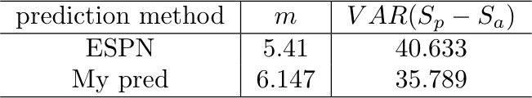
Accuracy (Playing Quarterbacks)

Slide 12
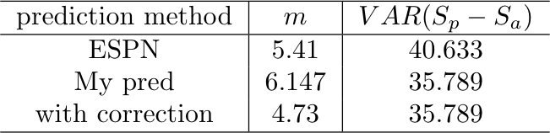
Systematic Error in Pred
Historically, predicted scores have been lower than actual scores across the board
In QB case this shift is about 4 fantasy points

