Slide 1
Introduction to MATLAB parallel computing toolbox
Keith Ma ---------------------------------------- keithma@bu.edu
Research Computing Services ----------- help@rcs.bu.edu
Boston University ----------------------------------------------------

Slide 2
Overview
Goals:
Basic understanding of parallel computing concepts
Familiarity with MATLAB parallel computing tools
Outline:
Parallelism, defined
Parallel “speedup” and its limits
Types of MATLAB parallelism
multi-threaded/implicit, distributed, explicit)
Tools: parpool, SPMD, parfor, gpuArray, etc

Slide 3
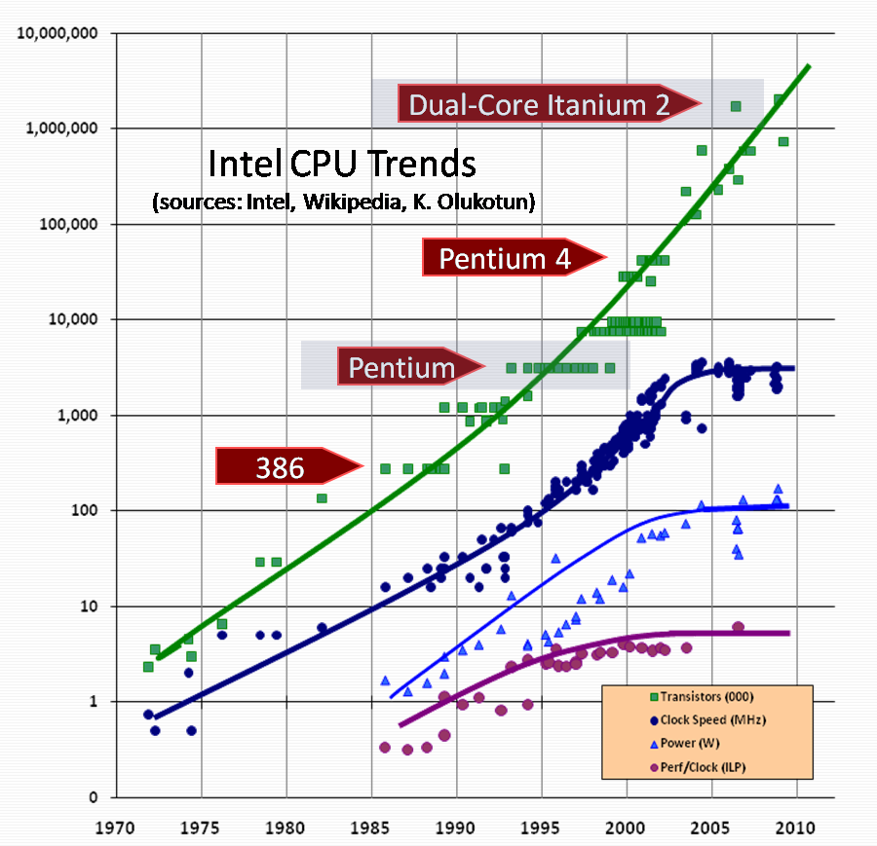
Parallel Computing
Definition: The use of two or more processors in combination to solve a single problem.
Serial performance improvements have slowed, while parallel hardware has become ubiquitous
Parallel programs are typically harder to write and debug than serial programs.
*http://web.eecs.umich.edu/~qstout/parallel.html
Select features of Intel CPUs over time, Sutter, H. (2005). The free lunch is over. Dr. Dobb’s Journal, 1–9.

Slide 4
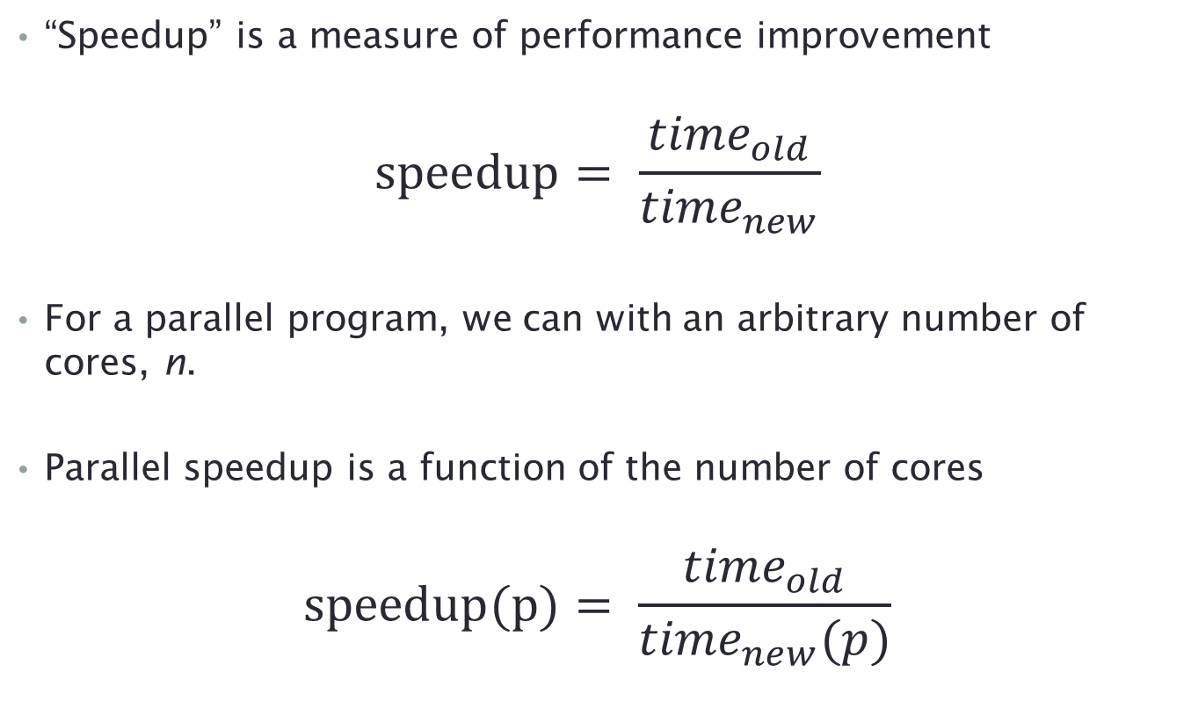
Parallel speedup, and its limits (1)
“Speedup” is a measure of performance improvement
$$speedup= \frac{{time}_{old}}{{time}_{new}}$$
For a parallel program, we can with an arbitrary number of cores, n.
Parallel speedup is a function of the number of cores
$$speedup(p)= \frac{{time}_{old}}{{time}_{new}(p)}$$

Slide 5
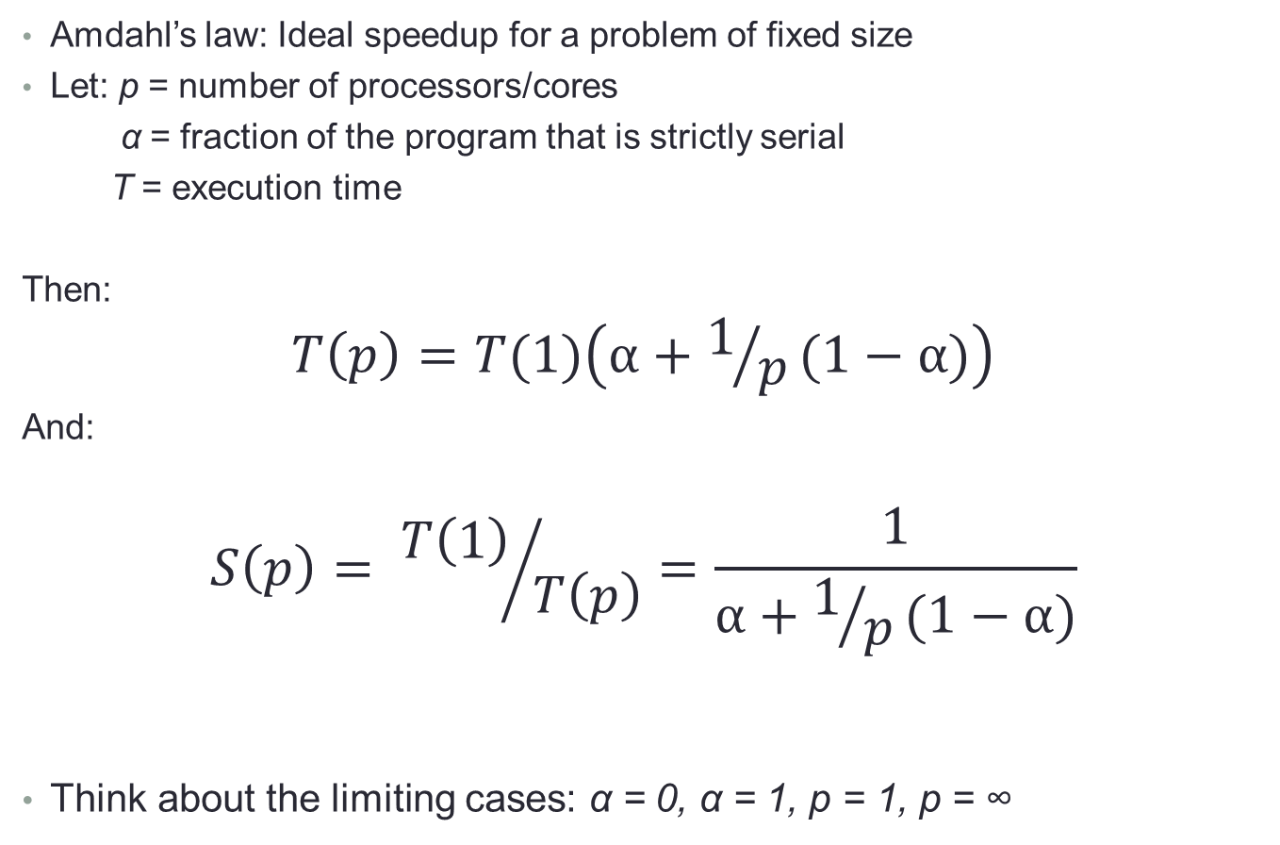
Parallel speedup, its limits (2)
Amdahl’s law: Ideal speedup for a problem of fixed size
Let: p = number of processors/cores
α = fraction of the program that is strictly serial
T = execution time
Then:
$$T\left(p\right)=T(1)\left(α+1/p(1−α)\right)$$
And:
$$S\left(p\right)= {T\left(1\right)}/{T\left(p\right)}=\frac{1}{α+1/p(1−α)}$$
Think about the limiting cases: α = 0, α = 1, p = 1, p = ∞

Slide 6
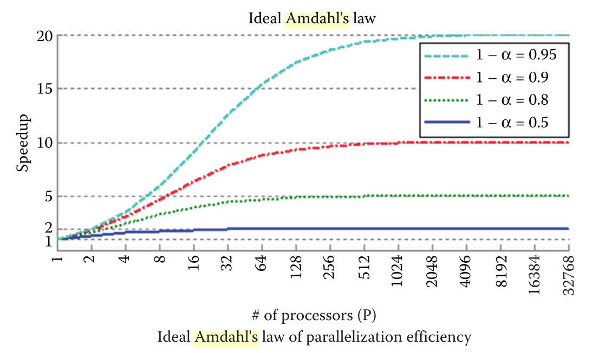
Parallel speedup, and its limits (3)
Diminishing returns as more processors are added
Speedup is limited if α < 0
“Linear speedup” is the best you can do (usually)
*
*Accelerating MATLAB Performance, Yair Altman, 2015

Slide 7
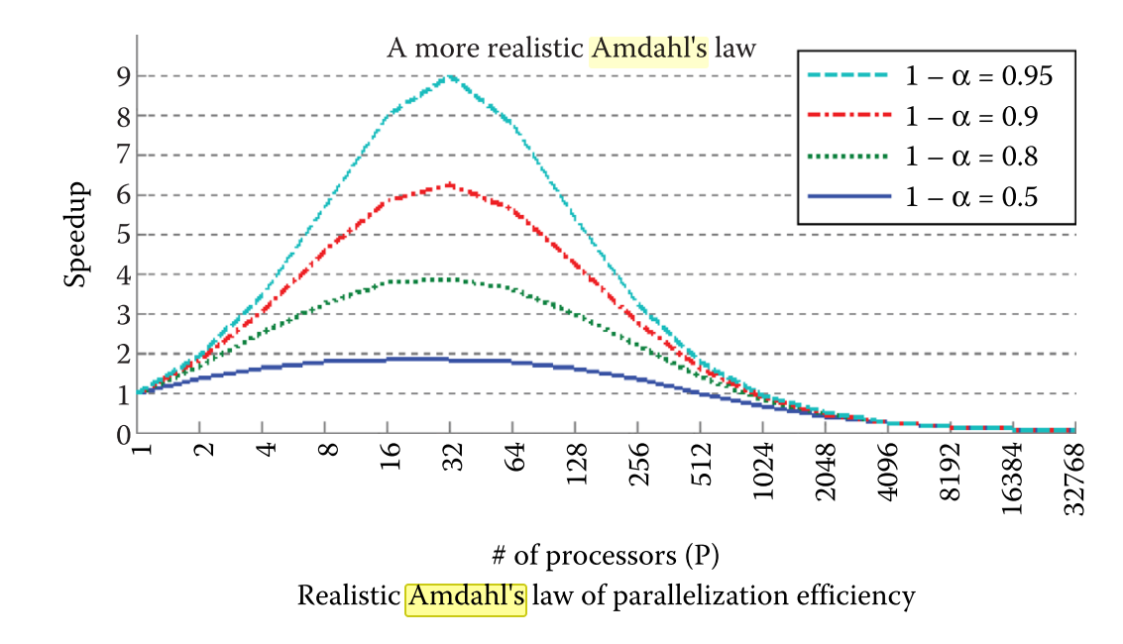
Parallel speedup, and its limits (3)
The program “chokes” if too many cores are added
Caused by communication cost and overhead, resource contention
*
*Accelerating MATLAB Performance, Yair Altman, 2015

Slide 8
Hardware: single core
No parallelism
Good luck finding one…
System memory
Network
Processor 1

Slide 9
Hardware: multi-core
Each processor core runs independently
All cores can access system memory
Common in desktops, laptops, smartphones, probably toasters…
System memory
Network
Processor 1

Slide 10
Hardware: multi-core, multi-processor
Each processor core runs independently
All cores can access system memory
Common in workstations and servers (including the SCC here at BU)
System memory
Network
Processor 1
Processor 2

Slide 11
Hardware: accelerators
Accelerator/ GPU
memory
Accelerator/GPU is an a separate chip with many simple cores.
GPU memory is separate from system memory
Not all GPUs are suitable for research computing tasks (need support for APIs, decent floating-point performance)
System memory
Network
Accelerator / GPU
Processor 1
Processor 2

Slide 12
Hardware: clusters
Accelerator/ GPU
memory
Several independent computers, linked via network
System memory is distributed (i.e. each core cannot access all cluster memory)
Bottlenecks: inter-processor and inter-node communications, contention for memory, disk, network bandwidth, etc.
System memory
Network
Accelerator / GPU
Processor 1
Processor 2
Accelerator/ GPU
memory
System memory
Network
Accelerator / GPU
Processor 1
Processor 2

Slide 13
Three Types of Parallel Computing
Parallel MATLAB: Multiple Processors and Multiple Cores, Cleve Moler, MathWorks
GPU memory
Multithreaded parallelism…
one instance of MATLAB automatically generates multiple simultaneous instruction streams. Multiple processors or cores, sharing the memory of a single computer, execute these streams. An example is summing the elements of a matrix.
Distributed computing.
Explicit parallelism.
System memory
Network
GPU
Processor 1
Processor 2
GPU memory
System memory
Network
GPU
Processor 1
Processor 2
Notes:
GPUs are borderline, they are technically explicit in that the GPU routines must be invoked, but they operate in a single MATLAB instance, and so I leave them in here
Figure notes: Multithreading makes use of these resources, but typically not full use

Slide 14
Three Types of Parallel Computing
Parallel MATLAB: Multiple Processors and Multiple Cores, Cleve Moler, MathWorks
GPU memory
Multithreaded parallelism.
Distributed computing.
multiple instances of MATLAB run multiple independent computations on separate computers, each with its own memory…In most cases, a single program is run many times with different parameters or different random number seeds.
Explicit parallelism.
System memory
Network
GPU
Processor 1
Processor 2
GPU memory
System memory
Network
GPU
Processor 1
Processor 2
Notes:
NEEDS WORK.

Slide 15
Three Types of Parallel Computing
Parallel MATLAB: Multiple Processors and Multiple Cores, Cleve Moler, MathWorks
GPU memory
Multithreaded parallelism.
Distributed computing.
Explicit parallelism…
several instances of MATLAB run on several processors or computers, often with separate memories, and simultaneously execute a single MATLAB command or M-function. New programming constructs, including parallel loops and distributed arrays, describe the parallelism.
System memory
Network
GPU
Processor 1
Processor 2
GPU memory
System memory
Network
GPU
Processor 1
Processor 2
Notes:
NEEDS WORK.

Slide 16
MATLAB parallel computing toolbox (PCT)
Supports multithreading (adds GPUs), distributed parallelism, and explicit parallelism
You need…
MATLAB and a PCT license
Note that licenses are limited at BU – 500 for MATLAB, 45 for PCT
Parallel hardware, as discussed above
Notes:
NEEDS WORK.

Slide 17
Distributed Jobs
Define and run independent jobs
No need to parallelize code!
Expect linear speedup
Each task must be entirely independent
Approach: define jobs, submit to a scheduler, gather results
Using MATLAB scheduler – not recommended:
c = parcluster;
j = createJob(c);
createTask(j, @sum, 1, {[1 1]});
createTask(j, @sum, 1, {[2 2]});
createTask(j, @sum, 1, {[3 3]});
submit(j);
wait(j);
out = fetchOutputs(j);
define
submit
gather
Notes:
Advantages: gathering output is relatively simple
Disadvantages: oddball, MATLAB-specific syntax, setting up the cluster configuration can be difficult

Slide 18
Distributed Jobs on SCC
For task-parallel jobs on SCC, use the cluster scheduler (not the tools provided by PCT)
To define and submit one job:
qsub matlab -nodisplay -singleCompThread -r “rand(5), exit”
To define and submit many jobs, use a job array:
qsub –N myjobs –t 1-10:2 matlab -nodisplay -singleCompThread –r \ “rand($SGE_TASK_ID), exit"
Results must be gathered manually, typically by a “cleanup” job that runs after the others have completed:
qsub –hold_jid myjobs matlab -nodisplay -singleCompThread –r \ “my_cleanup_function, exit"
Much more detail on MATLAB batch jobs on the SCC here.
submit
define
Notes:
Advantages: Make use of existing scheduling system, similar (but not identical) to most computing clusters, code does not depend on MATLAB scheduler availability
Disadvantages: results must be manually gathered after all jobs are completed

Slide 19
Parallel Jobs
Split up the work for a single task
Must write parallel code
Your mileage may vary - some parallel algorithms may run efficiently and others may not
Programs may include both parallel and serial sections
Client:
The head MATLAB session – creates workers, distributes work, receives results
Workers/Labs:
independent, headless, MATLAB sessions
do not share memory
create before you need them, destroy them when you are done
Modes:
pmode: special interactive mode for learning the PCT and development
matlabpool/parpool: is the general-use mode for both interactive and batch processing.
Notes:
Tell, then show by opening a new matlabpool killing it and doing this again…

Slide 20
Parallel Jobs: matlabpool/parpool
matlabpool/parpool creates workers (a.k.a labs) to do parallel computations.
Usage:
parpool(2)
% . . .
% perform parallel tasks
% . . .
delete(gcp)
No access to GUI or graphics (workers are “headless”)
Parallel method choices that use parpool workers:
parfor: parallel for-loop; can’t mix with spmd
spmd: single program multiple data parallel region
Notes:
DEMO OPENING MATLABPOOL

Slide 21
parfor (1)
Simple: a parallel for-loop
Work load is distributed evenly and automatically according to loop index. Details are intentionally opaque to user.
Many additional restrictions as to what can and cannot be done in a parfor loop – this is the price of simplicity
Data starts on client (base workspace), automatically copied to workers’ workspaces. Output copied back to client when done.
Basic usage:
parpool(2)
x = zeros(1,10);
parfor i=1:10
x(i) = sin(i);
end
delete(gcp)
Notes:
DEMO OPENING MATLABPOOL

Slide 22
parfor (2)
For the parfor loop to work, variables inside the loop must all fall into one of these categories:
Type | Description
Loop | A loop index variable for arrays
Sliced | An array whose segments are manipulated on different loop iterations
Broadcast | A variable defined before the loop and is used inside the loop but never modified
Reduction | Accumulates a value across loop iterations, regardless of iteration order
Temporary | Variable created inside the loop, but not used outside the loop
c = pi; s = 0;
X = rand(1,100);
parfor k = 1 : 100
a = k; % a - temporary variable; k - loop variable
s = s + k; % s - reduction variable
if i <= c % c - broadcast variable
a = 3*a - 1;
end
Y(k) = X(k) + a; % Y - output sliced var; X - input sliced var
end
Notes:
DEMO OPENING MATLABPOOL

Slide 23
parfor (3): what can’t you do?
Data dependency: loop iterations are must be independent
a = zeros(1,100);
parfor i = 2:100
a(i) = myfct(a(i-1));
end
Notes:
DEMO OPENING MATLABPOOL

Slide 24
parfor (4): what can’t you do?
Data dependency exceptions: “Reduction” operations that combine results from loop iterations in order-independent or entirely predictable ways
% computing factorial using parfor
x = 1;
parfor idx = 2:100
x = x * idx;
end
% reduction assignment with insert operator
d = [];
parfor idx = -10 : 10
d = [d, idx*idx*idx];
end
% reduction assignment of a row vector
v = zeros(1,100);
parfor idx = 1:n
v = v + (1:100)*idx;
end
Notes:
DEMO OPENING MATLABPOOL

Slide 25
parfor (4): what can’t you do?
Data dependency exception: “Reduction” operations that combine results from loop iterations
Reduction operations must not depend on loop order
must satisfy x ◊ (y ◊ z) = (x ◊ y) ◊ z
Plus (+) and multiply (*) operators pass, subtract (-) and divide (/) may fail.
s = 0;
parfor i=1:10
s = i-s;
end
Notes:
DEMO OPENING MATLABPOOL

Slide 26
parfor (5): what can’t you do?
Loop index must be consecutive integers.
parfor i = 1 : 100 % OK
parfor i = -20 : 20 % OK
parfor i = 1 : 2 : 25 % No
parfor i = -7.5 : 7.5 % No
A = [3 7 -2 6 4 -4 9 3 7]; parfor i = find(A > 0) % No
…and more! See the documentation
Notes:
DEMO OPENING MATLABPOOL

Slide 27
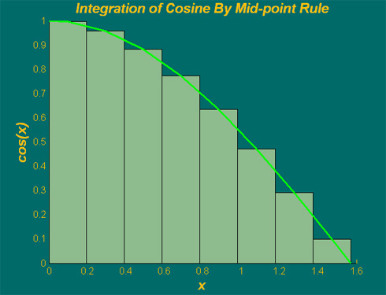
Integration example (1)
Integrate of the cos(x) between 0 and π/2 using mid-point rule
a = 0; b = pi/2; % range
m = 8; % # of increments
h = (b-a)/m; % increment
p = numlabs;
n = m/p; % inc. / worker
ai = a + (i-1)*n*h;
aij = ai + (j-1)*h;
Worker 1
mid-point of increment
Worker 2
cos(x)
h
Worker 3
Worker 4
x=a
x=b

Slide 28
Integration example (2): serial
% serial integration (with for-loop)
tic
m = 10000;
a = 0; % lower limit of integration
b = pi/2; % upper limit of integration
dx = (b – a)/m; % increment length
intSerial = 0; % initialize intSerial
for i=1:m
x = a+(i-0.5)*dx; % mid-point of increment i
intSerial = intSerial + cos(x)*dx;
end
toc
dx
X(1) = a + dx/2
X(m) = b - dx/2

Slide 29
Integration example (3): parfor
This example performs parallel integration with parfor.
matlabpool open 4
tic
m = 10000;
a = 0;
b = pi/2;
dx = (b – a)/m; % increment length
intParfor2 = 0;
parfor i=1:m
intParfor2 = intParfor2 + cos(a+(i-0.5)*dx)*dx;
end
toc
matlabpool close

Slide 30
spmd (1)
spmd = single program multiple data
Explicitly and/or automatically…
divide work and data between workers/labs
communicate between workers/labs
Syntax:
% execute on client/master
spmd
% execute on all workers
end
% execute on client/master
Notes:
DEMO OPENING MATLABPOOL

Slide 31
spmd (2): Integration example (4)
Example: specifying different behavior for each worker
numlabs() --- Return the total number of labs operating in parallel
labindex() --- Return the ID for this lab
parpool(2)
tic % includes the overhead cost of spmd
spmd
m = 10000;
a = 0;
b = pi/2;
n = m/numlabs; % # of increments per lab
deltax = (b - a)/numlabs; % length per lab
ai = a + (labindex - 1)*deltax; % local integration range
bi = a + labindex*deltax;
dx = deltax/n; % increment length for lab
x = ai+dx/2:dx:bi-dx/2; % mid-pts of n increments per worker
intSPMD = sum(cos(x)*dx); % integral sum per worker
intSPMD = gplus(intSPMD,1); % global sum over all workers
end % spmd
toc
delete(gcp)
f = 2; % execute on master
spmd(2)
R = rand(labindex) % execute on 2 workers
end
% back to master
Notes:
DEMO OPENING MATLABPOOL

Slide 32
spmd (3): where are the data?
Memory is not shared by the workers. Data can be shared between workers using explicit MPI-style commands:
spmd
if labindex == 1
A = labBroadcast(1,1:N); % send the sequence 1..N to all
else
A = labBroadcast(1); % receive data on other workers
end
% get an array chunk on each worker
I = find(A > N*(labindex-1)/numlabs & A <= N*labindex/numlabs);
% shift the data to the right among all workers
to = mod(labindex, numlabs) + 1; % one to the right
from = mod(labindex-2, numlabs) + 1; % one to the left
I = labSendReceive(labTo, labFrom, I);
out = gcat(I, 2, 1); % reconstruct the shifted array on the 1st worker
end
Data can also be shared by special PCT data-types
composite
distributed
codistributed
Notes:
DEMO OPENING MATLABPOOL

Slide 33
spmd (4): where are the data?
Memory is not shared by the workers. Data can be shared between workers using special data types: composite, distributed, codistributed
Composite: variable containing references to unique values on each worker.
On the workers, accessed like normal variables
On the client, elements on each worker are accessed using cell-array style notation.
Distributed/Codistributed: array is partitioned amongst the workers, each holds some of the data.
All elements are accessible to all workers
The distinction is subtle: a codistributed array on the workers is accessible on the client as a distributed array, and vice versa
Notes:
DEMO OPENING MATLABPOOL

Slide 34
spmd (5): where are the data?
created before spmd block: copied to all workers
Notes:
DEMO OPENING MATLABPOOL

Slide 35
spmd (6): where are the data?
created before spmd block: copied to all workers
created in spmd block, then unique to worker, composite on client
>> spmd
>> q = magic(labindex + 2);
>> end
>> q
q =
Lab 1: class = double, size = [3 3]
Lab 2: class = double, size = [4 4]
>> q{1}
ans =
8 1 6
3 5 7
4 9 2
Notes:
DEMO OPENING MATLABPOOL

Slide 36
spmd (7): where are the data?
created before spmd block: copied to all workers
created in spmd block, then unique to worker, composite on client
created as a distributed array before spmd: divided up as a codistributed array on workers
W = ones(6,6);
W = distributed(W); % Distribute to the workers
spmd
T = W*2; % Calculation performed on workers, in parallel
% T and W are both codistributed arrays here
end
T % View results in client
% T and W are both distributed arrays here
Notes:
DEMO OPENING MATLABPOOL

Slide 37
spmd (8): where are the data?
created before spmd block: copied to all workers
created in spmd block, then unique to worker, composite on client
created as a distributed array before spmd: divided up as a codistributed array on workers
created as a codistributed array in spmd: divided up on workers, accessible as distributed array on client
spmd(2)
RR = rand(20, codistributor()); % worker stores 20x10 array
end
Notes:
DEMO OPENING MATLABPOOL

Slide 38
Distributed matrices (1): creation
There are many ways to create distributed matrices – you have a great deal of control.
A = rand(3000); B = rand(3000);
spmd
p = rand(n, codistributor1d(1)); % 2 ways to directly create
q = codistributed.rand(n); % distributed random array
s = p * q; % run on workers; s is distributed
% distribute matrix after it is created
u = codistributed(A, codistributor1d(1)); % by row
v = codistributed(B, codistributor1d(2)); % by column
w = u * v; % run on workers; w is distributed
end
Notes:
DEMO OPENING MATLABPOOL

Slide 39
Distributed matrices (2): efficiency
For matrix-matrix multiply, here are 4 combinations on how to distribute the 2 matrices (by row or column) - some perform better than others.
n = 3000; A = rand(n); B = rand(n);
spmd
ar = codistributed(A, codistributor1d(1)) % distributed by row
ac = codistributed(A, codistributor1d(2)) % distributed by col
br = codistributed(B, codistributor1d(1)) % distributed by row
bc = codistributed(B, codistributor1d(2)) % distributed by col
crr = ar * br; crc = ar * bc;
ccr = ac * br; ccc = ac * bc;
end
Wall-clock times of the four ways to distribute A and B
C (row x row) | C (row x col) | C (col x row) | C (col x col)
2.44 | 2.22 | 3.95 | 3.67
Notes:
DEMO OPENING MATLABPOOL

Slide 40
Distributed matrices (3): function overloading
Some function/operators will recognize distributed array inputs and execute in parallel
matlabpool open 4
n = 3000; A = rand(n); B = rand(n);
C = A * B; % run with 4 threads
maxNumCompThreads(1);% set threads to 1
C1 = A * B; % run on single thread
a = distributed(A); % distributes A, B from client
b = distributed(B); % a, b on workers; accessible from client
c = a * b; % run on workers; c is distributed
matlabpool close
Wallclock times for the above (distribution time accounted separately)
C1 = A * B (1 thread) | C = A * B (4 threads) | a = distribute(A) b = distribute(B) | c = a * b (4 workers)
12.06 | 3.25 | 2.15 | 3.89
Notes:
DEMO OPENING MATLABPOOL

Slide 41
Linear system example: Ax = b
% serial
n = 3000; M = rand(n); x = ones(n,1);
[A, b] = linearSystem(M, x);
u = A\b; % solves Au = b; u should equal x
clear A b
% parallel in spmd
spmd
m = codistributed(M, codistributor('1d',2)); % by column
y = codistributed(x, codistributor(‘1d’,1)); % by row
[A, b] = linearSystem(m, y);
v = A\b;
end
clear A b m y
% parallel using distributed array overloading
m = distributed(M); y = distributed(x);
[A, b] = linearSystem(m, y);
W = A\b;
function [A, b] = linearSystem(M, x)
% Returns A and b of linear system Ax = b
A = M + M'; % A is real and symmetric
b = A * x; % b is the RHS of linear system
Notes:
DEMO OPENING MATLABPOOL

Slide 42
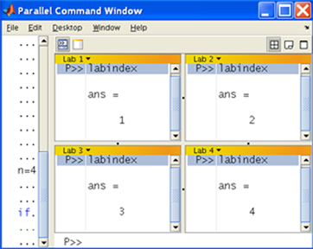
Parallel Jobs: pmode
>> pmode start 4
Worker number
Terminology:
worker = lab = processor
labindex = processor id
numlabs = number of
processors
Last command
Enter command
Commands at the “P>>” prompt are executed on all workers
Use if with labindex to issue instructions specific workers
Memory is NOT shared!
Notes:
BRIEF DEMO HERE.

Slide 43
Using GPUs (1)
For some problems, GPUs achieve better performance than CPUs.
MATLAB GPU utilities are limited, but growing.
Basic GPU operations:
>> n = 3000; % matrix size
>> a = rand(n); % n x n random matrix
>> A = gpuArray(a) % copy a to the GPU
>> B = gpuArray.rand(n) % create random array directly on GPU
>> C = A * B; % matrix multiply on GPU
>> c = gather(C); % bring data back to base workspace
On the SCC, there are compute nodes equipped with GPUs.
To request a GPU for interactive use (for debugging, learning)
scc1% qsh –l gpus=1
To submit batch job requesting a GPU
scc1% qsub –l gpus=1 batch_scc
Notes:
DEMO OPENING MATLABPOOL

Slide 44
Using GPUs (2): arrayfun
maxIterations = 500;
gridSize = 3000;
xlim = [-1, 1];
ylim = [ 0, 2];
x = gpuArray.linspace( xlim(1), xlim(2), gridSize );
y = gpuArray.linspace( ylim(1), ylim(2), gridSize );
[xGrid,yGrid] = meshgrid( x, y );
z0 = complex(xGrid, yGrid);
count0 = ones( size(z0) );
count = arrayfun( @aSerialFct, z0, count0, maxIterations );
count = gather( count ); % Fetch the data back from the GPU
Notes:
DEMO OPENING MATLABPOOL

