Slide 1

Tuning MATLAB for better performance
Keith Ma
Boston University
Research Computing Services

Slide 2
Tutorial Overview
General advice about optimization
A typical workflow for performance optimization
MATLAB's performance measurement tools
Common performance issues in MATLAB
Worked example: image smoothing (moving average)

Slide 3
General Advice on Performance Optimization
"The First Rule of Program Optimization: Don't do it. The Second Rule of Program Optimization (for experts only!): Don't do it yet." –- Micheal A. Jackson, 1988
"We should forget about small efficiencies, say about 97% of the time: premature optimization is the root of all evil. Yet we should not pass up our opportunities in that critical 3%. A good programmer will not be lulled into complacency by such reasoning, he will be wise to look carefully at the critical code; but only after that code has been identified" --- Donald Knuth, 1974
...learn to trust your instruments. If you want to know how a program behaves, your best bet is to run it and see what happens” --- Carlos Bueno, 2013

Slide 4
A typical optimization workflow
create
measure
while goals not met
  profile
  modify
  test
  measure
end while

Slide 5
A typical optimization workflow
create
measure
while goals not met
  profile
  modify
  test
  measure
end while
Design and write the program
Test to make sure that it works as designed / required
Don't pay “undue” attention to performance at this stage.

Slide 6
A typical optimization workflow
create
measure
while goals not met
  profile
  modify
  test
  measure
end while
Run and time the program
Be sure to try a typical workload, or a range of workloads if needed.
Compare your results with you goals/requirements. If it is “fast enough”, you are done!

Slide 7
A typical optimization workflow
create
measure
while goals not met
  profile
  modify
  test
  measure
end while
Detailed measurement of execution time, typically line-by-line
Use these data to identify “hotspots” that you should focus on

Slide 8
A typical optimization workflow
create
measure
while goals not met
  profile
  modify
  test
  measure
end while
Focus on just one “hotspot”
Diagnose and fix the problem, if you can

Slide 9
A typical optimization workflow
create
measure
while goals not met
  profile
  modify
  test
  measure
end while
You just made some changes to a working program, make sure you did not break it!

Slide 10
A typical optimization workflow
create
measure
while goals not met
  profile
  modify
  test
  measure
end while
Run and time the program, as before.

Slide 11
A typical optimization workflow
create
measure
while goals not met
  profile
  modify
  test
  measure
end while
Repeat until your performance goals are met

Slide 12
Tools to measure performance
tic and toc
  Simple timer functions (CPU time)
timeit
  Runs/times repeatedly, better estimate of the mean run time, for functions only
profile
  Detailed analysis of program execution time
  Measures time (CPU or wall) and much more
MATLAB Editor
  Code Analyzer (Mlint) warns of many common issues

Slide 13
Where to Find Performance Gains ?
Serial Performance
  Eliminate unnecessary work
  Vectorize (eliminate loops)
  Improve memory use
  Compile (MEX)
Parallel Performance
  “For-free” in many built-in MATLAB functions
  Explicit parallel programming using the Parallel computing toolbox

Slide 14
Unnecessary work (1): redundant operations
Avoid redundant operations in loops:
bad
for i=1:N
x = 10;
.
.
end
good
x = 10;
for i=1:N
.
.
end

Slide 15
Unnecessary work (2): reduce overhead
..from function calls
good
bad
function myfunc(i)
% do stuff
end
for i=1:N
myfunc(i);
end
function myfunc2(N)
for i=1:N
% do stuff
end
end
myfunc2(N);
..from loops
bad
good
for i=1:N
x(i) = i;
end
for i=1:N
y(i) = rand();
end
for i=1:N
x(i) = i;
y(i) = rand();
end

Slide 16
Unnecessary work (3): logical tests
...by moving known cases out of loops
Avoid unnecessary logical tests...
bad
...by using short-circuit logical operators
for i=1:N
if i == 1
% i=1 case
else
% i>1 case
end
end
bad
if (i == 1 | j == 2) & k == 5
% do something
end
good
if (i == 1 || j == 2) && k == 5
% do something
end
good
% i=1 case
for i=2:N
% i>1 case
end

Slide 17
Unnecessary work (4): reorganize equations
bad
c = 4;
for i=1:N
x(i)=y(i)/c;
v(i) = x(i) + x(i)^2 + x(i)^3;
z(i) = log(x(i)) * log(y(i));
end
Reorganize equations to use fewer or more efficient operators
Basic operators have different speeds:
Add 3- 6 cycles
Multiply 4- 8 cycles
Divide 32-45 cycles
Power, etc (worse)
good
s = 1/4;
for i=1:N
x(i) = y(i)*s;
v(i) = x(i)*(1+x(i)*(1+x(i)));
z(i) = log(x(i) + y(i));
end

Slide 18
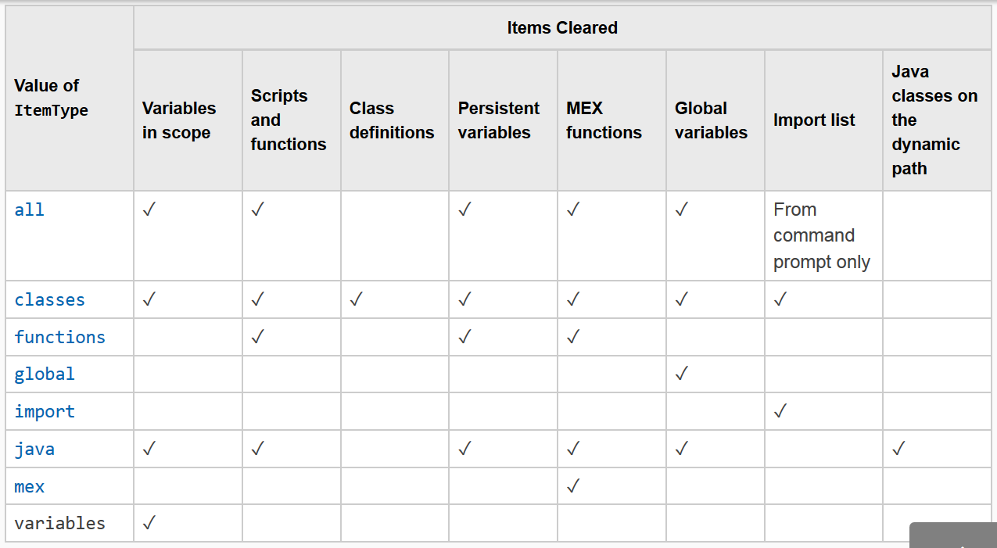
Unnecessary work (5): don't 'clear all'
MATLAB improves performance by interpreting a program only once, unless you tell it to forget that work

Slide 19
Vectorize (1)
MATLAB is designed for vector and matrix operations. The use of for-loop, in general, can be expensive, especially if the loop count is large and nested.
When possible, use vector representation instead of for-loops.
bad
good
i = 0;
for t = 0:.01:100
i = i + 1;
y(i) = sin(t);
end
t = 0:.01:100;
y = sin(t);

Slide 20
Vectorize (2): why is is faster?
Implicit (automated, internal) parallelization
Highly-tuned, compiled, math libraries employing state-of-the-art algorithms and performance optimizations techniques
Highly-tuned, compiled, core MATLAB functions
Make use of CPU-level vectorization

Slide 21
Vectorize (3): example using logical arrays
Logical arrays can be used for indexing:
bad
d = rand(1000, 1);
h = rand(1000, 1);
v = [ ];
for n = 1:1000
if h(n) > 0.5
v(end+1) = 1/12*pi*(d(n)^2)*h(n));
end
end
good
d = rand(1000, 1);
h = rand(1000, 1);
mask = h<0.5;
v = 1/12*pi*(d(mask)^2)*h(mask));

Slide 22
Vectorize (4): example using logical arrays
Or in other, more creative, ways:
bad
A = rand(100,1);
B = rand(100,1);
for i = 1:100
if B(i)>0.5
C(i) = A(i)^2;
else
C(i) = exp(B(i));
end
end
good
A = rand(100,1);
B = rand(100,1);
D = (B>0.5);
C = D.*(A.^2)+(~D).*exp(B);

Slide 23
Vectorize (5): example using repmat
repmat helps construct the matrices needed for vectorized calculations
x = -3:0.01:3;
y = -3:0.01:3;
xx = repmat(x, numel(y), 1);
yy = repmat(y' , 1, numel(x));
plane = 5+3*xx+2*yy;

Slide 24
Vectorize (6): example using bsxfun
bsxfun provides a way of combining matrices of different dimensions without using repmat to match their size first
Valid operations are:
@plus, @minus, @times, @rdivide, @ldivide, @power, @max, @min, @rem, @mod, @atan2, @atan2d, @hypot, @eq, @ne, @lt, @le, @gt, @ge, @and, @or, @xor
A = [97 89 84; 95 82 92; 64 80 99];
Abar = mean(A);
dev = A – repmat(Abar, size(A,1), 1);
A = [97 89 84; 95 82 92; 64 80 99];
Abar = mean(A);
dev = bsxfun(@minus, A, Abar);

Slide 25
Vectorize (6): other utility functions
Function | Description
all | Test to see if all elements are of a prescribed value
any | Test to see if any element is of a prescribed value
zeros | Create array of zeroes
ones | Create array of ones
repmat | Replicate and tile an array
find | Find indices and values of nonzero elements
diff | Find differences and approximate derivatives
squeeze | Remove singleton dimensions from an array
prod | Find product of array elements
sum | Find the sum of array elements
cumsum | Find cumulative sum
shiftdim | Shift array dimensions
logical | Convert numeric values to logical
sort | Sort array elements in ascending /descending order

Slide 26
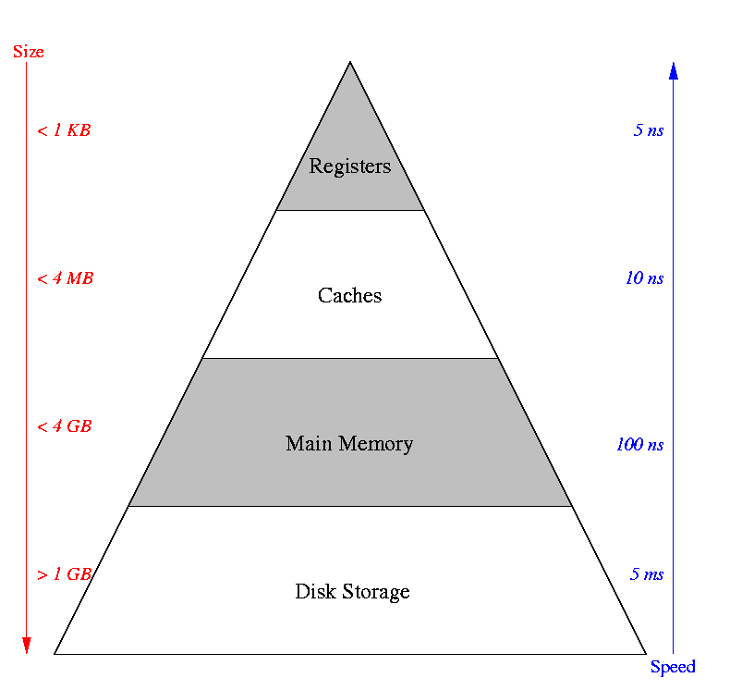
Memory (1): the memory hierarchy
To use memory efficiently:
Minimize disk I/O
Avoid unnecessary memory access
Make good use of the cache

Slide 27
Memory (2): preallocate arrays
Arrays are always allocated in contiguous address space
If an array changes size, and runs out of contiguous space, it must be moved.
x = 1;
for i = 2:4
x(i) = i;
end
This can be very very bad for performance when variables become large
Memory Address | Array Element
1 | x(1)
… | . . .
2000 | x(1)
2001 | x(2)
2002 | x(1)
2003 | x(2)
2004 | x(3)
. . . | . . .
10004 | x(1)
10005 | x(2)
10006 | x(3)
10007 | x(4)

Slide 28
Memory (3): preallocate arrays, cont.
Preallocating array to its maximum size prevents intermediate array movement and copying
A = zeros(n,m); % initialize A to 0
A(n,m) = 0; % or touch largest element
If maximum size is not known apriori, estimate with upperbound. Remove unused memory after.
A=rand(100,100);
% . . .
% if final size is 60x40, remove unused portion
A(61:end,:)=[]; A(:,41:end)=[]; % delete

Slide 29
Memory (4): cache and data locality
Cache is much faster than main memory (RAM)
Cache hit: required variable is in cache, fast
Cache miss: required variable not in cache, slower
Long story short: faster to access contiguous data

Slide 30
Memory (5): cache and data locality, cont.
“mini” cache
holds 2 lines, 4 words each
for i = 1:10
x(i) = i;
end
x(1)
x(9)
x(2)
x(10)
x(3)
a
x(4)
b
Main memory
x(5)
…
x(6)
…
x(7)
x(8)

Slide 31
Memory (6): cache and data locality, cont.
x(1)
ignore i for simplicity
need x(1), not in cache, cache miss
load line from memory into cache
next 3 loop indices result in cache hits
x(2)
x(3)
x(4)
x(1)
x(9)
x(2)
x(10)
x(3)
a
x(4)
b
x(5)
…
x(6)
…
for i=1:10
x(i) = i;
end
x(7)
x(8)

Slide 32
Memory (7): cache and data locality, cont.
x(1)
x(5)
need x(5), not in cache, cache miss
load line from memory into cache
free ride next 3 loop indices, cache hits
x(2)
x(6)
x(3)
x(7)
x(4)
x(8)
x(1)
x(9)
x(2)
x(10)
x(3)
a
x(4)
b
for i = 1:10
x(i) = i;
end
x(5)
…
x(6)
…
x(7)
x(8)

Slide 33
Memory (8): cache and data locality, cont.
x(9)
x(5)
need x(9), not in cache --> cache miss
load line from memory into cache
no room in cache, replace old line
x(6)
x(10)
a
x(7)
b
x(8)
x(1)
x(9)
x(2)
x(10)
x(3)
a
for i=1:10
x(i) = i;
end
x(4)
b
x(5)
…
x(6)
…
x(7)
x(8)

Slide 34
Memory (9): for-loop order
Multidimensional arrays are stored in memory along columns (column-major)
Best if inner-most loop is for array left-most index, etc.
bad
good
n=5000; x = zeros(n);
for i = 1:n % rows
for j = 1:n % columns
x(i,j) = i+(j-1)*n;
end
end
n=5000; x = zeros(n);
for j = 1:n % columns
for i = 1:n % rows
x(i,j) = i+(j-1)*n;
end
end

Slide 35
Memory (10): compute-in-place
Compute and save array in-place improves performance and reduces memory usage
Caveat: May not be work if the data type or size changes – these changes can force reallocation or disable JIT acceleration
More generally, avoid temporary variables
bad
good
x = rand(5000);
y = x.^2;
x = rand(5000);
x = x.^2;

Slide 36
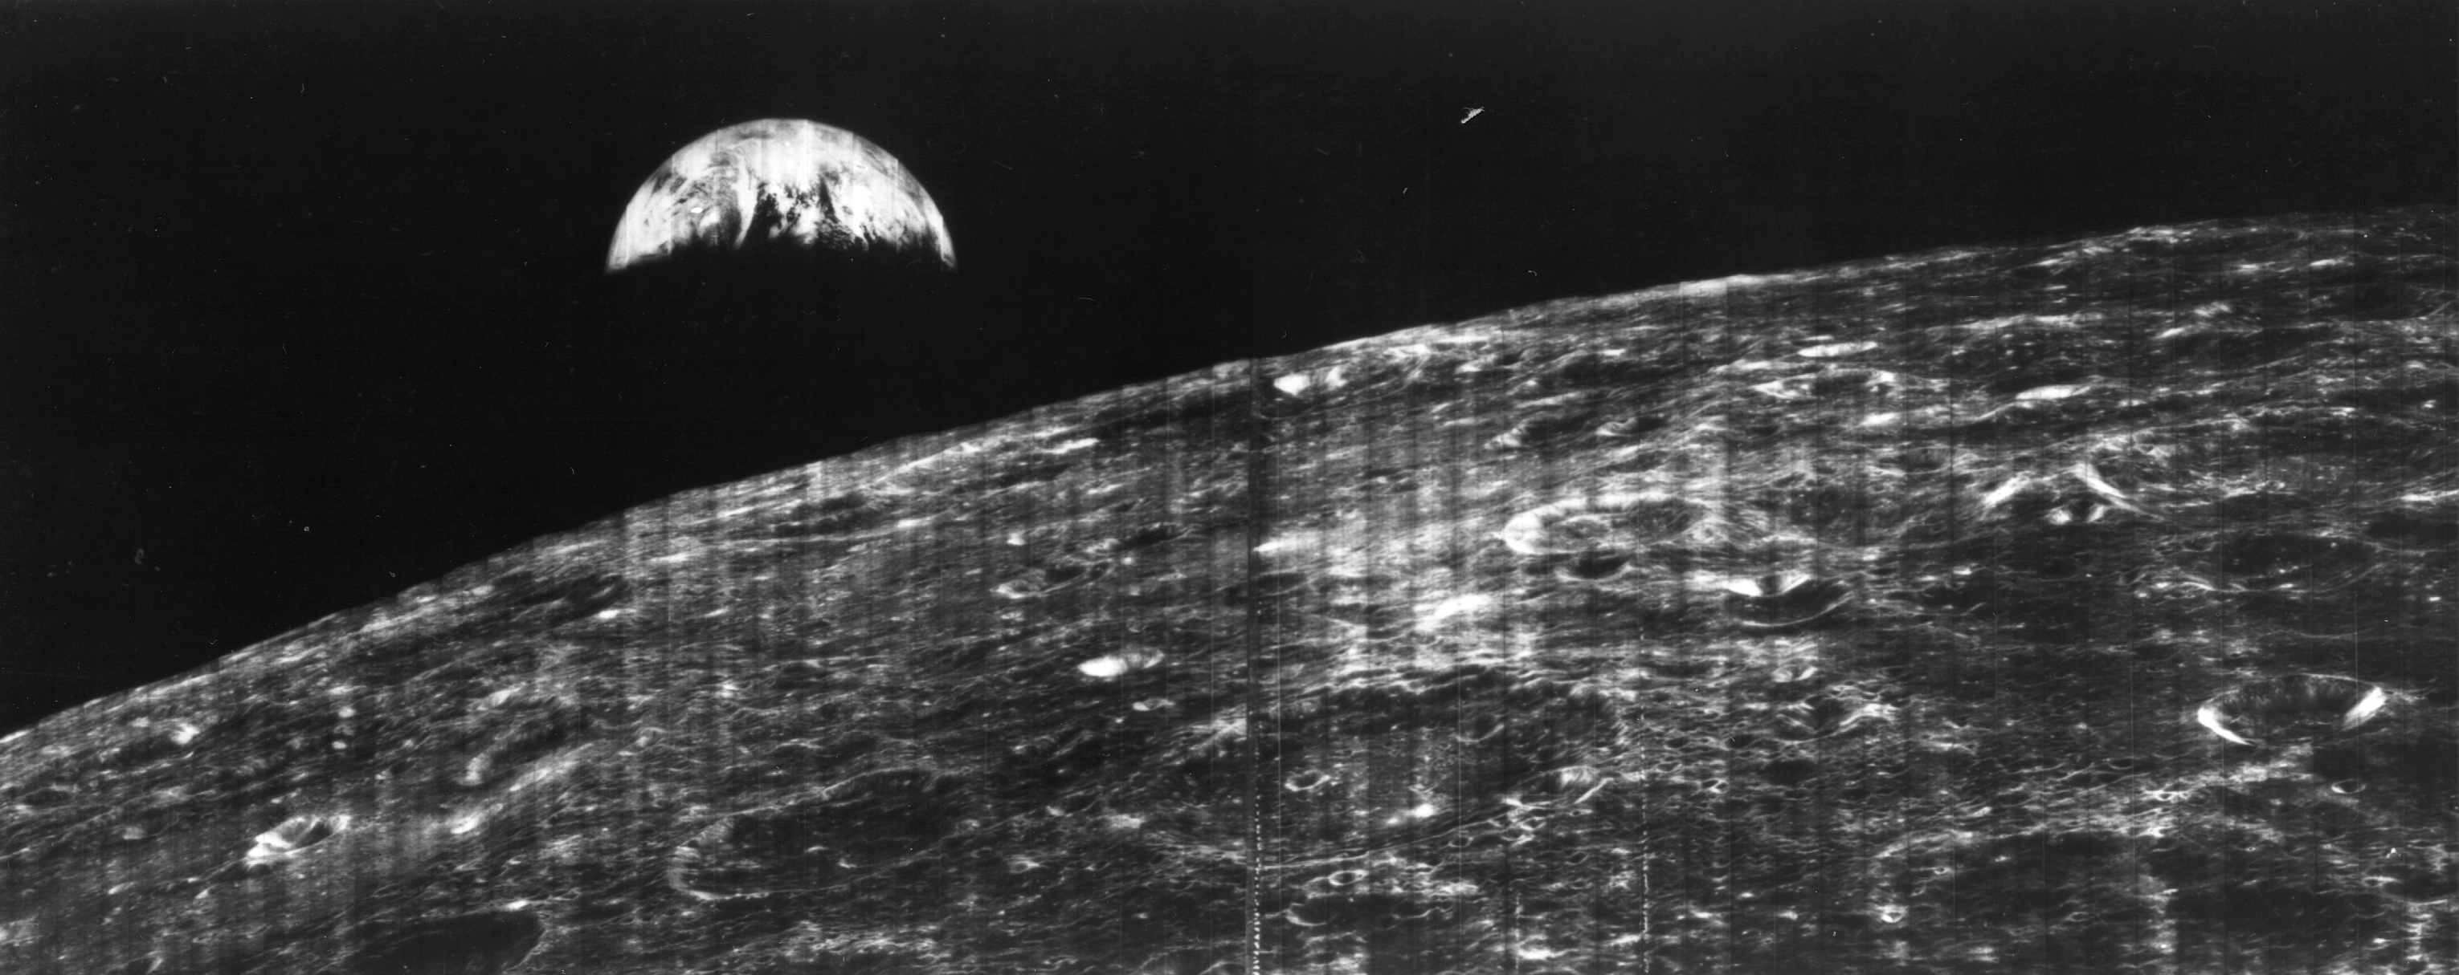

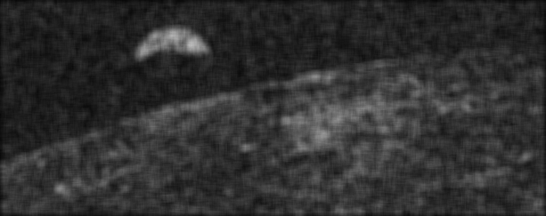
Worked Example: sliding window image smoothing
Original: first view of the earth from the moon, NASA Lunar Orbiter 1, 1966
Input: downsampled, with gaussian noise
Output: smoothed with 9x9 window

