Slide 1

Tuning MATLAB for better performance
Kadin Tseng
Boston University
Scientific Computing and Visualization

Slide 2
Where to Find Performance Gains ?
Serial Performance gain
Due to memory access
Due to caching
Due to vector representations
Due to compiler
Due to other ways
Parallel performance gain is covered in the MATLAB Parallel Computing Toolbox tutorial

Slide 3
Performance Issues Related to Memory Access

Slide 4
How Does MATLAB Allocate Arrays ?
Each MATLAB array is allocated in contiguous address space.
What happens if you don’t preallocate array x ?
x = 1;
for i=2:4
x(i) = i;
end
To satisfy contiguous memory placement rule, x may need to be moved from one memory segment to another many times during iteration process.
Memory Address | Array Element
1 | x(1)
… | . . .
2000 | x(1)
2001 | x(2)
2002 | x(1)
2003 | x(2)
2004 | x(3)
. . . | . . .
10004 | x(1)
10005 | x(2)
10006 | x(3)
10007 | x(4)

Slide 5
Always preallocate array before using it
Preallocating array to its maximum size prevents all intermediate array movement and copying described.
>> A=zeros(n,m); % initialize A to 0
>> A(n,m)=0; % or touch largest element
If maximum size is not known apriori, estimate with upperbound. Remove unused memory after.
>> A=rand(100,100);
>> % . . .
>> % if final size is 60x40, remove unused portion
>> A(61:end,:)=[]; A(:,41:end)=[]; % delete

Slide 6
Example
For efficiency considerations, MATLAB arrays are allocated in contiguous memory space.
A preallocated array avoids data copy.
Bad: Good:
n=5000;
tic
for i=1:n
x(i) = i^2;
end
toc
Wallclock time = 0.00046 seconds
n=5000; x = zeros(n, 1);
tic
for i=1:n
x(i) = i^2;
end
toc
Wallclock time = 0.00004 seconds
not_allocate.m allocate.m
The timing data are recorded on Katana. The actual times on your computer may vary depending on the processor.

Slide 7
Lazy Copy
MATLAB uses pass-by-reference if passed array is used without
changes; a copy will be made if the array is modified. MATLAB calls it
“lazy copy.” Example:
function y = lazyCopy(A, x, b, change)
If change, A(2,3) = 23; end % forces a local copy of a
y = A*x + b; % use x and b directly from calling program
pause(2) % keep memory longer to see it in Task Manager
On Windows, use Task Manager to monitor memory allocation history.
>> n = 5000; A = rand(n); x = rand(n,1); b = rand(n,1);
>> y = lazyCopy(A, x, b, 0); % no copy; pass by reference
>> y = lazyCopy(A, x, b, 1); % copy; pass by value

Slide 8
Performance Issues Related to Caching

Slide 9
Cache
Cache is a small chunk of fast memory between the main memory and the registers
registers
primary cache
secondary cache
main memory

Slide 10
Cache (2)
If variables are fetched from cache, code will run faster since cache memory is much faster than main memory
Variables are moved from main memory to cache in lines
L1 cache line sizes on our machines
Opteron (katana cluster) 64 bytes
Xeon (katana cluster) 64 bytes
Power4 (p-series) 128 bytes
PPC440 (Blue Gene) 32 bytes

Slide 11
Cache (3)
Why not just make the main memory out of the same stuff as cache?
Expensive
Runs hot
This was actually done in Cray computers
Liquid cooling system
Currently, special clusters (on XSEDE.org) available with very substantial flash main memory for I/O-bound applications

Slide 12
Cache (4)
Cache hit
Required variable is in cache
Cache miss
Required variable not in cache
If cache is full, something else must be thrown out (sent back to main memory) to make room
Want to minimize number of cache misses

Slide 13
Cache (5)
“mini” cache
holds 2 lines, 4 words each
for i=1:10
x(i) = i;
end
x(1)
x(9)
x(2)
x(10)
x(3)
a
x(4)
b
Main memory
x(5)
…
x(6)
…
x(7)
x(8)

Slide 14
Cache (6)
x(1)
will ignore i for simplicity
need x(1), not in cache → cache miss
load line from memory into cache
next 3 loop indices result in cache hits
x(2)
x(3)
x(4)
for i=1:10
x(i) = i;
end
x(1)
x(9)
x(2)
x(10)
x(3)
a
x(4)
b
x(5)
…
x(6)
…
x(7)
x(8)

Slide 15
Cache (7)
x(1)
x(5)
need x(5), not in cache → cache miss
load line from memory into cache
free ride next 3 loop indices → cache
hits
x(2)
x(6)
x(3)
x(7)
x(4)
x(8)
for i=1:10
x(i) = i;
end
x(1)
x(9)
x(2)
x(10)
x(3)
a
x(4)
b
x(5)
…
x(6)
…
x(7)
x(8)

Slide 16
Cache (8)
x(9)
x(5)
need x(9), not in cache --> cache miss
load line from memory into cache
no room in cache!
replace old line
x(10)
x(6)
a
x(7)
b
x(8)
for i=1:10
x(i) = i;
end
x(1)
x(9)
x(2)
x(10)
x(3)
a
x(4)
b
x(5)
…
x(6)
…
x(7)
x(8)

Slide 17
Cache (9)
Multidimensional array is stored in column-major order:
x(1,1)
x(2,1)
x(3,1)
.
.
x(1,2)
x(2,2)
x(3,2)
.
.

Slide 18
For-loop Order
Best if inner-most loop is for array left-most index, etc. (column-major)
Bad: Good:
n=5000; x = zeros(n);
for i = 1:n % rows
for j = 1:n % columns
x(i,j) = i+(j-1)*n;
end
end
Wallclock time = 0.88 seconds
n=5000; x = zeros(n);
for j = 1:n % columns
for i = 1:n % rows
x(i,j) = i+(j-1)*n;
end
end
Wallclock time = 0.48 seconds
forij.m forji.m
For a multi-dimensional array, x(i,j), the 1D representation of the
same array, x(k), follows column-wise order and inherently
possesses the contiguous property

Slide 19
Compute In-place
Compute and save array in-place improves performance and reduces memory usage
Bad: Good:
x = rand(5000);
tic
y = x.^2;
toc
Wallclock time = 0.30 seconds
x = rand(5000);
tic
x = x.^2;
toc
Wallclock time = 0.11 seconds
not_inplace.m inplace.m
Caveat: May not be worthwhile if it involves data type or size changes …

Slide 20
Eliminate redundant operations in loops
Bad:
Good:
Better performance to use vector than loops
for i=1:N
x = 10;
.
.
end
x = 10;
for i=1:N
.
.
end

Slide 21
Loop Fusion
Bad:
Good:
Reduces for-loop overhead
More important, improve chances of pipelining
Loop fisssion splits statements into multiple loops
for i=1:N
x(i) = i;
end
for i=1:N
y(i) = rand();
end
for i=1:N
x(i) = i;
y(i) = rand();
end

Slide 22
Avoid if statements within loops
Bad:
if has overhead
cost and may inhibit
pipelining
Good:
for i=1:N
if i == 1
%perform i=1 calculations
else
%perform i>1 calculations
end
end
%perform i=1 calculations
for i=2:N
%perform i>1 calculations
end

Slide 23
Divide is more expensive than multiply
Intel x86 clock cycles per operation
add 3-6
multiply 4-8
divide 32-45
Bad:
Good:
c = 4;
for i=1:N
x(i)=y(i)/c;
end
s = 1/c;
for i=1:N
x(i) = y(i)*s;
end

Slide 24
Function Call Overhead
for i=1:N
myfunc(i);
end
function myfunc(i)
do stuff
end
Bad:
Good:
myfunc2(N);
function myfunc2(N)
for i=1:N
do stuff
end
end
Function m-file is precompiled to lower overhead for repeated usage. Still, there is an overhead . Balance between modularity and performance.

Slide 25
Minimize calls to math & arithmetic operations
Bad:
Good:
for i=1:N
z(i) = log(x(i)) * log(y(i));
v(i) = x(i) + x(i)^2 + x(i)^3;
end
for i=1:N
z(i) = log(x(i) + y(i));
v(i) = x(i)*(1+x(i)*(1+x(i)));
end

Slide 26
Special Functions for Real Numbers
MATLAB provides a few functions for processing real number specifically.
These functions are more efficient than their generic versions:
realpow – power for real numbers
realsqrt – square root for real numbers
reallog – logarithm for real numbers
realmin/realmax – min/max for real numbers
n = 1000; x = 1:n;
x = x.^2;
tic
x = sqrt(x);
toc
Wallclock time = 0.00022 seconds
n = 1000; x = 1:n;
x = x.^2;
tic
x = realsqrt(x);
toc
Wallclock time = 0.00004 seconds
square_root.m real_square_root.m
isreal reports whether the array is real
single/double converts data to single-, or double-precision

Slide 27
Vector Is Better Than Loops
MATLAB is designed for vector and matrix operations. The use of for-loop, in general, can be expensive, especially if the loop count is large and nested.
Without array pre-allocation, its size extension in a for-loop is costly as shown before.
When possible, use vector representation instead of for-loops.
i = 0;
for t = 0:.01:100
i = i + 1;
y(i) = sin(t);
end
Wallclock time = 0.1069 seconds
t = 0:.01:100;
y = sin(t);
Wallclock time = 0.0007 seconds
for_sine.m vec_sine.m

Slide 28
Vector Operations of Arrays
>> A = magic(3) % define a 3x3 matrix A
A =
8 1 6
3 5 7
4 9 2
>> B = A^2; % B = A * A;
>> C = A + B;
>> b = 1:3 % define b as a 1x3 row vector
b =
1 2 3
>> [A, b'] % add b transpose as a 4th column to A
ans =
8 1 6 1
3 5 7 2
4 9 2 3

Slide 29
Vector Operations
>> [A; b] % add b as a 4th row to A
ans =
8 1 6
3 5 7
4 9 2
1 2 3
>> A = zeros(3) % zeros generates 3 x 3 array of 0’s
A =
0 0 0
0 0 0
0 0 0
>> B = 2*ones(2,3) % ones generates 2 x 3 array of 1’s
B =
2 2 2
2 2 2
Alternatively,
>> B = repmat(2,2,3) % matrix replication

Slide 30
Vector Operations
>> y = (1:5)’;
>> n = 3;
>> B = y(:, ones(1,n)) % B = y(:, [1 1 1]) or B=[y y y]
B =
1 1 1
2 2 2
3 3 3
4 4 4
5 5 5
Again, B can be generated via repmat as
>> B = repmat(y, 1, 3);

Slide 31
Vector Operations
>> A = magic(3)
A =
8 1 6
3 5 7
4 9 2
>> B = A(:, [1 3 2]) % switch 2nd and third columns of A
B =
8 6 1
3 7 5
4 2 9
>> A(:, 2) = [ ] % delete second column of A
A =
8 6
3 7
4 2

Slide 32
Vector Utility Functions
Function | Description
all | Test to see if all elements are of a prescribed value
any | Test to see if any element is of a prescribed value
zeros | Create array of zeroes
ones | Create array of ones
repmat | Replicate and tile an array
find | Find indices and values of nonzero elements
diff | Find differences and approximate derivatives
squeeze | Remove singleton dimensions from an array
prod | Find product of array elements
sum | Find the sum of array elements
cumsum | Find cumulative sum
shiftdim | Shift array dimensions
logical | Convert numeric values to logical
Sort | Sort array elements in ascending /descending order

Slide 33
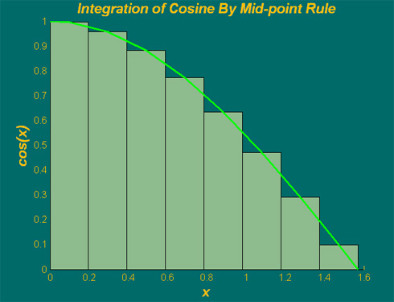

Integration Example
$$π$$
Integral is area under cosine function in range of 0 to /2
Equals to sum of all rectangles (width times height of bars)
cos(x)
a = 0; b = pi/2; % range
m = 8; % # of increments
h = (b-a)/m; % increment
h
mid-point of increment

Slide 34
Integration Example — using for-loop
% integration with for-loop
tic
m = 100;
a = 0; % lower limit of integration
b = pi/2; % upper limit of integration
h = (b – a)/m; % increment length
integral = 0; % initialize integral
for i=1:m
x = a+(i-0.5)*h; % mid-point of increment i
integral = integral + cos(x)*h;
end
toc
h
a
b
X(1) = a + h/2
X(m) = b - h/2

Slide 35
Integration Example — using vector form
% integration with vector form
tic
m = 100;
a = 0; % lower limit of integration
b = pi/2; % upper limit of integration
h = (b – a)/m; % increment length
x = a+h/2:h:b-h/2; % mid-point of m increments
integral = sum(cos(x))*h;
toc
h
a
b
X(1) = a + h/2
X(m) = b - h/2

Slide 36
Integration Example Benchmarks
increment m | for-loop | Vector
10000 | 0.00044 | 0.00017
20000 | 0.00087 | 0.00032
40000 | 0.00176 | 0.00064
80000 | 0.00346 | 0.00130
160000 | 0.00712 | 0.00322
320000 | 0.01434 | 0.00663
Timings (seconds) obtained on Intel Core i5 3.2 GHz PC
Computational effort linearly proportional to # of increments.

Slide 37
Laplace Equation (Steady incompressible potential flow)
Boundary Conditions:
Analytical solution:

Slide 38
Finite Difference Numerical Discretization
Discretize equation by centered-difference yields:
where n and n+1 denote the current and the next time step, respectively, while
For simplicity, we take

Slide 39
Computational Domain
y, j
x, i

Slide 40
Five-point Finite-difference Stencil
Interior cells.
Where solution of the Laplace equation is sought.
x
x
x
o
x
x
Exterior cells.
Green cells denote cells where homogeneous boundary conditions are imposed while non-homogeneous boundary conditions are colored in blue.
x
x
o
x
x

Slide 41
SOR Update Function
How to vectorize it ?
Remove the for-loops
Define i = ib:2:ie;
Define j = jb:2:je;
Use sum for del
% original code fragment
jb = 2; je = n+1; ib = 3; ie = m+1;
for i=ib:2:ie
for j=jb:2:je
up = ( u(i ,j+1) + u(i+1,j ) + ...
u(i-1,j ) + u(i ,j-1) )*0.25;
u(i,j) = (1.0 - omega)*u(i,j) +omega*up;
del = del + abs(up-u(i,j));
end
end
% equivalent vector code fragment
jb = 2; je = n+1; ib = 3; ie = m+1;
i = ib:2:ie; j = jb:2:je;
up = ( u(i ,j+1) + u(i+1,j ) + ...
u(i-1,j ) + u(i ,j-1) )*0.25;
u(i,j) = (1.0 - omega)*u(i,j) + omega*up;
del = sum(sum(abs(up-u(i,j))));

Slide 42
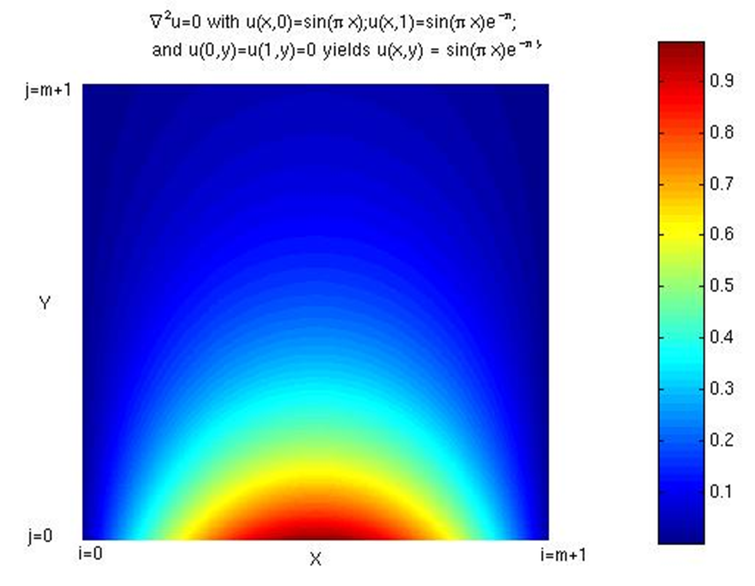
Solution Contour Plot

Slide 43
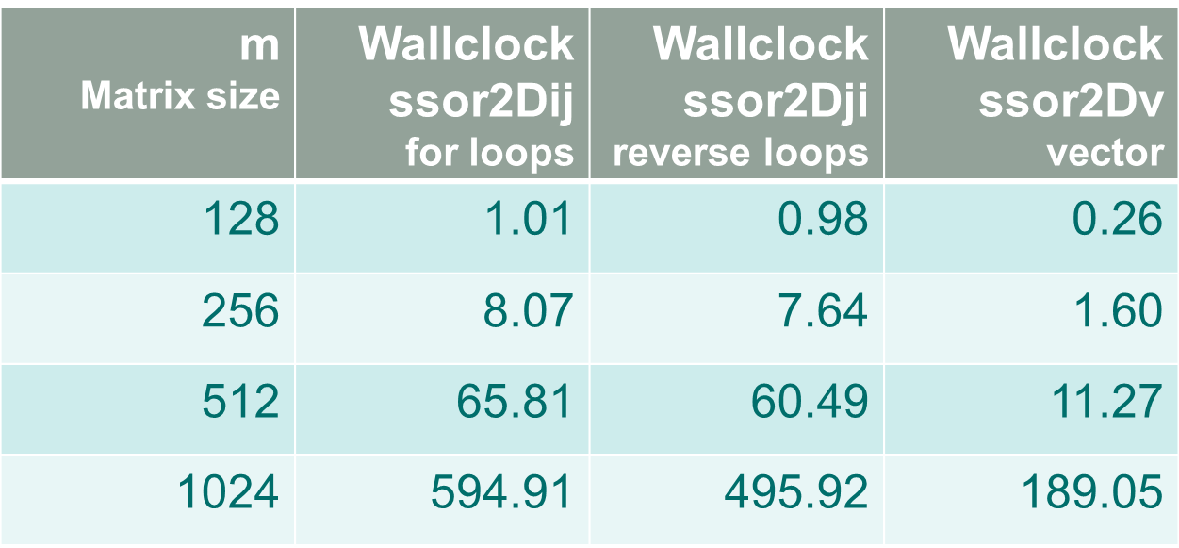
SOR Timing Benchmarks

Slide 44
Summation
For global sum of 2D matrices: sum(sum(A)) or sum(A(:))
Example: which is more efficient ?
A = rand(1000);
tic,sum(sum(A)),toc
tic,sum(A(:)),toc
No appreciable performance difference; latter more compact.
Your application calls for summing a matrix along rows (dim=2)
multiple times (inside a loop). Example:
A = rand(1000);
tic, for t=1:100,sum(A,2);end, toc
MATLAB matrix memory ordering is by column. Better performance if sum by column. Swap the two indices of A at the outset.
Example: B=A’; tic, for t=1:100, sum(B,1);end, toc (See twosums.m)

Slide 45
Other Tips
Generally better to use function rather than script
Script m-file is loaded into memory and evaluate one line at a time. Subsequent uses require reloading.
Function m-file is compiled into a pseudo-code and is loaded on first application. Subsequent uses of the function will be faster without reloading.
Function is modular; self cleaning; reusable.
Global variables are expensive; difficult to track.
Don’t reassign array that results in change of data type or shape
Limit m-files size and complexity
Structure of arrays more memory-efficient than array of structures

Slide 46
Memory Management
Maximize memory availability.
32-bit systems < 2 or 3 GB
64-bit systems running 32-bit MATLAB < 4GB
64-bit systems running 64-bit MATLAB < 8TB
(96 GB on some Katana nodes)
Minimize memory usage. (Details to follow …)

Slide 47
Minimize Memory Usage
Use clear, pack or other memory saving means when possible. If double precision (default) is not required, the use of ‘single’ data type could save substantial amount of memory. For example,
>> x=ones(10,'single'); y=x+1; % y inherits single from x
Use sparse to reduce memory footprint on sparse matrices
>> n=3000; A = zeros(n); A(3,2) = 1; B = ones(n);
>> tic, C = A*B; toc % 6 secs
>> As = sparse(A);
>> tic, D = As*B; toc % 0.12 secs; D not sparse
Be aware that array of structures uses more memory than structure of arrays. (pre-allocation is good practice too for structs!)

Slide 48
Minimize Memory Uage
For batch jobs, use “matlab –nojvm …” saves lots of memory
Memory usage query
For Linux:
Katana% top
For Windows:
>> m = feature('memstats'); % largest contiguous free block
Use MS Windows Task Manager to monitor memory allocation.
On multiprocessor systems, distribute memory among processors

Slide 49
Compilers
mcc is a MATLAB compiler:
It compiles m-files into C codes, object libraries, or stand-alone executables.
A stand-alone executable generated with mcc can run on compatible platforms without an installed MATLAB or a MATLAB license.
On special occasions, MATLAB access may be denied if all licenses are checked out. Running a stand-alone requires NO licenses and no waiting.
It is not meant to facilitate any performance gains.
coder ― m-file to C code converter

Slide 50
mcc example
How to build a standalone executable on Windows
>> mcc –o twosums –m twosums
How to run executable on Windows’ Command Promp (dos)
Command prompt:> twosums 3000 2000
Details:
twosums.m is a function m-file with 2 input arguments
Input arguments to code are processed as strings by mcc. Convert
with str2double: if isdeployed, N=str2double(N); end
Output cannot be returned; either save to file or display on screen.
The executable is twosums.exe

Slide 51
MATLAB Programming Tools
profile - profiler to identify “hot spots” for performance enhancement.
mlint - for inconsistencies and suspicious constructs in
m-files.
debug - MATLAB debugger.
guide - Graphical User Interface design tool.

Slide 52
MATLAB Profiler
To use profile viewer, DONOT start MATLAB with –nojvm option
>> profile on –detail 'builtin' –timer 'real'
>> serial_integration2 % run code to be profiled
>> profile viewer % view profiling data
>> profile off % turn off profiler
Turn on profiler. Time reported in wall clock. Include timings for built-in functions.

Slide 53
How to Save Profiling Data
Two ways to save profiling data:
Save into a directory of HTML files
Viewing is static, i.e., the profiling data displayed correspond to a
prescribed set of options. View with a browser.
2. Saved as a MAT file
Viewing is dynamic; you can change the options. Must be viewed
in the MATLAB environment.

Slide 54
Profiling – save as HTML files
Viewing is static, i.e., the profiling data displayed correspond to a
prescribed set of options. View with a browser.
>> profile on
>> serial_integration2
>> profile viewer
>> p = profile('info');
>> profsave(p, ‘my_profile') % html files in my_profile dir

Slide 55
Profiling – save as MAT file
Viewing is dynamic; you can change the options. Must be viewed in
the MATLAB environment.
>> profile on
>> serial_integration2
>> profile viewer
>> p = profile('info');
>> save myprofiledata p
>> clear p
>> load myprofiledata
>> profview(0,p)

Slide 56
MATLAB Editor
MATLAB editor does a lot more than file creation and editing …
Code syntax checking
Code performance suggestions
Runtime code debugging

Slide 57
Running MATLAB
Katana% matlab -nodisplay –nosplash –r “n=4, myfile(n); exit”
Add –nojvm to save memory if Java is not required
For batch jobs on Katana, use the above command in the
batch script.
Visit http://www.bu.edu/tech/research/computation/linux-cluster/katana-cluster/runningjobs/ for instructions on running batch jobs.

Slide 58
Multiprocessing with MATLAB
Explicit parallel operations
MATLAB Parallel Computing Toolbox Tutorial
www.bu.edu/tech/research/training/tutorials/matlab-pct/
Implicit parallel operations
Require shared-memory computer architecture (i.e., multicore).
Feature on by default. Turn it off with
katana% matlab –singleCompThread
Specify number of threads with maxNumCompThreads
(deprecated in future).
Activated by vector operation of applications such as hyperbolic or trigonometric functions, some LaPACK routines, Level-3 BLAS.
See “Implicit Parallelism” section of the above link.

Slide 59
Where Can I Run MATLAB ?
There are a number of ways:
Buy your own student version for $99.
http://www.bu.edu/tech/desktop/site-licensed-software/mathsci/matlab/faqs/#student
Check your own department to see if there is a computer
lab with installed MATLAB
With a valid BU userid, the engineering grid will let you gain
access remotely.
http://collaborate.bu.edu/moin/GridInstructions
If you have a Mac, Windows PC or laptop, you may have to
sync it with Active Directory (AD) first:
http://www.bu.edu/tech/accounts/remote/away/ad/
acs-linux.bu.edu, katana.bu.edu
http://www.bu.edu/tech/desktop/site-licensed-
software/mathsci/mathematica/student-resources-at-bu

Slide 60
Useful SCV Info
SCV home page (www.bu.edu/tech/research)
Resource Applications www.bu.edu/tech/accounts/special/research/accounts
Help
System
help@katana.bu.edu, bu.service-now.com
Web-based tutorials (www.bu.edu/tech/research/training/tutorials)
(MPI, OpenMP, MATLAB, IDL, Graphics tools)
HPC consultations by appointment
Kadin Tseng (kadin@bu.edu)
Yann Tambouret (yannpaul@bu.edu)

