Slide 1
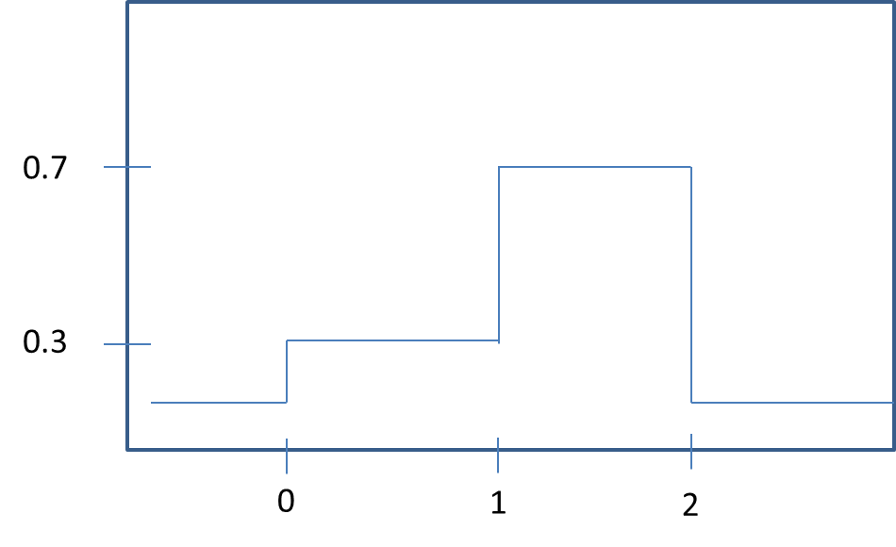
0.7
0.3
0
1
2

Slide 2
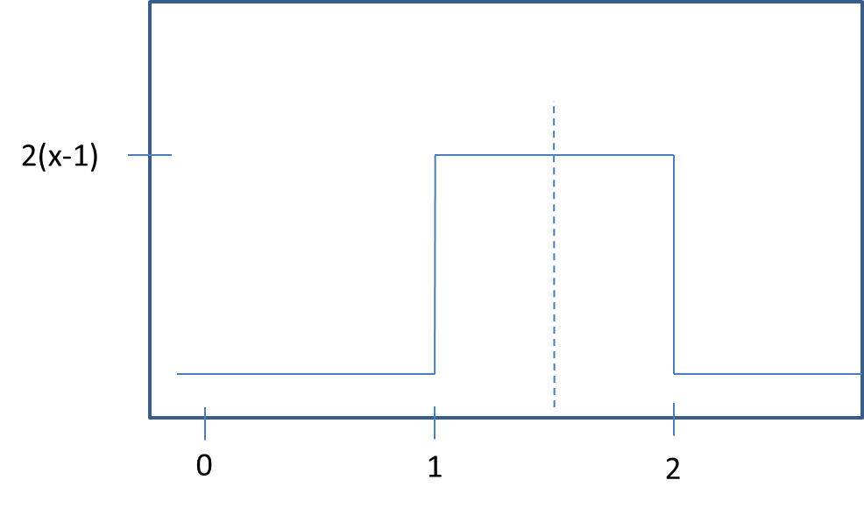
2(x-1)
0
1
2

Slide 3
