Slide 1

CAPSTONE PROJECT · GROUP 4
Hong Kong Parking Vacancy Prediction
「咪再兜」— Predict private-car vacancies 30–60 minutes ahead
with official open data, Machine Learning baselines, and an AI Agent app
Members: Lee Ki Yick (Keith) · Chin Ka Wang (Kelvin)

Slide 2
Problem & Research Question
The pain
Research question
Finding parking in HK is time-consuming and stressful
Drivers circle without knowing where spaces will open
Official vacancy data exists — but hard to use in real time
Need forward-looking guidance, not only “now”
Can we predict whether a car park will have private-car vacancies (classification) and how many (regression) 30–60 minutes ahead, using official real-time data + time features — and beat a same-weekday-same-hour historical baseline?
Group 4 · 咪再兜 / HK Parking Vacancy Prediction · Capstone
2 / 10

Slide 3
Dataset Description
~592
~18
Sources & characteristics
Transport Department (TD) / data.gov.hk Carpark Info Vacancy API (live + fees)
Hong Kong Observatory (HKO) Weather API (temp, humidity, regional stations)
Supabase Postgres API (carparks, vacancy, weather)
DeepSeek Chat API (natural language (NL) intent / agent replies)
Google Maps Geocoding + Maps JavaScript APIs
Google Speech Recognition API (voice input)
Microsoft Edge Text-to-Speech (Cantonese voice output)
Features: hour, day of week (DOW), weekend, park/district, temperature
Scope: car-park vacancy, not on-street meters
Car parks (territory-wide)
HK districts covered
~34.9k
~10 min
Historical snapshots (1 yr)
Collection cadence
Group 4 · 咪再兜 / HK Parking Vacancy Prediction · Capstone
3 / 10

Slide 4
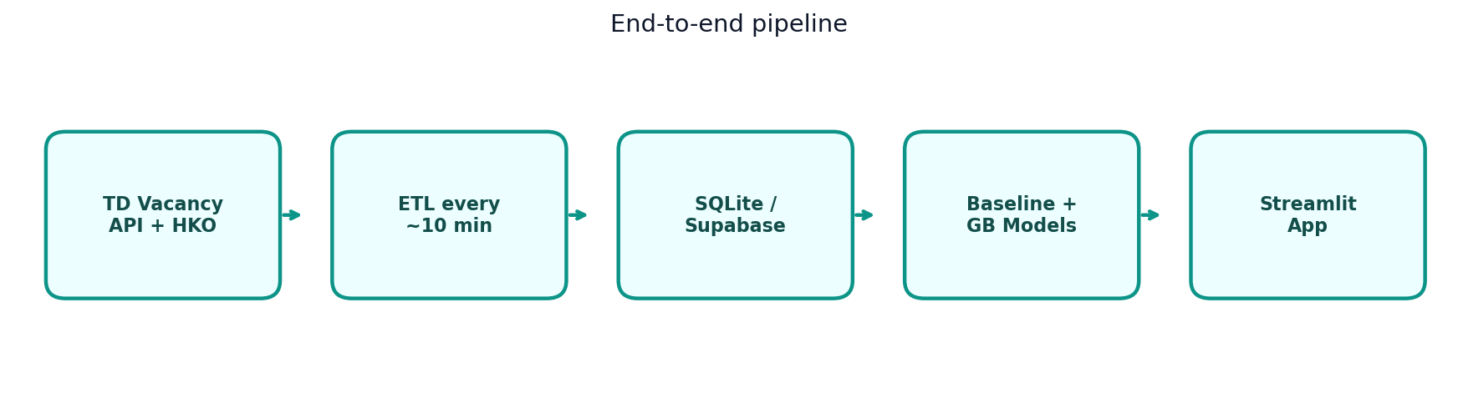
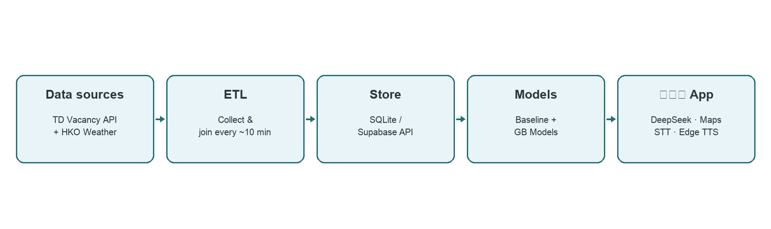
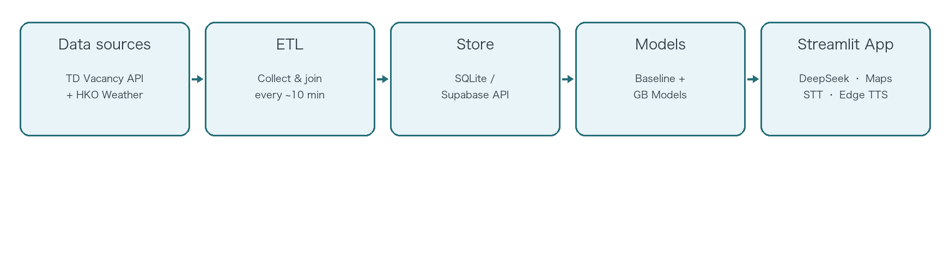
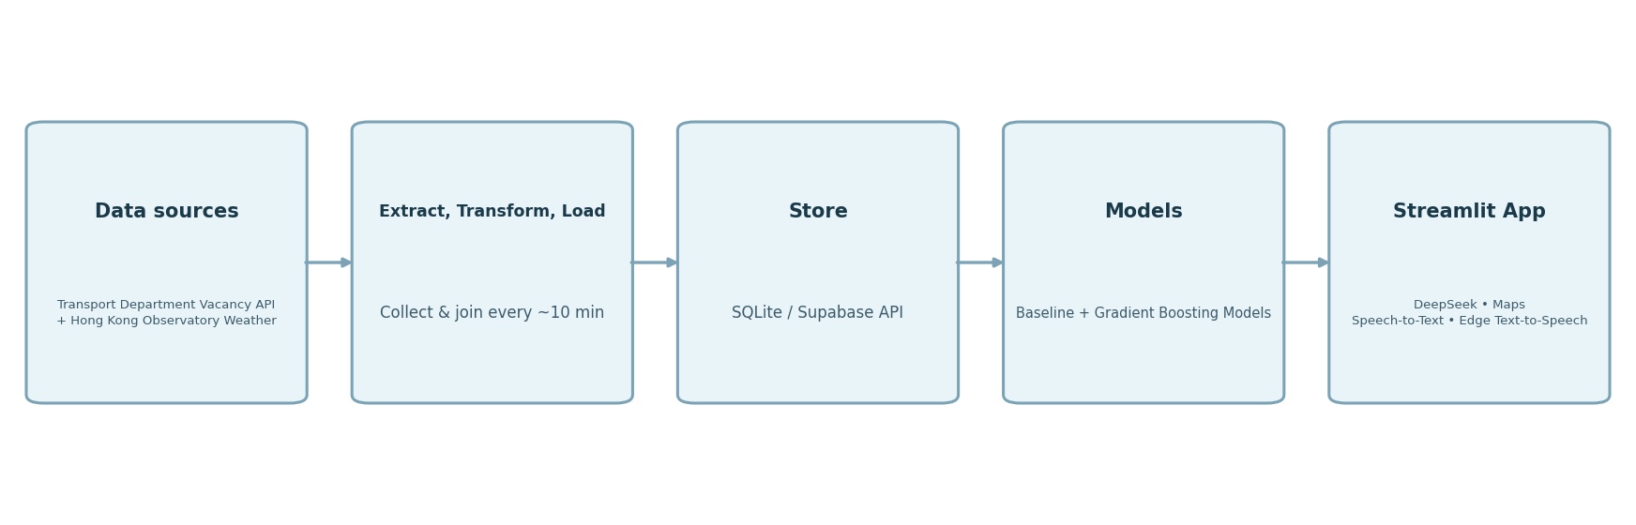
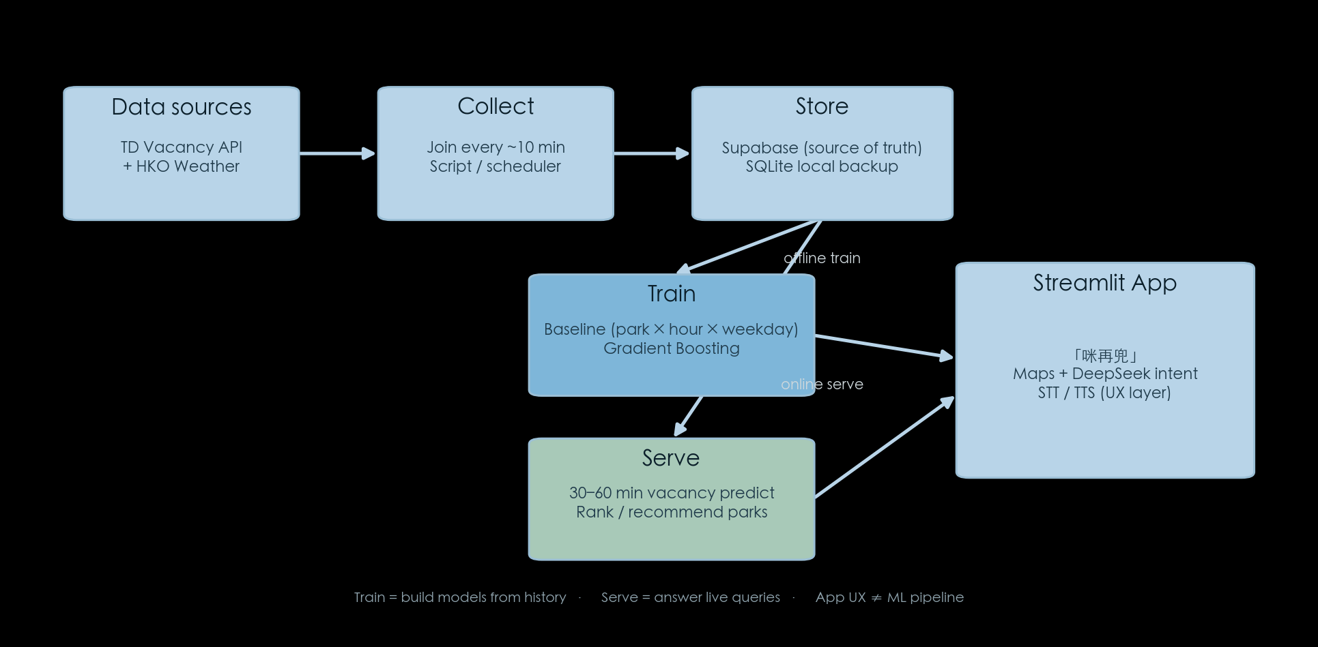
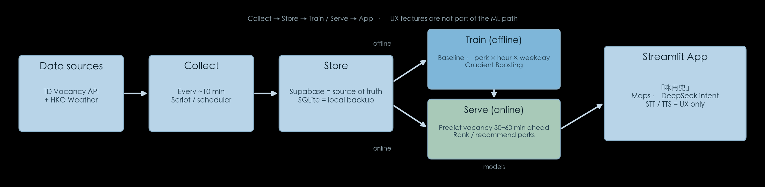
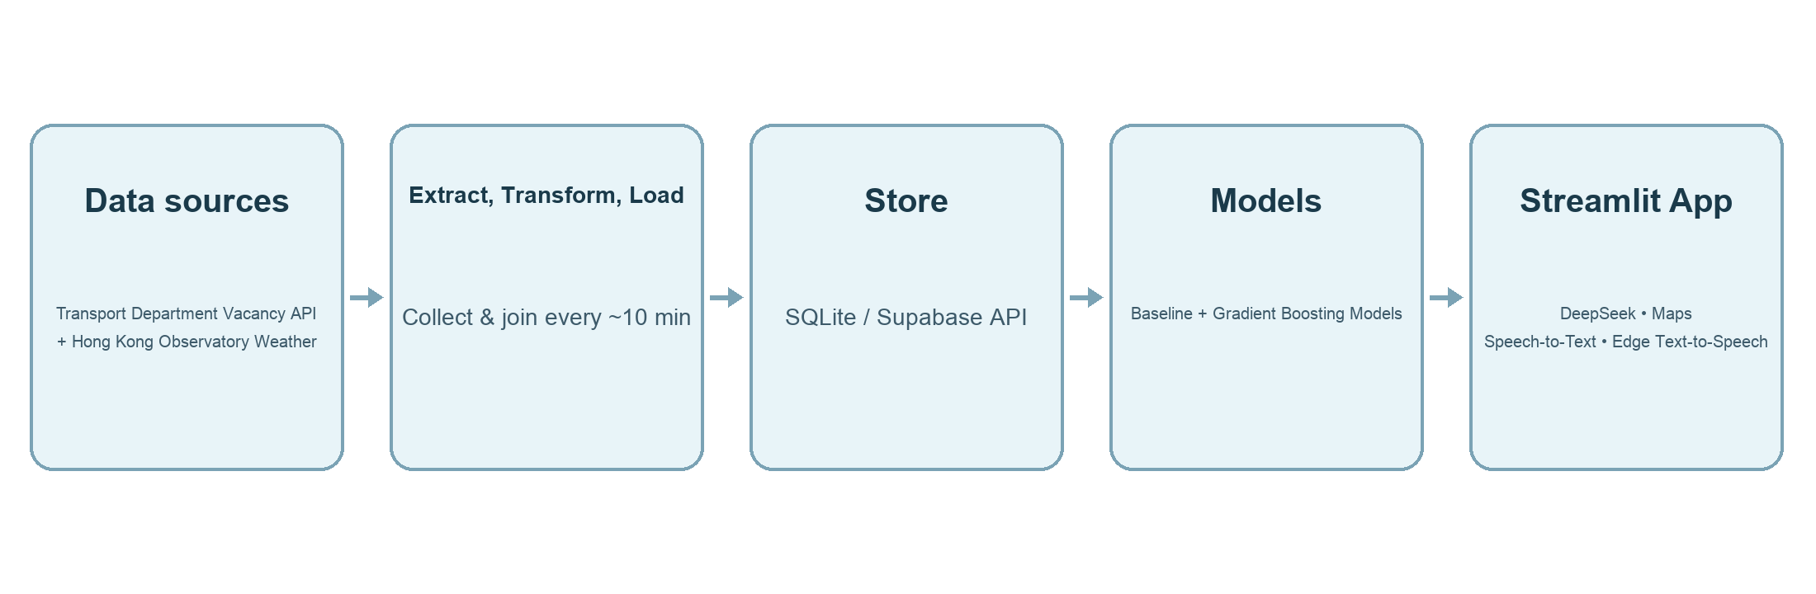
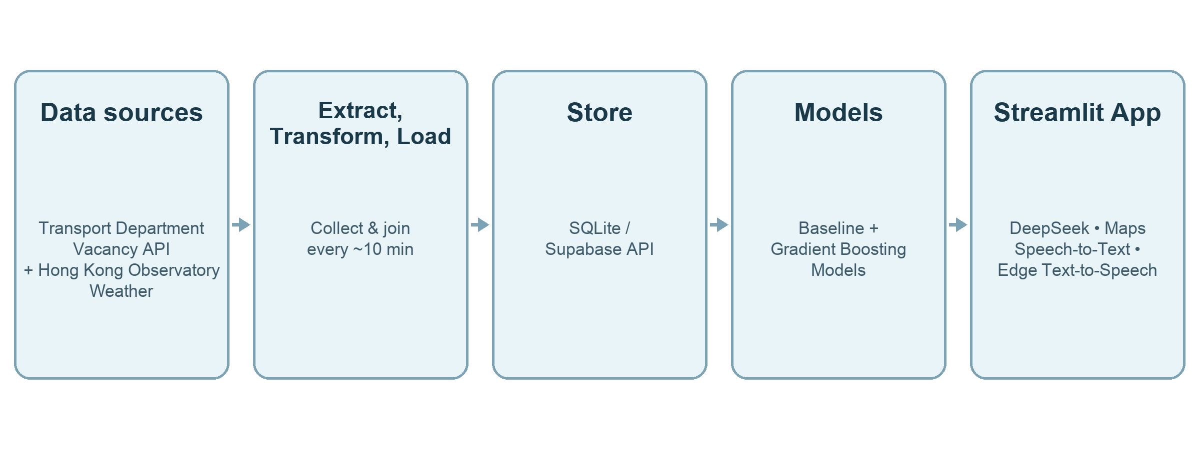
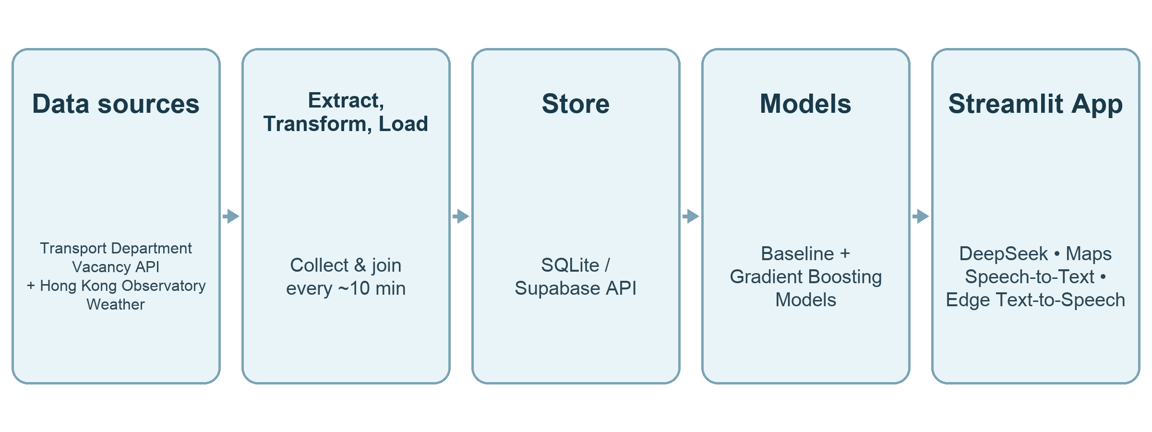
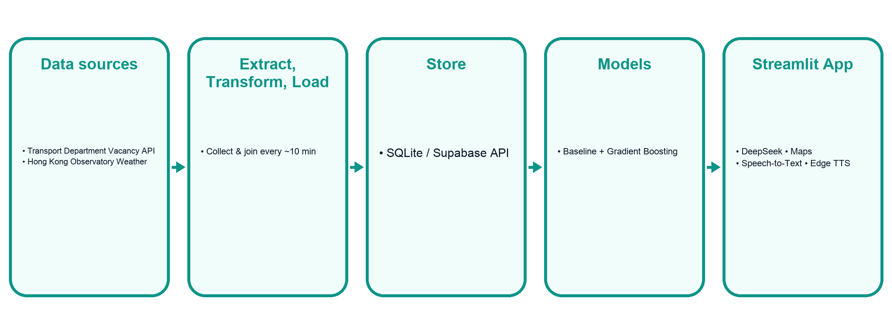
Methodology & Pipeline
Data sources
Transport Department Vacancy API
Hong Kong Observatory Weather
Extract, Transform, Load
Collect & join every ~10 min
Store
SQLite / Supabase API
Models
Baseline + Gradient Boosting
Streamlit App
DeepSeek
Maps
Speech-to-Text
Edge Text-to-Speech
Baseline
Machine Learning models
GenAI product
Same park × hour × weekday mean
Built from 365-day history
Strong, interpretable reference
Gradient Boosting Regressor → vacancy count
Gradient Boosting Classifier → has_vacancy
Time-based 70/30 train/test
DeepSeek → Natural Language intent parsing
Google Geocoding + Maps JavaScript
Google Speech-to-Text + Edge Text-to-Speech (Cantonese)
Nearby ranking + recommendations
Group 4 · 咪再兜 / HK Parking Vacancy Prediction · Capstone
4 / 10

Slide 5
Technical Skills Demonstrated
Python
pandas
scikit-learn
Streamlit
httpx
SQL / DB
SQLite
Supabase Postgres
Extract–Transform–Load
Scheduled collection
Migration scripts
API
Transport Department Vacancy
Hong Kong Observatory
Supabase
DeepSeek
Google Maps / Geocoding
Google Speech-to-Text
Edge Text-to-Speech
EDA / Viz
Vacancy-rate heatmaps
Live vs baseline
Machine Learning
Baseline
Gradient Boosting
GenAI
DeepSeek intent + replies
Google Speech-to-Text
Edge Text-to-Speech voice
Deploy
GitHub
Streamlit Cloud
Group 4 · 咪再兜 / HK Parking Vacancy Prediction · Capstone
5 / 10

Slide 6
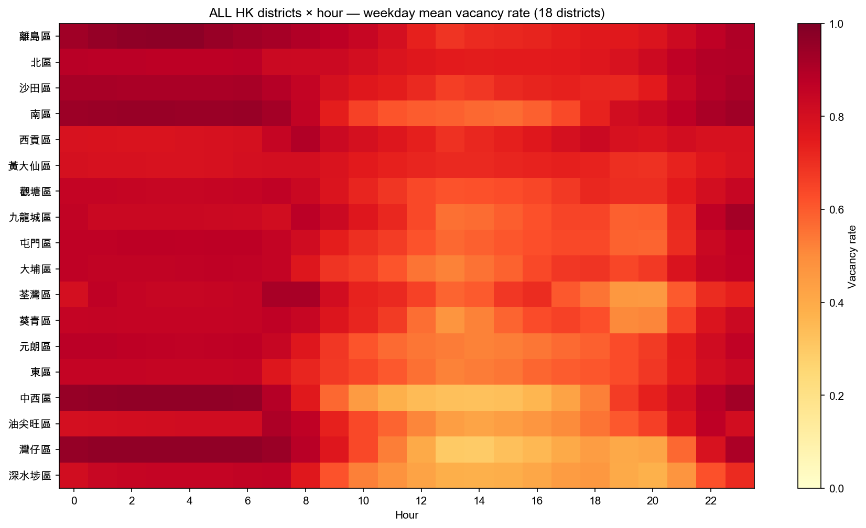
EDA Insights
What we see
Capacity-weighted vacancy rate by district × hour
Mid-day tighter; nights freer (especially Central Business District)
Central Business District (中西 / 油尖旺 / 灣仔) lower average rate
Some New Territories / Islands District stay freer on average
Patterns justify time + location features
Group 4 · 咪再兜 / HK Parking Vacancy Prediction · Capstone
6 / 10

Slide 7
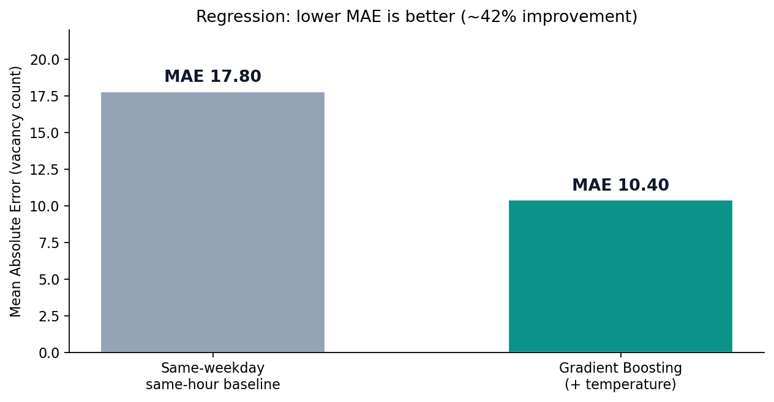
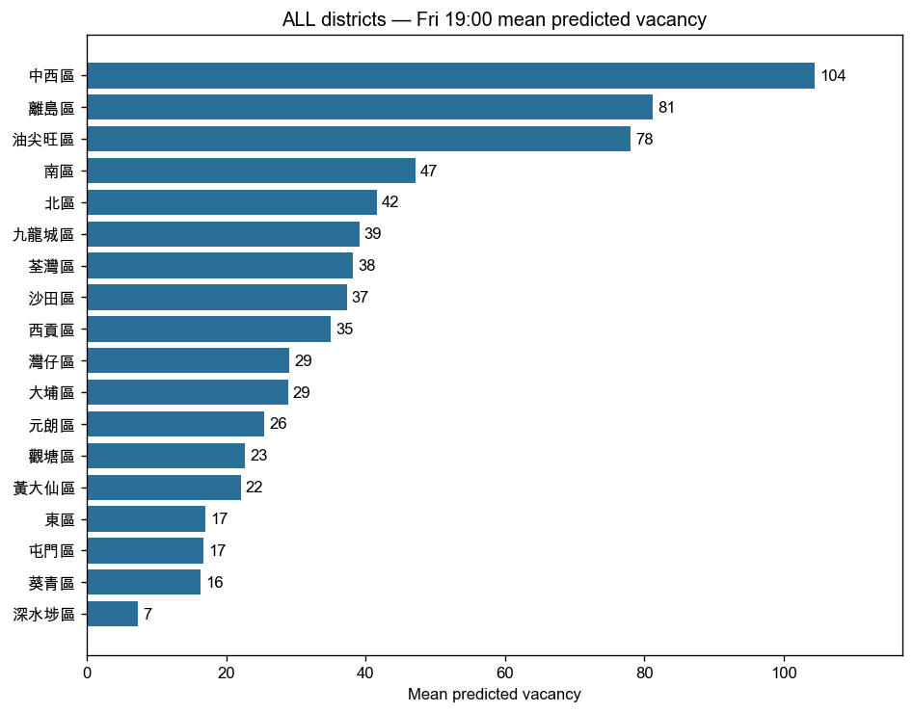
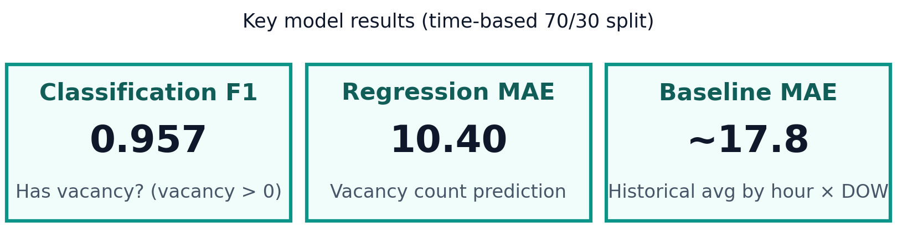
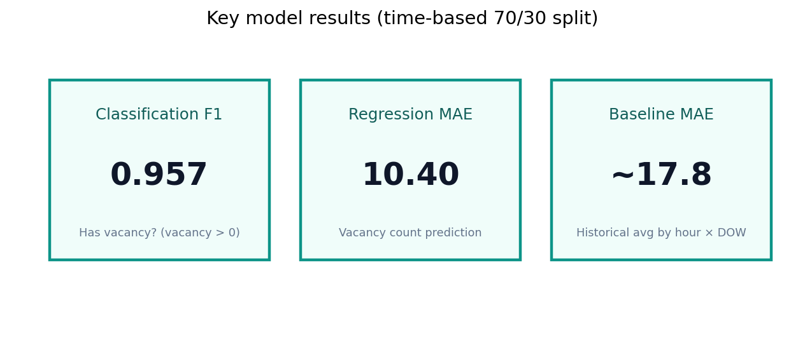
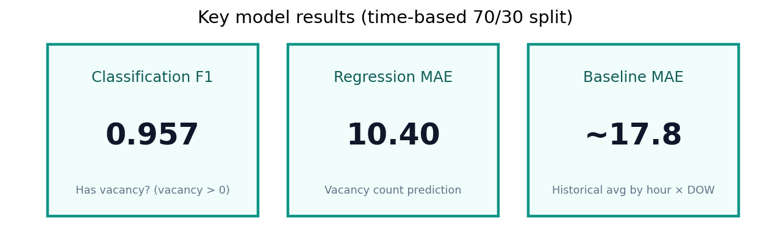
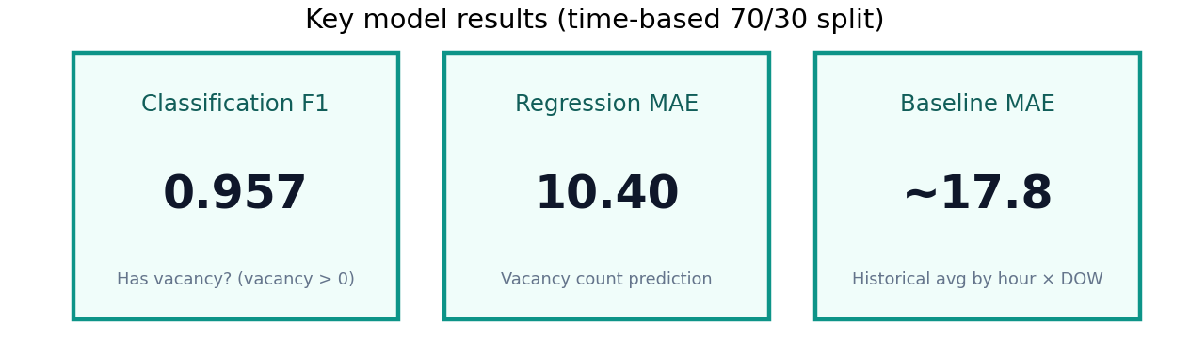
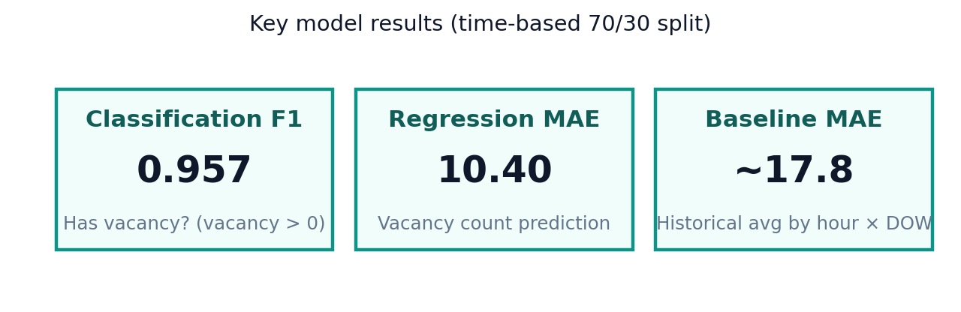
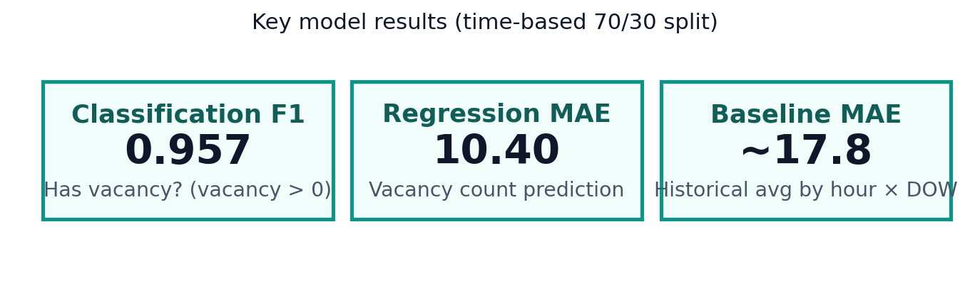
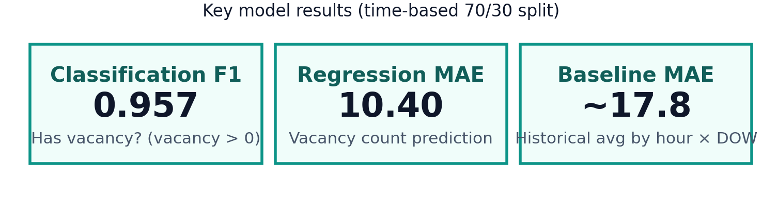
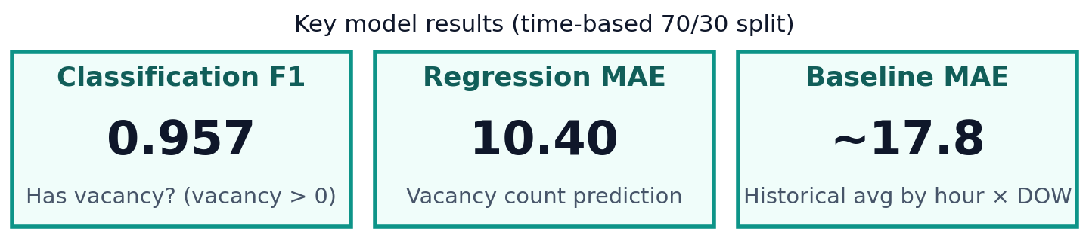
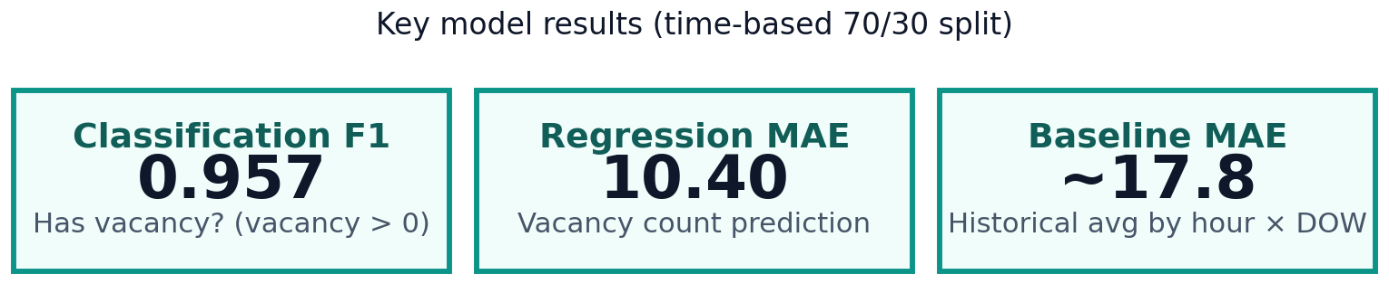
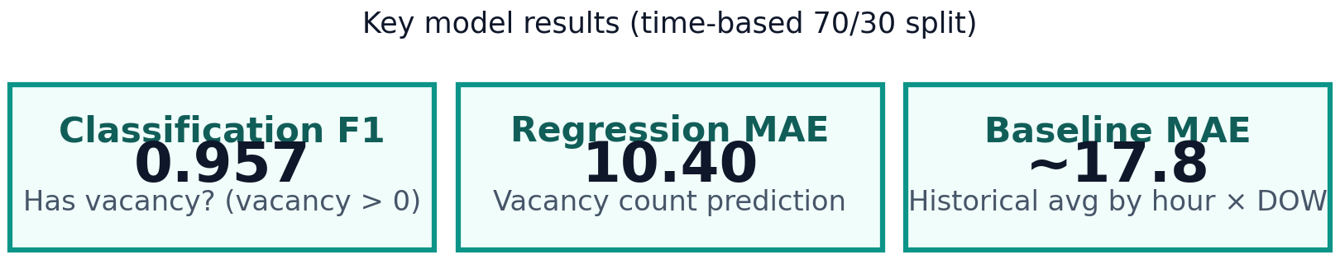
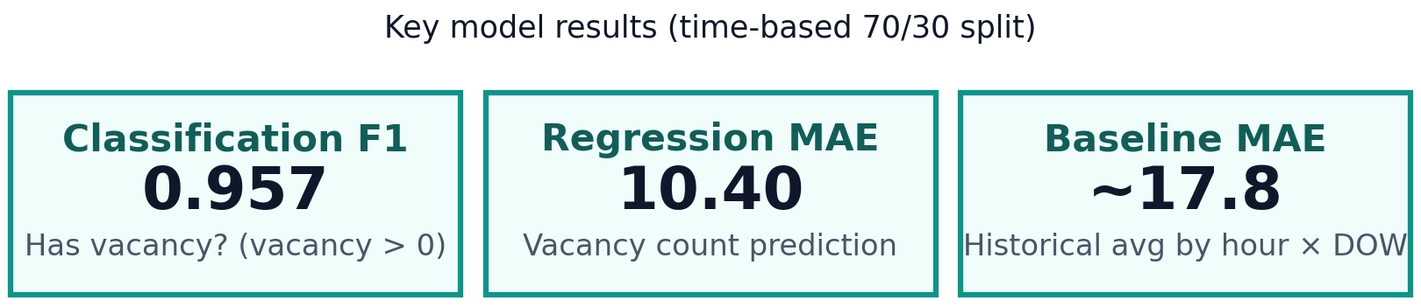
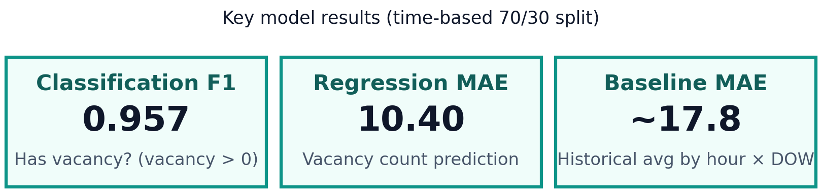
Analysis & Model Results
Gradient Boosting beats same-hour baseline; Friday 19:00 district ranking on the right
Group 4 · 咪再兜 / HK Parking Vacancy Prediction · Capstone
7 / 10

Slide 8
Challenges, Limitations & Future Work
Challenges & limitations
Future work
Early live collection gaps when machine sleeps
Car parks only — not on-street meters
Weather signals collected but underused
Short early training window; later expanded with 1-year baselines
Cloud disk limits for raw historical imports
Cloud cron / Edge Function for 24×7 collection
Richer weather + holiday / event features
Persist trained models to storage
Vacancy level classes (low / mid / high)
Stronger LLM-generated suggestion copy
Deeper error analysis by district / hour
Group 4 · 咪再兜 / HK Parking Vacancy Prediction · Capstone
8 / 10

Slide 9
Conclusion
Built an end-to-end data → Machine Learning → AI Agent product for HK parking vacancy
Gradient Boosting improves MAE from ~17.8 → 10.40; classification F1 ≈ 0.957
「咪再兜」lets drivers ask in Cantonese (text/voice) and get ranked suggestions
Foundation ready for longer history, richer features, and always-on cloud Extract, Transform, Load
Group 4 · 咪再兜 / HK Parking Vacancy Prediction · Capstone
9 / 10

Slide 10

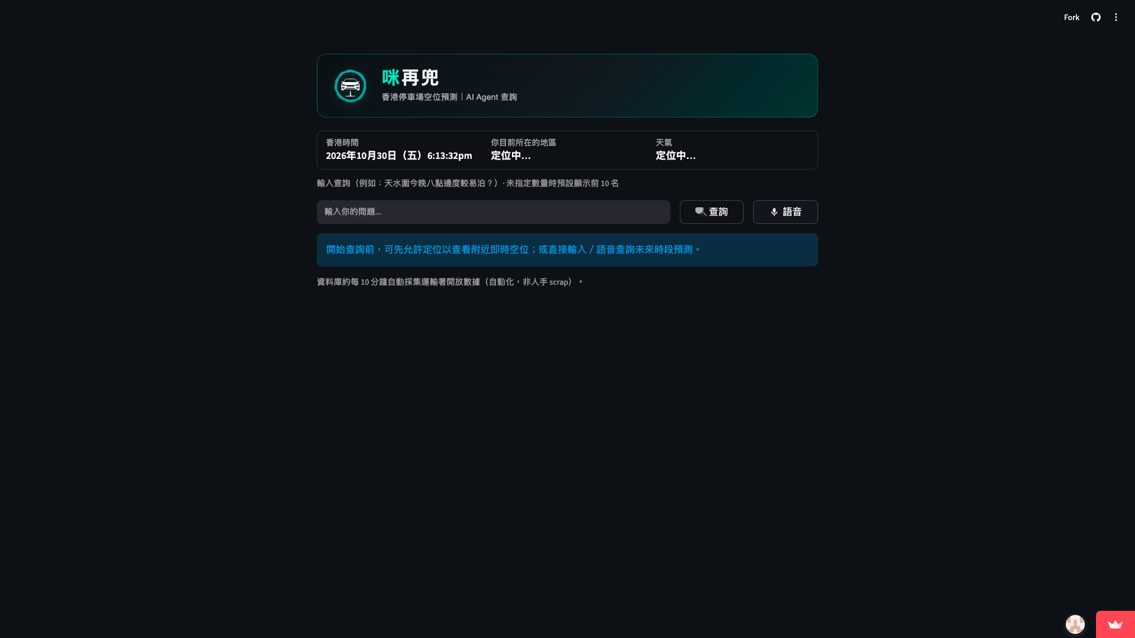
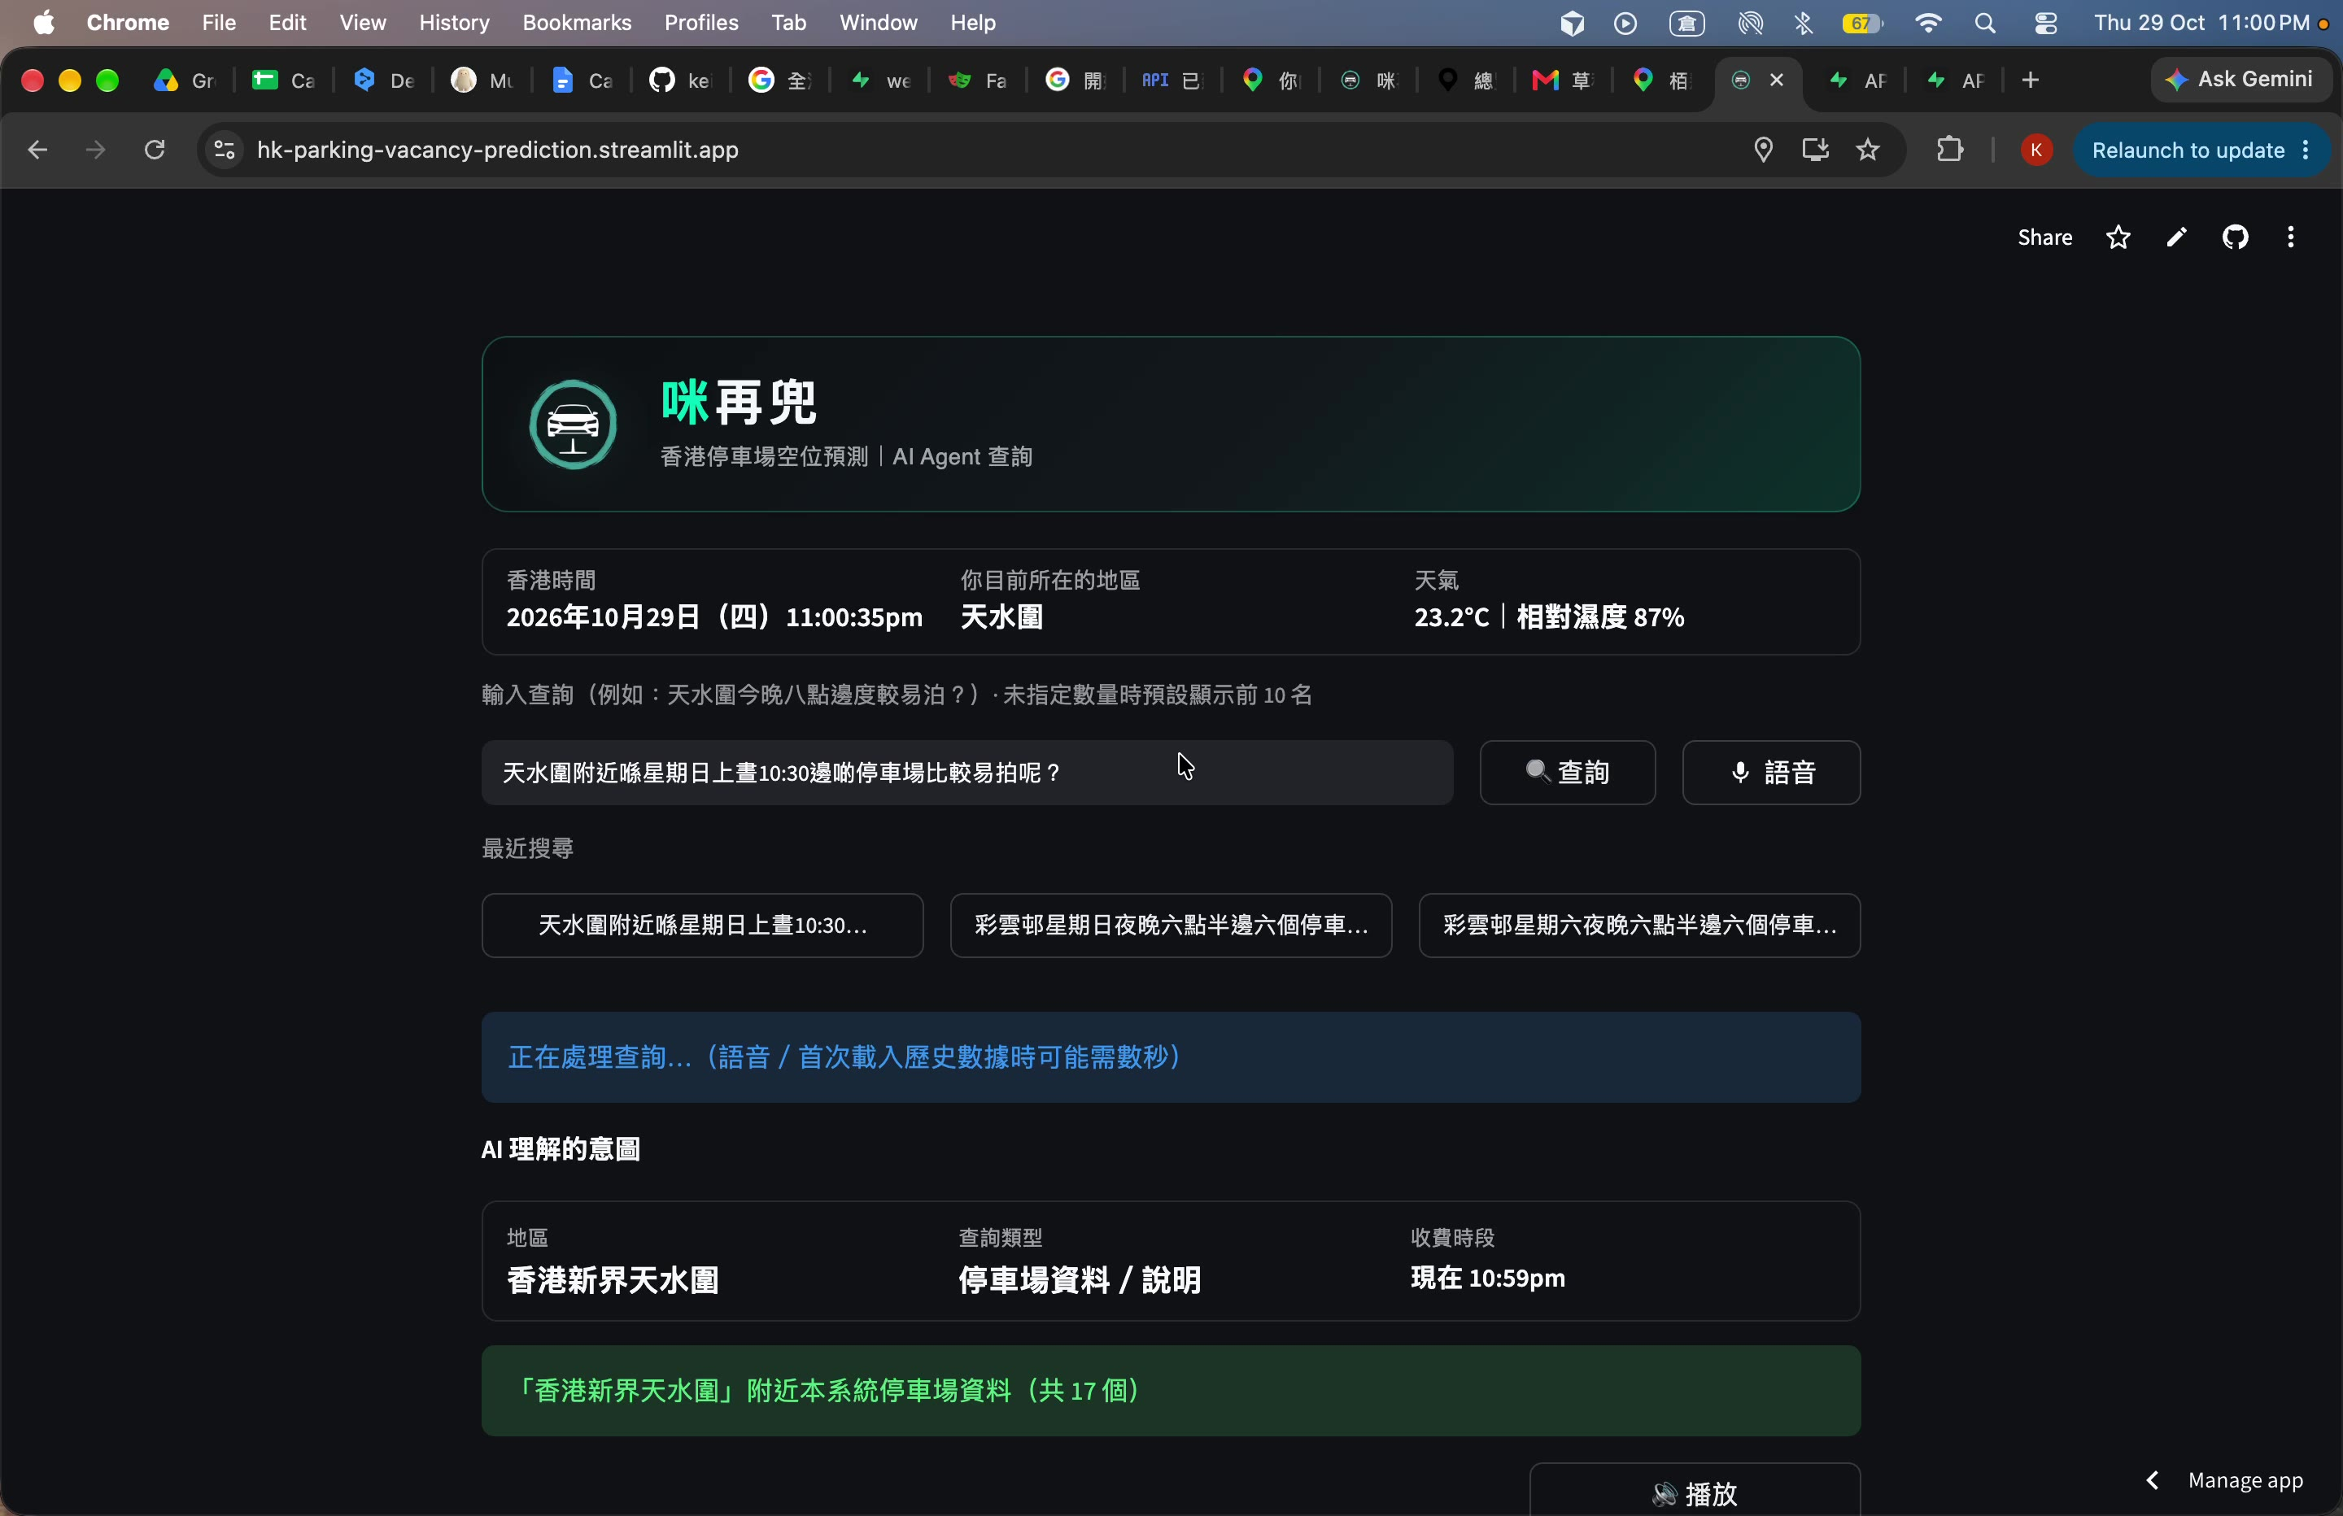
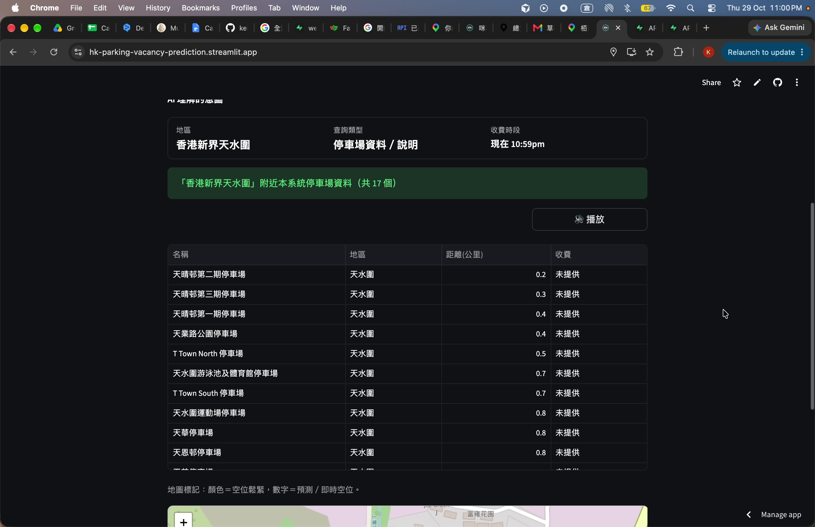
Product Demo — 咪再兜
Scan to open 咪再兜
https://hk-parking-vacancy-prediction.streamlit.app/
Group 4 · 咪再兜 / HK Parking Vacancy Prediction · Capstone
10 / 10

