Slide 1




Data visualization: From quality assurance to final publication.
Keith Lohse, PhD
Department of Health, Kinesiology, and Recreation
Department of Physical Therapy and Athletic Training
University of Utah
rehabinformatics@gmail.com
@keith_lohse
https://github.com/keithlohse/ASNR

Slide 2
Road Map
General principles of data visualization.
Save yourself a lot of time with reproducible code based graphics.
Visualizing discrete data.
Special considerations for repeated measures data.
Visualizing continuous data.
Special considerations for time-series data.

Slide 3

General Principles of Data Visualization

Slide 4
Why is visualizing data so important?
Let’s say I run an analysis in my stats program regressing Y onto X.
The Intercept is 3.00 and statistically significant.
The Slope is 0.50 and statistically significant.
Is it fair to assume that a 1-unit change in X leads to a 0.5-unit change in Y in an approximately linear relationship?

Slide 5
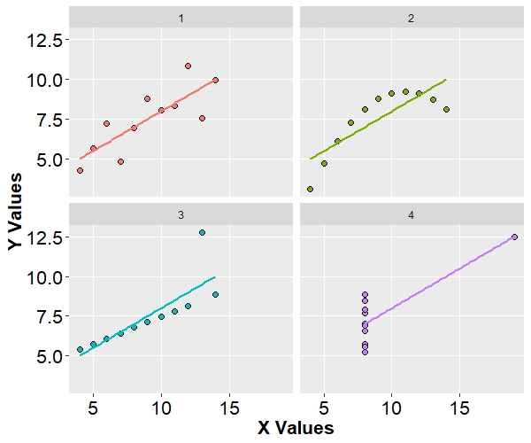
Why is visualizing data so important?
All of these datasets have identical slopes, intercepts, and p-values.
Model 1 is the only one that meets all the assumptions of linear regression.
2 = nonlinear.
3 = non-constant error variance.
4 = extreme leverage (Cook’s distance).
[Anscombe, 1974]

Slide 6
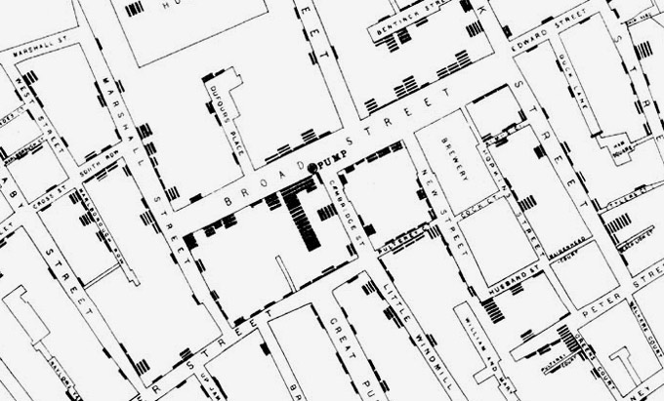
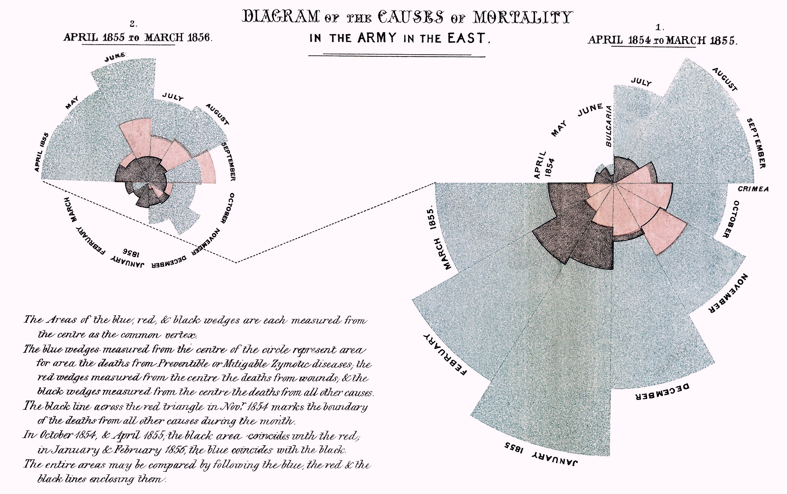
How do I make a good data visualization?
Could these famous data visualizations get published today?
Conventions exist for a reason, but conventions aren’t all that’s out there.

Slide 7

Why do I keep saying data visualization?
What’s the difference between a ‘graphic’ and a ‘data visualization’?
[An analogy] You come upon a door…

Slide 8

Why do I keep saying data visualization?
What’s the difference between a ‘graphic’ and a ‘data visualization’?
[An analogy] You come upon a door…
vs.

Slide 9
Why do I keep saying data visualization?
Like a Figure
Like a Visualization
Abstract…
General…
The impression is what's important.
Based on something real…
Specific…
The details really are key.
vs.
The rules of effective communication in one domain do not necessarily generalize to the other domain (e.g., science communication versus communication between scientists).

Slide 10
IMO, Good Visualizations Should…
Put your data on the table. Show “person-level” data and “group-level” statistics to paint the complete picture.
Reduce unnecessary complexity. The question motivating a visualization should be clear, as should the answer.
Have correspondence to your analysis. I can “see” your result without understanding the finer points of your analysis. The inferential statistics are just there to “back it up”.
Accept uncertainty. The data should speak for itself and visualizations should accurately reflect the data above all else.
[But see Healy, 2018; Tufte, 2001; Tukey, 1980; Wickham & Grolemund, 2017]

Slide 11
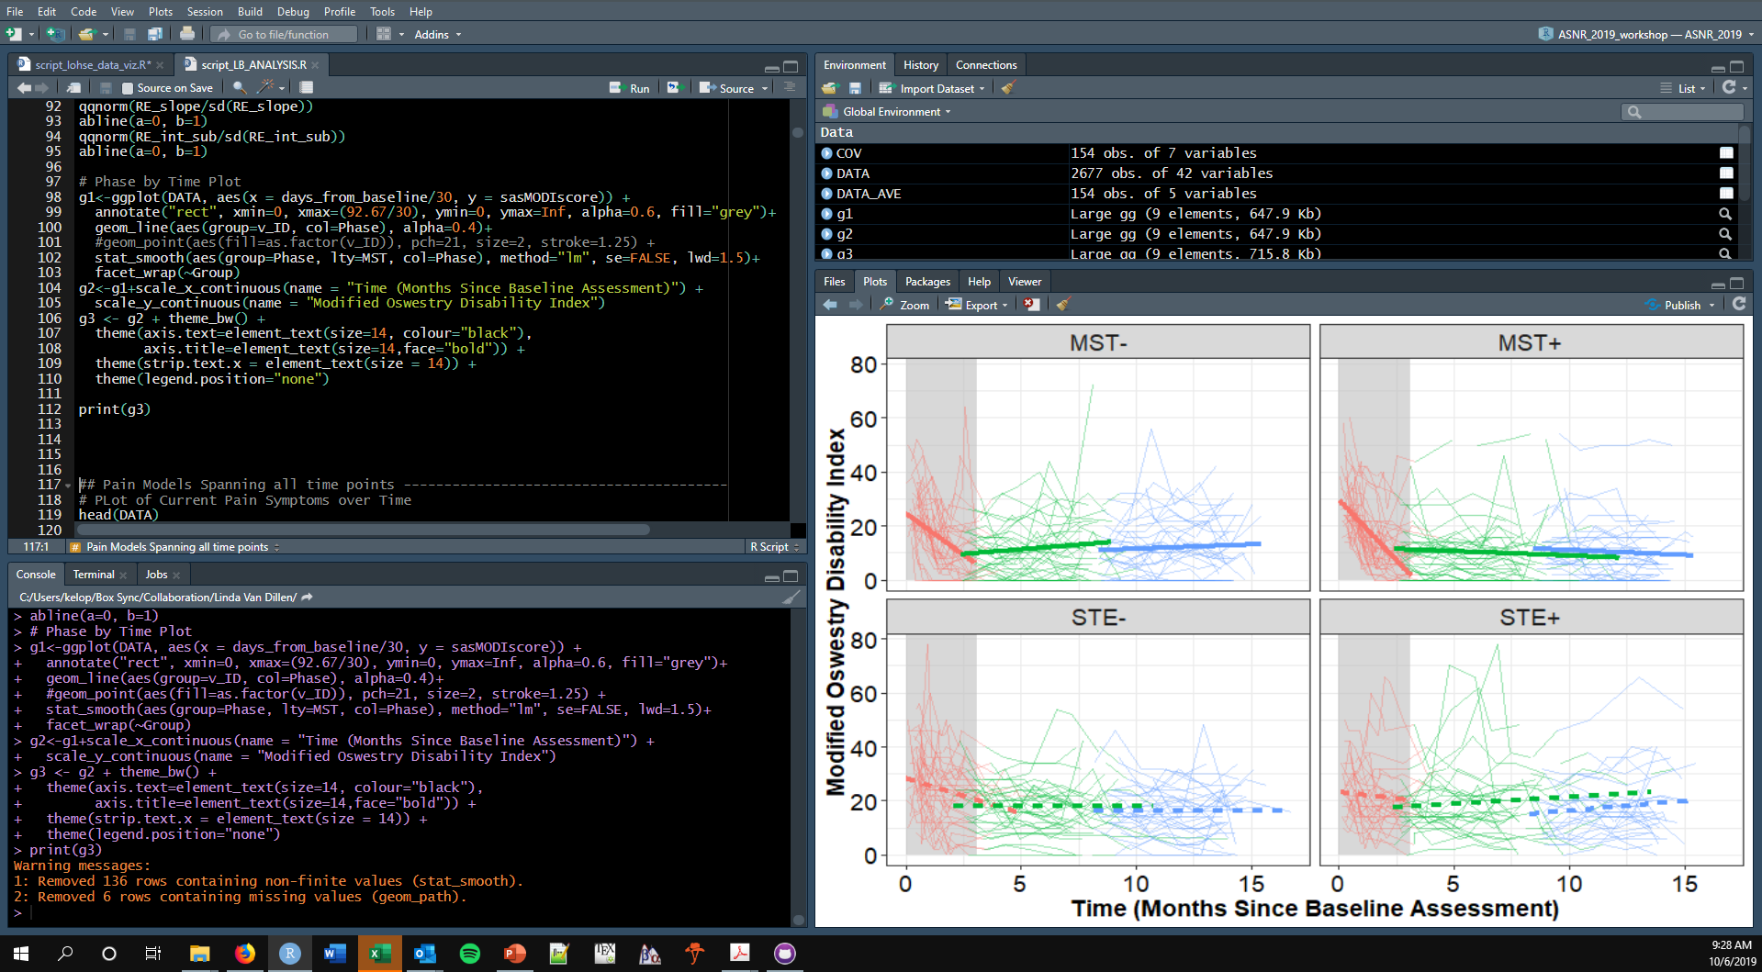
Reproducible, code based graphics.
Ultimately, anyway you create your visuals is fine as long as your visuals are accurate and informative.
But, code-based approaches have a lot of advantages in terms of efficiency and reproducibility.
[I create most of my graphics in ‘ggplot2’ using R. Any post-processing I do in the Gnu Image Manipulation Program.]

Slide 12
Visualizing Discrete Data

Slide 13
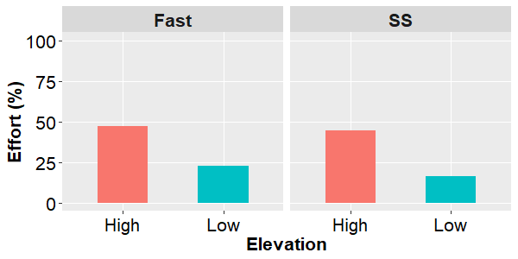
Consider a 2 x 2 factorial design.
Participants walked at fast or selected speeds at virtual high or low heights.
Among other things, we collected psychological perceptions of effort across the different trials.
No measure of central tendency.
No measures of spread.
No information about sample size.
No information about the correlation between measures.
[Raffegeau et al., Under Review]

Slide 14

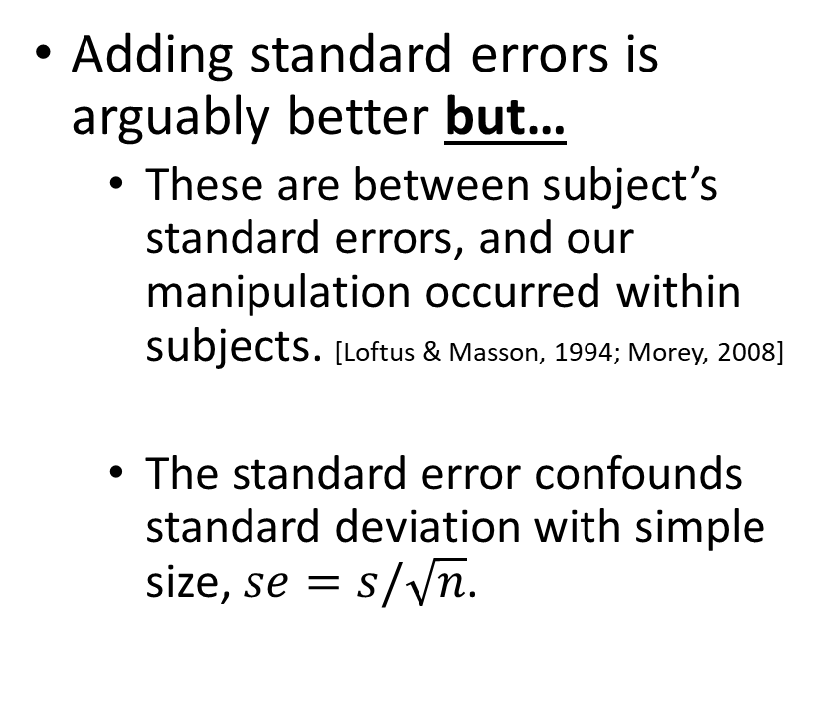
Consider a 2 x 2 factorial design.
Adding standard errors is arguably better but…
These are between subject’s standard errors, and our manipulation occurred within subjects. [Loftus & Masson, 1994; Morey, 2008]
The standard error confounds standard deviation with simple size, $se=s/\sqrt{n}$.
No measure of central tendency.
No measures of spread.
No information about sample size.
No information about the correlation between measures.
[Raffegeau et al., Under Review]

Slide 15
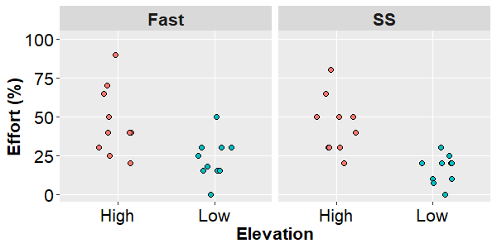
Consider a 2 x 2 factorial design.
What if we just plot all of the data?
To paraphrase Karl Pearson, we have now put our “data on the table”, but something has also been lost. [Stigler, 2002]
Measures of central tendency are critical to our statistical inference.
We have gained a rich description of our sample, but lost the correspondence to our analysis.
No measure of central tendency.
No measures of spread.
No information about sample size.
No information about the correlation between measures.
[Raffegeau et al., Under Review]

Slide 16
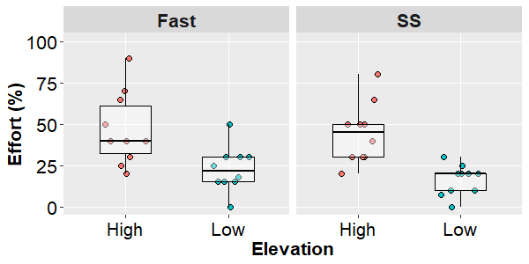
Consider a 2 x 2 factorial design.
Now this is good! By playing with overlay and transparency, group-level statistics are emphasized (for inference).
But all of the participant-level data are also visible (for description/assumptions).
One issue is that boxplots show medians, but most of our inferential statistics are based on means.
This isn’t bad, but potentially lacks correspondence between visualization and analysis.
In a within-subject design, we might want to know which points belong to whom.
No measure of central tendency.
No measures of spread.
No information about sample size.
No information about the correlation between measures.
[Raffegeau et al., Under Review]

Slide 17
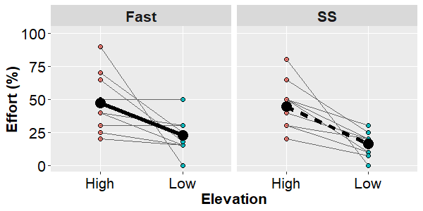
Consider a 2 x 2 factorial design.
Now this is good! By playing with overlay and transparency, group-level statistics are emphasized (for inference).
But all of the participant-level data are also visible (for description/assumptions).
One issue is that boxplots show medians, but most of our inferential statistics are based on means.
This isn’t bad, but potentially lacks correspondence between visualization and analysis.
No measure of central tendency.
No measures of spread.
No information about sample size.
No information about the correlation between measures.
[Raffegeau et al., Under Review]

Slide 18
Visualizing Continuous Data

Slide 19
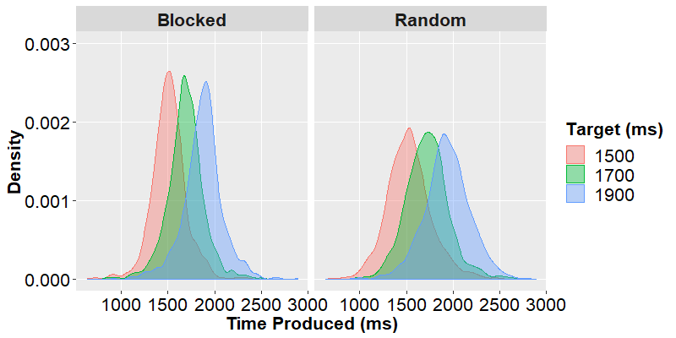
A Two Group Longitudinal Study
In a variable versus blocked practice experiment, participants learned to estimate different intervals of time in either a blocked order or a random order.
1500 ms
1700 ms
1900 ms
Focusing on response distributions to study ‘confusability’.
Acquisition
[Thomas et al., In Preparation]

Slide 20
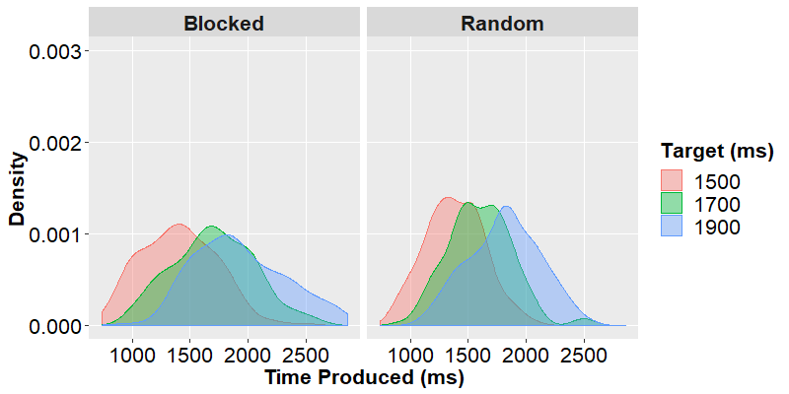

A Two Group Longitudinal Study
Acquisition
Delayed Retention Test
It’s a slightly different way of looking at it, but we replicate the traditional contextual interference effect.
[Fall Out, InterPlay Ent.]
[Thomas et al., In Preparation]

Slide 21
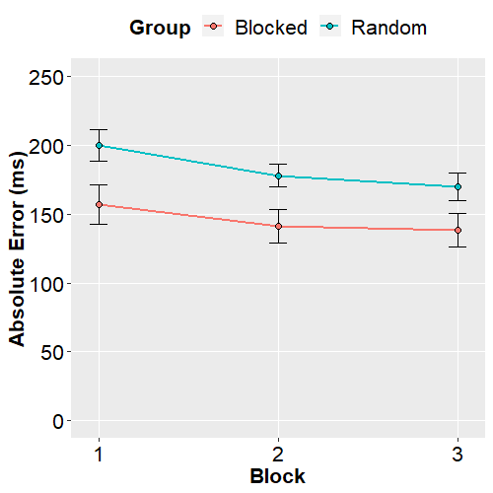
A Two Group Longitudinal Study
But learning is continuous process that happens over time.
In a more “classic” plot, we might average across trials and targets to look at average error in each block of practice.

Slide 22
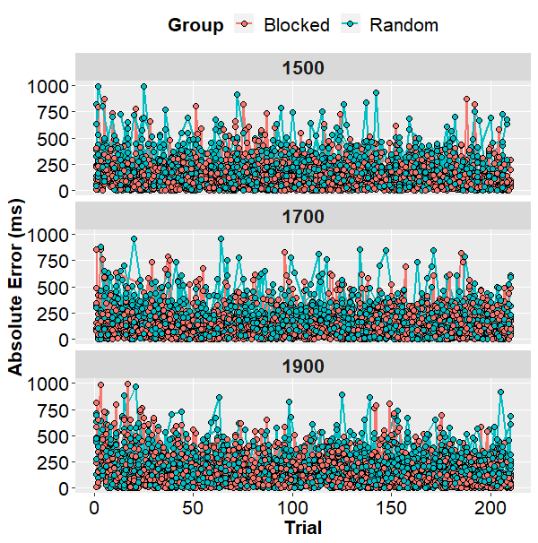
A Two Group Longitudinal Study
What if I want to see all of the data?
It’s too much!
We have so many acquisition trials that it makes identifying performance curves almost impossible.

Slide 23
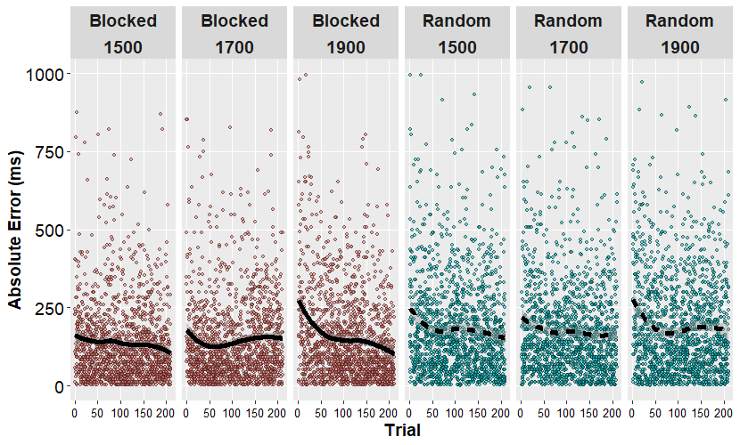
A Two Group Longitudinal Study
Again though, by playing with aesthetic features such as spacing, transparency, and line type, we can make the overall pattern much more interpretable.

Slide 24
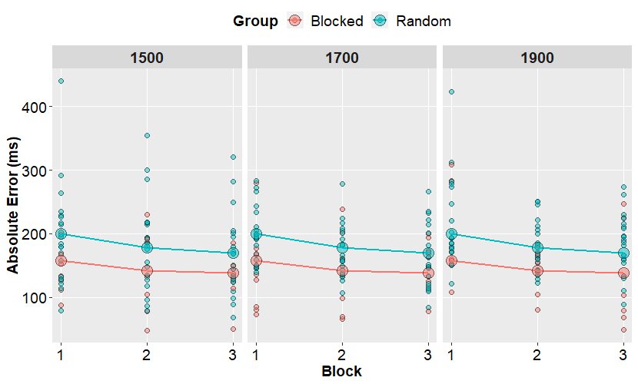
A Two Group Longitudinal Study
Alternatively, with a little bit of aggregating, we might be able to find a happier “middle ground”.

Slide 25
Conclusions

Slide 26
Conclusions
Something something something

Slide 27

Thank You!
For more information:
Special Thanks:
Lei Liew and James Finley
The American Society for Neurorehabilitation
Tiphanie Raffegeau and Joe Thomas for sharing parts of their data.
rehabinformatics@gmail.com
@keith_lohse
https://github.com/keithlohse/ASNR

