Slide 1




KINES 7103: Design and Analysis I
Keith Lohse, PhD, PStat
Assistant Professor
Department of Health, Kinesiology, and Recreation
Department of Physical Therapy and Athletic Training
University of Utah
keith.lohse@health.utah.edu
@keith_lohse

Slide 2
About Me…
In my research, I want to improve our understanding of the mechanisms underlying neurological rehabilitation.
Ultimately I want to create more efficient, individualized rehabilitation approaches and improve the quality of life for individuals with disabilities.
My background is in quantitative psychology, where I learned to model data and statistically test hypotheses about human learning.
I am accredited as a professional statistician (“Pstat”), by the American Statistical Association.
I have taught statistics in some capacity at either the undergraduate or graduate level since 2007.

Slide 3
What is KINES 7103?
Design and Analysis I is a foundational research methods course for the College of Health. This means that…
We have students with a wealth of different backgrounds and experiences.
In class, I will try to find examples from the different disciplines in the CoH. In office hours, I can provide more personalized instruction and even work with you on your own data.
We need to introduce statistical techniques from across the translational research pipeline.
I have worked on computational models of neural processes, Phase III randomized controlled trials, and epidemiological data “in the wild”.
In this class you will learn the complexities of statistical inference in the general linear model.
But remember that statistics is its own discipline. You wouldn’t be an expert in genetics after taking 1-2 classes; you won’t be an expert in statistics at the end of this class, and that’s okay.

Slide 4
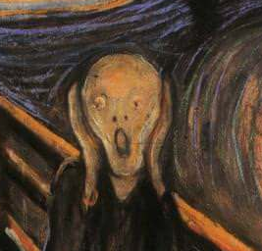
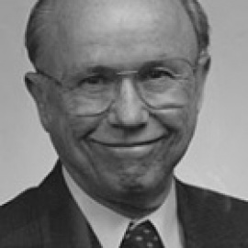
Introductory exercise…
“The Scream”
[Edvard Munch, 1893]
Scatter yourselves around the room in groups of 2-3. Try to sit with at least one person you don’t already know.
When I say “go”, you have 30 seconds to draw your new partner. At the end of 30 seconds, you need to show your partner their portrait.
“Creative Confidence”
[Bob McKim, Stanford University]

Slide 5
General Format for the Course
We have a flipped classroom model. Every week, you will*:
Read a chapter from the textbook.
Watch (or re-watch) the pre-recorded video lectures.
Complete an Online Quiz over the chapter.
Attend class, in which I will lead you through some problems, answer your questions, and then you will work on the remaining problems to complete the Lab Assignment.
Attend my office hours. You can follow-up with any questions you have or even bring in your own data that we can work on together.
I am genuinely happy for you to come to my office hours every week. You can treat it like a second class.
Be sure to submit your lab assignment before the next class.
[* This is just my recommended order. You may find a different order works better.]

Slide 6
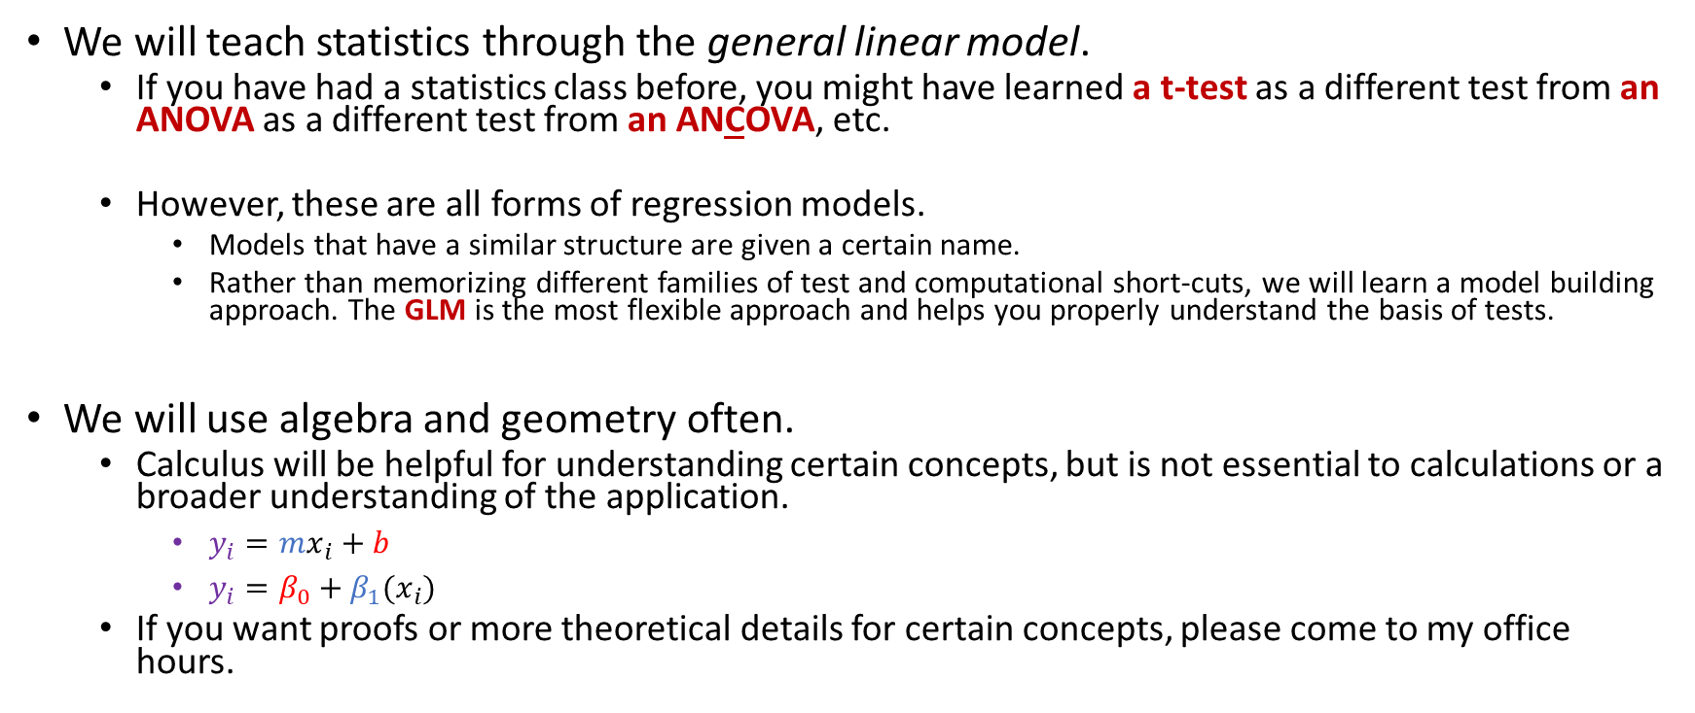
General Information
We will teach statistics through the general linear model.
If you have had a statistics class before, you might have learned a t-test as a different test from an ANOVA as a different test from an ANCOVA, etc.
However, these are all forms of regression models.
Models that have a similar structure are given a certain name.
Rather than memorizing different families of test and computational short-cuts, we will learn a model building approach. The GLM is the most flexible approach and helps you properly understand the basis of tests.
We will use algebra and geometry often.
Calculus will be helpful for understanding certain concepts, but is not essential to calculations or a broader understanding of the application.
$y_{i}=mx_{i}+b$
$y_{i}=β_{0}+β_{1}(x_{i})$
If you want proofs or more theoretical details for certain concepts, please come to my office hours.

Slide 7

General Information
When you encounter equations in the text, you want to be able to read them like a sentence and understand the concepts. For instance:
If you are having trouble understanding what an equation is saying conceptually:
Trying fixing all but one of the values. What happens to the outcome when you make that value bigger or smaller?
Shoot me an email,
Ask me in class,
Come to my office hours.
$$s_{x}= \sqrt{\frac{{\sum{\left(x_{i}−\overline{x}\right)}}^{2}}{(n−1)}}$$
The standard deviation tells us how different values are on average.
Specifically, how much a variable varies around its mean, standardized to the number of observations (more specifically the degrees of freedom).

Slide 8

Gaining “Experience Points”
In order of difficulty:
Online Quizzes
Lab Assignments
Quests
There are two quests throughout the course. These are assigned and completed online.
Quests must be completed individually.
Copies of old quests are included in the compressed files for the course.
The unknown as personified by a dragon.
You.
[Larry Elmore, 1983 ]

Slide 9
Today
Introduction to R and the R programming environment.
You do not need to know how to program in R to succeed in this course.
All* code will be provided for you.
R is free, powerful, and a valuable skill for both academia and industry.
Complete Lab Assignment 01 and submit it through Canvas.
Please also be sure to watch Video 01 and complete Quiz 01 by Wednesday if you have not already.
[*You may need to lightly edit code for lab assignments. ]

Slide 11
Creative Confidence and Peer Judgment
Perception:
What others seem to know.
What you know.

Slide 12
Creative Confidence and Peer Judgment
Perception:
What other people know.
What you know.

