Slide 1




Introduction to Data Analysis.
Keith Lohse, PhD
Assistant Professor
Department of Health, Kinesiology, and Recreation
Department of Physical Therapy and Athletic Training
University of Utah
keith.lohse@health.utah.edu
@keith_lohse

Slide 2
The “flipped” classroom | (╯°□°)╯︵ ┻━┻
Every week, we will have lecture materials that are posted online, that way you can watch and re-watch lectures in your own time.
Focused on theory and proving concepts.
In the lab, we will complete assignments that require you to use the concepts discussed in the lecture.
Take a quiz based on the lecture/s.
Put theory into practice with assignments.
Simulations, data manipulation, analysis, graphing, etc.
The links to the videos, scripts for lab assignments, and all other course materials can be found on the course webpage and on my personal site:
https://sites.google.com/site/lohsekr/data-analysis-i

Slide 3
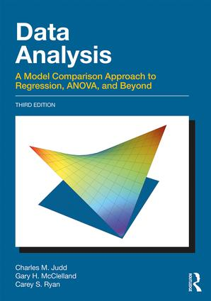
A Model Comparison Approach
http://www.dataanalysisbook.com/
DATA = MODEL + ERROR
DATA are our fundamental scores or observations.
MODELs are a compact description of representation of the DATA.
These MODELs are not perfect, however, and will leave behind residual ERROR.

Slide 4
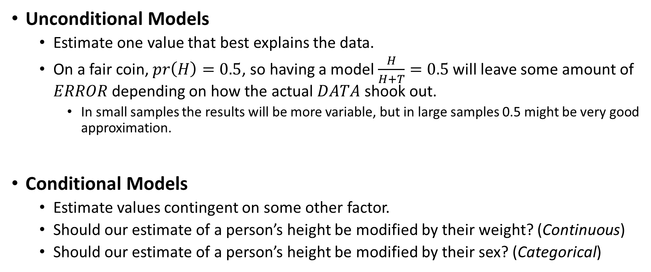


Different Types of Models
Unconditional Models
Estimate one value that best explains the data.
On a fair coin, $pr\left(H\right)=0.5$, so having a model $\frac{H}{H+T}=0.5$ will leave some amount of $ERROR$ depending on how the actual $DATA$ shook out.
In small samples the results will be more variable, but in large samples 0.5 might be very good approximation.
Conditional Models
Estimate values contingent on some other factor.
Should our estimate of a person’s height be modified by their weight? (Continuous)
Should our estimate of a person’s height be modified by their sex? (Categorical)
$$Y_{i}=β_{0}+ε_{i}$$
$$Y_{i}=β_{0}+β_{1}(x_{i})+ε_{i}$$

Slide 5


How do we compare models?
Let’s say that one researcher proposes that a person’s height is totally unrelated to their weight (unconditional):
$$y_{i}=β_{0}+0 (x_{i})+ε_{i}$$
Let’s say that another researcher proposes that a person’s height is related to their weight (conditional):
$$y_{i}=β_{0}+β_{1}(x_{i})+ε_{i}$$
We aren’t saying exactly what the magnitude of the relationship between height and weight is ($β_{1}$) but we are proposing that it is not zero.

Slide 6

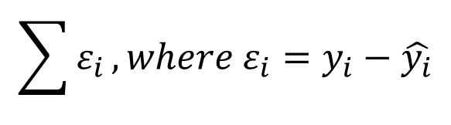

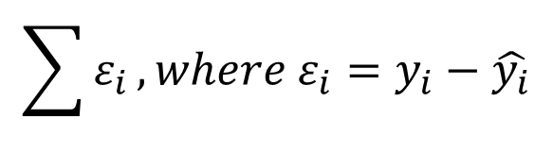

How do we compare models?
If we had access to all of the DATA (i.e., measured everyone to whom our model applies), then we could simply compare the ERRORs in our two different models:
Augmented Model: and
Compact Model: and
$$\sum{ε_{i}}, where ε_{i}=y_{i}−\hat{y_{i}}$$
$$\hat{y_{i}}=β_{0}+β_{1}\left(x_{i}\right)$$
$$\hat{y_{i}}=β_{0}+0 (x_{i})$$
$$\sum{ε_{i}}, where ε_{i}=y_{i}−\hat{y_{i}}$$
$$\hat{y_{i}}=β_{0}$$

Slide 7
How do we compare models?
If we could measure all of the data, we would simply need to see if ERROR(A) < ERROR(C) to decide if it was the better model.
However, we face some important issues:
How big of a reduction in ERROR is important? (Is a 1% reduction in error worth the added complexity.)
We aren’t going to get to measure everyone. (If I’m sampling from a population, how much faith do I have in the reduction in error in my sample?)
Does the absolute or relative error matter? (If I take a sample of 100 people, the sum of errors will likely be much larger than a sample of 10 people).

Slide 8


How do we compare models?
Proportional Reduction in Error:
So if ERROR(C) = 100 and ERROR(A) = 90,
But again, is 10% reduction in error good? If we had all of the data it certainly sounds good… but what about in a sample?
$$PRE=\frac{ERROR\left(C\right)−ERROR(A)}{ERROR(C)}=1−\frac{ERROR(A)}{ERROR(C)}$$
$$PRE=1−\frac{90}{100}=0.10$$

Slide 9
Effect Size
Variance
Sample Size

Slide 10
Effect Size
Variance
Sample Size
Everything we do is statistics is an elaboration and specification of this idea!

