Slide 1




A Note on Notation.
Keith Lohse, PhD
Assistant Professor
Department of Health, Kinesiology, and Recreation
Department of Physical Therapy and Athletic Training
University of Utah
keith.lohse@health.utah.edu
@keith_lohse

Slide 2
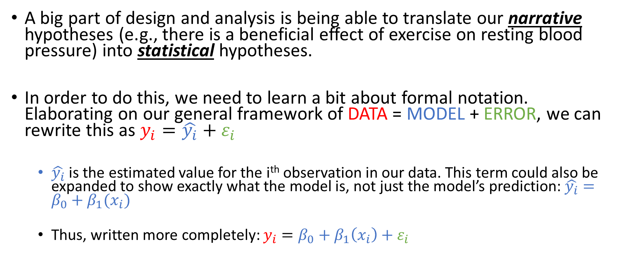
Formal Notation
A big part of design and analysis is being able to translate our narrative hypotheses (e.g., there is a beneficial effect of exercise on resting blood pressure) into statistical hypotheses.
In order to do this, we need to learn a bit about formal notation. Elaborating on our general framework of DATA = MODEL + ERROR, we can rewrite this as $y_{i}=\hat{y_{i}}+ε_{i}$
$\hat{y_{i}}$ is the estimated value for the i^{th} observation in our data. This term could also be expanded to show exactly what the model is, not just the model’s prediction: $\hat{y_{i}}=β_{0}+β_{1}(x_{i})$
Thus, written more completely: $y_{i}=β_{0}+β_{1}\left(x_{i}\right)+ε_{i}$

Slide 3
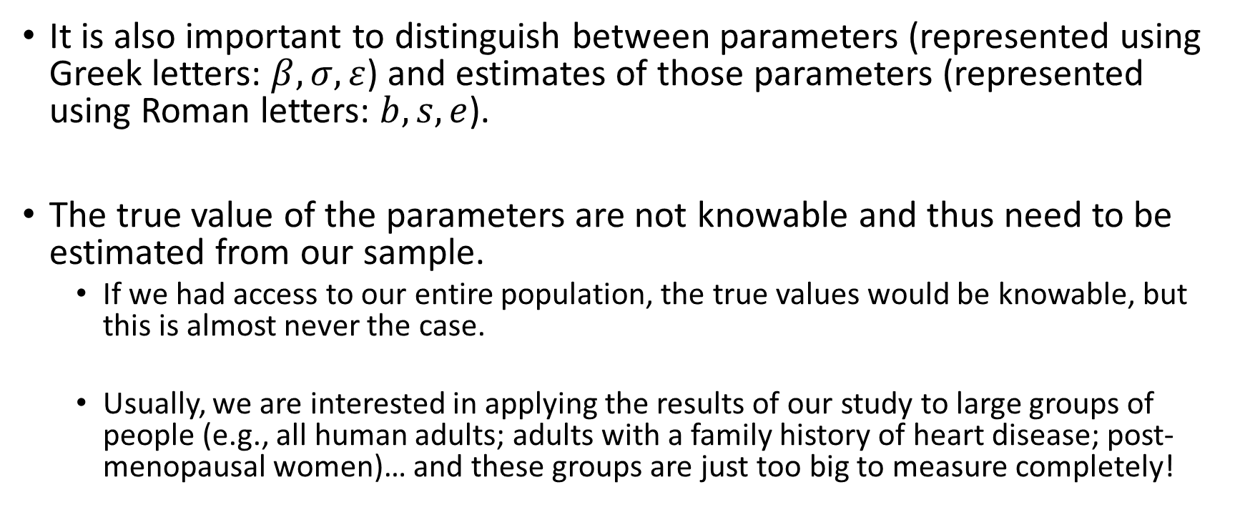
Formal Notation
It is also important to distinguish between parameters (represented using Greek letters: $β,σ,ε$) and estimates of those parameters (represented using Roman letters: $b, s,e$).
The true value of the parameters are not knowable and thus need to be estimated from our sample.
If we had access to our entire population, the true values would be knowable, but this is almost never the case.
Usually, we are interested in applying the results of our study to large groups of people (e.g., all human adults; adults with a family history of heart disease; post-menopausal women)… and these groups are just too big to measure completely!

Slide 4



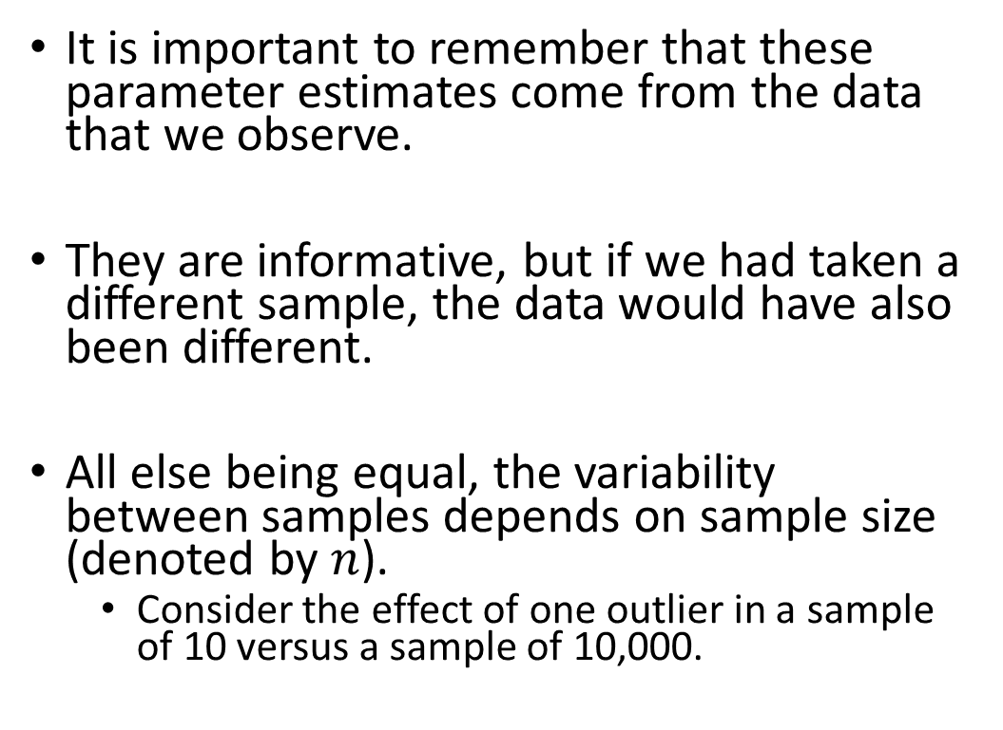





Parameter Estimates
$$b_{01}$$
It is important to remember that these parameter estimates come from the data that we observe.
They are informative, but if we had taken a different sample, the data would have also been different.
All else being equal, the variability between samples depends on sample size (denoted by $n$).
Consider the effect of one outlier in a sample of 10 versus a sample of 10,000.
$$b_{02}$$
Larger sampling variability in Small samples
(e.g., n = 10)
$$β_{0}$$
$$b_{03}$$
Smaller sampling variability in large samples
(e.g., n = 1,000)
$$b_{01}$$
$$β_{0}$$
$$b_{02}$$
$$b_{03}$$

Slide 5
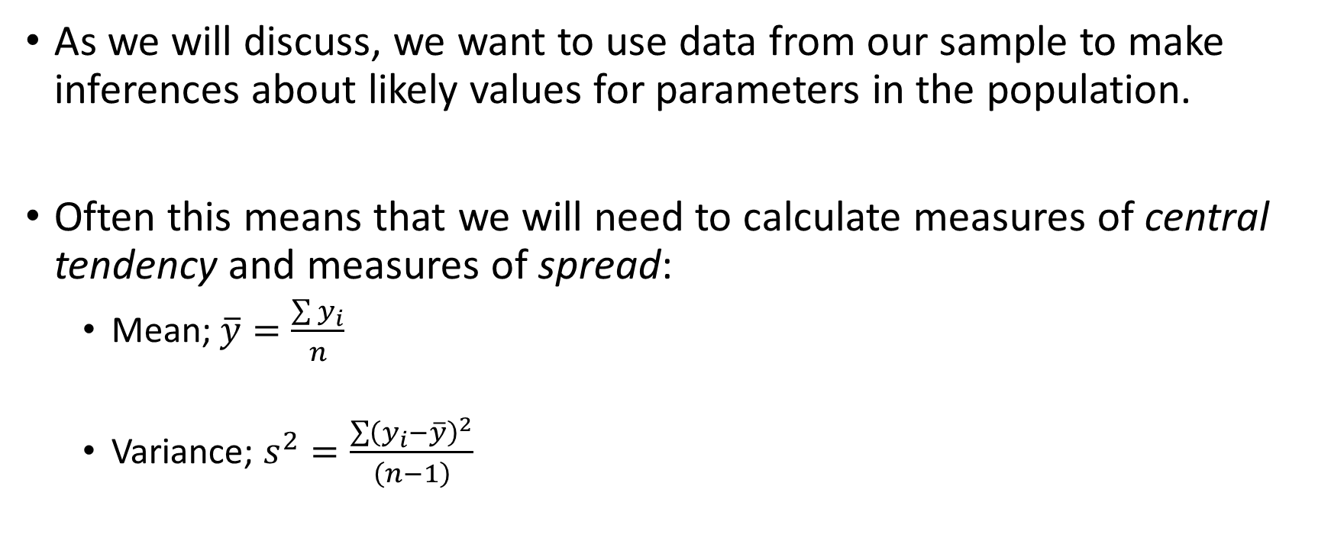
Sample Statistics
As we will discuss, we want to use data from our sample to make inferences about likely values for parameters in the population.
Often this means that we will need to calculate measures of central tendency and measures of spread:
Mean; $\overline{y}=\frac{\sum{y_{i}}}{n}$
Variance; $s^{2}=\frac{\sum{{\left(y_{i}−\overline{y}\right)}^{2}}}{\left(n−1\right)}$
y
15
25
22
13
17
19

