Slide 1




Definitions of Error and Parameter Estimates.
Keith Lohse, PhD
Assistant Professor
Department of Health, Kinesiology, and Recreation
Department of Physical Therapy and Athletic Training
University of Utah
keith.lohse@health.utah.edu
@keith_lohse

Slide 2
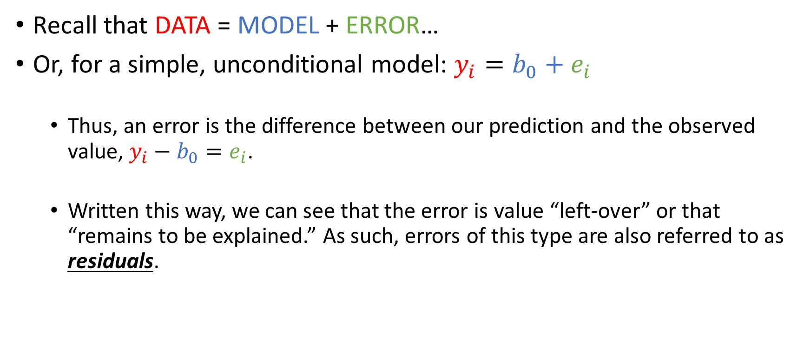
Definition of Errors
Recall that DATA = MODEL + ERROR…
Or, for a simple, unconditional model: $y_{i}=b_{0}+e_{i}$
Thus, an error is the difference between our prediction and the observed value, $y_{i}−b_{0}=e_{i}$.
Written this way, we can see that the error is value “left-over” or that “remains to be explained.” As such, errors of this type are also referred to as residuals.

Slide 3
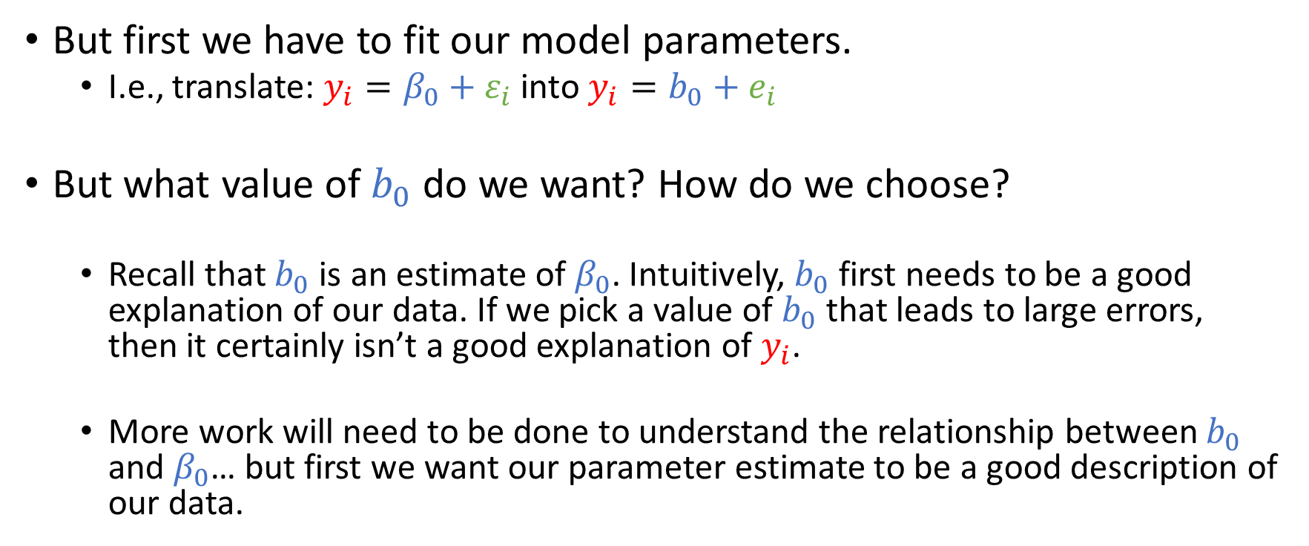
Definition of Errors
But first we have to fit our model parameters.
I.e., translate: $y_{i}=β_{0}+ε_{i}$ into $y_{i}=b_{0}+e_{i}$
But what value of $b_{0}$ do we want? How do we choose?
Recall that $b_{0}$ is an estimate of $β_{0}$. Intuitively, $b_{0}$ first needs to be a good explanation of our data. If we pick a value of $b_{0}$ that leads to large errors, then it certainly isn’t a good explanation of $y_{i}$.
More work will need to be done to understand the relationship between $b_{0}$ and $β_{0}$… but first we want our parameter estimate to be a good description of our data.

Slide 4

Different Methods of Calculating Errors
Estimating the number of books read over the summer by students.
$y_{i}=β_{0}+ε_{i}$
# Books
1
3
5
9
14

Slide 5
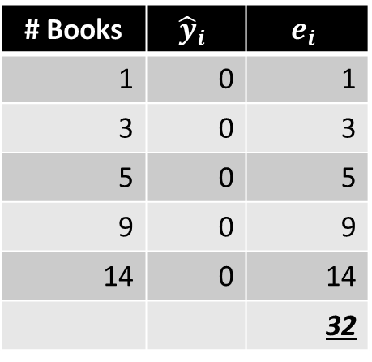
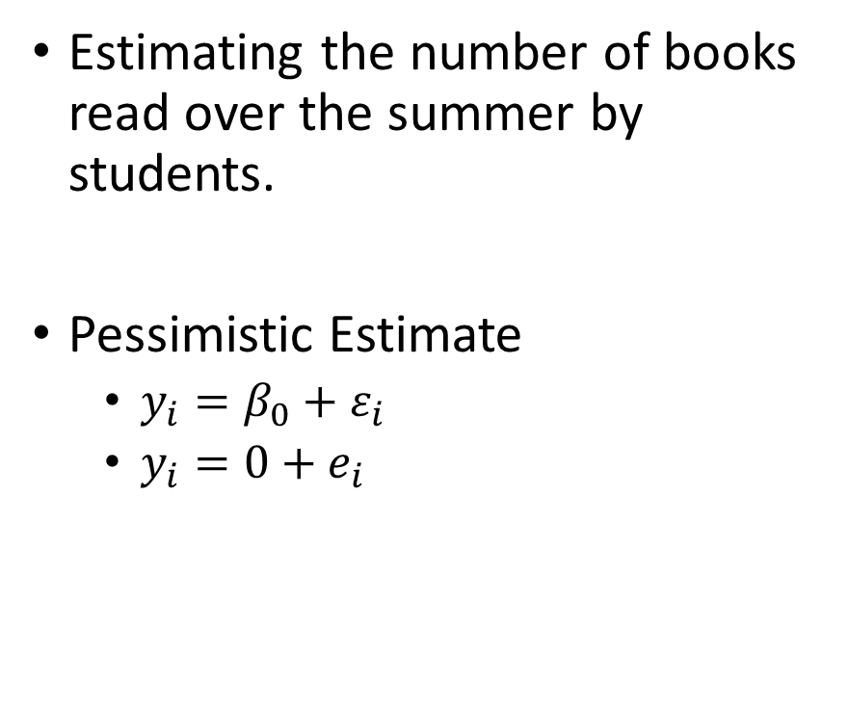
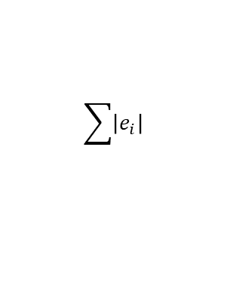
Sum of Absolute Errors
Estimating the number of books read over the summer by students.
Pessimistic Estimate
$y_{i}=β_{0}+ε_{i}$
$y_{i}=0+e_{i}$
# Books | $${\hat{y}}_{i}$$ | $$e_{i}$$
1 | 0 | 1
3 | 0 | 3
5 | 0 | 5
9 | 0 | 9
14 | 0 | 14
 |  | 32
$$\sum{\left|e_{i}\right|}$$

Slide 6
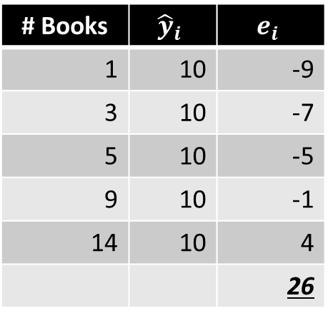
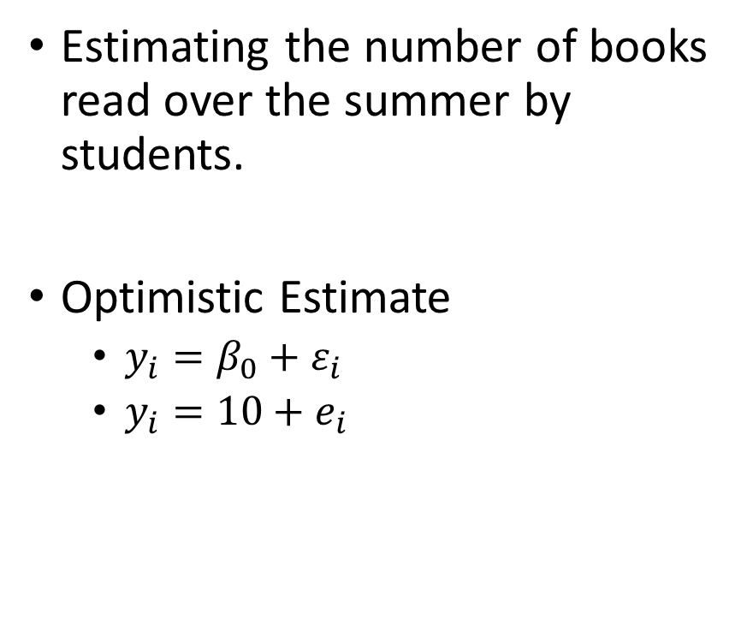
Sum of Absolute Errors
Estimating the number of books read over the summer by students.
Optimistic Estimate
$y_{i}=β_{0}+ε_{i}$
$y_{i}=10+e_{i}$
# Books | $${\hat{y}}_{i}$$ | $$e_{i}$$
1 | 10 | -9
3 | 10 | -7
5 | 10 | -5
9 | 10 | -1
14 | 10 | 4
 |  | 26
$$\sum{\left|e_{i}\right|}$$

Slide 7
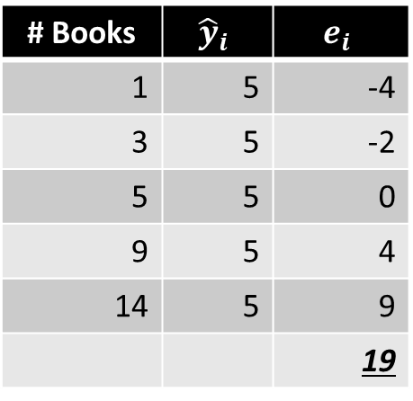
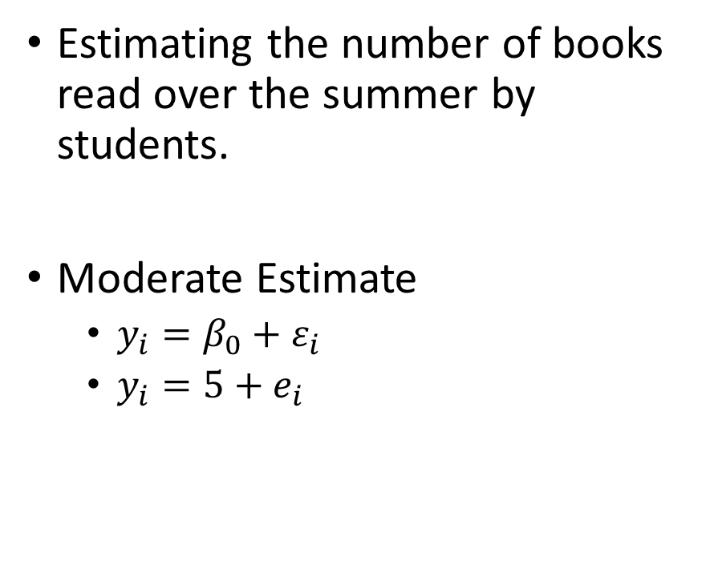
Sum of Absolute Errors
Estimating the number of books read over the summer by students.
Moderate Estimate
$y_{i}=β_{0}+ε_{i}$
$y_{i}=5+e_{i}$
# Books | $${\hat{y}}_{i}$$ | $$e_{i}$$
1 | 5 | -4
3 | 5 | -2
5 | 5 | 0
9 | 5 | 4
14 | 5 | 9
 |  | 19
$$\sum{\left|e_{i}\right|}$$

Slide 8

Sum of Absolute Errors
# Books | $${\hat{y}}_{i}$$ | $$e_{i}$$
1 | 5 | -4
3 | 5 | -2
5 | 5 | 0
9 | 5 | 4
14 | 5 | 9
 |  | 19
The median will always produce the smallest sum of absolute errors.

Slide 9
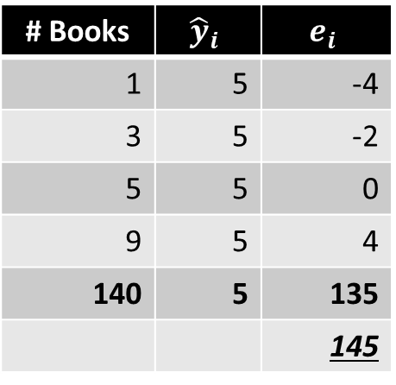
Sum of Absolute Errors
# Books | $${\hat{y}}_{i}$$ | $$e_{i}$$
1 | 5 | -4
3 | 5 | -2
5 | 5 | 0
9 | 5 | 4
140 | 5 | 135
 |  | 145
The median will always produce the smallest sum of absolute errors.

Slide 10
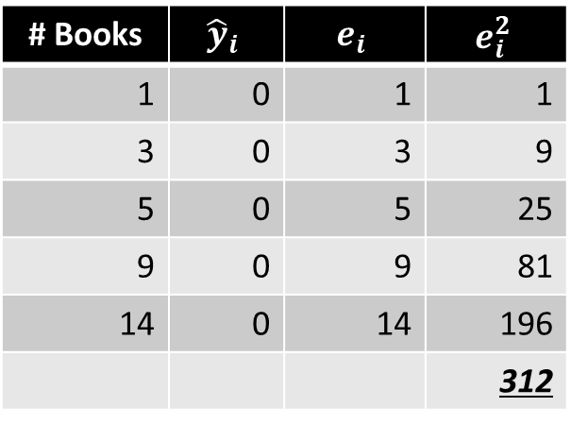
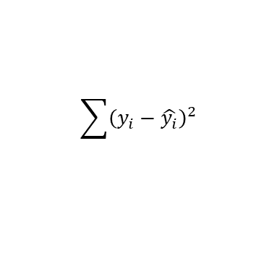
Sum of Squared Errors
Estimating the number of books read over the summer by students.
Pessimistic Estimate
$y_{i}=β_{0}+ε_{i}$
$y_{i}=0+e_{i}$
# Books | $${\hat{y}}_{i}$$ | $$e_{i}$$ | $$e_{i}^{2}$$
1 | 0 | 1 | 1
3 | 0 | 3 | 9
5 | 0 | 5 | 25
9 | 0 | 9 | 81
14 | 0 | 14 | 196
 |  |  | 312
$$\sum{{\left(y_{i}−\hat{y_{i}}\right)}^{2}}$$

Slide 11
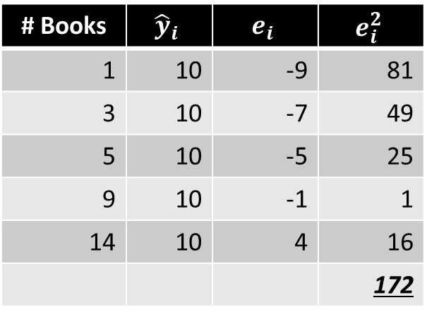
Sum of Squared Errors
Estimating the number of books read over the summer by students.
Optimistic Estimate
$y_{i}=β_{0}+ε_{i}$
$y_{i}=10+e_{i}$
# Books | $${\hat{y}}_{i}$$ | $$e_{i}$$ | $$e_{i}^{2}$$
1 | 10 | -9 | 81
3 | 10 | -7 | 49
5 | 10 | -5 | 25
9 | 10 | -1 | 1
14 | 10 | 4 | 16
 |  |  | 172
$$\sum{{\left(y_{i}−\hat{y_{i}}\right)}^{2}}$$

Slide 12
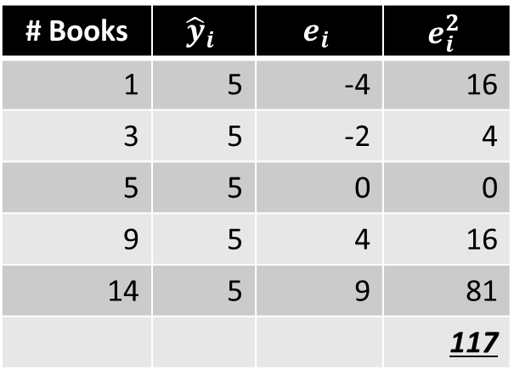
Sum of Squared Errors
Estimating the number of books read over the summer by students.
Moderate Estimate
$y_{i}=β_{0}+ε_{i}$
$y_{i}=5+e_{i}$
# Books | $${\hat{y}}_{i}$$ | $$e_{i}$$ | $$e_{i}^{2}$$
1 | 5 | -4 | 16
3 | 5 | -2 | 4
5 | 5 | 0 | 0
9 | 5 | 4 | 16
14 | 5 | 9 | 81
 |  |  | 117
$$\sum{{\left(y_{i}−\hat{y_{i}}\right)}^{2}}$$

Slide 13
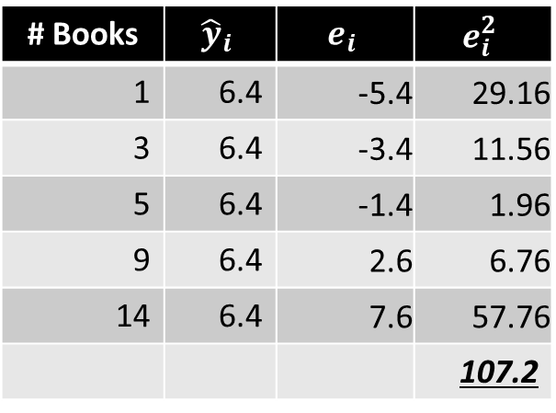
Sum of Square Errors
6.4
# Books | $${\hat{y}}_{i}$$ | $$e_{i}$$ | $$e_{i}^{2}$$
1 | 6.4 | -5.4 | 29.16
3 | 6.4 | -3.4 | 11.56
5 | 6.4 | -1.4 | 1.96
9 | 6.4 | 2.6 | 6.76
14 | 6.4 | 7.6 | 57.76
 |  |  | 107.2
The mean will always produce the smallest sum of squared errors.

Slide 14
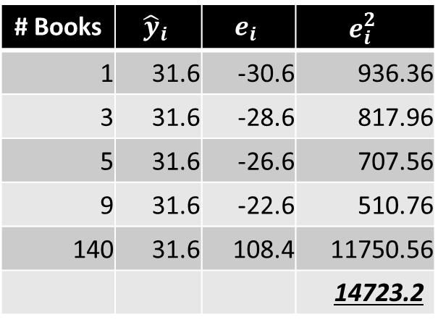
Sum of Square Errors
31.6
# Books | $${\hat{y}}_{i}$$ | $$e_{i}$$ | $$e_{i}^{2}$$
1 | 31.6 | -30.6 | 936.36
3 | 31.6 | -28.6 | 817.96
5 | 31.6 | -26.6 | 707.56
9 | 31.6 | -22.6 | 510.76
140 | 31.6 | 108.4 | 11750.56
 |  |  | 14723.2
The mean will always produce the smallest sum of squared errors.
But also note that the mean is sensitive to outliers, whereas the median is not.

Slide 15
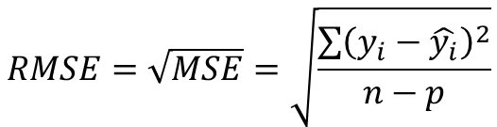

Describing Error
When describing errors in a sample, total error is not especially useful, as larger samples will likely produce more error.
We need to standardize our sums of errors with respect to the sample size.
For SAE, we will take median absolute error.
For SSE, we will take the mean squared-error (a variance) or the root mean squared-error (a standard deviation).
$$RMSE=\sqrt{MSE}=\sqrt{\frac{\sum{{\left(y_{i}−\hat{y_{i}}\right)}^{2}}}{n−p}}$$
$$MSE=\frac{SSE}{n−p}=\frac{\sum{{\left(y_{i}−\hat{y_{i}}\right)}^{2}}}{n−p}$$
[Where n = number of observations and p = number of estimated parameters]

Slide 16
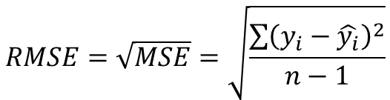
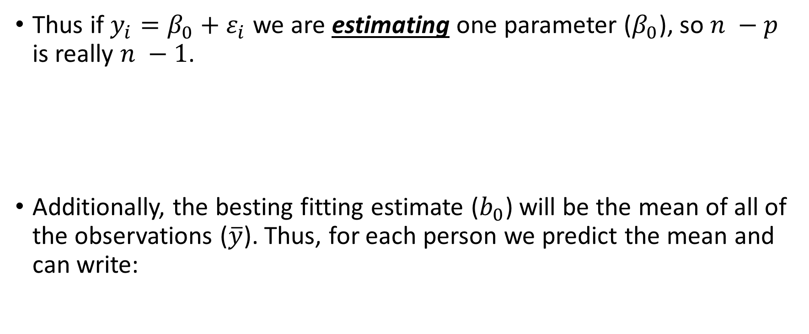
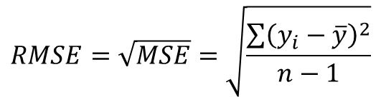
Describing Error
Thus if $y_{i}=β_{0}+ε_{i}$ we are estimating one parameter ($β_{0}$), so $n −p$ is really $n −1$.
Additionally, the besting fitting estimate ($b_{0}$) will be the mean of all of the observations ($\overline{y}$). Thus, for each person we predict the mean and can write:
$$RMSE=\sqrt{MSE}=\sqrt{\frac{\sum{{\left(y_{i}−\hat{y_{i}}\right)}^{2}}}{n−1}}$$
$$RMSE=\sqrt{MSE}=\sqrt{\frac{\sum{{\left(y_{i}−\overline{y}\right)}^{2}}}{n−1}}$$
[Which is the formula for the standard deviation in a sample you have probably encounter before.]

