Slide 1




Models of Error and Sampling Distributions
Keith Lohse, PhD
Assistant Professor
Department of Health, Kinesiology, and Recreation
Department of Physical Therapy and Athletic Training
University of Utah
keith.lohse@health.utah.edu
@keith_lohse

Slide 2
Estimation and sampling
We are often trying to make inferences about a population from a sample.
Values we observe in our sample are estimates of “true” values in the population (estimands).
The function used to obtain the value of the estimate is the estimator.
Thus, we want to employ functions (estimators) that give us representative values (estimates) for the quantity of interest (estimands).

Slide 3
Desirable Properties of Estimators
Unbiased
The estimator is not necessarily accurate, but it is as likely to over-estimate as it is to under-estimate.
Efficient
Given that two estimators are unbiased, we will prefer the one that has a smaller variance (or spread) around the estimand.
Consistent
As the sample size increases, the estimator produces better and better approximations of the estimand.

Slide 4
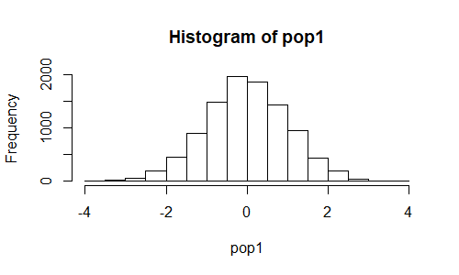
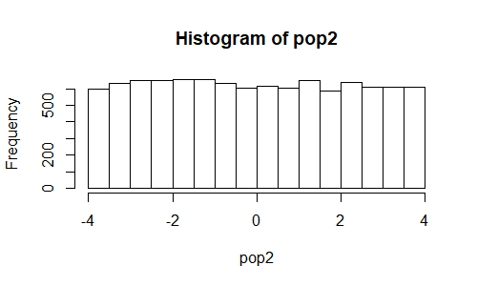
Sampling from a population of errors
Standard Normal Errors
Uniform Errors

Slide 5
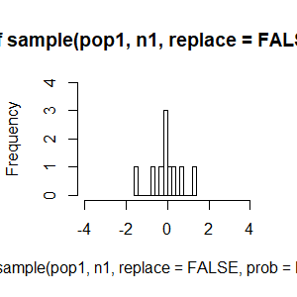
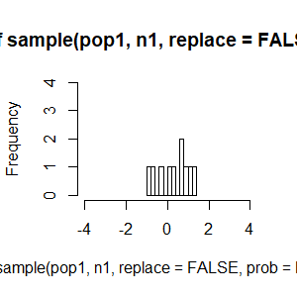
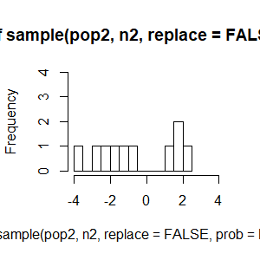
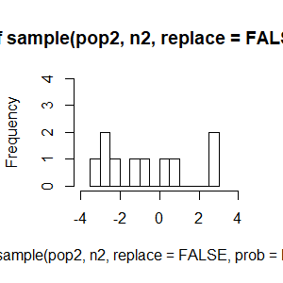
Sampling from a population of errors
Standard Normal Errors
Uniform Errors

Slide 6
Across 10k samples of n = 10
 | Mean(Means) | SD(Means) | Mean(Medians) | SD(Medians)
“Normal” Population | -0.007 | 0.320 | -0.008 | 0.373
Uniform Population | -0.025 | 0.722 | -0.049 | 1.097

Slide 7
Across 10k samples of n = 10
 | Mean(Means) | SD(Means) | Mean(Medians) | SD(Medians)
“Normal” Population | -0.007 | 0.320 | -0.008 | 0.373
Uniform Population | -0.025 | 0.722 | -0.049 | 1.097
Across 10k samples of n = 50
 | Mean(Means) | SD(means) | Mean(Medians) | SD(Medians)
“Normal” Population | -0.005 | 0.144 | -0.012 | 0.173
Uniform Population | -0.037 | 0.327 | -0.073 | 0.555

Slide 8
Choosing among different estimators
Both the mean and the median are unbiased and consistent estimators.
In the examples we looked at, the mean tends to be a more efficient estimator than the median.
Thus, we would choose the sum of squared errors and it’s associated estimator (i.e., the mean) as the preferred method.
However, this conclusion will depend on the underlying distribution.

Slide 9
Choosing among different estimators
There are many possible distributions of errors that we might assume, but there are good reasons for choosing the normal distribution.
Empirical data show us that (approximately) normal distributions are very common.
Linear combinations of random variables (even non-normal variables!) lead to (approximately) normal distributions.
The central limit theorem shows that sample means, even from non-normal distributions will be approximately normal.
Even when non-normal, many distributions can be transformed to become approximately normal.
E.g., skewed distributions can be square-root transformed or log transformed.

Slide 10
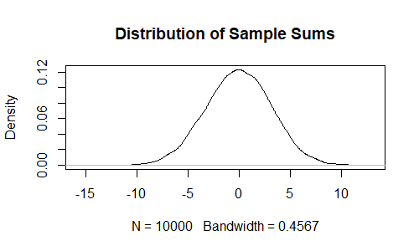
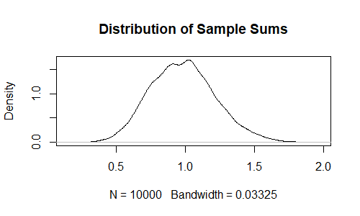
Distribution of Sample Sums
Standard Normal Errors
Uniform Errors
10k samples of n = 10
10k samples of n = 10

