Slide 1




Formal Specification of the Normal Distribution
Keith Lohse, PhD
Assistant Professor
Department of Health, Kinesiology, and Recreation
Department of Physical Therapy and Athletic Training
University of Utah
keith.lohse@health.utah.edu
@keith_lohse

Slide 2
“Know thy Distributions”
It’s easy to get lost in the weeds of mathematical formalisms.
But it’s important to dwell here for a while so that we appreciate the power that understanding these distributions allows.
Specifically, knowing a distribution allows us to make quantitative statements about the probability of an event.
I.e., “Assuming a normal distribution, what is the probability of observing a values >/= 1?”

Slide 3

The Normal Distribution
$f\left(x\right)=\frac{1}{σ(2π)}e^{−{\left(x−μ\right)}^{2}/2σ^{2}}$
Where $μ$ is the mean and $σ$ is the standard deviation. When $μ=0$ and $σ=1$, this is referred to as the standard normal distribution.

Slide 4
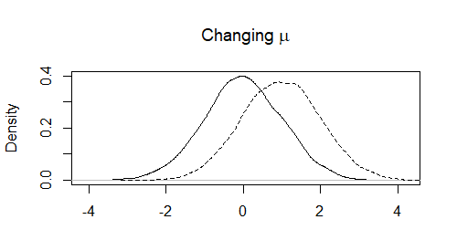
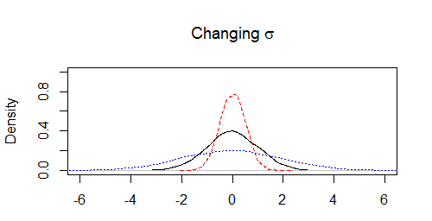








The Normal Distribution
$f\left(x\right)=\frac{1}{σ(2π)}e^{−{\left(x−μ\right)}^{2}/2σ^{2}}$
$$σ=1$$
$σ=$1
$$σ=0.5$$
$$σ=2$$
$$μ=0$$
$$μ=0$$
$μ=$1

Slide 5
The Normal Distribution
For any of these normal distributions, we can find the probability that a number lies in a specific range (e.g, between -1 and +1, or greater than +2).
Technically, as our values are continuous, the probability of being precisely one is zero, p(1) = 0. This is because, for a continuous variable, 1 is different from 0.999 and 1.000.
With infinite precision, the probability of something being exactly anything is going to be 0.
However, we could look in a very narrow range (1.00 to 1.01).

Slide 6
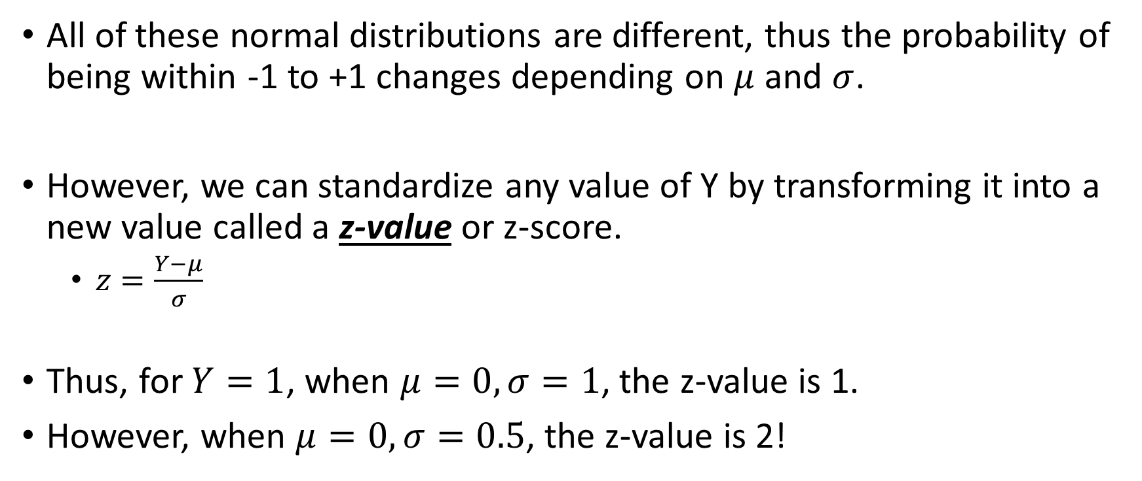
Standardizing a variable
All of these normal distributions are different, thus the probability of being within -1 to +1 changes depending on $μ$ and $σ$.
However, we can standardize any value of Y by transforming it into a new value called a z-value or z-score.
$z=\frac{Y−μ}{σ}$
Thus, for $Y=1$, when $μ=0,σ=1$, the z-value is 1.
However, when $μ=0,σ=0.5$, the z-value is 2!

Slide 7
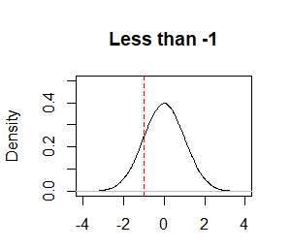
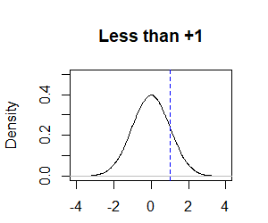
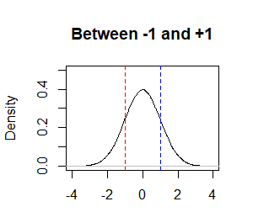
Standardizing a variable
Once standardized, we can find the probability associated with specific z-values!
15.8%
84.1%
68.3%
(We will use built-in functions in R to calculate the probabilities for continuous variables, but we will calculations for some discrete variables by hand!)

Slide 8
Know thy distributions
We will discuss how to calculate these probabilities in more detail for both normal and non-normal distributions.
Regardless of the specific distribution, the lesson is the same: if we know the underlying distribution or we are confident the distribution is a reasonable assumption, we can make very explicit quantitative statements about the probability of observing an event.

