Slide 1




Finding a Loaded Die.
Keith Lohse, PhD
Assistant Professor
Department of Health, Kinesiology, and Recreation
Department of Physical Therapy and Athletic Training
University of Utah
keith.lohse@health.utah.edu
@keith_lohse

Slide 2
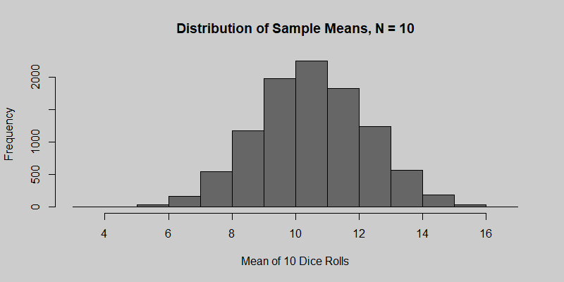
Mean of 10 Dice Rolls, 20-Sided Die

Slide 3
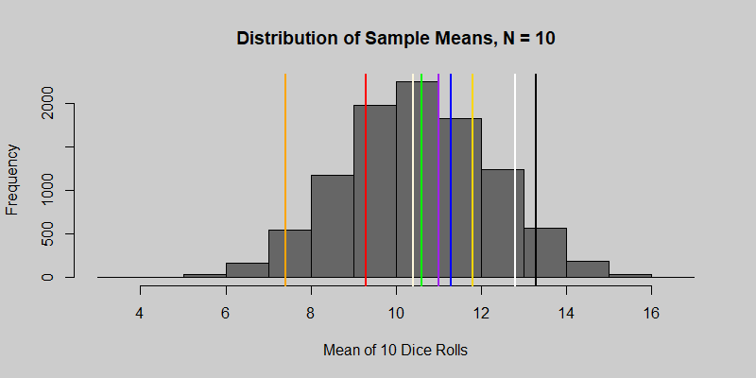
Mean of 10 Dice Rolls, 20-Sided Die
Orange | Red | Cream | Green | Purple | Blue | Gold | White | Black
7.4 | 9.3 | 10.4 | 10.6 | 11 | 11.3 | 11.8 | 12.8 | 13.3

Slide 4





What is the probability of observing a mean?
$$q_{i}=(x_{i}−\overline{x})/s_{SDOM}$$
$$q_{orange}=(7.4−10.5)/1.74$$
$$q_{red}=(9.3−10.5)/1.74$$
$$q_{cream}=(10.4−10.5)/1.74$$
$$q_{green}= …$$
Orange | Red | Cream | Green | Purple | Blue | Gold | White | Black
7.4 | 9.3 | 10.4 | 10.6 | 11 | 11.3 | 11.8 | 12.8 | 13.3

Slide 5
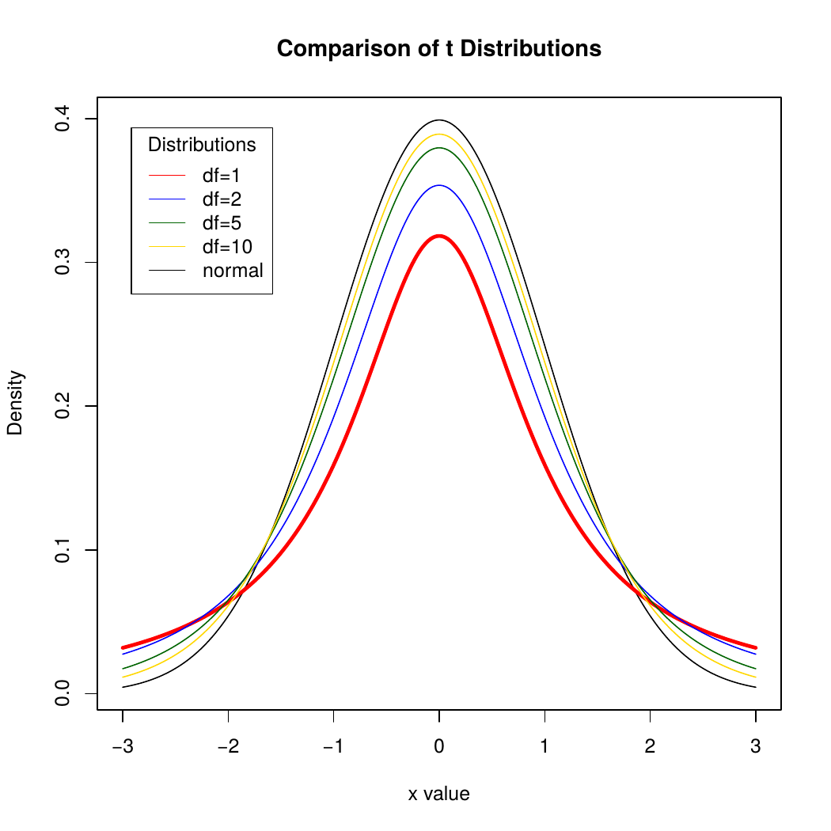
What is the probability of observing a mean?

Slide 6
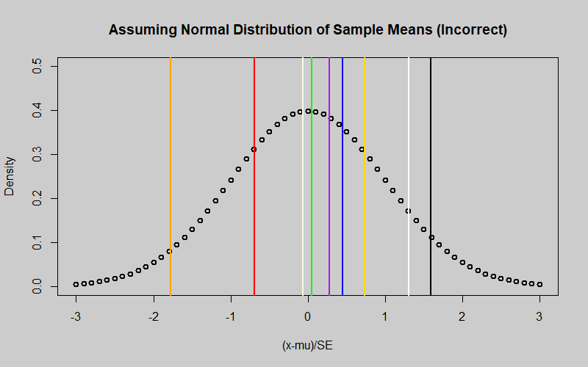

What is the probability of observing a mean?
$$q_{i}=(x_{i}−\overline{x})/s_{SDOM}$$
0.038
0.055
pnorm(Qobs, mean=0, sd=1)

Slide 7
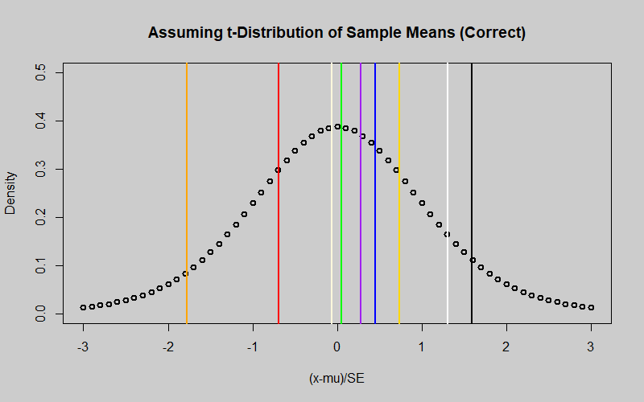
What is the probability of observing a mean?
$$q_{i}=(x_{i}−\overline{x})/s_{SDOM}$$
0.163
0.178
pt(Qobs,(10-9))

Slide 8
Which die was “loaded”?
The black die is biased to produce higher numbers.
(E[X] = 12.5 versus E[X] = 10.5)
All of the other dice were “fair” dice, so any variation we saw in those values was due to sampling variability.

