Slide 1




Statistical Inferences about Parameters
Keith Lohse, PhD
Assistant Professor
Department of Health, Kinesiology, and Recreation
Department of Physical Therapy and Athletic Training
University of Utah
keith.lohse@health.utah.edu
@keith_lohse

Slide 2
‘Fitting’ Parameters
As we have discussed, the sum of squared errors is an excellent method for measuring total error, for reasons of efficiency, mathematical practicality, and tradition.
This also means (and we have shown) that the sample mean is an unbiased but not necessarily accurate estimate of the population mean.
Armed with this knowledge, we can use the tools we already have to answer some important questions.

Slide 3
Does having the flu increase your temperature?
Let’s say that I have a hypothesis that having the flu increases your body’s temperature.
I formulated this hypothesis based on the anecdotal observation that when I touch the foreheads of sick people, they seem warmer than me.
I randomly sample ten people with the flu and take their surface temperature on the forehead. (Arguably not the best, but at least a non-invasive measure of temperature.)

Slide 4
Does having the flu increase your temperature?
37.57 | 37.98
37.79 | 38.08
36.74 | 37.97
37.63 | 38.26
37.98 | 36.59
What is the sum of squared errors for 37*C?

Slide 5
Does having the flu increase your temperature?
37.57 | 37.98
37.79 | 38.08
36.74 | 37.97
37.63 | 38.26
37.98 | 36.59
What is the sum of squared errors for 37*C?
7.197
0.57 | 0.98
0.79 | 1.08
-0.26 | 0.97
0.63 | 1.26
0.98 | -0.41

Slide 6
Does having the flu increase your temperature?
37.57 | 37.98
37.79 | 38.08
36.74 | 37.97
37.63 | 38.26
37.98 | 36.59
What is the sum of squared errors if we “fit” beta with our sample mean?
Sample mean = 37.659

Slide 7
Does having the flu increase your temperature?
37.57 | 37.98
37.79 | 38.08
36.74 | 37.97
37.63 | 38.26
37.98 | 36.59
What is the sum of squared errors if we “fit” beta with our sample mean?
Sample mean = 37.659
2.854
-0.089 | 0.321
0.131 | 0.421
-0.919 | 0.311
-0.029 | 0.601
0.321 | -1.069

Slide 8
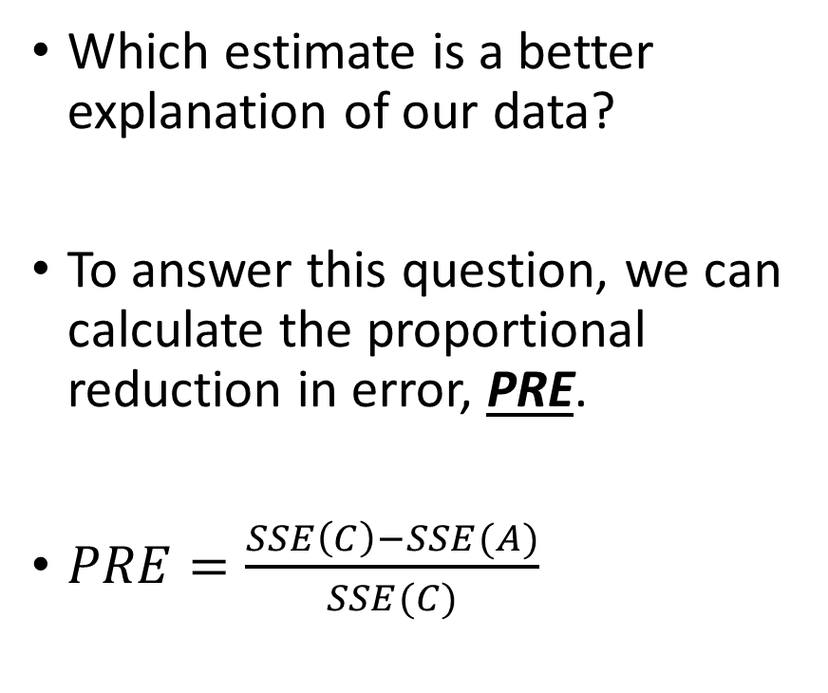
Does having the flu increase your temperature?
Residuals 1
SSE(C) = 7.197
Which estimate is a better explanation of our data?
To answer this question, we can calculate the proportional reduction in error, PRE.
$PRE=\frac{SSE\left(C\right)−SSE(A)}{SSE(C)}$
0.57 | 0.98
0.79 | 1.08
-0.26 | 0.97
0.63 | 1.26
0.98 | -0.41
Residuals 2
SSE(A) = 2.854
-0.089 | 0.321
0.131 | 0.421
-0.919 | 0.311
-0.029 | 0.601
0.321 | -1.069

Slide 9
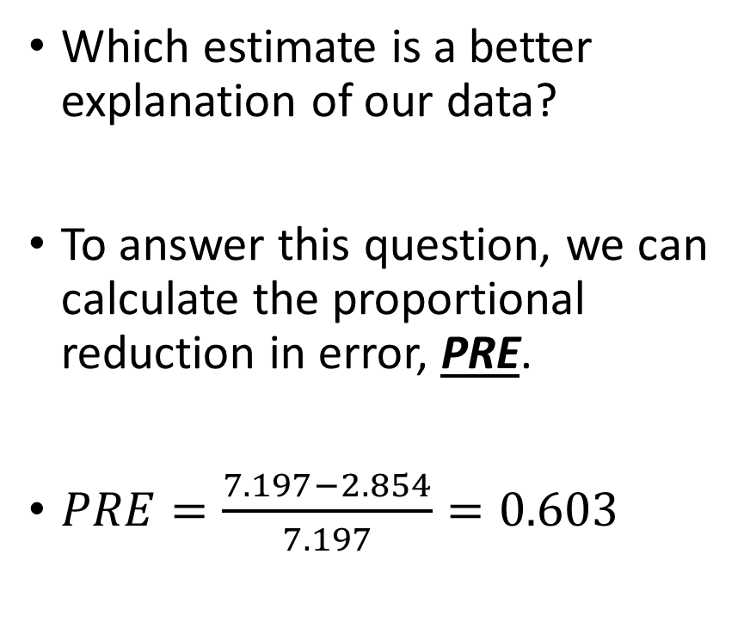
Does having the flu increase your temperature?
Residuals 1
SSE(C) = 7.197
Which estimate is a better explanation of our data?
To answer this question, we can calculate the proportional reduction in error, PRE.
$PRE=\frac{7.197−2.854}{7.197}=0.603$
0.57 | 0.98
0.79 | 1.08
-0.26 | 0.97
0.63 | 1.26
0.98 | -0.41
Residuals 2
SSE(A) = 2.854
-0.089 | 0.321
0.131 | 0.421
-0.919 | 0.311
-0.029 | 0.601
0.321 | -1.069

Slide 10
Does having the flu increase your temperature?
Thus, using our sample mean led to ~60% less error than estimating the average human body temperature of 37*C.
But does this mean that having the flu increases your temperature? How much better does an explanation need to be before we decide it is the better explanation?
How can we use the proportional reduction in error to make an inference from our sample to the population?

Slide 11
The sampling distribution of PRE
Recall that the mean will always produce the smallest SSE for a given set of numbers. Thus, it is not unusual that SSE(A) < SSE(C).
In order to make an inference, therefore, we need to see if SSE(A) is sufficiently smaller than SSE(C) to make the result statistically interesting.
That is, is the reduction in SSE large enough that we think it is unlikely to happen by sampling variability alone?

Slide 12
The sampling distribution of PRE
In class, we will show the sampling distribution of PRE using simulations.
For now, let’s focus on two key concepts:
The proportional reduction in error will always be ≥ 0 in this situation, because the sample mean will provide the smallest SSE for a set of numbers. (If the mean had been 37 exactly, PRE would be 0.)
The larger the proportional reduction in error, the less likely we think a result is to have occurred from sampling variability alone.
(That is, if the variability explained by the estimate is large compared to the residual variability, there might be something systematic rather than random happening in our data.)

Slide 13
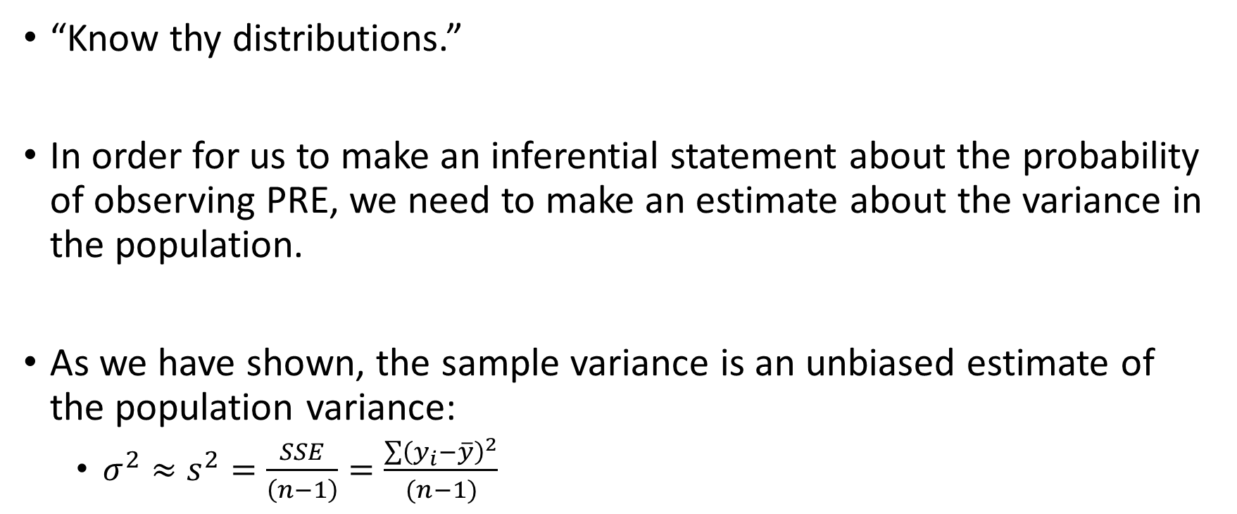
The sampling distribution of PRE
“Know thy distributions.”
In order for us to make an inferential statement about the probability of observing PRE, we need to make an estimate about the variance in the population.
As we have shown, the sample variance is an unbiased estimate of the population variance:
$σ^{2}≈s^{2}=\frac{SSE}{\left(n−1\right)}=\frac{\sum{{\left(y_{i}−\overline{y}\right)}^{2}}}{(n−1)}$

Slide 14
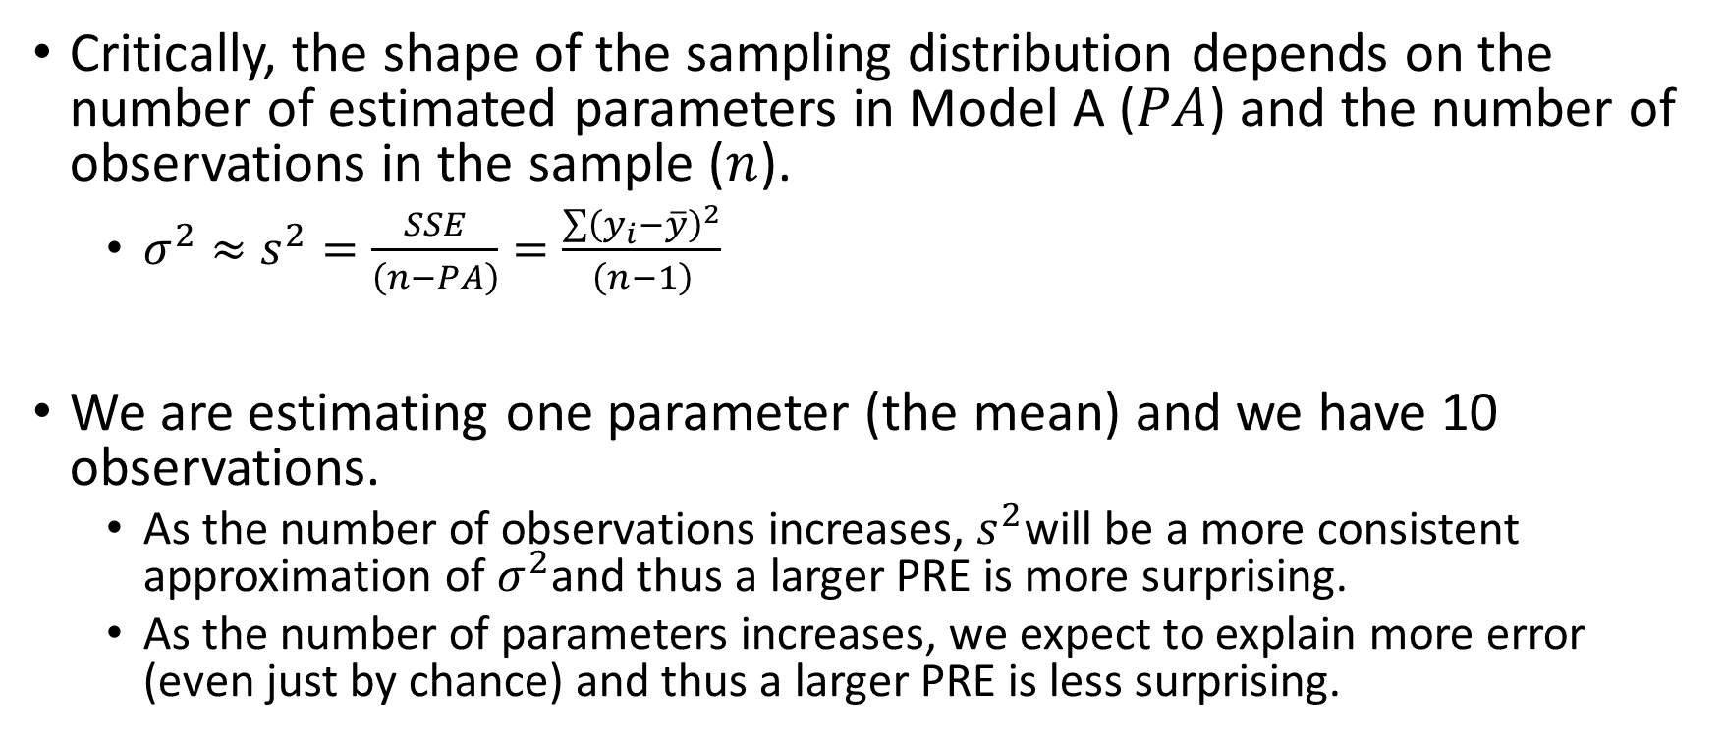
The sampling distribution of PRE
Critically, the shape of the sampling distribution depends on the number of estimated parameters in Model A ($PA$) and the number of observations in the sample ($n$).
$σ^{2}≈s^{2}=\frac{SSE}{\left(n−PA\right)}=\frac{\sum{{\left(y_{i}−\overline{y}\right)}^{2}}}{\left(n−1\right)}$
We are estimating one parameter (the mean) and we have 10 observations.
As the number of observations increases, $s^{2}$will be a more consistent approximation of $σ^{2}$and thus a larger PRE is more surprising.
As the number of parameters increases, we expect to explain more error (even just by chance) and thus a larger PRE is less surprising.

Slide 15
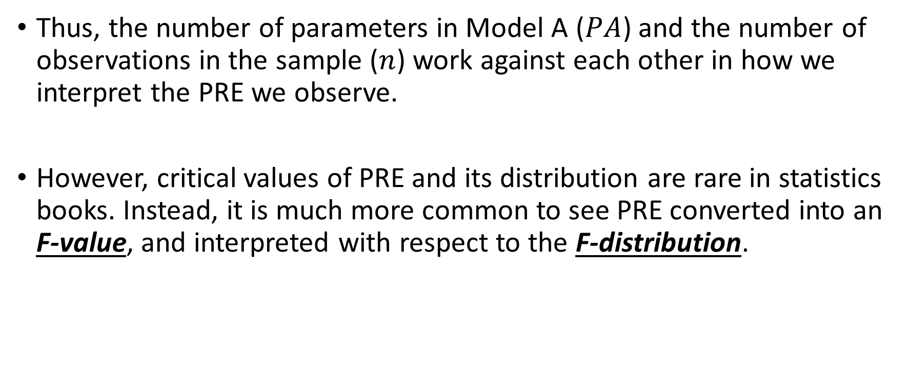
The sampling distribution of PRE
Thus, the number of parameters in Model A ($PA$) and the number of observations in the sample ($n$) work against each other in how we interpret the PRE we observe.
However, critical values of PRE and its distribution are rare in statistics books. Instead, it is much more common to see PRE converted into an F-value, and interpreted with respect to the F-distribution.

