Slide 1




The Sampling Distribution of PRE and the F-Distribution.
Keith Lohse, PhD
Assistant Professor
Department of Health, Kinesiology, and Recreation
Department of Physical Therapy and Athletic Training
University of Utah
keith.lohse@health.utah.edu
@keith_lohse

Slide 2
The sampling distribution of PRE
In class, we will show the sampling distribution of PRE using simulations.
For now, let’s focus on two key concepts:
The proportional reduction in error will always be ≥ 0 in this situation, because the sample mean will provide the smallest SSE for a set of numbers. (If the mean had been 37 exactly, PRE would be 0.)
The larger the proportional reduction in error, the less likely we think a result is to have occurred from sampling variability alone. (That is, if the variability explained by the estimate is large compared to the residual variability, there might be something systematic rather than random happening in our data.)

Slide 3
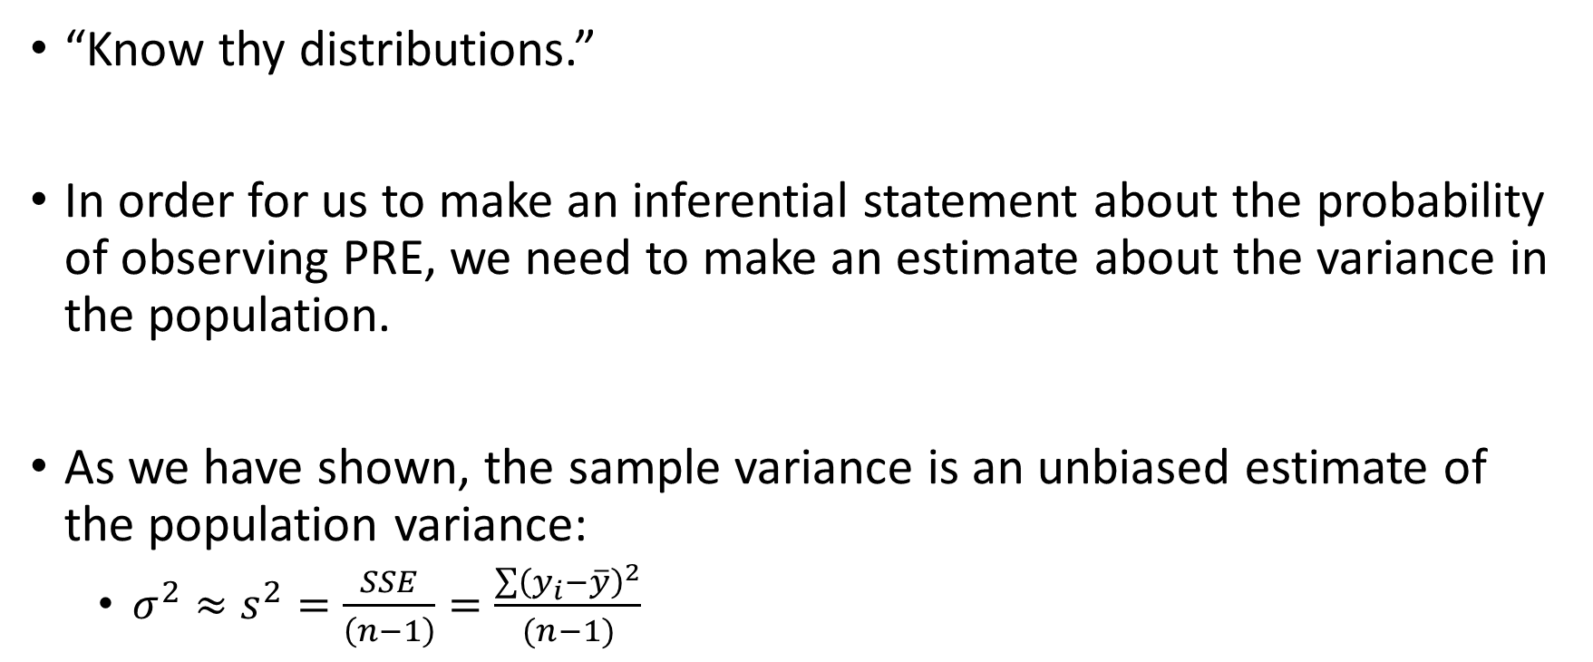
The sampling distribution of PRE
“Know thy distributions.”
In order for us to make an inferential statement about the probability of observing PRE, we need to make an estimate about the variance in the population.
As we have shown, the sample variance is an unbiased estimate of the population variance:
$σ^{2}≈s^{2}=\frac{SSE}{\left(n−1\right)}=\frac{\sum{{\left(y_{i}−\overline{y}\right)}^{2}}}{(n−1)}$

Slide 4
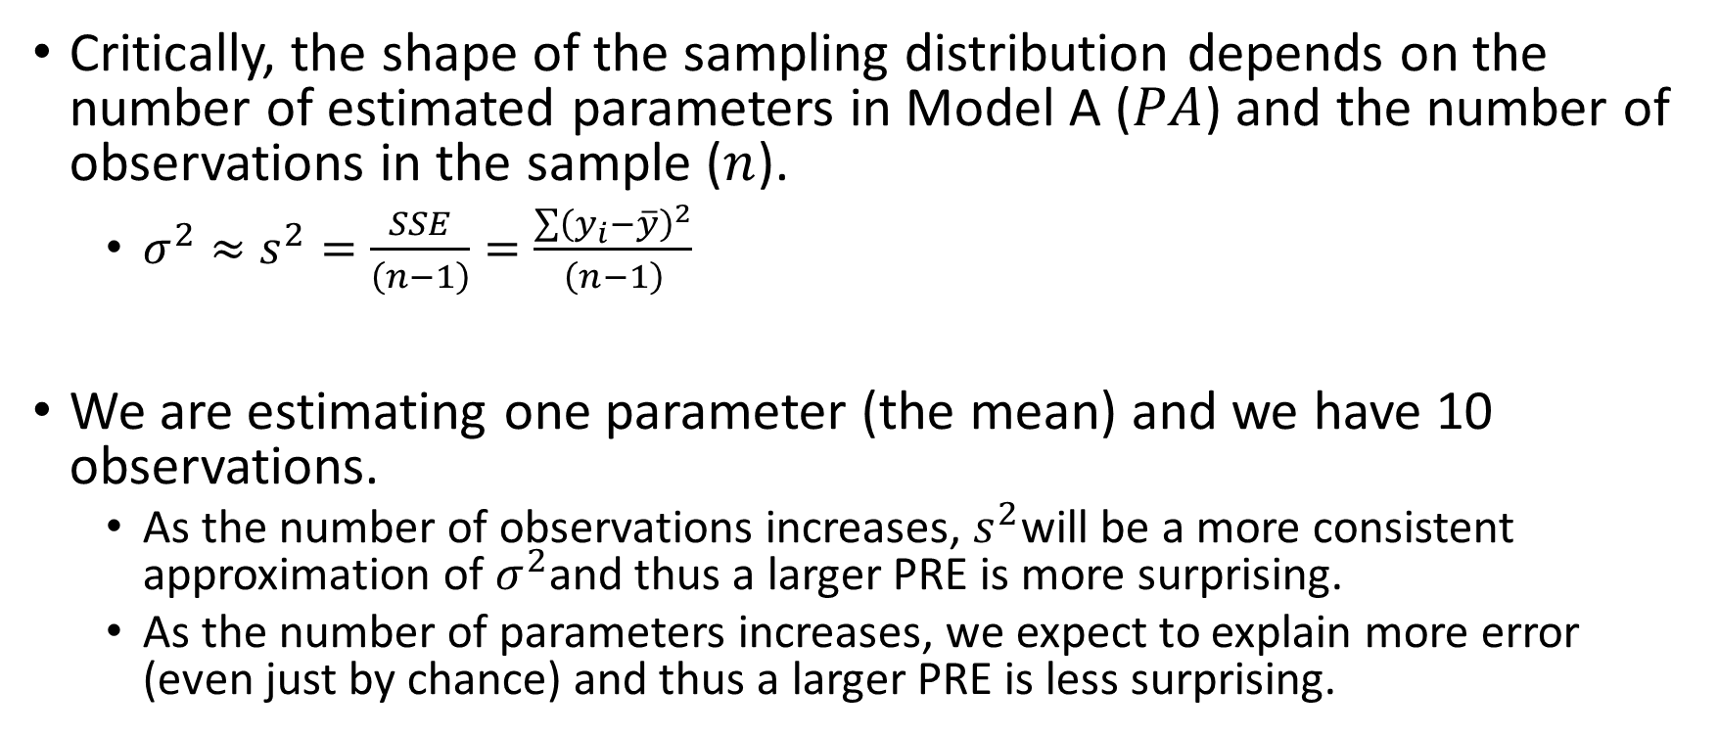
The sampling distribution of PRE
Critically, the shape of the sampling distribution depends on the number of estimated parameters in Model A ($PA$) and the number of observations in the sample ($n$).
$σ^{2}≈s^{2}=\frac{SSE}{\left(n−1\right)}=\frac{\sum{{\left(y_{i}−\overline{y}\right)}^{2}}}{\left(n−1\right)}$
We are estimating one parameter (the mean) and we have 10 observations.
As the number of observations increases, $s^{2}$will be a more consistent approximation of $σ^{2}$and thus a larger PRE is more surprising.
As the number of parameters increases, we expect to explain more error (even just by chance) and thus a larger PRE is less surprising.

Slide 5
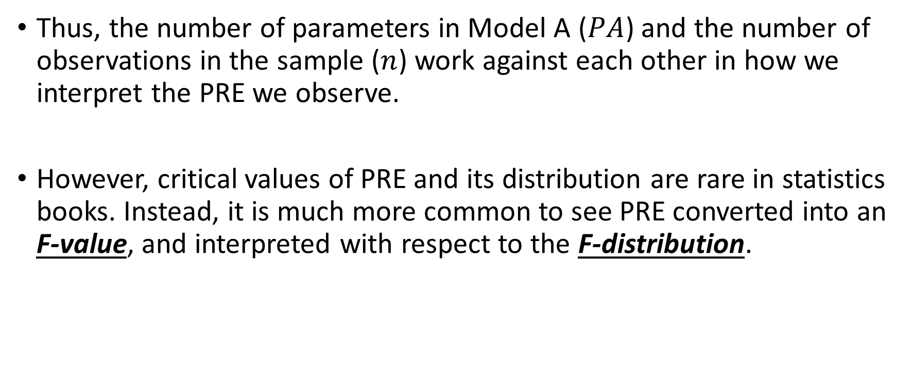
The sampling distribution of PRE
Thus, the number of parameters in Model A ($PA$) and the number of observations in the sample ($n$) work against each other in how we interpret the PRE we observe.
However, critical values of PRE and its distribution are rare in statistics books. Instead, it is much more common to see PRE converted into an F-value, and interpreted with respect to the F-distribution.

Slide 6

The F-statistic and F-distribution
The F-statistic is defined as:
$$F=\frac{PRE/(PA−PC)}{(1−PRE)/(n−PA)}$$

Slide 7
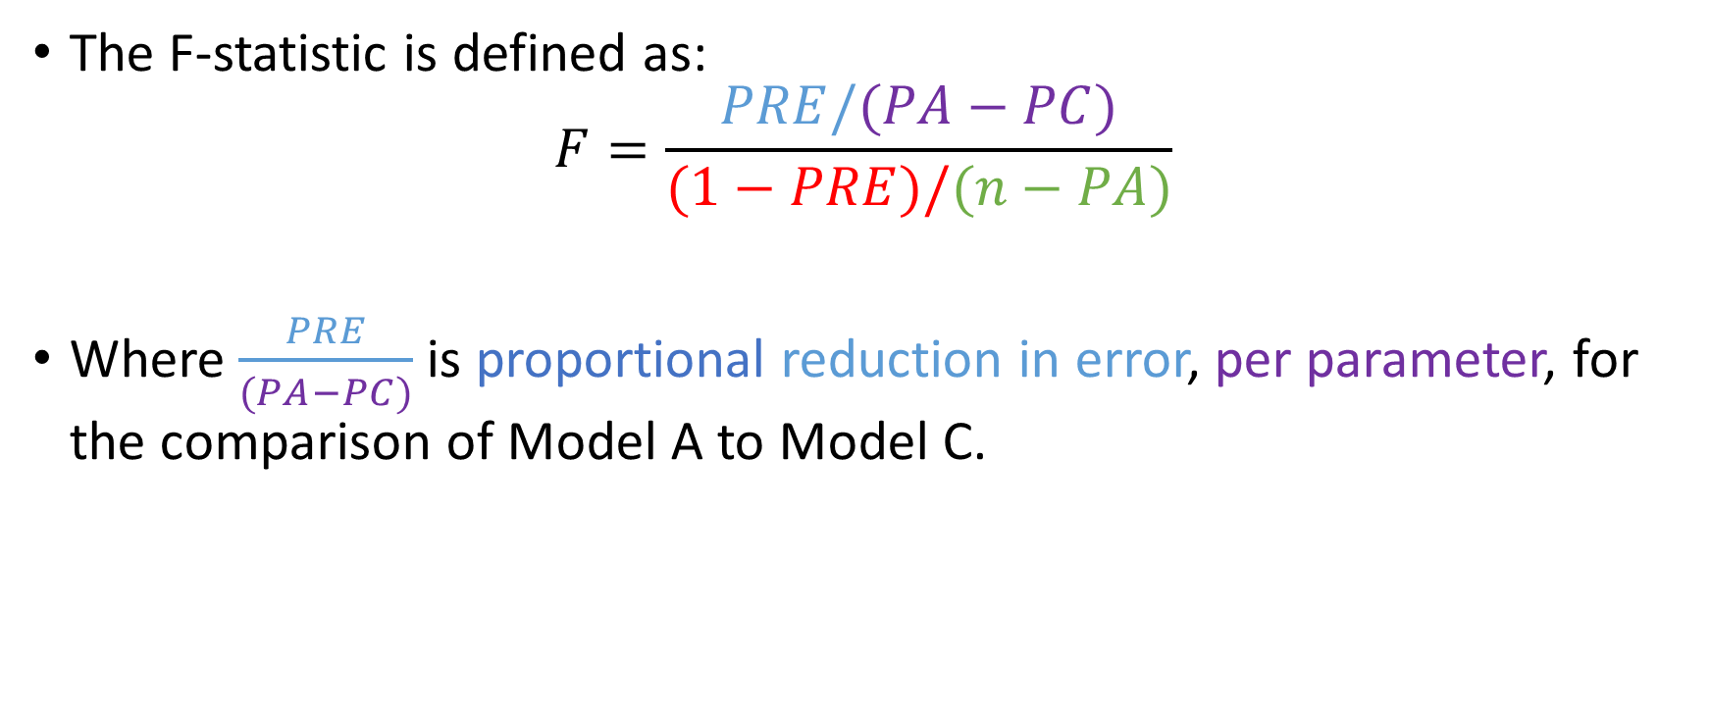
The F-statistic and F-distribution
The F-statistic is defined as:
$$F=\frac{PRE/(PA−PC)}{(1−PRE)/(n−PA)}$$
Where $\frac{PRE}{(PA−PC)}$ is proportional reduction in error, per parameter, for the comparison of Model A to Model C.

Slide 8
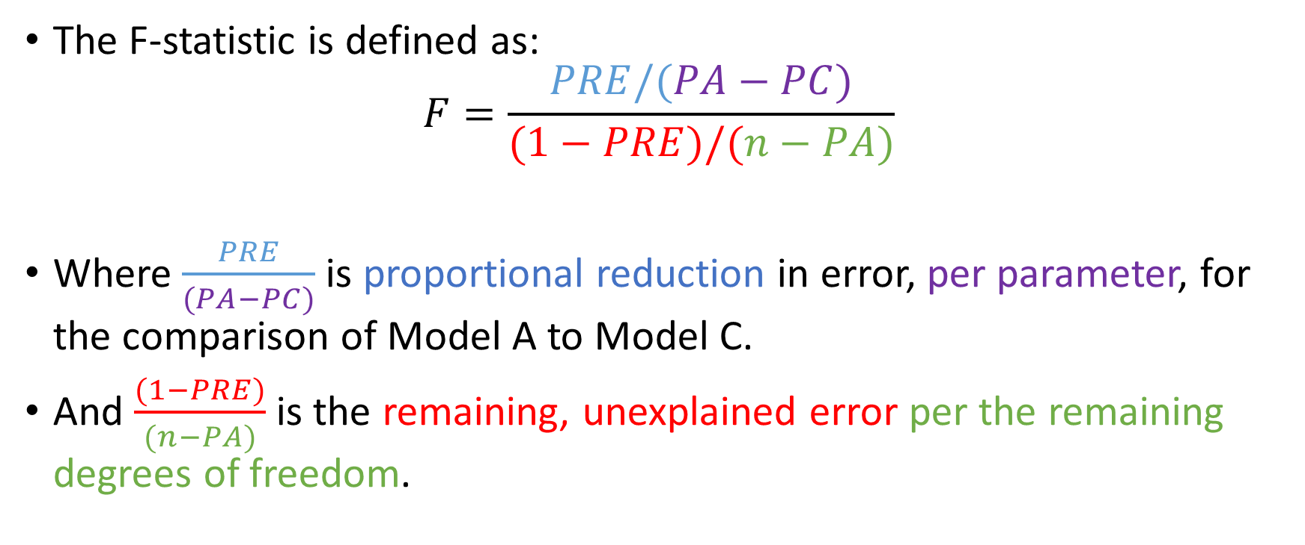
The F-statistic and F-distribution
The F-statistic is defined as:
$$F=\frac{PRE/(PA−PC)}{(1−PRE)/(n−PA)}$$
Where $\frac{PRE}{(PA−PC)}$ is proportional reduction in error, per parameter, for the comparison of Model A to Model C.
And $\frac{(1−PRE)}{(n−PA)}$ is the remaining, unexplained error per the remaining degrees of freedom.

Slide 9
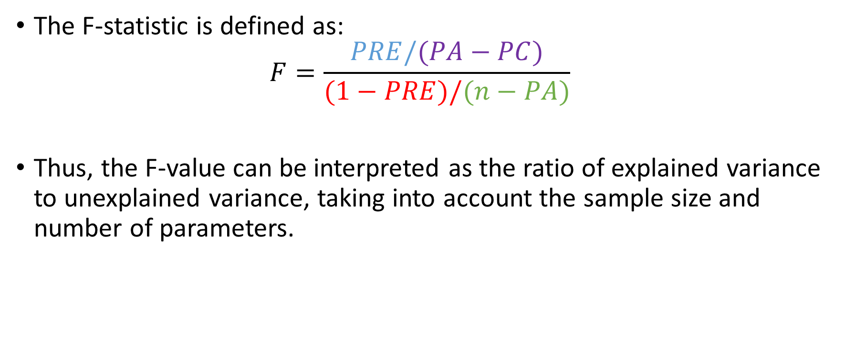
The F-statistic and F-distribution
The F-statistic is defined as:
$$F=\frac{PRE/(PA−PC)}{(1−PRE)/(n−PA)}$$
Thus, the F-value can be interpreted as the ratio of explained variance to unexplained variance, taking into account the sample size and number of parameters.

Slide 10
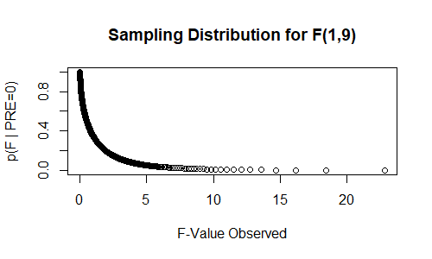
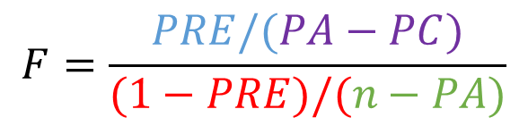
The F-statistic and F-distribution
Our particular F-observed value can then be compared to the F-distribution for that number of parameters (df1) and number of observations (df2).
$$F=\frac{PRE/(PA−PC)}{(1−PRE)/(n−PA)}$$

Slide 11
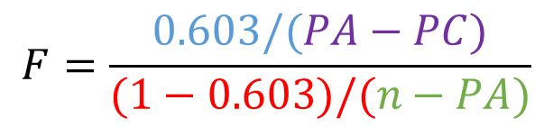
The F-statistic and F-distribution
Our particular F-observed value can then be compared to the F-distribution for that number of parameters (df1) and number of observations (df2).
$$F=\frac{0.603/(PA−PC)}{(1−0.603)/(n−PA)}$$

Slide 12
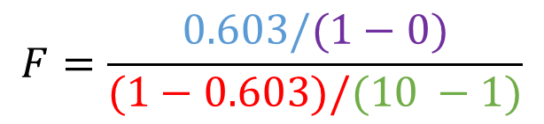
The F-statistic and F-distribution
Our particular F-observed value can then be compared to the F-distribution for that number of parameters (df1) and number of observations (df2).
$$F=\frac{0.603/(1−0)}{(1−0.603)/(10 −1)}$$

Slide 13


The F-statistic and F-distribution
Our particular F-observed value can then be compared to the F-distribution for that number of parameters (df1) and number of observations (df2).
$$F=\frac{0.603/(1−0)}{(1−0.603)/(10 −1)}$$
$$F=\frac{0.603}{(0.397)/(9)}$$
$$F=13.67$$

Slide 14
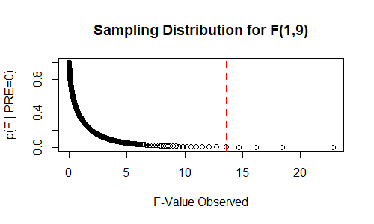

The F-statistic and F-distribution
Our particular F-observed value can then be compared to the F-distribution for that number of parameters (df1) and number of observations (df2).
$$F=13.67$$
Assuming the null-hypothesis, with 1 and 9 degrees of freedom, we would expect to see an F-value ≥ 13.67 about 0.005% of the time due to sampling variability alone.
F(1,9) = 13.67, p = 0.005

Slide 15
What is the p-value?
Given a particular null-distribution, this is the probability of observing an effect this large (or larger) assuming that sampling variability is the only factor operating on our data.
P-values can indicate how incompatible the data are with your pre-specified statistical model (i.e., the null model).
We need to make sure that our assumption of a particular null distribution is reasonable (e.g., normality of errors).
We need to control for other sources of bias through our study design (e.g., were participants randomly selected and assigned?).

Slide 16
The p-value is not...
Not the probability that your result is real/true.
Not the probability that the result was observed by chance alone.
Not the probability that your alternative hypothesis is correct. It also does not prove the null-hypothesis is false.
Not the probability that another researcher running the same experiment would get the same answer.
Not (by itself) an indication of the size or importance of the observed effect.

