Slide 1




Estimating Statistical Power using PRE and F-distributions.
Keith Lohse, PhD
Assistant Professor
Department of Health, Kinesiology, and Recreation
Department of Physical Therapy and Athletic Training
University of Utah
keith.lohse@health.utah.edu
@keith_lohse

Slide 2


Statistical decisions and types of errors.
Model C:
 | True State of Nature
Statistical Decision | Model C Correct | Model C Incorrect
“Reject Model C” | False Positive | True Positive
“Do not reject Model C” | True Negative | False Negative
$$y_{i}=β_{0}$$
Model A:
$$y_{i}=β_{0}+β_{1}x_{i}$$
False Positive (Type 1) Error: We reject Model C when model C is ultimately correct.
False Negative (Type 2) Error: We do not reject Model C when model C is ultimately not correct.

Slide 3
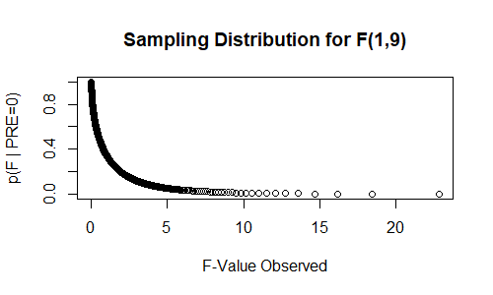
The false positive rate (α).
Given the null distributions, we can find *critical* values of F.
These values divide the F-distribution into different proportions, allowing us to make statements about the probability of F-observed.

Slide 4


The false positive rate (α).
$$F_{\left(1,9\right);α=0.05}=5.12$$
$$F_{\left(1,9\right);α=0.01}=10.56$$
Given the null distributions, we can find *critical* values of F.
These values divide the F-distribution into different proportions, allowing us to make statements about the probability of F-observed.

Slide 5
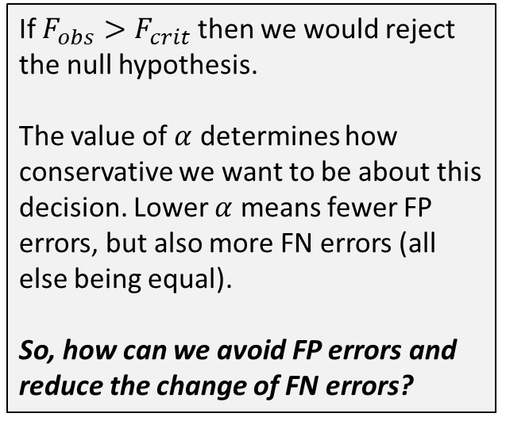
The false positive rate (α).
If $F_{obs}>F_{crit}$ then we would reject the null hypothesis.
The value of $α$ determines how conservative we want to be about this decision. Lower $α$ means fewer FP errors, but also more FN errors (all else being equal).
So, how can we avoid FP errors and reduce the change of FN errors?
$$F_{\left(1,9\right);α=0.05}=5.12$$
$$F_{\left(1,9\right);α=0.01}=10.56$$
Given the null distributions, we can find *critical* values of F.
These values divide the F-distribution into different proportions, allowing us to make statements about the probability of F-observed.

Slide 6
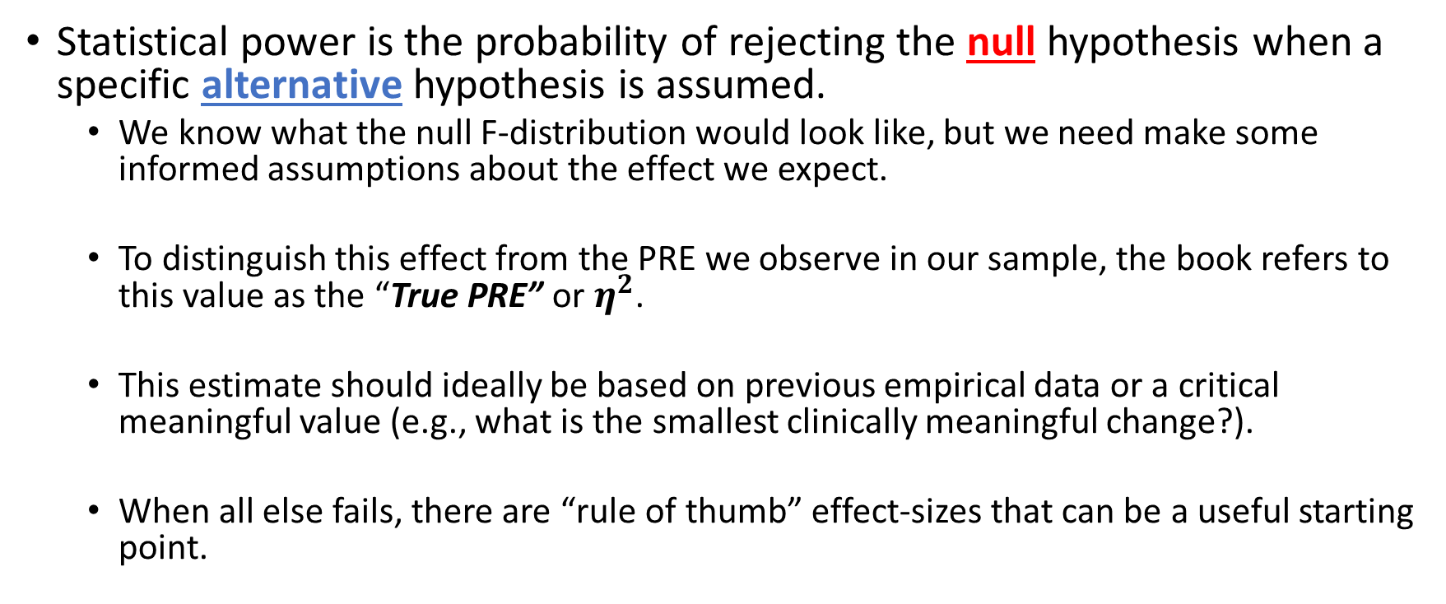
Statistical Power
Statistical power is the probability of rejecting the null hypothesis when a specific alternative hypothesis is assumed.
We know what the null F-distribution would look like, but we need make some informed assumptions about the effect we expect.
To distinguish this effect from the PRE we observe in our sample, the book refers to this value as the “True PRE” or $η^{2}$.
This estimate should ideally be based on previous empirical data or a critical meaningful value (e.g., what is the smallest clinically meaningful change?).
When all else fails, there are “rule of thumb” effect-sizes that can be a useful starting point.

Slide 7
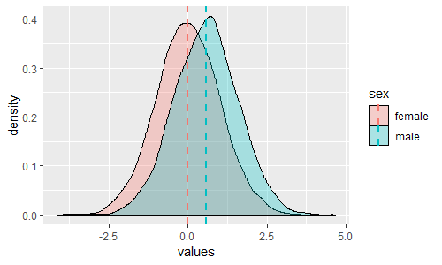
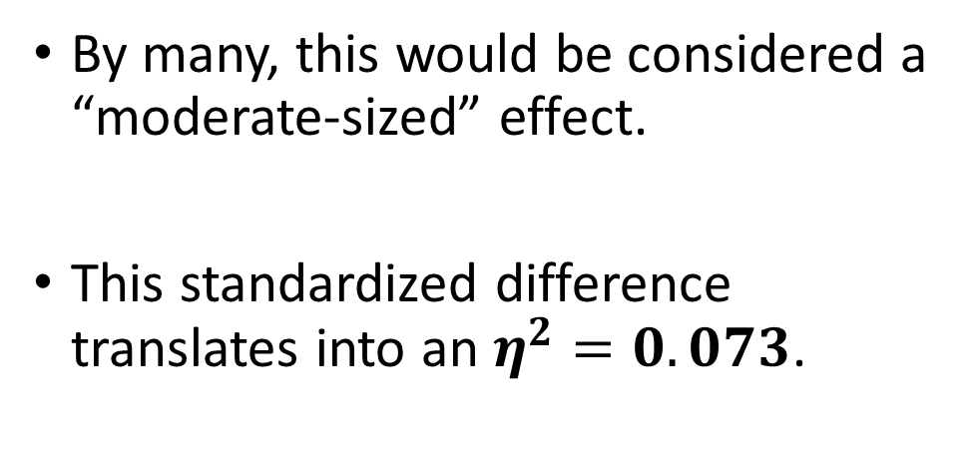
Statistical Power
For instance, the difference in mass between adult men and women in the United States is about 0.56 standard deviations. (NHANES dataset. Heymsfield et al., 2014)
By many, this would be considered a “moderate-sized” effect.
This standardized difference translates into an $η^{2}=0.073$.

Slide 8
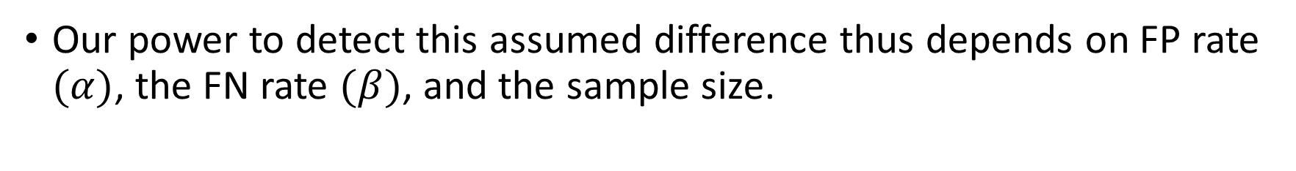

Statistical Power
Our power to detect this assumed difference thus depends on FP rate $(α)$, the FN rate $(β)$, and the sample size.
n/group = 10
If we have 10 people per group, we correctly conclude that men weigh more than women (on average) in only 22% of studies.
Given our assumed $η^{2}=0.073$ and $α=0.05$, our Power (1-β) = 0.22.

Slide 9

Statistical Power
Our power to detect this assumed difference thus depends on FP rate $(α)$, the FN rate $(β)$, and the sample size.
n/group = 20
If we have 20 people per group, we correctly conclude that men weigh more than women (on average) in only 41% of studies.
Given our assumed $η^{2}=0.073$ and $α=0.05$, our Power (1-β) = 0.41.

Slide 10

Statistical Power
Our power to detect this assumed difference thus depends on FP rate $(α)$, the FN rate $(β)$, and the sample size.
n/group = 52
If we have 52 people per group, we correctly conclude that men weigh more than women (on average) in 81% of studies.
Given our assumed $η^{2}=0.073$ and $α=0.05$, our Power (1-β) = 0.81.

Slide 11
Statistical Power
Thus, if you think the effect you are trying to ascertain is more subtle than the fact that men weigh more than women, you probably want more than 50 people per group!
Fortunately, there are other things we can do besides increasing n to improve statistical power.
Justify your α (e.g., if you are replicating an established effect or if the cost of a false positive is low, could α = 0.10?).
Reduce variability/error in your data (e.g. stratifying your sample or proper use of covariates can reduce unwanted variability).
Increase the effect-size (e.g., in a drug trial, do you need to use a subtle dose, or could you use a substantial dose?).

