Slide 1
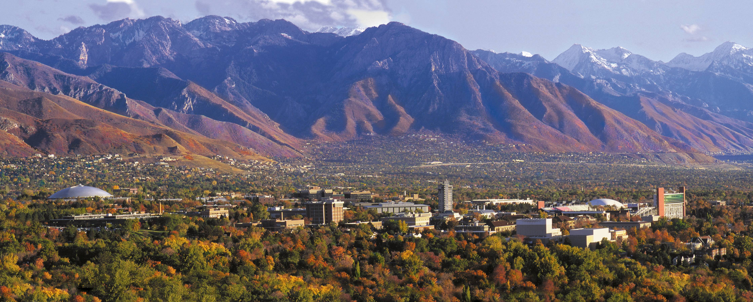



Estimating Parameters in a Simple Linear Model.
Keith Lohse, PhD
Assistant Professor
Department of Health, Kinesiology, and Recreation
Department of Physical Therapy and Athletic Training
University of Utah
keith.lohse@health.utah.edu
@keith_lohse

Slide 2
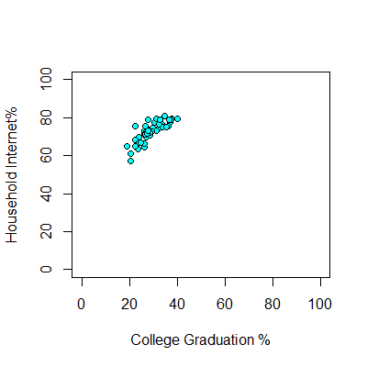


Internet Access Rates
> head(DAT1)
State Internet College
1 AK 63.5 23.5
2 AL 79.0 28.0
3 AR 60.9 20.6
4 AZ 73.9 27.4
5 CA 77.9 31.0
CO 79.4 37.8
…
Model C:
$$y_{i}=β_{0}$$
Model A:
$$y_{i}=β_{0}+β_{1}(x_{i})$$

Slide 3


Internet Access Rates
Which produces the smaller sum of squared errors?
> head(DAT1)
State Internet College
1 AK 63.5 23.5
2 AL 79.0 28.0
3 AR 60.9 20.6
4 AZ 73.9 27.4
5 CA 77.9 31.0
CO 79.4 37.8
…
Model C:
$$y_{i}=β_{0}$$
Model A:
$$y_{i}=β_{0}+β_{1}(x_{i})$$

Slide 4
Internet Access Rates
Which produces the smaller sum of squared errors?
> head(DAT1)
State Internet College
1 AK 63.5 23.5
2 AL 79.0 28.0
3 AR 60.9 20.6
4 AZ 73.9 27.4
5 CA 77.9 31.0
CO 79.4 37.8
…
Model C:
$$y_{i}=β_{0}$$
Model A:
First, we need to be able to estimate the intercept and the slope!
$$y_{i}=β_{0}+β_{1}(x_{i})$$

Slide 5


Estimating Two Linear Parameters
Slope
DAT1$x_res<-DAT1$College-mean(DAT1$College)
DAT1$y_res<-DAT1$Internet-mean(DAT1$Internet)
DAT1$xy_cov<-DAT1$x_res*DAT1$y_res
DAT1$x_var<-DAT1$x_res^2
> head(DAT1)
State Internet College x_res y_res xy_cov x_var
1 AK 63.5 23.5 -5.384 -9.306 50.103504 28.987456
2 AL 79.0 28.0 -0.884 6.194 -5.475496 0.781456
3 AR 60.9 20.6 -8.284 -11.906 98.629304 68.624656
4 AZ 73.9 27.4 -1.484 1.094 -1.623496 2.202256
5 CA 77.9 31.0 2.116 5.094 10.778904 4.477456
6 CO 79.4 37.8 8.916 6.594 58.792104 79.495056
$$b_{1}=\frac{\sum{(x_{i}−\overline{x})(y_{i}−\overline{y})}}{\sum{{(x_{i}−\overline{x})}^{2}}}$$
Intercept:
$$b_{0}=\overline{y}−b_{1}\overline{x}$$

Slide 6

Estimating Two Linear Parameters
Slope
DAT1$x_res<-DAT1$College-mean(DAT1$College)
DAT1$y_res<-DAT1$Internet-mean(DAT1$Internet)
DAT1$xy_cov<-DAT1$x_res*DAT1$y_res
DAT1$x_var<-DAT1$x_res^2
> head(DAT1)
State Internet College x_res y_res xy_cov x_var
1 AK 63.5 23.5 -5.384 -9.306 50.103504 28.987456
2 AL 79.0 28.0 -0.884 6.194 -5.475496 0.781456
3 AR 60.9 20.6 -8.284 -11.906 98.629304 68.624656
4 AZ 73.9 27.4 -1.484 1.094 -1.623496 2.202256
5 CA 77.9 31.0 2.116 5.094 10.778904 4.477456
6 CO 79.4 37.8 8.916 6.594 58.792104 79.495056
$$b_{1}=\frac{\sum{(x_{i}−\overline{x})(y_{i}−\overline{y})}}{\sum{{(x_{i}−\overline{x})}^{2}}}=0.86$$
Intercept:
$$b_{0}=\overline{y}−b_{1}\overline{x}$$
> sum(DAT1$xy_cov)/sum(DAT1$x_var)
[1] 0.8618517

Slide 7

Estimating Two Linear Parameters
Slope
$$b_{1}=\frac{\sum{(x_{i}−\overline{x})(y_{i}−\overline{y})}}{\sum{{(x_{i}−\overline{x})}^{2}}}=0.86$$
Intercept:
> mean(DAT1$Internet)-0.8618517*mean(DAT1$College)
[1] 47.91228
$$b_{0}=\overline{y}−b_{1}\overline{x}=47.91$$

Slide 8
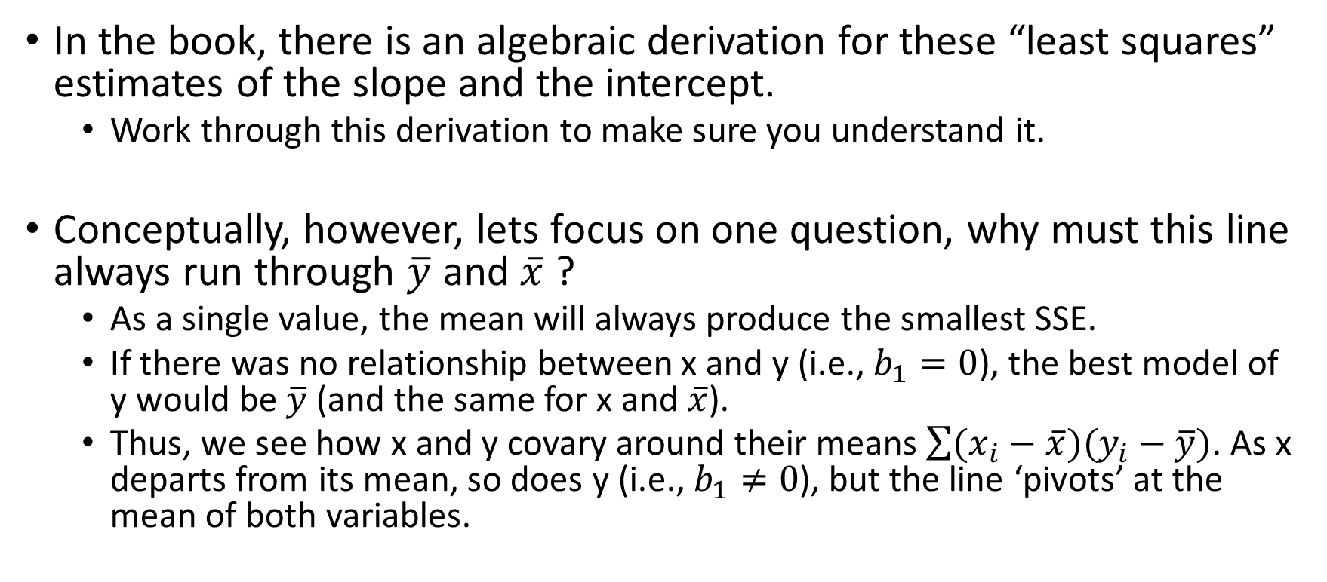
Derivation of the Slope and Intercept Estimates
In the book, there is an algebraic derivation for these “least squares” estimates of the slope and the intercept.
Work through this derivation to make sure you understand it.
Conceptually, however, lets focus on one question, why must this line always run through $\overline{y}$ and $\overline{x}$ ?
As a single value, the mean will always produce the smallest SSE.
If there was no relationship between x and y (i.e., $b_{1}=0$), the best model of y would be $\overline{y}$ (and the same for x and $\overline{x}$).
Thus, we see how x and y covary around their means $\sum{(x_{i}−\overline{x})(y_{i}−\overline{y})}$. As x departs from its mean, so does y (i.e., $b_{1}≠0$), but the line ‘pivots’ at the mean of both variables.

