Slide 1
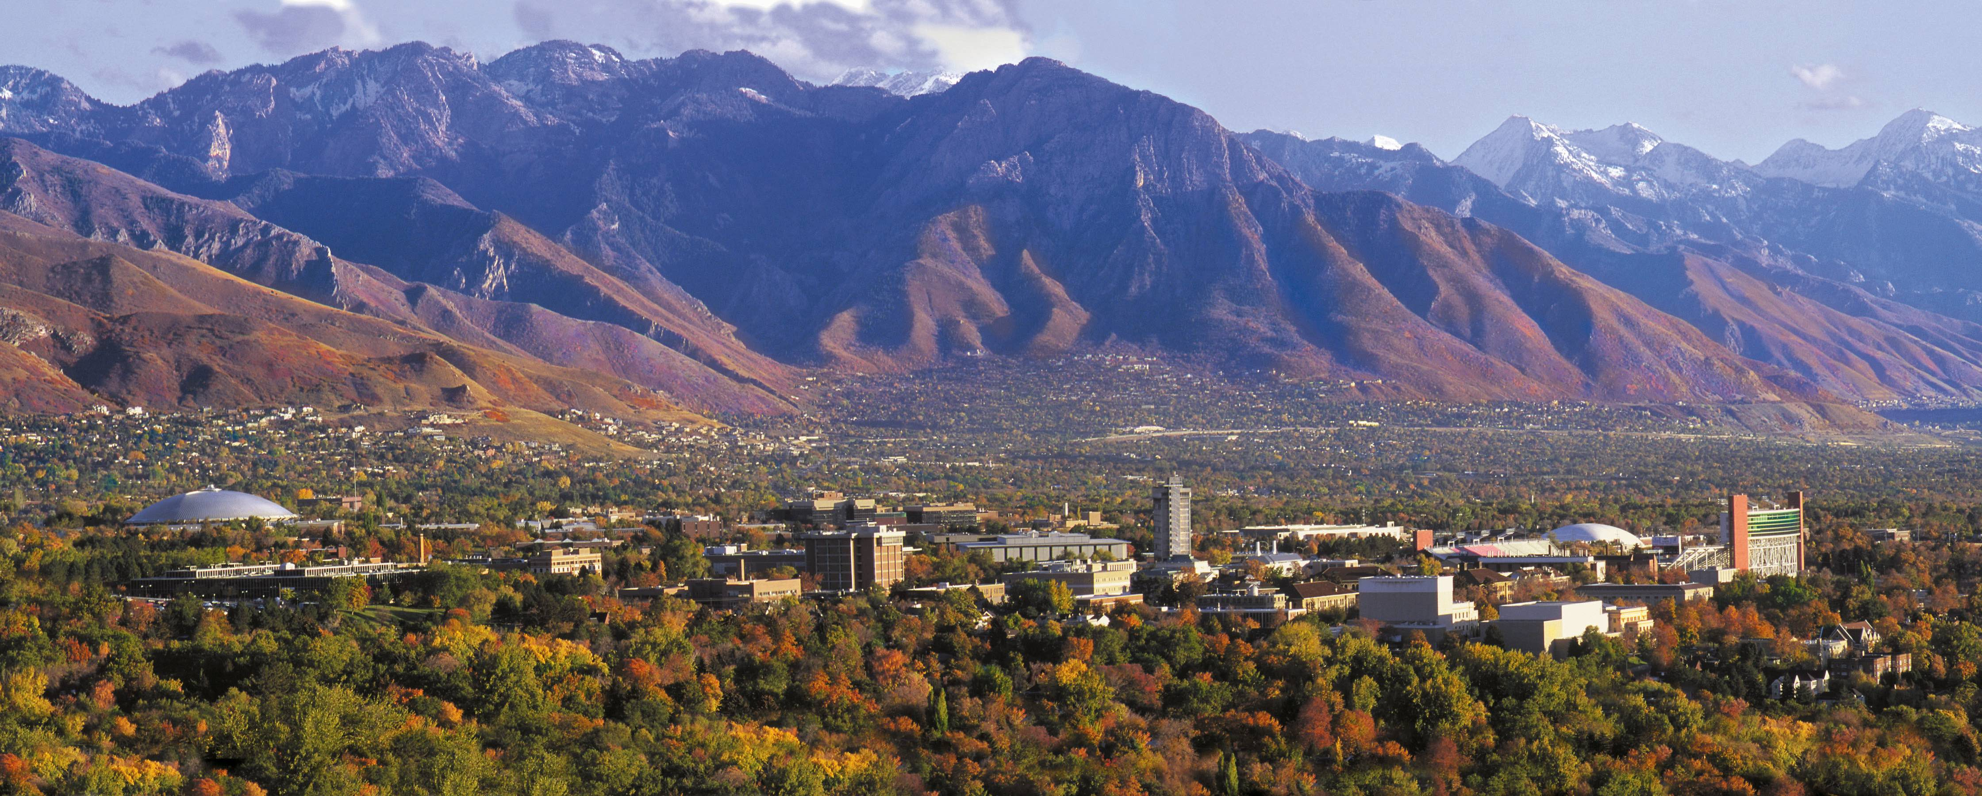



Interpreting Parameter Estimates.
Keith Lohse, PhD
Assistant Professor
Department of Health, Kinesiology, and Recreation
Department of Physical Therapy and Athletic Training
University of Utah
keith.lohse@health.utah.edu
@keith_lohse

Slide 2
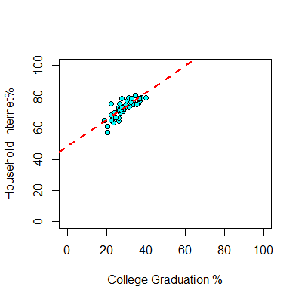


Interpreting Linear Parameters
> head(DAT1)
State Internet College
1 AK 63.5 23.5
2 AL 79.0 28.0
3 AR 60.9 20.6
4 AZ 73.9 27.4
5 CA 77.9 31.0
CO 79.4 37.8
…
Slope
$$b_{1}=\frac{\sum{(x_{i}−\overline{x})(y_{i}−\overline{y})}}{\sum{{(x_{i}−\overline{x})}^{2}}}=0.86$$
Intercept:
$$b_{0}=\overline{y}−b_{1}\overline{x}=47.91$$

Slide 3
Interpreting Linear Parameters
> head(DAT1)
State Internet College
1 AK 63.5 23.5
2 AL 79.0 28.0
3 AR 60.9 20.6
4 AZ 73.9 27.4
5 CA 77.9 31.0
CO 79.4 37.8
…
The intercept is estimated the value of y when all x’s are zero.
The slope is the estimated change in y for a 1-unit change in x.
These general rules will always be true. For more specific interpretations, it depends on exactly what x and y are (scale, type of variable, etc).
Slope
$$b_{1}=\frac{\sum{(x_{i}−\overline{x})(y_{i}−\overline{y})}}{\sum{{(x_{i}−\overline{x})}^{2}}}=0.86$$
Intercept:
$$b_{0}=\overline{y}−b_{1}\overline{x}=47.91$$

Slide 4
Untransformed Variables
lm(formula = Internet ~ College, data = DAT1)
Coefficients:
(Intercept) College
47.9123 0.8619

Slide 5
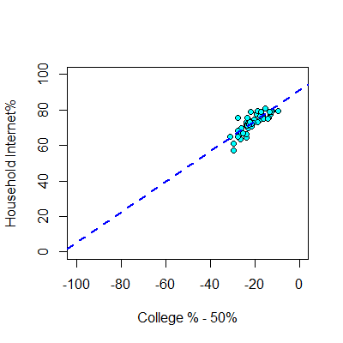

Value-Centered Variable
DAT1$College50<-DAT1$College-50
lm(formula = Internet ~ College50, data = DAT1)
Coefficients:
(Intercept) College50
91.0049 0.8619
$$x_{50i}=x_{i}−50$$

Slide 6
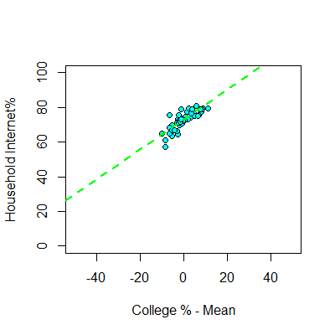

Mean-Centered Variable
DAT1$College.c<-DAT1$College-mean(DAT1$College)
lm(formula = Internet ~ College.c, data = DAT1)
Coefficients:
(Intercept) College.c
72.8060 0.8619
$$x_{ci}=x_{i}−\overline{x}$$

Slide 7
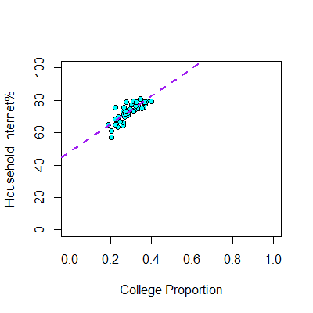

Changing the Scale of X
DAT1$College.p<-DAT1$College/100
lm(formula = Internet ~ College.p, data = DAT1)
Coefficients:
(Intercept) College.p
47.91 86.19
$$x_{pi}=x_{i}/100$$

Slide 8
Changing the Scale of X
DAT1$College.p<-DAT1$College/100
lm(formula = Internet ~ College.p, data = DAT1)
Coefficients:
(Intercept) College.p
47.91 86.19
$$x_{pi}=x_{i}/100$$
lm(formula = Internet ~ College, data = DAT1)
Coefficients:
(Intercept) College
47.9123 0.8619

