Slide 1




Statistical Inferences About Parameters.
Keith Lohse, PhD
Assistant Professor
Department of Health, Kinesiology, and Recreation
Department of Physical Therapy and Athletic Training
University of Utah
keith.lohse@health.utah.edu
@keith_lohse

Slide 2
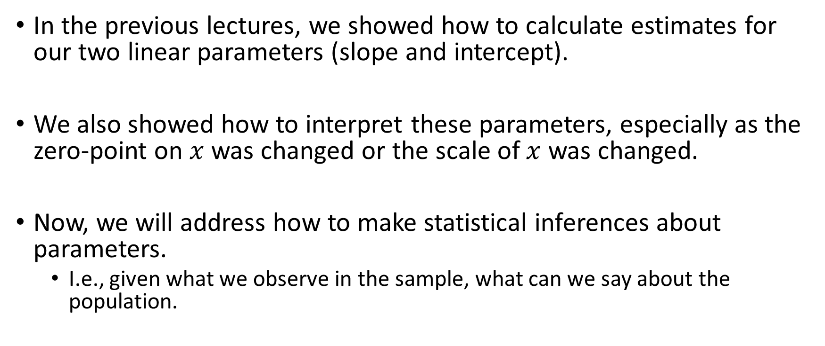
Statistical Inferences
In the previous lectures, we showed how to calculate estimates for our two linear parameters (slope and intercept).
We also showed how to interpret these parameters, especially as the zero-point on $x$ was changed or the scale of $x$ was changed.
Now, we will address how to make statistical inferences about parameters.
I.e., given what we observe in the sample, what can we say about the population.

Slide 3
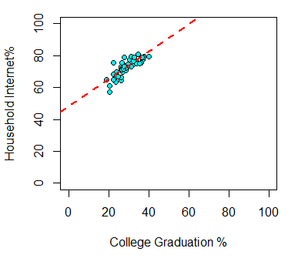


Model Comparison
Model C:
$$y_{i}=β_{0}$$
Model A:
$$y_{i}=β_{0}+β_{1}(x_{i})$$

Slide 4


Model Comparison
Model C:
$$y_{i}=β_{0}$$
Model A:
$$y_{i}=β_{0}+β_{1}(x_{i})$$
Slope
$$b_{1}=\frac{\sum{(x_{i}−\overline{x})(y_{i}−\overline{y})}}{\sum{{(x_{i}−\overline{x})}^{2}}}$$
Intercept:
$$b_{0}=\overline{y}−b_{1}\overline{x}$$

Slide 5
Model Comparison
Model C:
$$y_{i}=β_{0}$$
Model A:
$$y_{i}=β_{0}+β_{1}(x_{i})$$
Slope
$$b_{1}=\frac{\sum{(x_{i}−\overline{x})(y_{i}−\overline{y})}}{\sum{{(x_{i}−\overline{x})}^{2}}}$$
> head(DAT1)
State Internet College
1 AK 63.5 23.5
2 AL 79.0 28.0
3 AR 60.9 20.6
4 AZ 73.9 27.4
5 CA 77.9 31.0
CO 79.4 37.8
…
Intercept:
$$b_{0}=\overline{y}−b_{1}\overline{x}$$

Slide 6
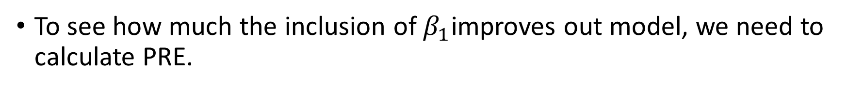

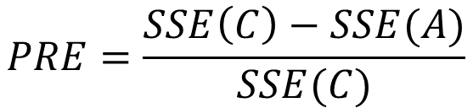
Statistical Inferences for $β_{1}$
To see how much the inclusion of $β_{1}$improves out model, we need to calculate PRE.
$$PRE=\frac{SSE\left(C\right)−SSE(A)}{SSE(C)}$$

Slide 7
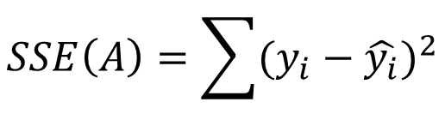
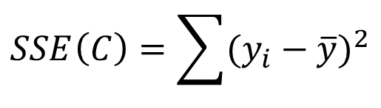
Statistical Inferences for $β_{1}$
To see how much the inclusion of $β_{1}$improves out model, we need to calculate PRE.
$$PRE=\frac{SSE\left(C\right)−SSE(A)}{SSE(C)}$$
$$SSE\left(C\right)=\sum{{(y_{i}−\overline{y})}^{2}}$$
$$SSE\left(A\right)=\sum{{(y_{i}−\hat{y_{i}})}^{2}}$$

Slide 8
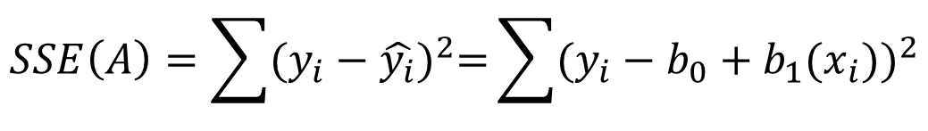
Statistical Inferences for $β_{1}$
To see how much the inclusion of $β_{1}$improves out model, we need to calculate PRE.
$$PRE=\frac{SSE\left(C\right)−SSE(A)}{SSE(C)}$$
$$SSE\left(C\right)=\sum{{(y_{i}−\overline{y})}^{2}}$$
$$SSE\left(A\right)=\sum{{(y_{i}−\hat{y_{i}})}^{2}=}\sum{{(y_{i}−b_{0}+b_{1}(x_{i}))}^{2}}$$

Slide 9
Statistical Inferences for $β_{1}$
To see how much the inclusion of $β_{1}$improves out model, we need to calculate PRE.
> head(DAT1)
State Internet College Y_c e_c Y_a e_a
1 AK 63.5 23.5 72.806 -9.306 68.1690 -4.6690
2 AL 79.0 28.0 72.806 6.194 72.0480 6.9520
3 AR 60.9 20.6 72.806 -11.906 65.6692 -4.7692
4 AZ 73.9 27.4 72.806 1.094 71.5308 2.3692
5 CA 77.9 31.0 72.806 5.094 74.6340 3.2660
6 CO 79.4 37.8 72.806 6.594 80.4956 -1.0956
$$PRE=\frac{SSE\left(C\right)−SSE(A)}{SSE(C)}$$
$$SSE\left(C\right)=\sum{{(y_{i}−\overline{y})}^{2}}$$
$$SSE\left(A\right)=\sum{{(y_{i}−\hat{y_{i}})}^{2}=}\sum{{(y_{i}−b_{0}+b_{1}(x_{i}))}^{2}}$$

Slide 10
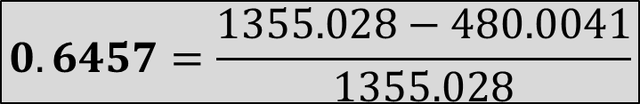
Statistical Inferences for $β_{1}$
To see how much the inclusion of $β_{1}$improves out model, we need to calculate PRE.
> head(DAT1)
State Internet College Y_c e_c Y_a e_a
1 AK 63.5 23.5 72.806 -9.306 68.1690 -4.6690
2 AL 79.0 28.0 72.806 6.194 72.0480 6.9520
3 AR 60.9 20.6 72.806 -11.906 65.6692 -4.7692
4 AZ 73.9 27.4 72.806 1.094 71.5308 2.3692
5 CA 77.9 31.0 72.806 5.094 74.6340 3.2660
6 CO 79.4 37.8 72.806 6.594 80.4956 -1.0956
$$PRE=\frac{SSE\left(C\right)−SSE(A)}{SSE(C)}$$
$$SSE\left(C\right)=\sum{{(y_{i}−\overline{y})}^{2}}$$
$$SSE\left(A\right)=\sum{{(y_{i}−\hat{y_{i}})}^{2}}$$
$$0.6457=\frac{1355.028−480.0041}{1355.028}$$

Slide 11

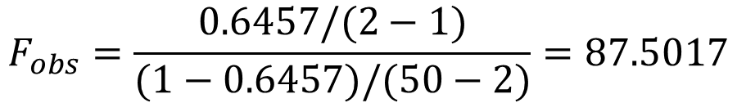
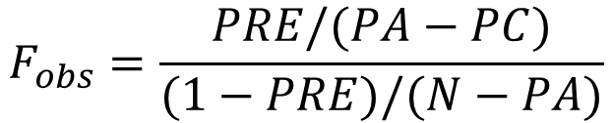
Statistical Inferences for $β_{1}$
Once we have a calculation of PRE, we can calculate an $F$ statistic.
$$F_{obs}=\frac{PRE/(PA−PC)}{(1−PRE)/(N−PA)}$$
$$F_{obs}=\frac{0.6457/(2−1)}{(1−0.6457)/(50−2)}=87.5017$$

Slide 12
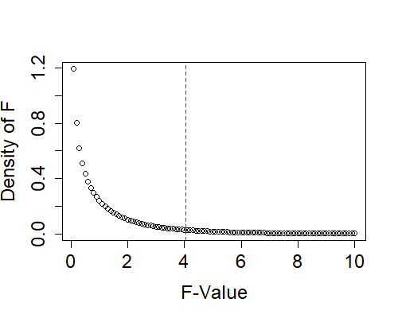




Statistical Inferences for $β_{1}$
Once we have a calculation of PRE, we can calculate an $F$ statistic.
$$F_{obs}=\frac{PRE/(PA−PC)}{(1−PRE)/(N−PA)}$$
$$F_{(1,48)}^{∗}=4.0247$$
$$F_{obs}=87.5017$$
$$α=0.05$$
We can then compare $F_{obs}$ to the null distribution for $F_{(1,48)}$.

Slide 13

Statistical Inferences for $β_{1}$
Once we have a calculation of PRE, we can calculate an $F$ statistic.
$$F_{obs}=\frac{PRE/(PA−PC)}{(1−PRE)/(N−PA)}$$
$$F_{(1,48)}^{∗}=4.0247$$
$$F_{obs}=87.5017$$
$$α=0.05$$
$$F_{obs}=87.5017$$
We can then compare $F_{obs}$ to the null distribution for $F_{(1,48)}$.

Slide 14

Statistical Inferences for $β_{1}$
Once we have a calculation of PRE, we can calculate an $F$ statistic.
$$F_{obs}=\frac{PRE/(PA−PC)}{(1−PRE)/(N−PA)}$$
$$F_{(1,48)}^{∗}=4.0247$$
$$F_{obs}=87.5017$$
$$α=0.05$$
$$F_{obs}=87.5017$$
We can then compare $F_{obs}$ to the null distribution for $F_{(1,48)}$.
$$F\left(1,48\right)=87.50,p<0.001$$

Slide 15
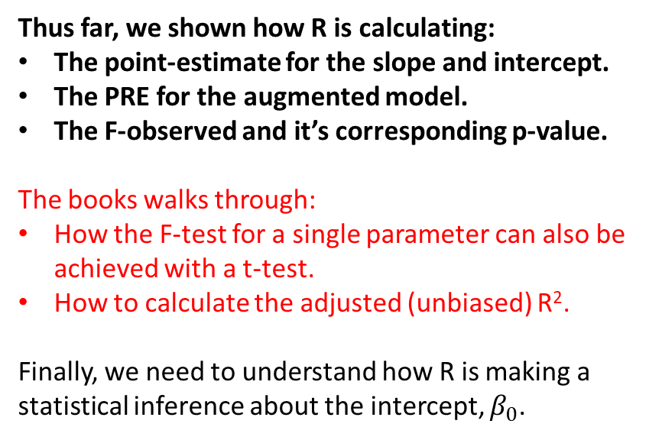
Linear Model Output from R
> mod1<-lm(Internet~College, data=DAT1)
> summary(mod1)
Call:
lm(formula = Internet ~ College, data = DAT1)
Residuals:
Min 1Q Median 3Q Max
-8.094 -1.722 -0.175 1.470 8.296
Coefficients:
Estimate Std. Error t value Pr(>|t|)
(Intercept) 47.91227 2.69854 17.755 < 2e-16 ***
College 0.86185 0.09213 9.354 2.15e-12 ***
---
Signif. codes: 0 ‘***’ 0.001 ‘**’ 0.01 ‘*’ 0.05 ‘.’ 0.1 ‘ ’ 1
Residual standard error: 3.162 on 48 degrees of freedom
Multiple R-squared: 0.6458, Adjusted R-squared: 0.6384
F-statistic: 87.5 on 1 and 48 DF, p-value: 2.15e-12
Thus far, we shown how R is calculating:
The point-estimate for the slope and intercept.
The PRE for the augmented model.
The F-observed and it’s corresponding p-value.
The books walks through:
How the F-test for a single parameter can also be achieved with a t-test.
How to calculate the adjusted (unbiased) R².
Finally, we need to understand how R is making a statistical inference about the intercept, $β_{0}$.

Slide 16







Statistical Inferences for $β_{0}$
Recall that the point estimate for $β_{0}$ is calculated after $β_{1}$.
This is because having a slope in our model changes the value of the intercept (predicted $y$ when $x = 0$).
$$b_{0}=\overline{y}−b_{1}\overline{x}$$
Statistical Test for the Slope
Statistical Test for the Intercept
Model C:
$$y_{i}=β_{0}+0(x_{i})$$
Model C:
$$y_{i}=0+β_{1}(x_{i})$$
Model A:
$$y_{i}=β_{0}+β_{1}(x_{i})$$
Model A:
$$y_{i}=β_{0}+β_{1}(x_{i})$$

Slide 17
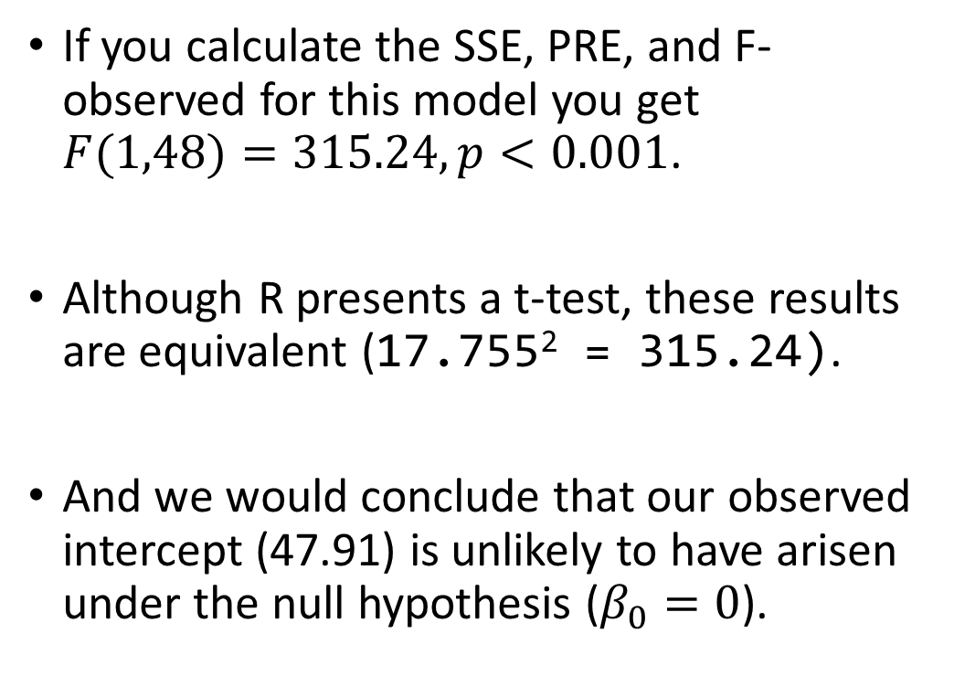


Statistical Inferences for $β_{0}$
Statistical Test for the Intercept
If you calculate the SSE, PRE, and F-observed for this model you get $F(1,48)=315.24, p<0.001$.
Although R presents a t-test, these results are equivalent (17.755² = 315.24).
And we would conclude that our observed intercept (47.91) is unlikely to have arisen under the null hypothesis ($β_{0}=0$).
Model C:
$$y_{i}=0+β_{1}(x_{i})$$
Model A:
$$y_{i}=β_{0}+β_{1}(x_{i})$$

Slide 18




Linear Model Output from R
> mod1<-lm(Internet~College, data=DAT1)
> summary(mod1)
Call:
lm(formula = Internet ~ College, data = DAT1)
Residuals:
Min 1Q Median 3Q Max
-8.094 -1.722 -0.175 1.470 8.296
Coefficients:
Estimate Std. Error t value Pr(>|t|)
(Intercept) 47.91227 2.69854 17.755 < 2e-16 ***
College 0.86185 0.09213 9.354 2.15e-12 ***
---
Signif. codes: 0 ‘***’ 0.001 ‘**’ 0.01 ‘*’ 0.05 ‘.’ 0.1 ‘ ’ 1
Residual standard error: 3.162 on 48 degrees of freedom
Multiple R-squared: 0.6458, Adjusted R-squared: 0.6384
F-statistic: 87.5 on 1 and 48 DF, p-value: 2.15e-12
Is the parameter statistically different from 0?
Statistical Test for the Intercept
Model C:
$$y_{i}=0+β_{1}(x_{i})$$
Model A:
$$y_{i}=β_{0}+β_{1}(x_{i})$$
Statistical Test for the Slope
Model C:
$$y_{i}=β_{0}+0(x_{i})$$
Model A:
$$y_{i}=β_{0}+β_{1}(x_{i})$$

