Slide 1




Models with Multiple Continuous Predictors.
Keith Lohse, PhD
Assistant Professor
Department of Health, Kinesiology, and Recreation
Department of Physical Therapy and Athletic Training
University of Utah
keith.lohse@health.utah.edu
@keith_lohse

Slide 2

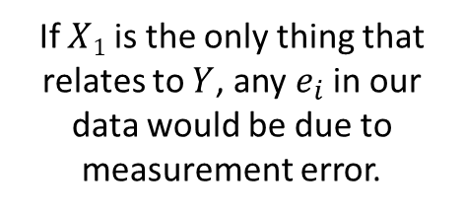

Multi-variable Regression
Usually, conditioning our predictions on a single variable won’t be enough.
This is because most variables we might measure (height, academic achievement, probability of winning a match) are caused by multiple factors or at least associated with multiple factors.
$$X1$$
$$Y$$
If $X1$ is the only thing that relates to $Y$, any $e_{i}$ in our data would be due to measurement error.

Slide 3



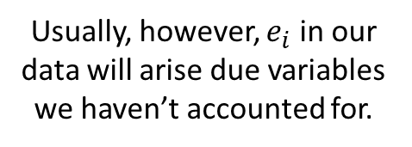

Multi-variable Regression
Usually, conditioning our predictions on a single variable won’t be enough.
This is because most variables we might measure (height, academic achievement, probability of winning a match) are caused by multiple factors or at least associated with multiple factors.
$$X_{3}$$
$$X1$$
$$Y$$
$$X1$$
$$Y$$
If $X1$ is the only thing that relates to $Y$, any $e_{i}$ in our data would be due to measurement error.
$$X_{2}$$
Usually, however, $e_{i}$ in our data will arise due variables we haven’t accounted for.

Slide 4
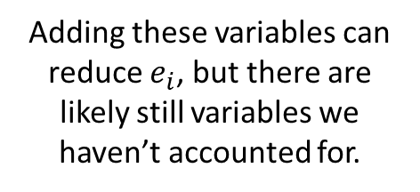



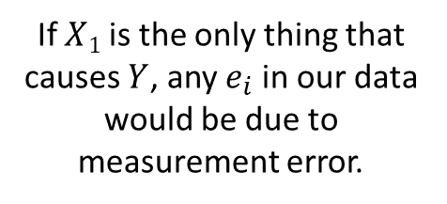


Multi-variable Regression
Usually, conditioning our predictions on a single variable won’t be enough.
This is because most variables we might measure (height, academic achievement, probability of winning a match) are caused by multiple factors or at least associated with multiple factors.
$$X_{4}$$
$$X_{3}$$
$$X_{3}$$
$$X1$$
$$Y$$
$$X1$$
$$Y$$
$$X1$$
$$Y$$
If $X1$ is the only thing that causes $Y$, any $e_{i}$ in our data would be due to measurement error.
$$X_{2}$$
$$X_{2}$$
Usually, however, $e_{i}$ in our data will arise due variables we haven’t accounted for.
Adding these variables can reduce $e_{i}$, but there are likely still variables we haven’t accounted for.

Slide 5

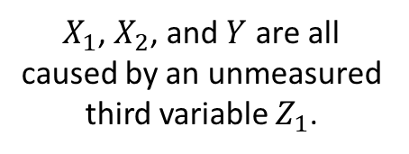









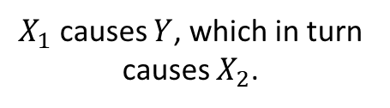

Multi-variable Regression
Further, causation is not established by the statistical relationship but by logical analysis/experimental design.
Some example associations:
$$X1$$
$$X1$$
$$X1$$
$$X_{2}$$
$$Y$$
$$Z_{1}$$
$$X_{2}$$
$$X_{2}$$
$$Y$$
$$Y$$
$X_{1}$ and $X_{2}$ both cause $Y$.
$X_{1}$ causes $Y$, which in turn causes $X_{2}$.
$X_{1}$, $X_{2}$, and $Y$ are all caused by an unmeasured third variable $Z_{1}$.

Slide 6
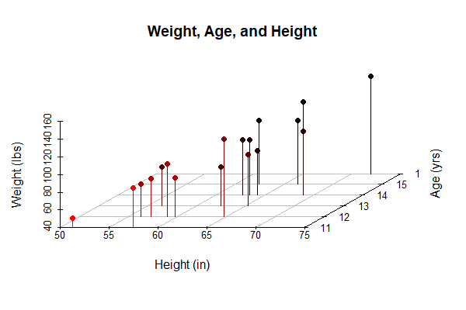
Unpacking a multi-variable relationship
For this example, we will look at the relationship between students’ heights, weights, and ages presented in the chapter.
> head(dat)
Name Sex Age Height Weight
1 Alfred M 14 69.0 112.5
2 Alice F 13 56.5 84.0
3 Barbara F 13 65.3 98.0
4 Carol F 14 62.8 102.5
5 Henry M 14 63.5 102.5
6 James M 12 57.3 83.0

Slide 7
Going from univariable to multivariable regression:
Multivariable model:
Intercept
The effect of X₁ on Y_{P}
The effect of X₂ on Y_{P}

Slide 8
Going from univariable to multivariable regression:
Multivariable model:
Intercept
The effect of X₁ on Y_{i}
The effect of X₂ on Y_{i}
$${\hat{Wt}}_{i}=−141.22+3.60∗{Ht}_{i}+1.28∗{Age}_{i}$$

Slide 9
Going from univariable to multivariable regression:
How do we interpret a single variable in the multivariable model?
$${\hat{Wt}}_{i}=−141.22+3.60∗{Ht}_{i}+1.28∗{Age}_{i}$$
This is the effect of Height controlling for Age.
But what does it mean to control for age?

Slide 10
Going from univariable to multivariable regression:
How do we interpret a single variable in the multivariable model?
$${\hat{Wt}}_{i}=−141.22+3.60∗{Ht}_{i}+1.28∗{Age}_{i}$$
This is the effect of Height controlling for Age.
But what does it mean to control for age?
Similarly, this is the effect of Age controlling for Height, but what does it mean to control for height?

Slide 11
Controlling for Shared Variance

Slide 12
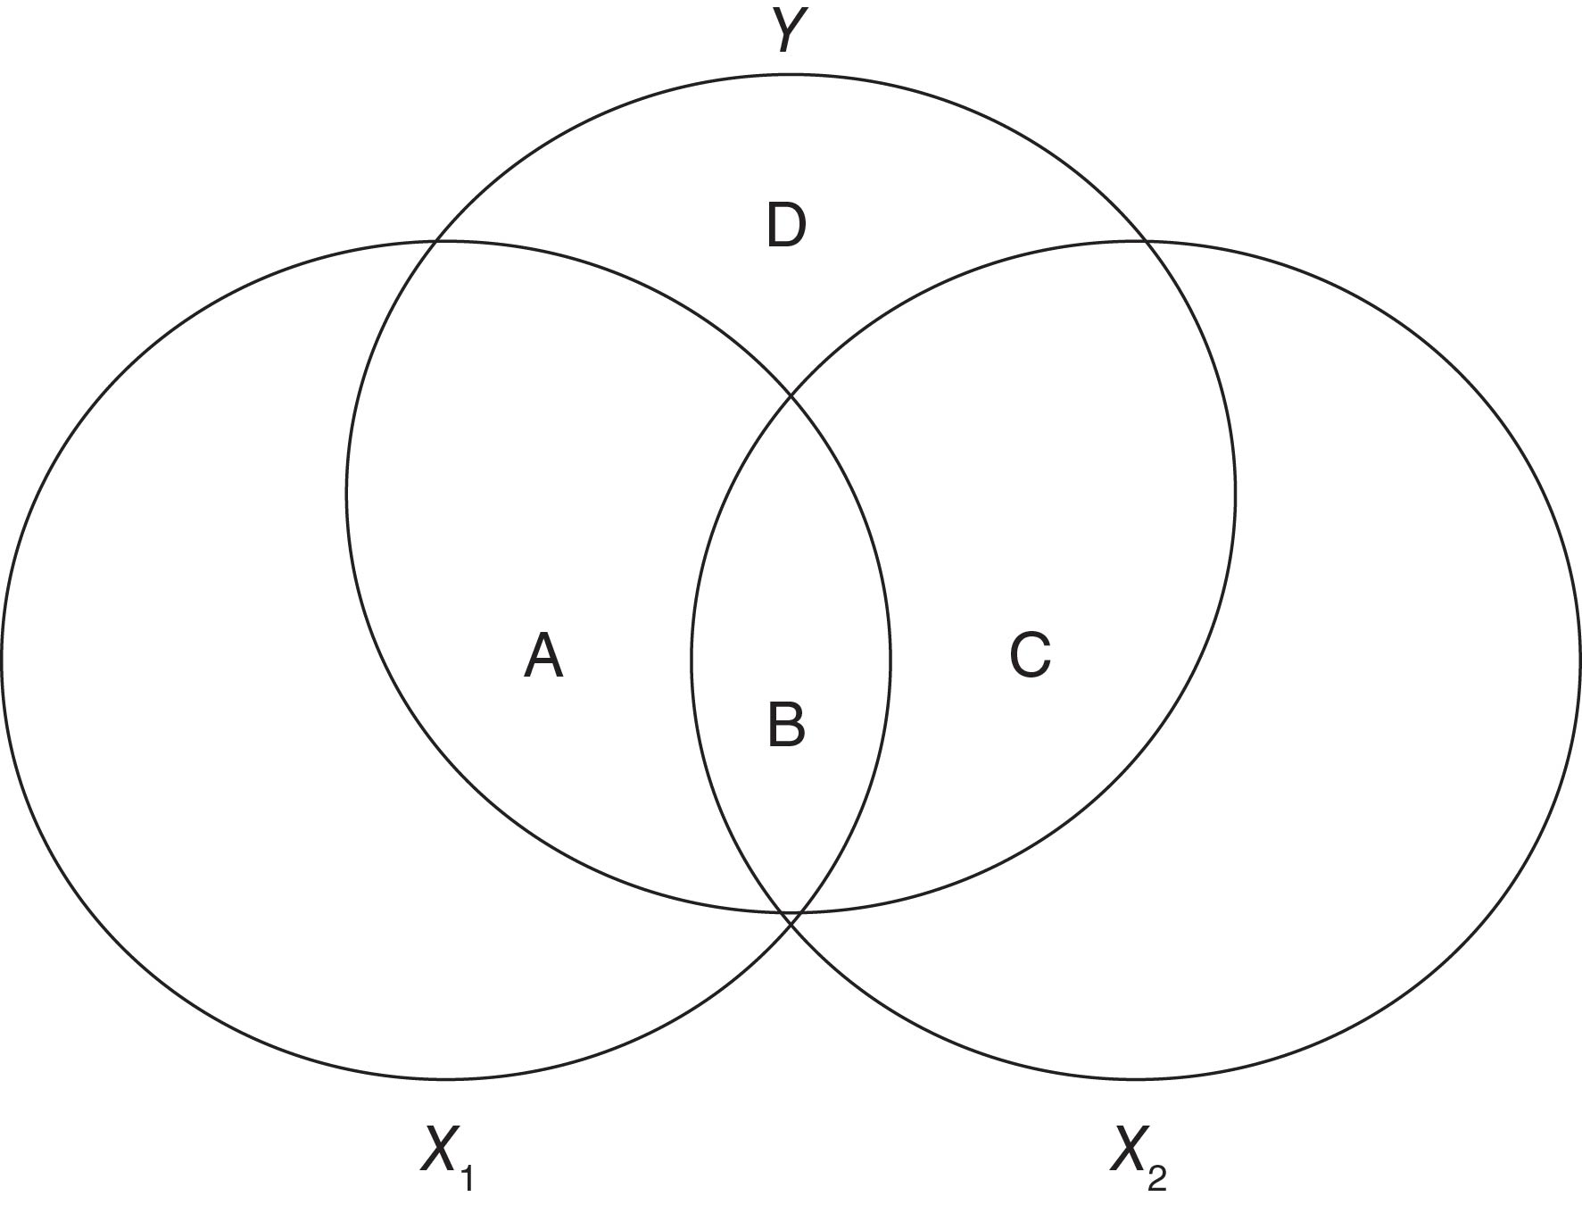
(Weight)
Circles represent the total variance in a variable.
Areas of overlap represent shared variance.
(Height)
(Age)

Slide 13

Weight
The effect of HEIGHT controlling for age means that we remove the shared variance (Height-Age and Weight-Age) and look only at the parts of HEIGHT and WEIGHT that vary independent of age.
We will use R to explain what this means statistically.
Height
Age

Slide 14
Weight
In more simple terms, we can think of this as the effect of HEIGHT while “holding age constant”.
That is, assuming we had lots of people of exactly the same age, how would we expect their weight to vary as a function of their height.
Height
Age

Slide 15
Weight
In more simple terms, we can think of this as the effect of HEIGHT while “holding age constant”.
That is, assuming we had lots of people of exactly the same age, how would we expect their weight to vary as a function of their height.
Height
Age

Slide 16
Note that the shared variance is completed excluded from both variables. This can be a problem is both variables are highly related.
Weight
Height
Age

Slide 17
Collinearity
On it’s own, the length of the left of a person’s left leg is a very good predictor of their total height.
Left Leg Length
Total Height

Slide 18
Collinearity
However, if we put both left leg length and right leg length in the same model, their shared variance will be excluded.
This collinearity (i.e., correlation) between left leg length and right leg length means that neither of these variables is a very good predictor controlling for the other.
Left Leg Length
Total Height
Right Leg Length

