Slide 1
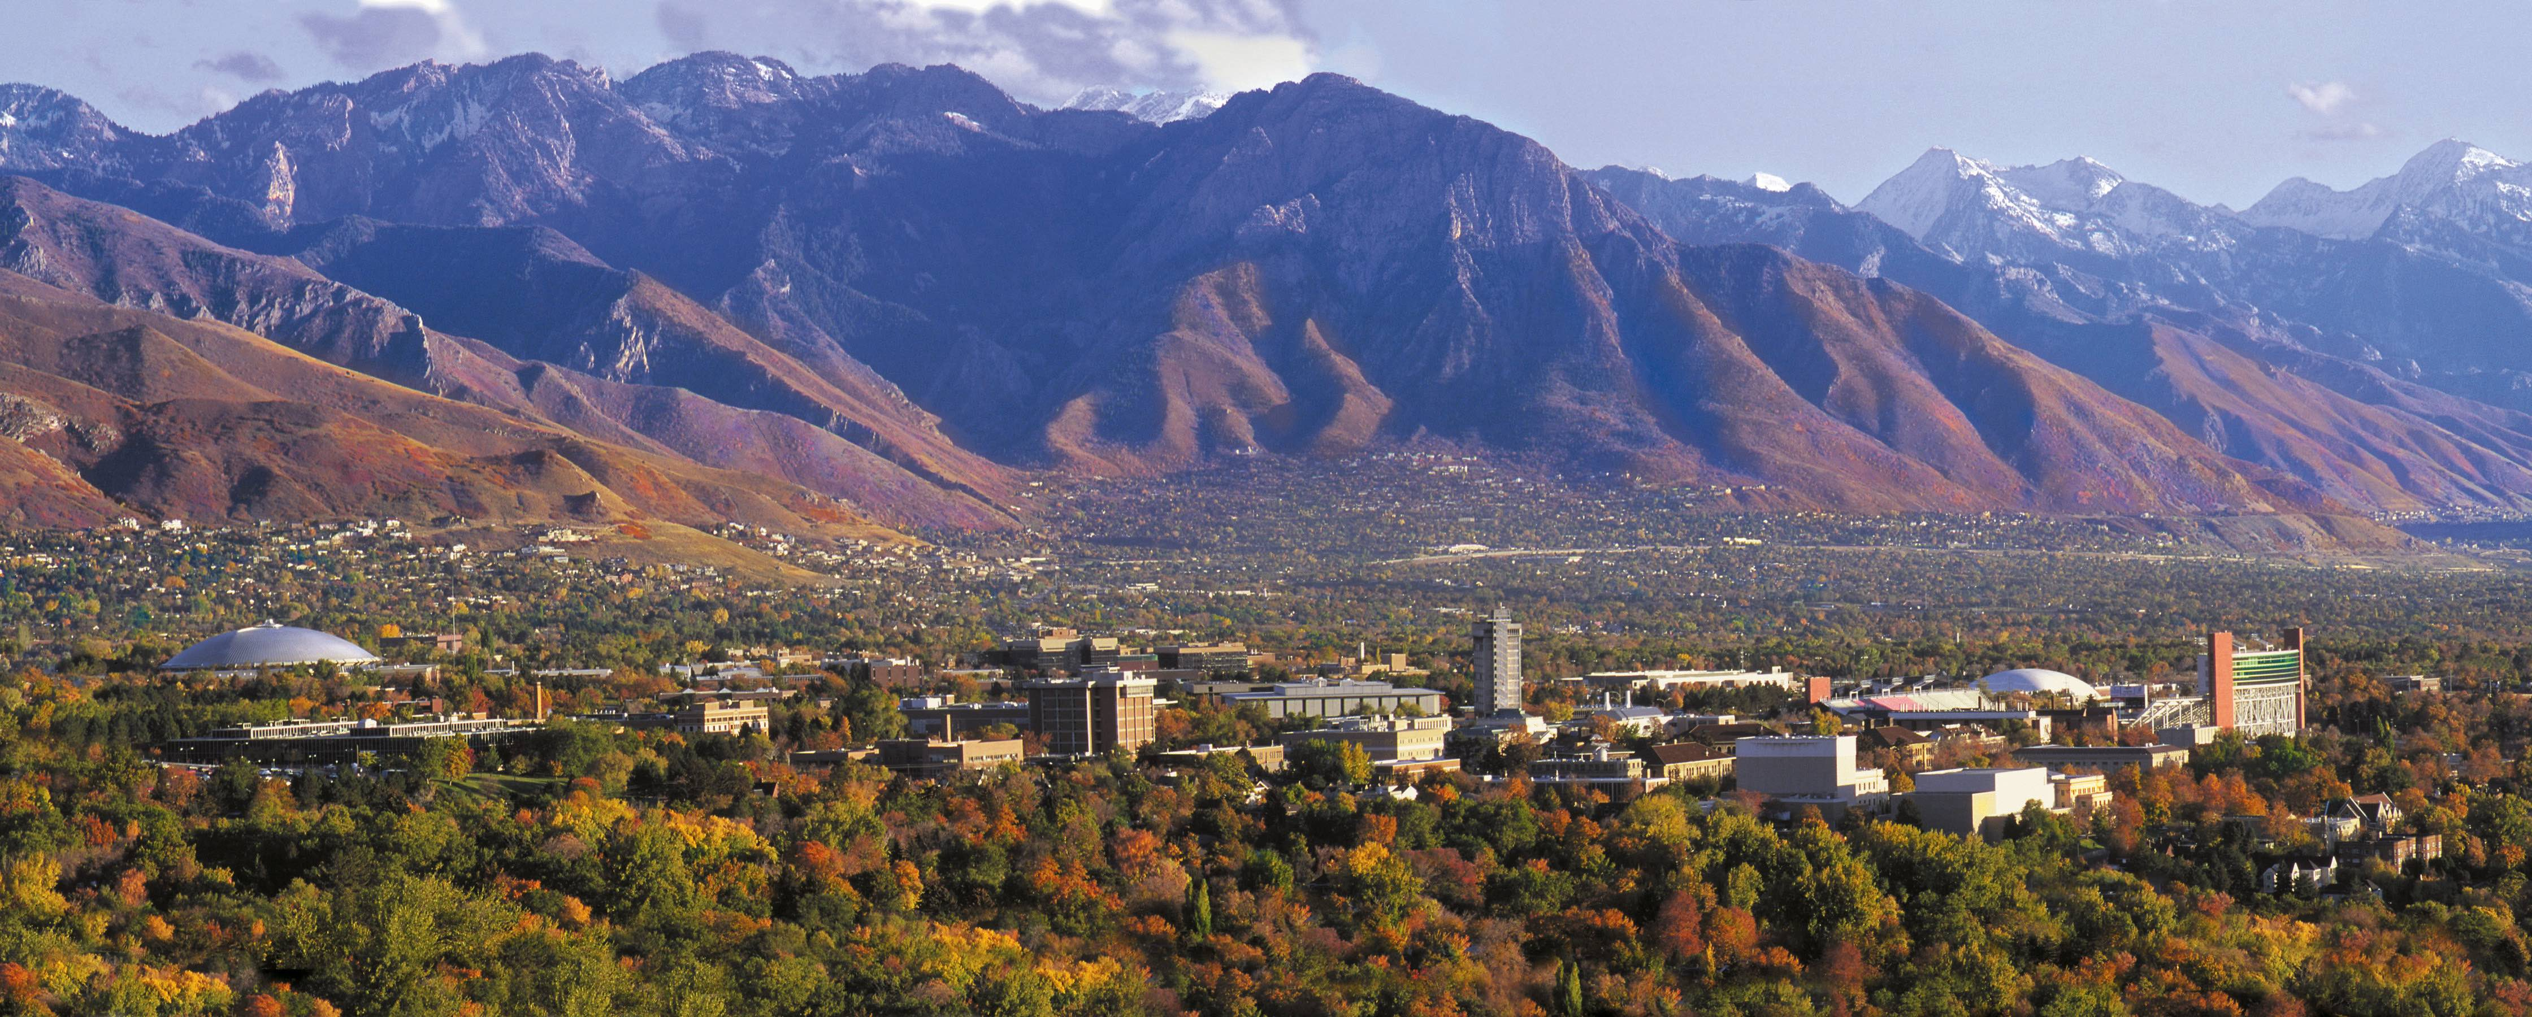



Moderated and Non-Linear Models.
Keith Lohse, PhD
Assistant Professor
Department of Health, Kinesiology, and Recreation
Department of Physical Therapy and Athletic Training
University of Utah
keith.lohse@health.utah.edu
@keith_lohse

Slide 2
Definitions
Nonlinear: The effect of one variable changes as a function of itself.
Moderated: The effect of one variable changes as a function of another variable.

Slide 3
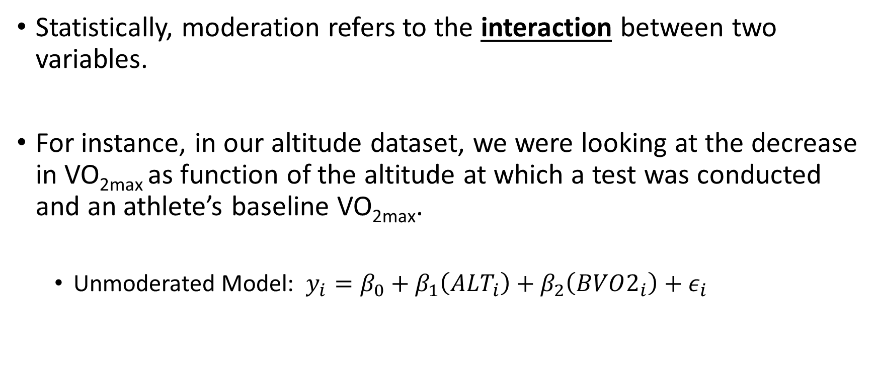
Moderated Models
Statistically, moderation refers to the interaction between two variables.
For instance, in our altitude dataset, we were looking at the decrease in VO_{2max} as function of the altitude at which a test was conducted and an athlete’s baseline VO_{2max}.
Unmoderated Model: $y_{i}=β_{0}+β_{1}\left({ALT}_{i}\right)+β_{2}\left(BVO2_{i}\right)+ε_{i}$

Slide 4
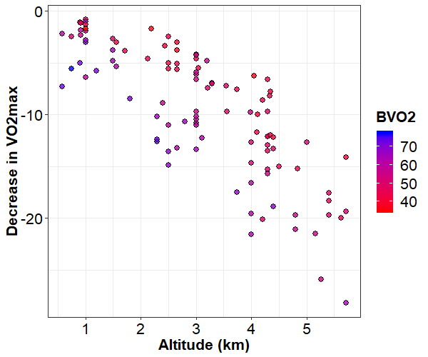

Unmoderated (Additive) Model
Unmoderated Model: $y_{i}=18.698−4.078\left({ALT}_{i}\right)−0.294\left(BVO2_{i}\right)+ε_{i}$
$$y_{i}=[18.698−0.294\left(40\right)]−4.078\left({ALT}_{i}\right)+ε_{i}$$
$$y_{i}=6.938−4.078\left({ALT}_{i}\right)+ε_{i}$$

Slide 5

Unmoderated (Additive) Model
Unmoderated Model: $y_{i}=18.698−4.078\left({ALT}_{i}\right)−0.294\left(BVO2_{i}\right)+ε_{i}$
$$y_{i}=[18.698−0.294\left(40\right)]−4.078\left({ALT}_{i}\right)+ε_{i}$$
$$y_{i}=6.938−4.078\left({ALT}_{i}\right)+ε_{i}$$
$$y_{i}=[18.698−0.294\left(55\right)]−4.078\left({ALT}_{i}\right)+ε_{i}$$
$$y_{i}=2.528−4.078\left({ALT}_{i}\right)+ε_{i}$$

Slide 6

Unmoderated (Additive) Model
Unmoderated Model: $y_{i}=18.698−4.078\left({ALT}_{i}\right)−0.294\left(BVO2_{i}\right)+ε_{i}$
$$y_{i}=[18.698−0.294\left(40\right)]−4.078\left({ALT}_{i}\right)+ε_{i}$$
$$y_{i}=6.938−4.078\left({ALT}_{i}\right)+ε_{i}$$
$$y_{i}=[18.698−0.294\left(55\right)]−4.078\left({ALT}_{i}\right)+ε_{i}$$
$$y_{i}=2.528−4.078\left({ALT}_{i}\right)+ε_{i}$$
$$y_{i}=[18.698−0.294\left(70\right)]−4.078\left({ALT}_{i}\right)+ε_{i}$$
$$y_{i}=−1.882−4.078\left({ALT}_{i}\right)+ε_{i}$$

Slide 7
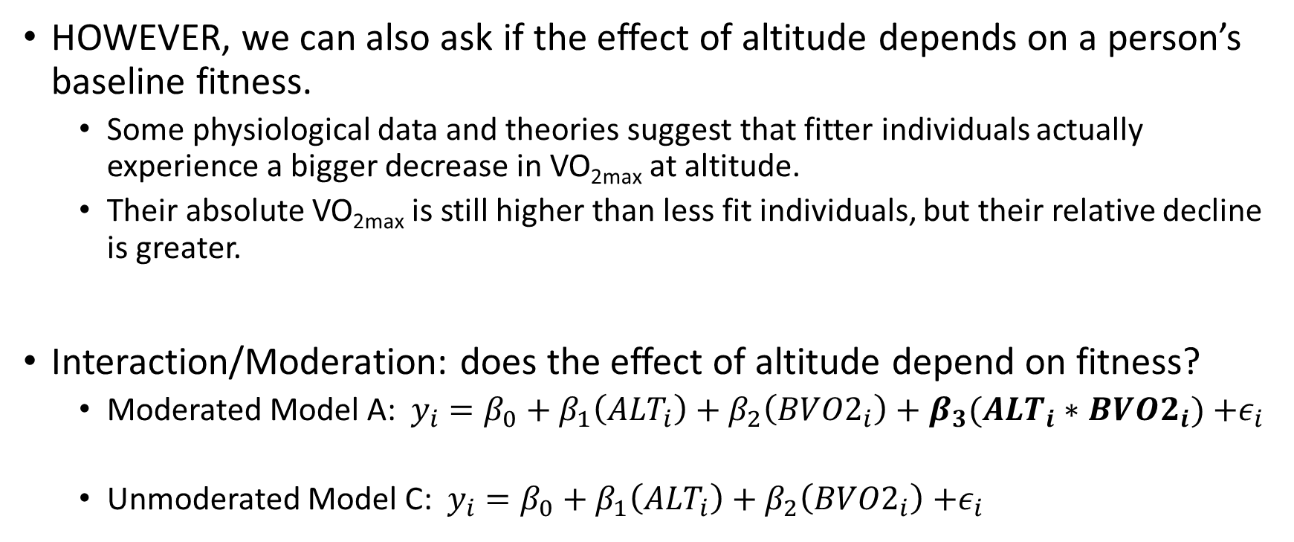
Moderated (Multiplicative) Models
HOWEVER, we can also ask if the effect of altitude depends on a person’s baseline fitness.
Some physiological data and theories suggest that fitter individuals actually experience a bigger decrease in VO_{2max} at altitude.
Their absolute VO_{2max} is still higher than less fit individuals, but their relative decline is greater.
Interaction/Moderation: does the effect of altitude depend on fitness?
Moderated Model A: $y_{i}=β_{0}+β_{1}\left({ALT}_{i}\right)+β_{2}\left(BVO2_{i}\right)+β_{3}(ALT_{i}∗BVO2_{i})$ $+ε_{i}$
Unmoderated Model C: $y_{i}=β_{0}+β_{1}\left({ALT}_{i}\right)+β_{2}\left(BVO2_{i}\right)$ $+ε_{i}$

Slide 8
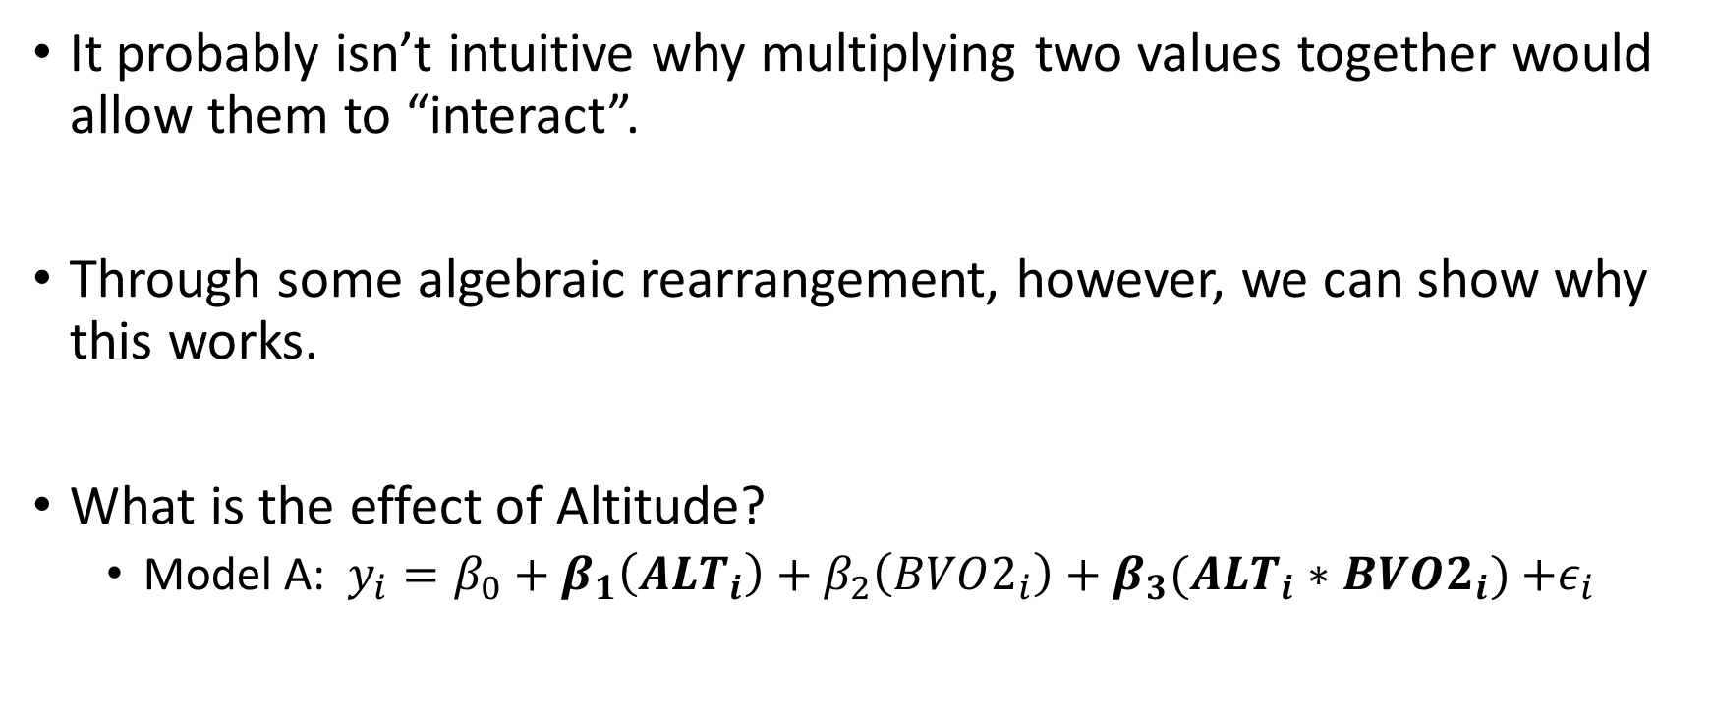
How does a moderated model work?
It probably isn’t intuitive why multiplying two values together would allow them to “interact”.
Through some algebraic rearrangement, however, we can show why this works.
What is the effect of Altitude?
Model A: $y_{i}=β_{0}+β_{1}\left({ALT}_{i}\right)+β_{2}\left(BVO2_{i}\right)+β_{3}(ALT_{i}∗BVO2_{i})$ $+ε_{i}$

Slide 9
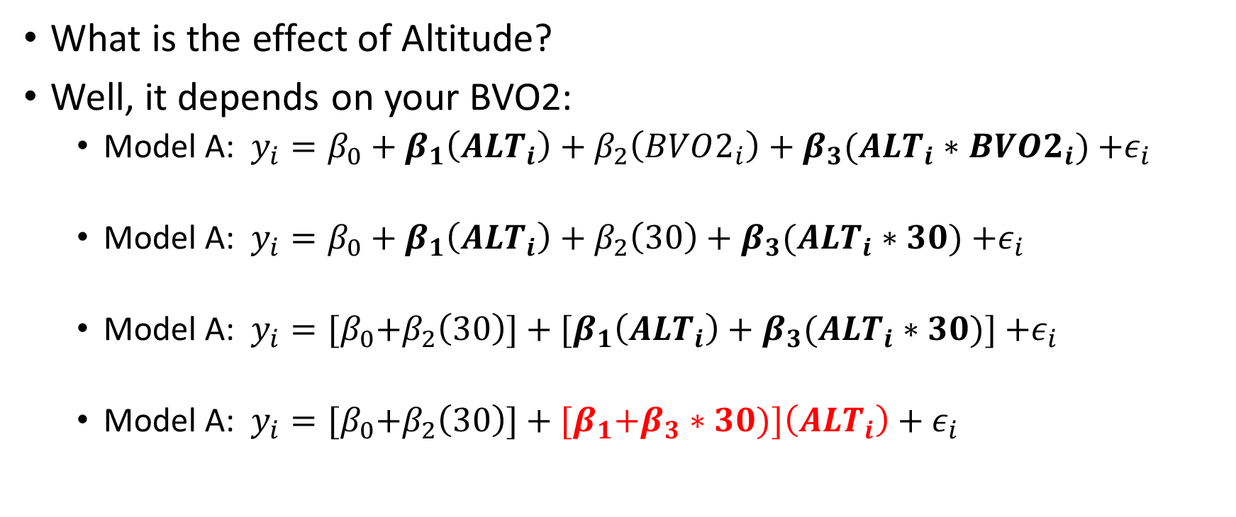
How does a moderated model work?
What is the effect of Altitude?
Well, it depends on your BVO2:
Model A: $y_{i}=β_{0}+β_{1}\left({ALT}_{i}\right)+β_{2}\left(BVO2_{i}\right)+β_{3}(ALT_{i}∗BVO2_{i})$ $+ε_{i}$
Model A: $y_{i}=β_{0}+β_{1}\left({ALT}_{i}\right)+β_{2}\left(30\right)+β_{3}(ALT_{i}∗30)$ $+ε_{i}$
Model A: $y_{i}={[β}_{0}+β_{2}\left(30\right)]+{[β}_{1}\left({ALT}_{i}\right)+β_{3}(ALT_{i}∗30)]$ $+ε_{i}$
Model A: $y_{i}={[β}_{0}+β_{2}\left(30\right)]+{[β}_{1}+β_{3}∗30)]\left({ALT}_{i}\right)+ε_{i}$
This is the ‘simple slope’ of altitude when BVO2 = 30!

Slide 10
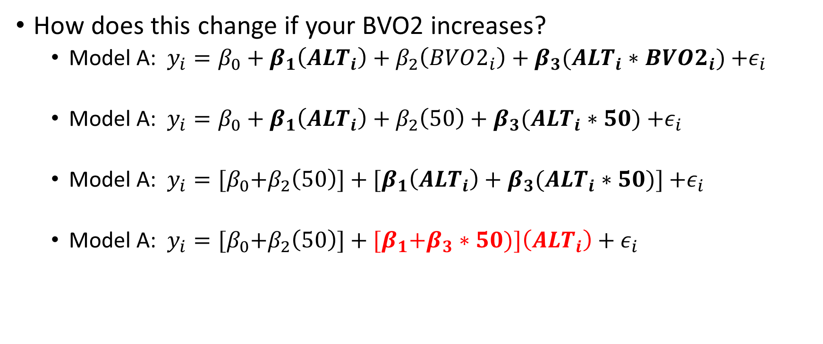
How does a moderated model work?
How does this change if your BVO2 increases?
Model A: $y_{i}=β_{0}+β_{1}\left({ALT}_{i}\right)+β_{2}\left(BVO2_{i}\right)+β_{3}(ALT_{i}∗BVO2_{i})$ $+ε_{i}$
Model A: $y_{i}=β_{0}+β_{1}\left({ALT}_{i}\right)+β_{2}\left(50\right)+β_{3}(ALT_{i}∗50)$ $+ε_{i}$
Model A: $y_{i}={[β}_{0}+β_{2}\left(50\right)]+{[β}_{1}\left({ALT}_{i}\right)+β_{3}(ALT_{i}∗50)]$ $+ε_{i}$
Model A: $y_{i}={[β}_{0}+β_{2}\left(50\right)]+{[β}_{1}+β_{3}∗50)]\left({ALT}_{i}\right)+ε_{i}$
This is the ‘simple slope’ of altitude when BVO2 = 50!
Thus, in the moderated model, the effect of altitude changes with a person’s BVO2.

Slide 11
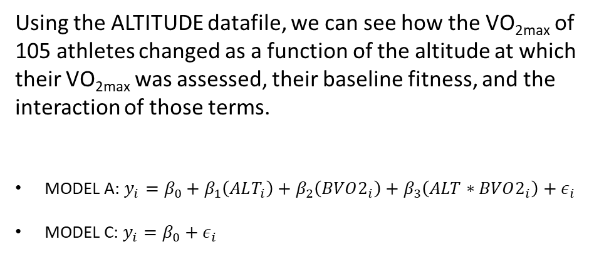
Is there an interaction?
Using the ALTITUDE datafile, we can see how the VO_{2max} of 105 athletes changed as a function of the altitude at which their VO_{2max} was assessed, their baseline fitness, and the interaction of those terms.
MODEL A: $y_{i}=β_{0}+β_{1}\left(ALT_{i}\right)+β_{2}\left(BVO2_{i}\right)+β_{3}\left(ALT∗BVO2_{i}\right)+ε_{i}$
MODEL C: $y_{i}=β_{0}+ε_{i}$

Slide 12
Is there an interaction?
lm(formula = decrease ~ alt_km * BVO2, data = dat)
Residuals:
Min 1Q Median 3Q Max
-7.2307 -1.4511 -0.1014 1.2200 6.9343
Coefficients:
Estimate Std. Error t value Pr(>|t|)
(Intercept) 8.51588 3.01436 2.825 0.005697 **
alt_km -0.11323 1.00029 -0.113 0.910097
BVO2 -0.10874 0.05266 -2.065 0.041512 *
alt_km:BVO2 -0.07448 0.01849 -4.027 0.000109 ***
---
Signif. codes: 0 ‘***’ 0.001 ‘**’ 0.01 ‘*’ 0.05 ‘.’ 0.1 ‘ ’ 1
Residual standard error: 2.432 on 101 degrees of freedom
Multiple R-squared: 0.8488, Adjusted R-squared: 0.8443
F-statistic: 189 on 3 and 101 DF, p-value: < 2.2e-16

Slide 13
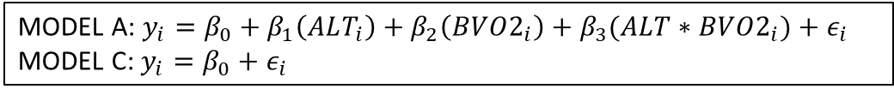
Is there an interaction?
lm(formula = decrease ~ alt_km * BVO2, data = dat)
Residuals:
Min 1Q Median 3Q Max
-7.2307 -1.4511 -0.1014 1.2200 6.9343
Coefficients:
Estimate Std. Error t value Pr(>|t|)
(Intercept) 8.51588 3.01436 2.825 0.005697 **
alt_km -0.11323 1.00029 -0.113 0.910097
BVO2 -0.10874 0.05266 -2.065 0.041512 *
alt_km:BVO2 -0.07448 0.01849 -4.027 0.000109 ***
---
Signif. codes: 0 ‘***’ 0.001 ‘**’ 0.01 ‘*’ 0.05 ‘.’ 0.1 ‘ ’ 1
Residual standard error: 2.432 on 101 degrees of freedom
Multiple R-squared: 0.8488, Adjusted R-squared: 0.8443
F-statistic: 189 on 3 and 101 DF, p-value: < 2.2e-16
MODEL A: $y_{i}=β_{0}+β_{1}\left(ALT_{i}\right)+β_{2}\left(BVO2_{i}\right)+β_{3}(ALT∗BVO2_{i})+ε_{i}$
MODEL C: $y_{i}=β_{0}+ε_{i}$

Slide 14
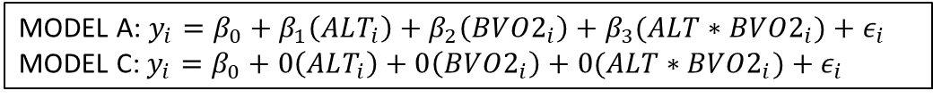
Is there an interaction?
lm(formula = decrease ~ alt_km * BVO2, data = dat)
Residuals:
Min 1Q Median 3Q Max
-7.2307 -1.4511 -0.1014 1.2200 6.9343
Coefficients:
Estimate Std. Error t value Pr(>|t|)
(Intercept) 8.51588 3.01436 2.825 0.005697 **
alt_km -0.11323 1.00029 -0.113 0.910097
BVO2 -0.10874 0.05266 -2.065 0.041512 *
alt_km:BVO2 -0.07448 0.01849 -4.027 0.000109 ***
---
Signif. codes: 0 ‘***’ 0.001 ‘**’ 0.01 ‘*’ 0.05 ‘.’ 0.1 ‘ ’ 1
Residual standard error: 2.432 on 101 degrees of freedom
Multiple R-squared: 0.8488, Adjusted R-squared: 0.8443
F-statistic: 189 on 3 and 101 DF, p-value: < 2.2e-16
MODEL A: $y_{i}=β_{0}+β_{1}\left(ALT_{i}\right)+β_{2}\left(BVO2_{i}\right)+β_{3}(ALT∗BVO2_{i})+ε_{i}$
MODEL C: $y_{i}=β_{0}+{0\left(ALT_{i}\right)+0\left(BVO2_{i}\right)+0(ALT∗BVO2_{i})+ε}_{i}$

Slide 15
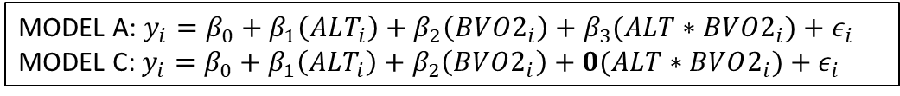
Is there an interaction?
lm(formula = decrease ~ alt_km * BVO2, data = dat)
Residuals:
Min 1Q Median 3Q Max
-7.2307 -1.4511 -0.1014 1.2200 6.9343
Coefficients:
Estimate Std. Error t value Pr(>|t|)
(Intercept) 8.51588 3.01436 2.825 0.005697 **
alt_km -0.11323 1.00029 -0.113 0.910097
BVO2 -0.10874 0.05266 -2.065 0.041512 *
alt_km:BVO2 -0.07448 0.01849 -4.027 0.000109 ***
---
Signif. codes: 0 ‘***’ 0.001 ‘**’ 0.01 ‘*’ 0.05 ‘.’ 0.1 ‘ ’ 1
Residual standard error: 2.432 on 101 degrees of freedom
Multiple R-squared: 0.8488, Adjusted R-squared: 0.8443
F-statistic: 189 on 3 and 101 DF, p-value: < 2.2e-16
MODEL A: $y_{i}=β_{0}+β_{1}\left(ALT_{i}\right)+β_{2}\left(BVO2_{i}\right)+β_{3}(ALT∗BVO2_{i})+ε_{i}$
MODEL C: $y_{i}=β_{0}+{β_{1}\left(ALT_{i}\right)+β_{2}\left(BVO2_{i}\right)+0(ALT∗BVO2_{i})+ε}_{i}$
MODEL A: $y_{i}=β_{0}+β_{1}\left(ALT_{i}\right)+β_{2}\left(BVO2_{i}\right)+β_{3}(ALT∗BVO2_{i})+ε_{i}$
MODEL C: $y_{i}=β_{0}+{0\left(ALT_{i}\right)+0\left(BVO2_{i}\right)+0(ALT∗BVO2_{i})+ε}_{i}$

Slide 16
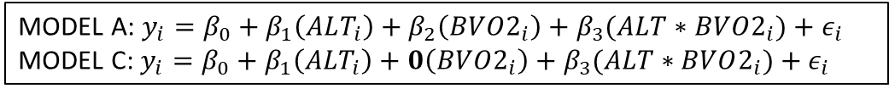
Is there an interaction?
lm(formula = decrease ~ alt_km * BVO2, data = dat)
Residuals:
Min 1Q Median 3Q Max
-7.2307 -1.4511 -0.1014 1.2200 6.9343
Coefficients:
Estimate Std. Error t value Pr(>|t|)
(Intercept) 8.51588 3.01436 2.825 0.005697 **
alt_km -0.11323 1.00029 -0.113 0.910097
BVO2 -0.10874 0.05266 -2.065 0.041512 *
alt_km:BVO2 -0.07448 0.01849 -4.027 0.000109 ***
---
Signif. codes: 0 ‘***’ 0.001 ‘**’ 0.01 ‘*’ 0.05 ‘.’ 0.1 ‘ ’ 1
Residual standard error: 2.432 on 101 degrees of freedom
Multiple R-squared: 0.8488, Adjusted R-squared: 0.8443
F-statistic: 189 on 3 and 101 DF, p-value: < 2.2e-16
MODEL A: $y_{i}=β_{0}+β_{1}\left(ALT_{i}\right)+β_{2}\left(BVO2_{i}\right)+β_{3}(ALT∗BVO2_{i})+ε_{i}$
MODEL C: $y_{i}=β_{0}+{β_{1}\left(ALT_{i}\right)+0\left(BVO2_{i}\right)+β_{3}(ALT∗BVO2_{i})+ε}_{i}$
MODEL A: $y_{i}=β_{0}+β_{1}\left(ALT_{i}\right)+β_{2}\left(BVO2_{i}\right)+β_{3}(ALT∗BVO2_{i})+ε_{i}$
MODEL C: $y_{i}=β_{0}+{β_{1}\left(ALT_{i}\right)+β_{2}\left(BVO2_{i}\right)+0(ALT∗BVO2_{i})+ε}_{i}$
MODEL A: $y_{i}=β_{0}+β_{1}\left(ALT_{i}\right)+β_{2}\left(BVO2_{i}\right)+β_{3}(ALT∗BVO2_{i})+ε_{i}$
MODEL C: $y_{i}=β_{0}+{0\left(ALT_{i}\right)+0\left(BVO2_{i}\right)+0(ALT∗BVO2_{i})+ε}_{i}$

Slide 17
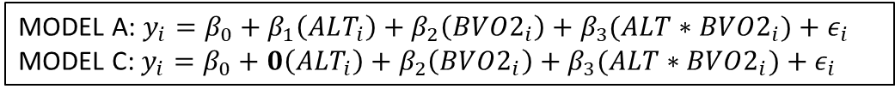
Is there an interaction?
lm(formula = decrease ~ alt_km * BVO2, data = dat)
Residuals:
Min 1Q Median 3Q Max
-7.2307 -1.4511 -0.1014 1.2200 6.9343
Coefficients:
Estimate Std. Error t value Pr(>|t|)
(Intercept) 8.51588 3.01436 2.825 0.005697 **
alt_km -0.11323 1.00029 -0.113 0.910097
BVO2 -0.10874 0.05266 -2.065 0.041512 *
alt_km:BVO2 -0.07448 0.01849 -4.027 0.000109 ***
---
Signif. codes: 0 ‘***’ 0.001 ‘**’ 0.01 ‘*’ 0.05 ‘.’ 0.1 ‘ ’ 1
Residual standard error: 2.432 on 101 degrees of freedom
Multiple R-squared: 0.8488, Adjusted R-squared: 0.8443
F-statistic: 189 on 3 and 101 DF, p-value: < 2.2e-16
MODEL A: $y_{i}=β_{0}+β_{1}\left(ALT_{i}\right)+β_{2}\left(BVO2_{i}\right)+β_{3}(ALT∗BVO2_{i})+ε_{i}$
MODEL C: $y_{i}=β_{0}+{0\left(ALT_{i}\right)+β_{2}\left(BVO2_{i}\right)+β_{3}(ALT∗BVO2_{i})+ε}_{i}$
MODEL A: $y_{i}=β_{0}+β_{1}\left(ALT_{i}\right)+β_{2}\left(BVO2_{i}\right)+β_{3}(ALT∗BVO2_{i})+ε_{i}$
MODEL C: $y_{i}=β_{0}+{β_{1}\left(ALT_{i}\right)+0\left(BVO2_{i}\right)+β_{3}(ALT∗BVO2_{i})+ε}_{i}$
MODEL A: $y_{i}=β_{0}+β_{1}\left(ALT_{i}\right)+β_{2}\left(BVO2_{i}\right)+β_{3}(ALT∗BVO2_{i})+ε_{i}$
MODEL C: $y_{i}=β_{0}+{β_{1}\left(ALT_{i}\right)+β_{2}\left(BVO2_{i}\right)+0(ALT∗BVO2_{i})+ε}_{i}$
MODEL A: $y_{i}=β_{0}+β_{1}\left(ALT_{i}\right)+β_{2}\left(BVO2_{i}\right)+β_{3}(ALT∗BVO2_{i})+ε_{i}$
MODEL C: $y_{i}=β_{0}+{0\left(ALT_{i}\right)+0\left(BVO2_{i}\right)+0(ALT∗BVO2_{i})+ε}_{i}$

Slide 18
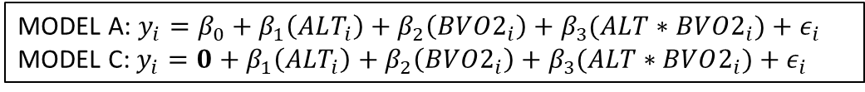
Is there an interaction?
lm(formula = decrease ~ alt_km * BVO2, data = dat)
Residuals:
Min 1Q Median 3Q Max
-7.2307 -1.4511 -0.1014 1.2200 6.9343
Coefficients:
Estimate Std. Error t value Pr(>|t|)
(Intercept) 8.51588 3.01436 2.825 0.005697 **
alt_km -0.11323 1.00029 -0.113 0.910097
BVO2 -0.10874 0.05266 -2.065 0.041512 *
alt_km:BVO2 -0.07448 0.01849 -4.027 0.000109 ***
---
Signif. codes: 0 ‘***’ 0.001 ‘**’ 0.01 ‘*’ 0.05 ‘.’ 0.1 ‘ ’ 1
Residual standard error: 2.432 on 101 degrees of freedom
Multiple R-squared: 0.8488, Adjusted R-squared: 0.8443
F-statistic: 189 on 3 and 101 DF, p-value: < 2.2e-16
MODEL A: $y_{i}=β_{0}+β_{1}\left(ALT_{i}\right)+β_{2}\left(BVO2_{i}\right)+β_{3}(ALT∗BVO2_{i})+ε_{i}$
MODEL C: $y_{i}=0+{β_{1}\left(ALT_{i}\right)+β_{2}\left(BVO2_{i}\right)+β_{3}(ALT∗BVO2_{i})+ε}_{i}$
MODEL A: $y_{i}=β_{0}+β_{1}\left(ALT_{i}\right)+β_{2}\left(BVO2_{i}\right)+β_{3}(ALT∗BVO2_{i})+ε_{i}$
MODEL C: $y_{i}=β_{0}+{0\left(ALT_{i}\right)+β_{2}\left(BVO2_{i}\right)+β_{3}(ALT∗BVO2_{i})+ε}_{i}$
MODEL A: $y_{i}=β_{0}+β_{1}\left(ALT_{i}\right)+β_{2}\left(BVO2_{i}\right)+β_{3}(ALT∗BVO2_{i})+ε_{i}$
MODEL C: $y_{i}=β_{0}+{β_{1}\left(ALT_{i}\right)+0\left(BVO2_{i}\right)+β_{3}(ALT∗BVO2_{i})+ε}_{i}$
MODEL A: $y_{i}=β_{0}+β_{1}\left(ALT_{i}\right)+β_{2}\left(BVO2_{i}\right)+β_{3}(ALT∗BVO2_{i})+ε_{i}$
MODEL C: $y_{i}=β_{0}+{β_{1}\left(ALT_{i}\right)+β_{2}\left(BVO2_{i}\right)+0(ALT∗BVO2_{i})+ε}_{i}$
MODEL A: $y_{i}=β_{0}+β_{1}\left(ALT_{i}\right)+β_{2}\left(BVO2_{i}\right)+β_{3}(ALT∗BVO2_{i})+ε_{i}$
MODEL C: $y_{i}=β_{0}+{0\left(ALT_{i}\right)+0\left(BVO2_{i}\right)+0(ALT∗BVO2_{i})+ε}_{i}$

Slide 19
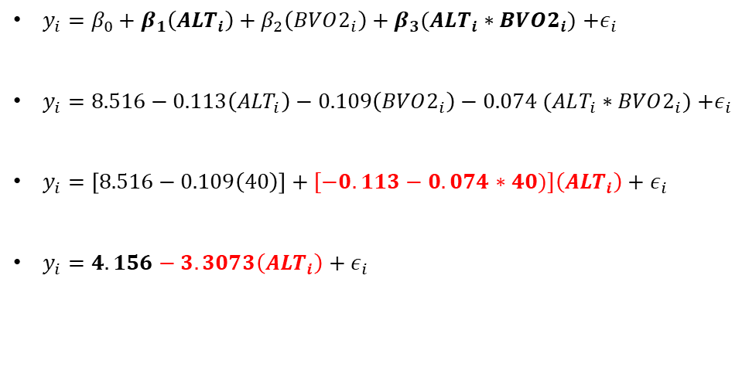
So what does our interaction mean?
The effect of altitude depends on your baseline fitness.
What is the effect of altitude for someone with a BVO2 = 40?
$y_{i}=β_{0}+β_{1}\left({ALT}_{i}\right)+β_{2}\left(BVO2_{i}\right)+β_{3}(ALT_{i}∗BVO2_{i})$ $+ε_{i}$
$y_{i}=8.516−0.113\left({ALT}_{i}\right)−0.109\left(BVO2_{i}\right)−0.074 (ALT_{i}∗BVO2_{i})$ $+ε_{i}$
$y_{i}=\left[8.516−0.109\left(40\right)\right]+[−0.113−0.074∗40)]\left({ALT}_{i}\right)+ε_{i}$
$y_{i}=4.156−3.3073\left({ALT}_{i}\right)+ε_{i}$

Slide 20
So what does our interaction mean?
The effect of altitude depends on your baseline fitness.
What is the effect of altitude for someone with a BVO2 = 40?
$y_{i}=β_{0}+β_{1}\left({ALT}_{i}\right)+β_{2}\left(BVO2_{i}\right)+β_{3}(ALT_{i}∗BVO2_{i})$ $+ε_{i}$
$y_{i}=8.516−0.113\left({ALT}_{i}\right)−0.109\left(BVO2_{i}\right)−0.074 (ALT_{i}∗BVO2_{i})$ $+ε_{i}$
$y_{i}=\left[8.516−0.109\left(40\right)\right]+[−0.113−0.074∗40)]\left({ALT}_{i}\right)+ε_{i}$
$y_{i}=4.156−3.3073\left({ALT}_{i}\right)+ε_{i}$

Slide 21
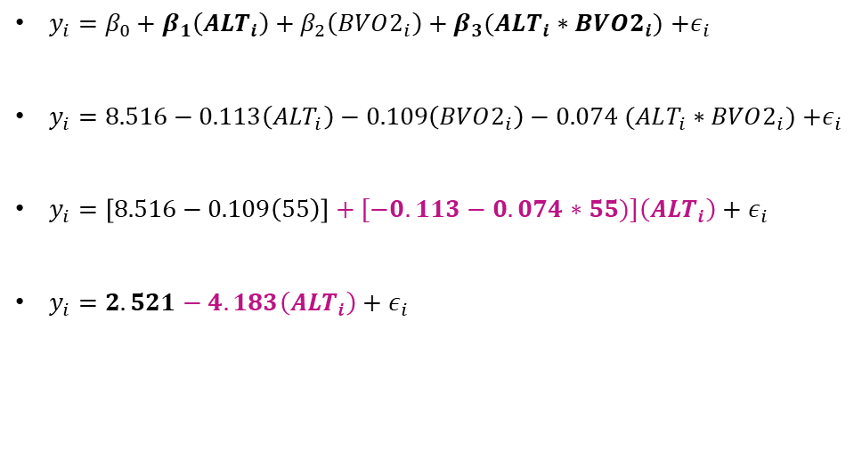
So what does our interaction mean?
The effect of altitude depends on your baseline fitness.
What is the effect of altitude for someone with a BVO2 = 55?
$y_{i}=β_{0}+β_{1}\left({ALT}_{i}\right)+β_{2}\left(BVO2_{i}\right)+β_{3}(ALT_{i}∗BVO2_{i})$ $+ε_{i}$
$y_{i}=8.516−0.113\left({ALT}_{i}\right)−0.109\left(BVO2_{i}\right)−0.074 (ALT_{i}∗BVO2_{i})$ $+ε_{i}$
$y_{i}=\left[8.516−0.109\left(55\right)\right]+[−0.113−0.074∗55)]\left({ALT}_{i}\right)+ε_{i}$
$y_{i}=2.521−4.183\left({ALT}_{i}\right)+ε_{i}$

Slide 22
So what does our interaction mean?
The effect of altitude depends on your baseline fitness.
What is the effect of altitude for someone with a BVO2 = 55?
$y_{i}=β_{0}+β_{1}\left({ALT}_{i}\right)+β_{2}\left(BVO2_{i}\right)+β_{3}(ALT_{i}∗BVO2_{i})$ $+ε_{i}$
$y_{i}=8.516−0.113\left({ALT}_{i}\right)−0.109\left(BVO2_{i}\right)−0.074 (ALT_{i}∗BVO2_{i})$ $+ε_{i}$
$y_{i}=\left[8.516−0.109\left(55\right)\right]+[−0.113−0.074∗55)]\left({ALT}_{i}\right)+ε_{i}$
$y_{i}=2.521−4.183\left({ALT}_{i}\right)+ε_{i}$

Slide 23
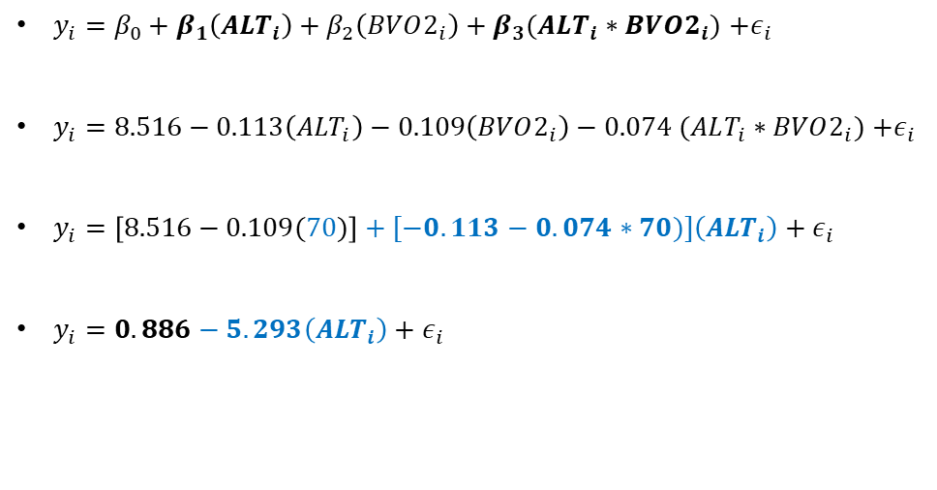
So what does our interaction mean?
The effect of altitude depends on your baseline fitness.
What is the effect of altitude for someone with a BVO2 = 70?
$y_{i}=β_{0}+β_{1}\left({ALT}_{i}\right)+β_{2}\left(BVO2_{i}\right)+β_{3}(ALT_{i}∗BVO2_{i})$ $+ε_{i}$
$y_{i}=8.516−0.113\left({ALT}_{i}\right)−0.109\left(BVO2_{i}\right)−0.074 (ALT_{i}∗BVO2_{i})$ $+ε_{i}$
$y_{i}=\left[8.516−0.109(70)\right]+[−0.113−0.074∗70)]\left({ALT}_{i}\right)+ε_{i}$
$y_{i}=0.886−5.293\left({ALT}_{i}\right)+ε_{i}$

Slide 24
So what does our interaction mean?
The effect of altitude depends on your baseline fitness.
What is the effect of altitude for someone with a BVO2 = 70?
$y_{i}=β_{0}+β_{1}\left({ALT}_{i}\right)+β_{2}\left(BVO2_{i}\right)+β_{3}(ALT_{i}∗BVO2_{i})$ $+ε_{i}$
$y_{i}=8.516−0.113\left({ALT}_{i}\right)−0.109\left(BVO2_{i}\right)−0.074 (ALT_{i}∗BVO2_{i})$ $+ε_{i}$
$y_{i}=\left[8.516−0.109(70)\right]+[−0.113−0.074∗70)]\left({ALT}_{i}\right)+ε_{i}$
$y_{i}=0.886−5.293\left({ALT}_{i}\right)+ε_{i}$

Slide 25

So what does our interaction mean?
The effect of altitude depends on your baseline fitness.
$y_{i}=8.516−0.113\left({ALT}_{i}\right)−0.109\left(BVO2_{i}\right)−0.074 (ALT_{i}∗BVO2_{i})$ $+ε_{i}$
$y_{i}=4.156−3.3073\left({ALT}_{i}\right)+ε_{i}$
$y_{i}=2.521−4.183\left({ALT}_{i}\right)+ε_{i}$
$y_{i}=0.886−5.293\left({ALT}_{i}\right)+ε_{i}$
40
55
70

Slide 26
ANOVA table for the full model
Source | SSE | Df | MSE | F_obs | Pr(>F_obs)
Intercept | 47.21 | 1 | 47.21 | 7.981 | 0.006
Alt (km) | 0.08 | 1 | 0.08 | 0.0128 | 0.910
BVO2 | 25.22 | 1 | 25.22 | 4.263 | 0.042
Alt * BVO2 | 95.95 | 1 | 95.95 | 16.221 | <0.001
Residuals | 597.44 | 101 | 5.92
Total | 765.90 | 104

