Slide 1




Moderated and Nonlinear Models: Part 2.
Keith Lohse, PhD
Assistant Professor
Department of Health, Kinesiology, and Recreation
Department of Physical Therapy and Athletic Training
University of Utah
keith.lohse@health.utah.edu
@keith_lohse

Slide 2
Definitions
Nonlinear: The effect of one variable changes as a function of itself.
Moderated: The effect of one variable changes as a function of another variable.

Slide 3
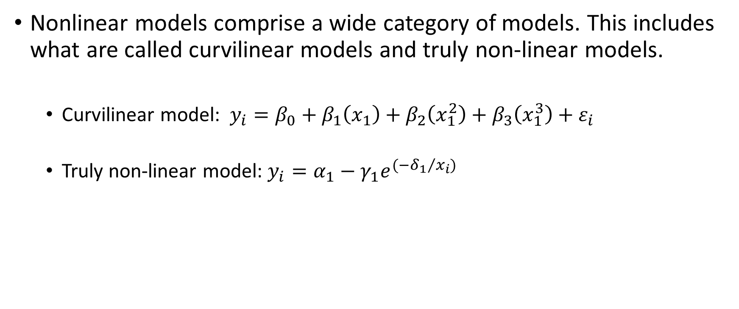
Nonlinear Models
Nonlinear models comprise a wide category of models. This includes what are called curvilinear models and truly non-linear models.
Curvilinear model: $y_{i}=β_{0}+β_{1}\left(x_{1}\right)+β_{2}\left(x_{1}^{2}\right)+β_{3}\left(x_{1}^{3}\right)+ε_{i}$
Truly non-linear model: $y_{i}=α_{1}−γ_{1}e^{({−δ_{1}}/{x_{i})}}$

Slide 4
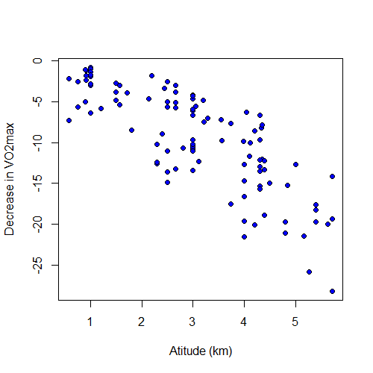
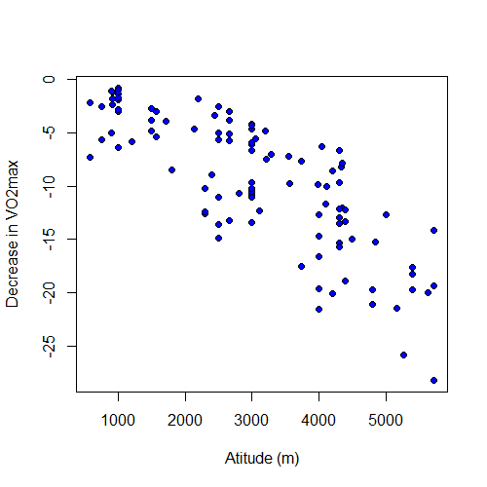
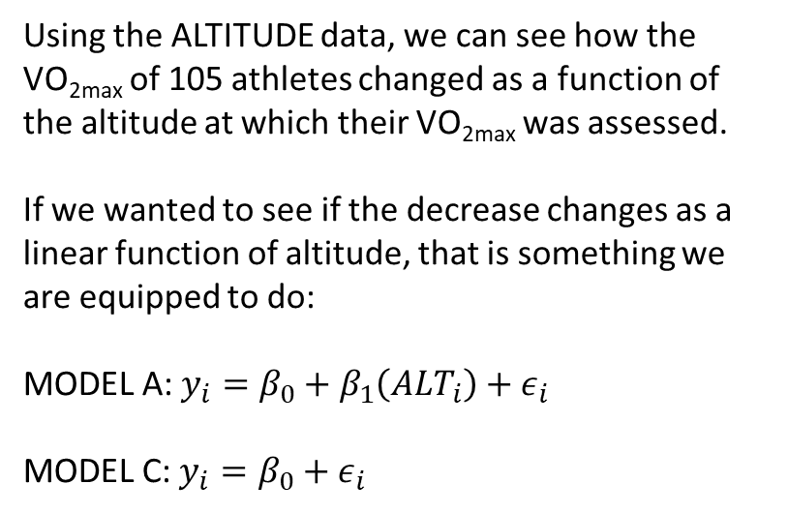
VO_{2max} changes as a function of altitude.
Using the ALTITUDE data, we can see how the VO_{2max} of 105 athletes changed as a function of the altitude at which their VO_{2max} was assessed.
If we wanted to see if the decrease changes as a linear function of altitude, that is something we are equipped to do:
MODEL A: $y_{i}=β_{0}+β_{1}\left(ALT_{i}\right)+ε_{i}$
MODEL C: $y_{i}=β_{0}+ε_{i}$

Slide 5
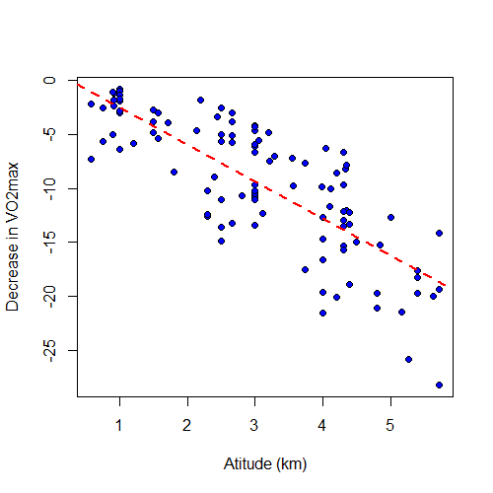
VO_{2max} changes as a function of altitude.
lm(formula = decrease ~ alt_km, data = dat)
Residuals:
Min 1Q Median 3Q Max
-9.5185 -2.1186 0.3748 2.9344 7.2001
Coefficients:
Estimate Std. Error t value Pr(>|t|)
(Intercept) 0.9817 0.8855 1.109 0.27
alt_km -3.4376 0.2616 -13.143 <2e-16 ***
---
Signif. codes: 0 ‘***’ 0.001 ‘**’ 0.01 ‘*’ 0.05 ‘.’ 0.1 ‘ ’ 1
Residual standard error: 3.786 on 103 degrees of freedom
Multiple R-squared: 0.6264, Adjusted R-squared: 0.6228
F-statistic: 172.7 on 1 and 103 DF, p-value: < 2.2e-16

Slide 6
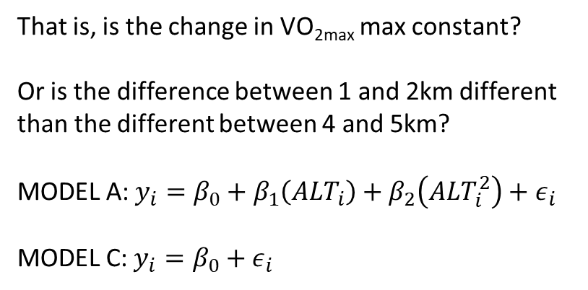
Is the VO_{2max} change curvilinear?
That is, is the change in VO_{2max} max constant?
Or is the difference between 1 and 2km different than the different between 4 and 5km?
MODEL A: $y_{i}=β_{0}+β_{1}\left(ALT_{i}\right)+β_{2}\left(ALT_{i}^{2}\right)+ε_{i}$
MODEL C: $y_{i}=β_{0}+ε_{i}$

Slide 7
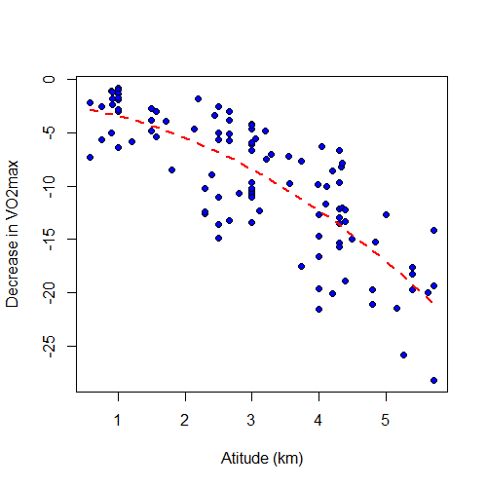
Is the VO_{2max} change curvilinear?
lm(formula = decrease ~ alt_km + alt_km_sq, data = dat)
Residuals:
Min 1Q Median 3Q Max
-9.3091 -2.4191 0.9296 2.4161 7.0271
Coefficients:
Estimate Std. Error t value Pr(>|t|)
(Intercept) -2.2708 1.5327 -1.482 0.1415
alt_km -0.6921 1.0994 -0.630 0.5304
alt_km_sq -0.4532 0.1766 -2.567 0.0117 *
---
Signif. codes: 0 ‘***’ 0.001 ‘**’ 0.01 ‘*’ 0.05 ‘.’ 0.1 ‘ ’ 1
Residual standard error: 3.687 on 102 degrees of freedom
Multiple R-squared: 0.6491, Adjusted R-squared: 0.6422
F-statistic: 94.35 on 2 and 102 DF, p-value: < 2.2e-16

Slide 8
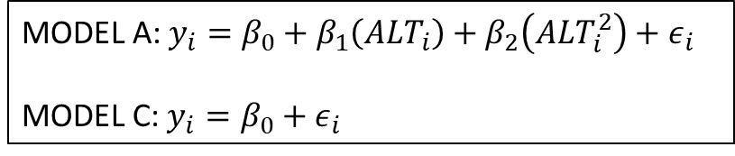
Which models are being compared?
lm(formula = decrease ~ alt_km + alt_km_sq, data = dat)
Residuals:
Min 1Q Median 3Q Max
-9.3091 -2.4191 0.9296 2.4161 7.0271
Coefficients:
Estimate Std. Error t value Pr(>|t|)
(Intercept) -2.2708 1.5327 -1.482 0.1415
alt_km -0.6921 1.0994 -0.630 0.5304
alt_km_sq -0.4532 0.1766 -2.567 0.0117 *
---
Signif. codes: 0 ‘***’ 0.001 ‘**’ 0.01 ‘*’ 0.05 ‘.’ 0.1 ‘ ’ 1
Residual standard error: 3.687 on 102 degrees of freedom
Multiple R-squared: 0.6491, Adjusted R-squared: 0.6422
F-statistic: 94.35 on 2 and 102 DF, p-value: < 2.2e-16
MODEL A: $y_{i}=β_{0}+β_{1}\left(ALT_{i}\right)+β_{2}\left(ALT_{i}^{2}\right)+ε_{i}$
MODEL C: $y_{i}=β_{0}+ε_{i}$

Slide 9
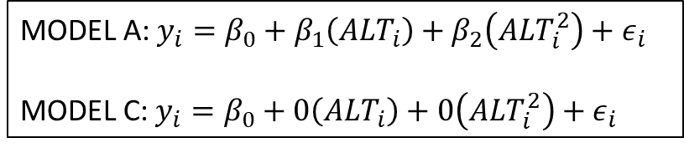
Which models are being compared?
lm(formula = decrease ~ alt_km + alt_km_sq, data = dat)
Residuals:
Min 1Q Median 3Q Max
-9.3091 -2.4191 0.9296 2.4161 7.0271
Coefficients:
Estimate Std. Error t value Pr(>|t|)
(Intercept) -2.2708 1.5327 -1.482 0.1415
alt_km -0.6921 1.0994 -0.630 0.5304
alt_km_sq -0.4532 0.1766 -2.567 0.0117 *
---
Signif. codes: 0 ‘***’ 0.001 ‘**’ 0.01 ‘*’ 0.05 ‘.’ 0.1 ‘ ’ 1
Residual standard error: 3.687 on 102 degrees of freedom
Multiple R-squared: 0.6491, Adjusted R-squared: 0.6422
F-statistic: 94.35 on 2 and 102 DF, p-value: < 2.2e-16
MODEL A: $y_{i}=β_{0}+β_{1}\left(ALT_{i}\right)+β_{2}\left(ALT_{i}^{2}\right)+ε_{i}$
MODEL C: $y_{i}=β_{0}+0\left(ALT_{i}\right)+0\left(ALT_{i}^{2}\right)+ε_{i}$

Slide 10
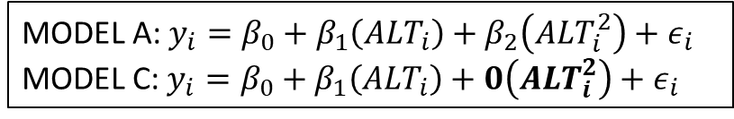
Which models are being compared?
lm(formula = decrease ~ alt_km + alt_km_sq, data = dat)
Residuals:
Min 1Q Median 3Q Max
-9.3091 -2.4191 0.9296 2.4161 7.0271
Coefficients:
Estimate Std. Error t value Pr(>|t|)
(Intercept) -2.2708 1.5327 -1.482 0.1415
alt_km -0.6921 1.0994 -0.630 0.5304
alt_km_sq -0.4532 0.1766 -2.567 0.0117 *
---
Signif. codes: 0 ‘***’ 0.001 ‘**’ 0.01 ‘*’ 0.05 ‘.’ 0.1 ‘ ’ 1
Residual standard error: 3.687 on 102 degrees of freedom
Multiple R-squared: 0.6491, Adjusted R-squared: 0.6422
F-statistic: 94.35 on 2 and 102 DF, p-value: < 2.2e-16
MODEL A: $y_{i}=β_{0}+β_{1}\left(ALT_{i}\right)+β_{2}\left(ALT_{i}^{2}\right)+ε_{i}$
MODEL C: $y_{i}=β_{0}+β_{1}\left(ALT_{i}\right)+0\left(ALT_{i}^{2}\right)+ε_{i}$
MODEL A: $y_{i}=β_{0}+β_{1}\left(ALT_{i}\right)+β_{2}\left(ALT_{i}^{2}\right)+ε_{i}$
MODEL C: $y_{i}=β_{0}+0\left(ALT_{i}\right)+0\left(ALT_{i}^{2}\right)+ε_{i}$

Slide 11
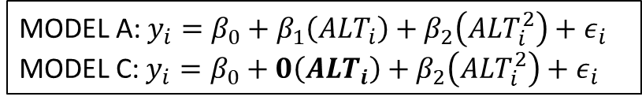
Which models are being compared?
lm(formula = decrease ~ alt_km + alt_km_sq, data = dat)
Residuals:
Min 1Q Median 3Q Max
-9.3091 -2.4191 0.9296 2.4161 7.0271
Coefficients:
Estimate Std. Error t value Pr(>|t|)
(Intercept) -2.2708 1.5327 -1.482 0.1415
alt_km -0.6921 1.0994 -0.630 0.5304
alt_km_sq -0.4532 0.1766 -2.567 0.0117 *
---
Signif. codes: 0 ‘***’ 0.001 ‘**’ 0.01 ‘*’ 0.05 ‘.’ 0.1 ‘ ’ 1
Residual standard error: 3.687 on 102 degrees of freedom
Multiple R-squared: 0.6491, Adjusted R-squared: 0.6422
F-statistic: 94.35 on 2 and 102 DF, p-value: < 2.2e-16
MODEL A: $y_{i}=β_{0}+β_{1}\left(ALT_{i}\right)+β_{2}\left(ALT_{i}^{2}\right)+ε_{i}$
MODEL C: $y_{i}=β_{0}+0\left(ALT_{i}\right)+β_{2}\left(ALT_{i}^{2}\right)+ε_{i}$
MODEL A: $y_{i}=β_{0}+β_{1}\left(ALT_{i}\right)+β_{2}\left(ALT_{i}^{2}\right)+ε_{i}$
MODEL C: $y_{i}=β_{0}+β_{1}\left(ALT_{i}\right)+0\left(ALT_{i}^{2}\right)+ε_{i}$
MODEL A: $y_{i}=β_{0}+β_{1}\left(ALT_{i}\right)+β_{2}\left(ALT_{i}^{2}\right)+ε_{i}$
MODEL C: $y_{i}=β_{0}+ε_{i}$

Slide 12
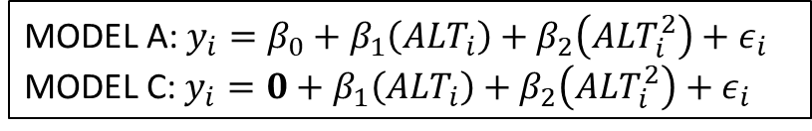
Which models are being compared?
lm(formula = decrease ~ alt_km + alt_km_sq, data = dat)
Residuals:
Min 1Q Median 3Q Max
-9.3091 -2.4191 0.9296 2.4161 7.0271
Coefficients:
Estimate Std. Error t value Pr(>|t|)
(Intercept) -2.2708 1.5327 -1.482 0.1415
alt_km -0.6921 1.0994 -0.630 0.5304
alt_km_sq -0.4532 0.1766 -2.567 0.0117 *
---
Signif. codes: 0 ‘***’ 0.001 ‘**’ 0.01 ‘*’ 0.05 ‘.’ 0.1 ‘ ’ 1
Residual standard error: 3.687 on 102 degrees of freedom
Multiple R-squared: 0.6491, Adjusted R-squared: 0.6422
F-statistic: 94.35 on 2 and 102 DF, p-value: < 2.2e-16
MODEL A: $y_{i}=β_{0}+β_{1}\left(ALT_{i}\right)+β_{2}\left(ALT_{i}^{2}\right)+ε_{i}$
MODEL C: $y_{i}=0+β_{1}\left(ALT_{i}\right)+β_{2}\left(ALT_{i}^{2}\right)+ε_{i}$
MODEL A: $y_{i}=β_{0}+β_{1}\left(ALT_{i}\right)+β_{2}\left(ALT_{i}^{2}\right)+ε_{i}$
MODEL C: $y_{i}=β_{0}+0\left(ALT_{i}\right)+β_{2}\left(ALT_{i}^{2}\right)+ε_{i}$
MODEL A: $y_{i}=β_{0}+β_{1}\left(ALT_{i}\right)+β_{2}\left(ALT_{i}^{2}\right)+ε_{i}$
MODEL C: $y_{i}=β_{0}+β_{1}\left(ALT_{i}\right)+0\left(ALT_{i}^{2}\right)+ε_{i}$
MODEL A: $y_{i}=β_{0}+β_{1}\left(ALT_{i}\right)+β_{2}\left(ALT_{i}^{2}\right)+ε_{i}$
MODEL C: $y_{i}=β_{0}+ε_{i}$

Slide 13
How do we interpret the parameters?
$$y_{i}=−2.2708−0.6921\left(ALT_{i}\right)−0.4532\left(ALT_{i}^{2}\right)+e_{i}$$
lm(formula = decrease ~ alt_km + alt_km_sq, data = dat)
Residuals:
Min 1Q Median 3Q Max
-9.3091 -2.4191 0.9296 2.4161 7.0271
Coefficients:
Estimate Std. Error t value Pr(>|t|)
(Intercept) -2.2708 1.5327 -1.482 0.1415
alt_km -0.6921 1.0994 -0.630 0.5304
alt_km_sq -0.4532 0.1766 -2.567 0.0117 *
---
Signif. codes: 0 ‘***’ 0.001 ‘**’ 0.01 ‘*’ 0.05 ‘.’ 0.1 ‘ ’ 1
Residual standard error: 3.687 on 102 degrees of freedom
Multiple R-squared: 0.6491, Adjusted R-squared: 0.6422
F-statistic: 94.35 on 2 and 102 DF, p-value: < 2.2e-16

Slide 14

How do we interpret the parameters?
$$y_{i}=−2.2708−0.6921\left(ALT_{i}\right)−0.4532\left(ALT_{i}^{2}\right)+e_{i}$$
$$y_{i}=−2.2708−0.6921\left(0\right)−0.4532\left(0\right)+e_{i}$$
$$y_{i}=−2.2708+e_{i}$$

Slide 15

How do we interpret the parameters?
$$y_{i}=−2.2708−0.6921\left(ALT_{i}\right)−0.4532\left(ALT_{i}^{2}\right)+e_{i}$$
$$y_{i}=−2.2708−0.6921\left(2\right)−0.4532\left(4\right)+e_{i}$$
$$y_{i}=−5.4678+e_{i}$$

Slide 16

How do we interpret the parameters?
$$y_{i}=−2.2708−0.6921\left(ALT_{i}\right)−0.4532\left(ALT_{i}^{2}\right)+e_{i}$$
$$y_{i}=−2.2708−0.6921\left(4\right)−0.4532\left(16\right)+e_{i}$$
$$y_{i}=−12.2904+e_{i}$$

Slide 17
ANOVA table for the full model
Source | SSE | Df | MSE | F_obs | Pr(>F_obs)
Intercept | 29.84 | 1 | 29.84 | 2.195 | 0.141
Alt (km) | 5.39 | 1 | 5.39 | 0.396 | 0.530
Alt^2 (km^2) | 89.59 | 1 | 89.59 | 6.589 | 0.012
Residuals | 1386.74 | 102 | 13.59
Total | 1511.56 | 104

