Slide 1
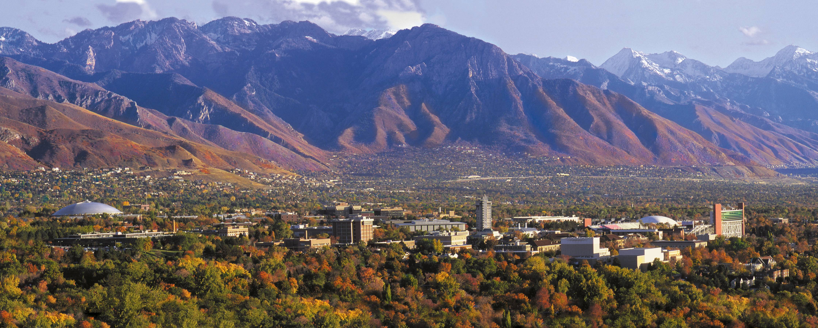



Models with a Single Categorical Predictor (Independent t-test).
Keith Lohse, PhD
Assistant Professor
Department of Health, Kinesiology, and Recreation
Department of Physical Therapy and Athletic Training
University of Utah
keith.lohse@health.utah.edu
@keith_lohse

Slide 2
Categorical Predictors
Thus far, we have looked at the relationships between continuous predictor variables (X’s) and continuous outcome variables (Y’s).
Now, we will shift our focus to categorical predictors (X’s) and continuous outcome variables (Y’s).
Categorical predictors can be “natural” groupings (e.g., a cohort study) or could be experimental groupings (e.g., a randomized controlled trial).
Categorical variables can also be “made” by breaking continuous variables into groups. However, breaking a continuous variable into a categorical variable is generally a bad practice and has a negative effect on statistical power.

Slide 3
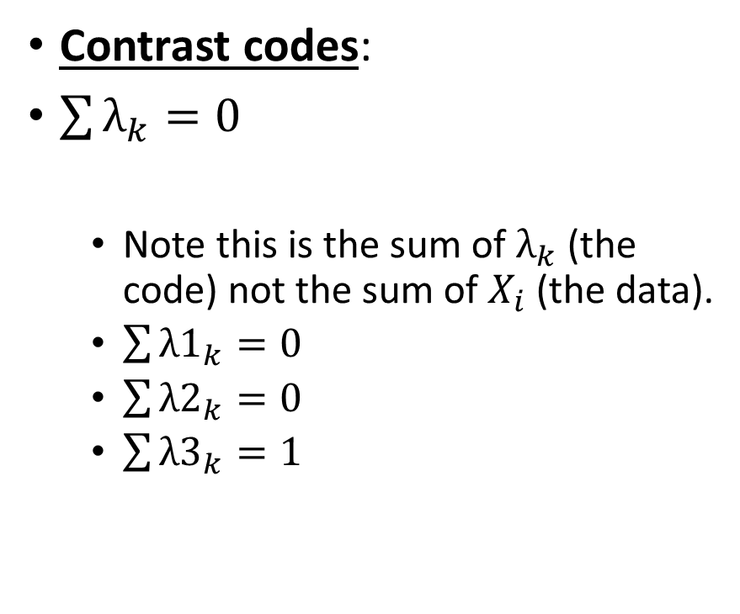
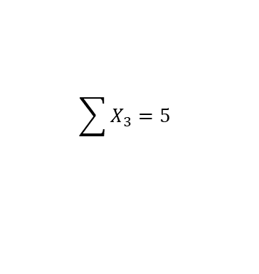
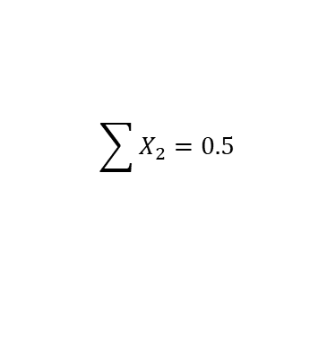
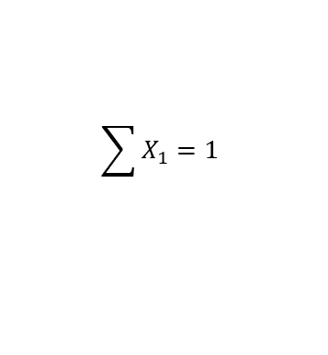
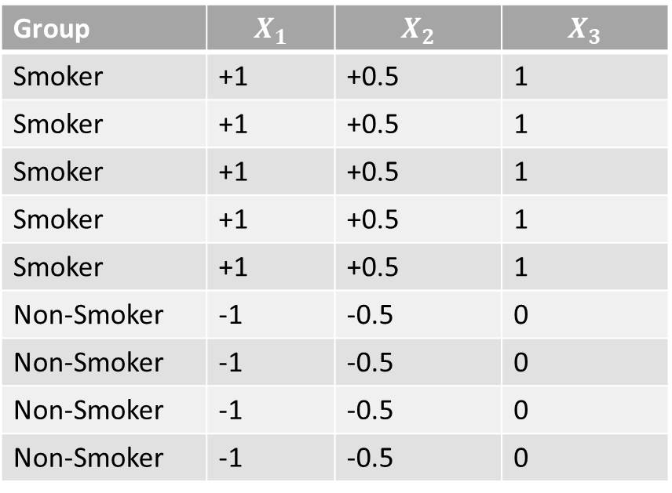
How do we represent a categorical variable?
Contrast codes:
$\sum{λ_{k}=0}$
Note this is the sum of $λ_{k}$(the code) not the sum of $X_{i}$ (the data).
$\sum{{λ1}_{k}=0}$
$\sum{{λ2}_{k}=0}$
$\sum{{λ3}_{k}=1}$
Group | $$X_{1}$$ | $$X_{2}$$ | $$X_{3}$$
Smoker | +1 | +0.5 | 1
Smoker | +1 | +0.5 | 1
Smoker | +1 | +0.5 | 1
Smoker | +1 | +0.5 | 1
Smoker | +1 | +0.5 | 1
Non-Smoker | -1 | -0.5 | 0
Non-Smoker | -1 | -0.5 | 0
Non-Smoker | -1 | -0.5 | 0
Non-Smoker | -1 | -0.5 | 0
$$\sum{X_{1}=1}$$
$$\sum{X_{2}=0.5}$$
$$\sum{X_{3}=5}$$

Slide 4
How do we represent a categorical variable?
Contrast codes: the levels of our code sum to zero.
Equivalent to mean-centering of continuous variables.
Treatment/ ‘Dummy’ codes: levels of the code do not sum to zero. One group is coded as zero across all levels of the code.
Analogous to having an interpretable 0 in your continuous variable.
Group | $$X_{1}$$ | $$X_{2}$$ | $$X_{3}$$
Smoker | +1 | +0.5 | 1
Smoker | +1 | +0.5 | 1
Smoker | +1 | +0.5 | 1
Smoker | +1 | +0.5 | 1
Smoker | +1 | +0.5 | 1
Non-Smoker | -1 | -0.5 | 0
Non-Smoker | -1 | -0.5 | 0
Non-Smoker | -1 | -0.5 | 0
Non-Smoker | -1 | -0.5 | 0

Slide 5

Using Contrast Codes in Practice
Student | Group | SAT
1 | Course | 580
2 | Course | 560
3 | Course | 660
4 | Course | 620
5 | Course | 600
6 | Course | 580
7 | Course | 590
8 | Course | 640
9 | Course | 620
10 | Course | 600
11 | No Course | 580
12 | No Course | 530
13 | No Course | 590
14 | No Course | 550
15 | No Course | 610
16 | No Course | 590
17 | No Course | 600
18 | No Course | 530
19 | No Course | 590
20 | No Course | 600
If we want to test the efficacy of an SAT prep course, we would have a model comparison:
A: $y_{i}=β_{0}+β_{1}\left(X_{1i}\right)+ε_{i}$
C: $y_{i}=β_{0}+ε_{i}$

Slide 6
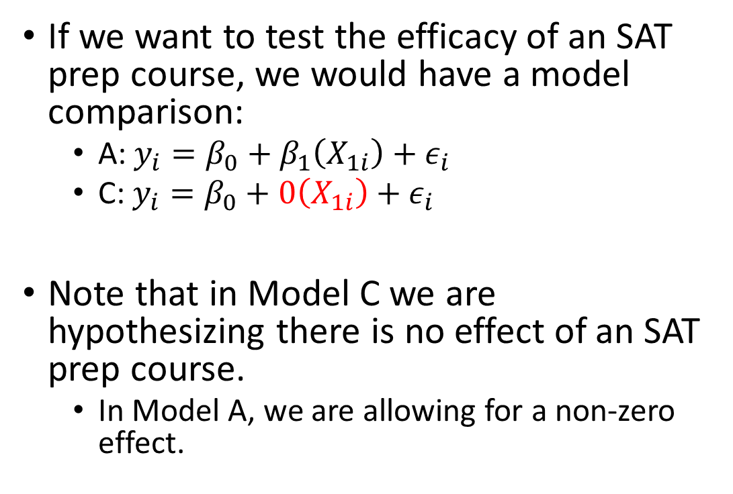
Using Contrast Codes in Practice
Student | Group | SAT
1 | Course | 580
2 | Course | 560
3 | Course | 660
4 | Course | 620
5 | Course | 600
6 | Course | 580
7 | Course | 590
8 | Course | 640
9 | Course | 620
10 | Course | 600
11 | No Course | 580
12 | No Course | 530
13 | No Course | 590
14 | No Course | 550
15 | No Course | 610
16 | No Course | 590
17 | No Course | 600
18 | No Course | 530
19 | No Course | 590
20 | No Course | 600
If we want to test the efficacy of an SAT prep course, we would have a model comparison:
A: $y_{i}=β_{0}+β_{1}\left(X_{1i}\right)+ε_{i}$
C: $y_{i}=β_{0}+0\left(X_{1i}\right)+ε_{i}$
Note that in Model C we are hypothesizing there is no effect of an SAT prep course.
In Model A, we are allowing for a non-zero effect.

Slide 7
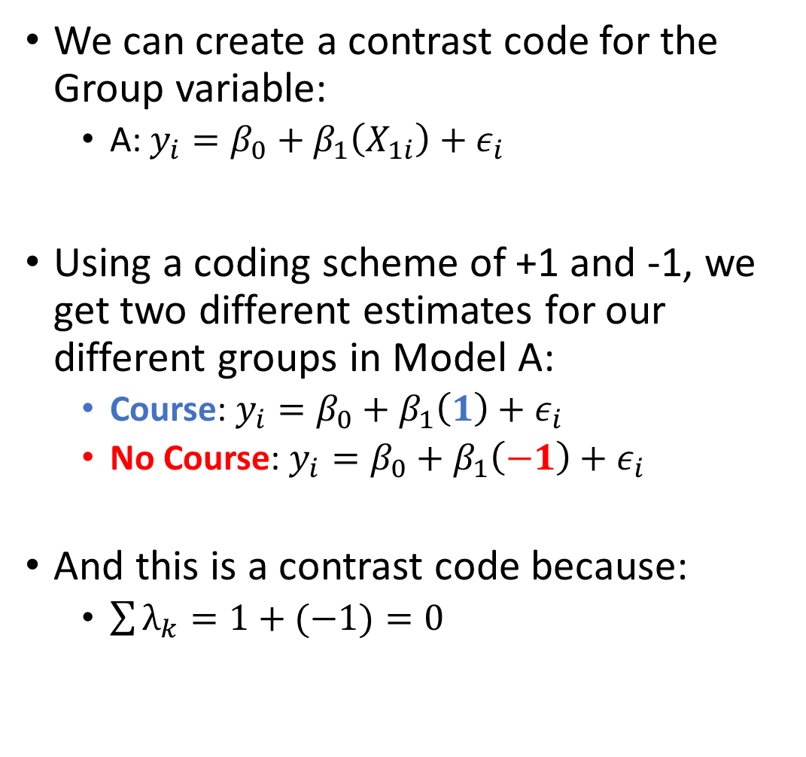
Using Contrast Codes in Practice
Student | Group | SAT | X₁
1 | Course | 580 | 1
2 | Course | 560 | 1
3 | Course | 660 | 1
4 | Course | 620 | 1
5 | Course | 600 | 1
6 | Course | 580 | 1
7 | Course | 590 | 1
8 | Course | 640 | 1
9 | Course | 620 | 1
10 | Course | 600 | 1
11 | No Course | 580 | -1
12 | No Course | 530 | -1
13 | No Course | 590 | -1
14 | No Course | 550 | -1
15 | No Course | 610 | -1
16 | No Course | 590 | -1
17 | No Course | 600 | -1
18 | No Course | 530 | -1
19 | No Course | 590 | -1
20 | No Course | 600 | -1
We can create a contrast code for the Group variable:
A: $y_{i}=β_{0}+β_{1}\left(X_{1i}\right)+ε_{i}$
Using a coding scheme of +1 and -1, we get two different estimates for our different groups in Model A:
Course: $y_{i}=β_{0}+β_{1}\left(1\right)+ε_{i}$
No Course: $y_{i}=β_{0}+β_{1}\left(−1\right)+ε_{i}$
And this is a contrast code because:
$\sum{λ_{k}=1+(−1)}=0$

Slide 8
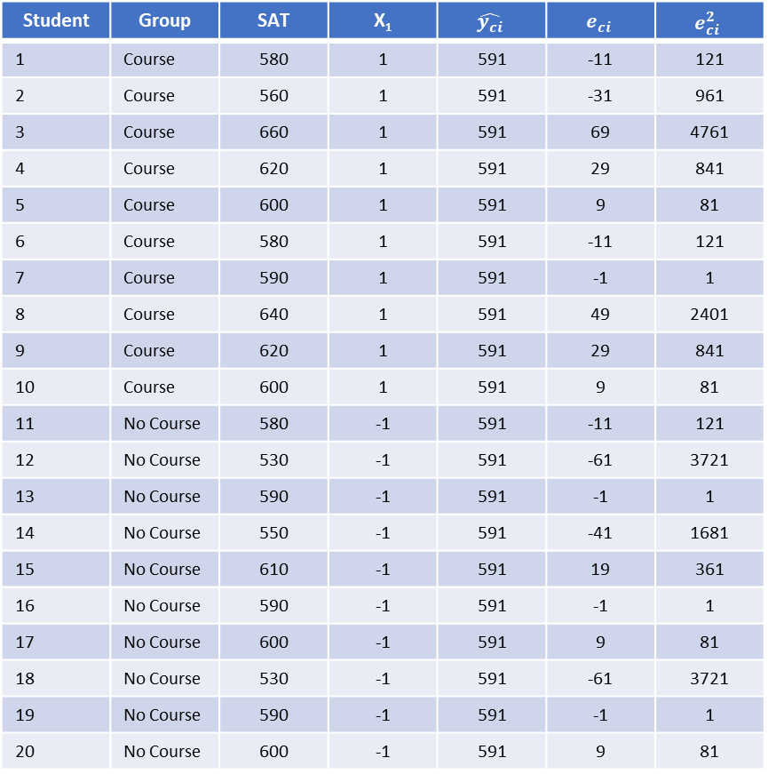

Error and ‘Fitting’ Model C
Student | Group | SAT | X₁ | $$\hat{y_{ci}}$$ | $$e_{ci}$$ | $$e_{ci}^{2}$$
1 | Course | 580 | 1 | 591 | -11 | 121
2 | Course | 560 | 1 | 591 | -31 | 961
3 | Course | 660 | 1 | 591 | 69 | 4761
4 | Course | 620 | 1 | 591 | 29 | 841
5 | Course | 600 | 1 | 591 | 9 | 81
6 | Course | 580 | 1 | 591 | -11 | 121
7 | Course | 590 | 1 | 591 | -1 | 1
8 | Course | 640 | 1 | 591 | 49 | 2401
9 | Course | 620 | 1 | 591 | 29 | 841
10 | Course | 600 | 1 | 591 | 9 | 81
11 | No Course | 580 | -1 | 591 | -11 | 121
12 | No Course | 530 | -1 | 591 | -61 | 3721
13 | No Course | 590 | -1 | 591 | -1 | 1
14 | No Course | 550 | -1 | 591 | -41 | 1681
15 | No Course | 610 | -1 | 591 | 19 | 361
16 | No Course | 590 | -1 | 591 | -1 | 1
17 | No Course | 600 | -1 | 591 | 9 | 81
18 | No Course | 530 | -1 | 591 | -61 | 3721
19 | No Course | 590 | -1 | 591 | -1 | 1
20 | No Course | 600 | -1 | 591 | 9 | 81
C: $y_{i}=β_{0}+ε_{i}$
C: $y_{i}=591+e_{i}$
$SSE\left(C\right)=\sum{{\left(y_{i}−\hat{y_{ci}}\right)}^{2}=}\sum{{\left(e_{ci}\right)}^{2}}$
$SSE\left(C\right)=19,980$

Slide 9
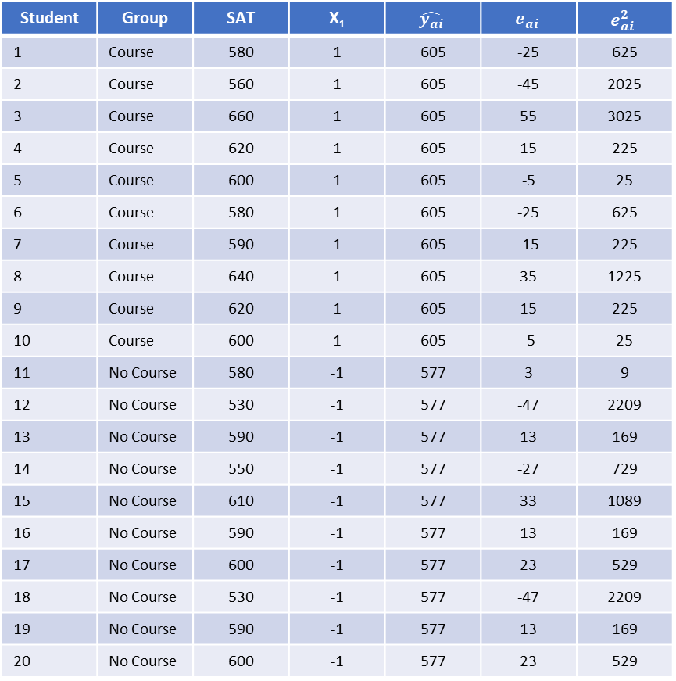

Error and ‘Fitting’ Model A
Student | Group | SAT | X₁ | $$\hat{y_{ai}}$$ | $$e_{ai}$$ | $$e_{ai}^{2}$$
1 | Course | 580 | 1 | 605 | -25 | 625
2 | Course | 560 | 1 | 605 | -45 | 2025
3 | Course | 660 | 1 | 605 | 55 | 3025
4 | Course | 620 | 1 | 605 | 15 | 225
5 | Course | 600 | 1 | 605 | -5 | 25
6 | Course | 580 | 1 | 605 | -25 | 625
7 | Course | 590 | 1 | 605 | -15 | 225
8 | Course | 640 | 1 | 605 | 35 | 1225
9 | Course | 620 | 1 | 605 | 15 | 225
10 | Course | 600 | 1 | 605 | -5 | 25
11 | No Course | 580 | -1 | 577 | 3 | 9
12 | No Course | 530 | -1 | 577 | -47 | 2209
13 | No Course | 590 | -1 | 577 | 13 | 169
14 | No Course | 550 | -1 | 577 | -27 | 729
15 | No Course | 610 | -1 | 577 | 33 | 1089
16 | No Course | 590 | -1 | 577 | 13 | 169
17 | No Course | 600 | -1 | 577 | 23 | 529
18 | No Course | 530 | -1 | 577 | -47 | 2209
19 | No Course | 590 | -1 | 577 | 13 | 169
20 | No Course | 600 | -1 | 577 | 23 | 529
A: $y_{i}=β_{0}+β_{1}(X_{1})ε_{i}$
A: $y_{i}=591+14\left(X_{1}\right)+e_{i}$
$SSE\left(A\right)=\sum{{\left(y_{i}−\hat{y_{ai}}\right)}^{2}=}\sum{{\left(e_{ai}\right)}^{2}}$
$SSE\left(A\right)=16,060$

Slide 10
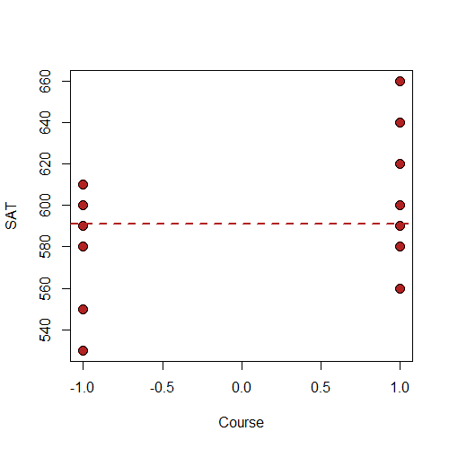
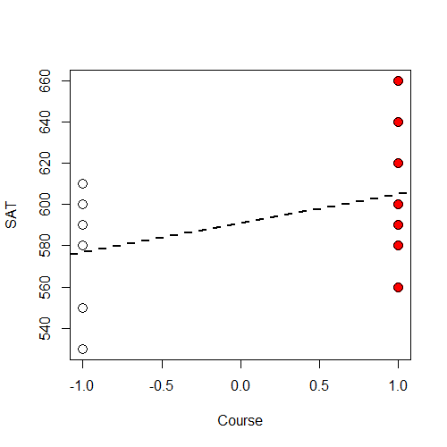


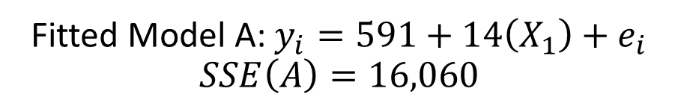
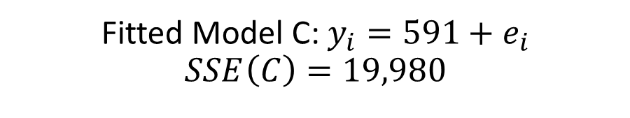
Comparing the Two Models
Fitted Model C: $y_{i}=591+e_{i}$
$$SSE\left(C\right)=19,980$$
Fitted Model A: $y_{i}=591+14\left(X_{1}\right)+e_{i}$
$$SSE\left(A\right)=16,060$$
$$X_{1}=−1$$
$$X_{1}=1$$

Slide 11
ANOVA Table Testing the Null Hypothesis
Source | SSE | Df | MSE | F_obs | Pr(>F_obs)
Regression | 3,920.00 | 1 | 3,920.00 | 4.39 | 0.0505
Error | 16,060.00 | 18 | 892.22
Total | 19,980.00 | 19

Slide 12
Statistical Summary from R
lm(formula = SAT ~ Course, data = DATA)
Residuals:
Min 1Q Median 3Q Max
-47 -25 8 17 55
Coefficients:
Estimate Std. Error t value Pr(>|t|)
(Intercept) 591.000 6.679 88.484 <2e-16 ***
Course 14.000 6.679 2.096 0.0505 .
---
Signif. codes: 0 ‘***’ 0.001 ‘**’ 0.01 ‘*’ 0.05 ‘.’ 0.1 ‘ ’ 1
Residual standard error: 29.87 on 18 degrees of freedom
Multiple R-squared: 0.1962, Adjusted R-squared: 0.1515
F-statistic: 4.394 on 1 and 18 DF, p-value: 0.05048

Slide 13
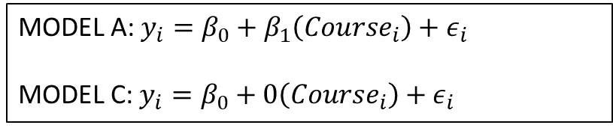
Statistical Summary from R
lm(formula = SAT ~ Course, data = DATA)
Residuals:
Min 1Q Median 3Q Max
-47 -25 8 17 55
Coefficients:
Estimate Std. Error t value Pr(>|t|)
(Intercept) 591.000 6.679 88.484 <2e-16 ***
Course 14.000 6.679 2.096 0.0505 .
---
Signif. codes: 0 ‘***’ 0.001 ‘**’ 0.01 ‘*’ 0.05 ‘.’ 0.1 ‘ ’ 1
Residual standard error: 29.87 on 18 degrees of freedom
Multiple R-squared: 0.1962, Adjusted R-squared: 0.1515
F-statistic: 4.394 on 1 and 18 DF, p-value: 0.05048
MODEL A: $y_{i}=β_{0}+β_{1}\left(Course_{i}\right)+ε_{i}$
MODEL C: $y_{i}=β_{0}+0\left(Course_{i}\right)+ε_{i}$

Slide 14
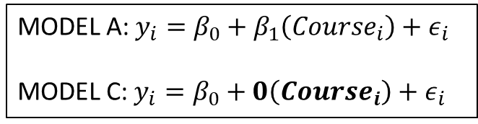
Statistical Summary from R
lm(formula = SAT ~ Course, data = DATA)
Residuals:
Min 1Q Median 3Q Max
-47 -25 8 17 55
Coefficients:
Estimate Std. Error t value Pr(>|t|)
(Intercept) 591.000 6.679 88.484 <2e-16 ***
Course 14.000 6.679 2.096 0.0505 .
---
Signif. codes: 0 ‘***’ 0.001 ‘**’ 0.01 ‘*’ 0.05 ‘.’ 0.1 ‘ ’ 1
Residual standard error: 29.87 on 18 degrees of freedom
Multiple R-squared: 0.1962, Adjusted R-squared: 0.1515
F-statistic: 4.394 on 1 and 18 DF, p-value: 0.05048
MODEL A: $y_{i}=β_{0}+β_{1}\left(Course_{i}\right)+ε_{i}$
MODEL C: $y_{i}=β_{0}+0\left(Course_{i}\right)+ε_{i}$
MODEL A: $y_{i}=β_{0}+β_{1}\left(Course_{i}\right)+ε_{i}$
MODEL C: $y_{i}=β_{0}+0\left(Course_{i}\right)+ε_{i}$

Slide 15
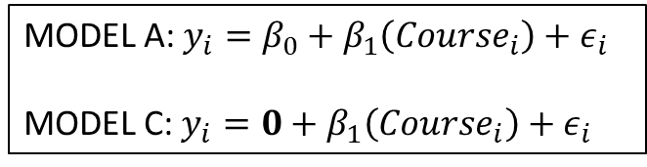
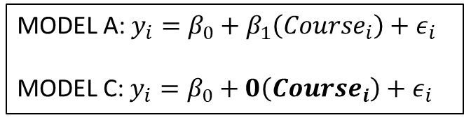
Statistical Summary from R
lm(formula = SAT ~ Course, data = DATA)
Residuals:
Min 1Q Median 3Q Max
-47 -25 8 17 55
Coefficients:
Estimate Std. Error t value Pr(>|t|)
(Intercept) 591.000 6.679 88.484 <2e-16 ***
Course 14.000 6.679 2.096 0.0505 .
---
Signif. codes: 0 ‘***’ 0.001 ‘**’ 0.01 ‘*’ 0.05 ‘.’ 0.1 ‘ ’ 1
Residual standard error: 29.87 on 18 degrees of freedom
Multiple R-squared: 0.1962, Adjusted R-squared: 0.1515
F-statistic: 4.394 on 1 and 18 DF, p-value: 0.05048
MODEL A: $y_{i}=β_{0}+β_{1}\left(Course_{i}\right)+ε_{i}$
MODEL C: $y_{i}=0+β_{1}\left(Course_{i}\right)+ε_{i}$
MODEL A: $y_{i}=β_{0}+β_{1}\left(Course_{i}\right)+ε_{i}$
MODEL C: $y_{i}=β_{0}+0\left(Course_{i}\right)+ε_{i}$
MODEL A: $y_{i}=β_{0}+β_{1}\left(Course_{i}\right)+ε_{i}$
MODEL C: $y_{i}=β_{0}+0\left(Course_{i}\right)+ε_{i}$

Slide 16
But how do we get those estimates?
At the moment, we have let the statistical program calculate the estimate of the intercept and the estimate of the slope for us.
These are the best fitting intercepts and slopes in our sample, but they are estimates of the true effects in the population.
In the next lecture, we will walk through this process in detail, but these estimates are still based on least-squared error estimation that we have done before.

