Slide 1




Estimating Coefficients with Contrast-Coded Predictors.
Keith Lohse, PhD
Assistant Professor
Department of Health, Kinesiology, and Recreation
Department of Physical Therapy and Athletic Training
University of Utah
keith.lohse@health.utah.edu
@keith_lohse

Slide 2
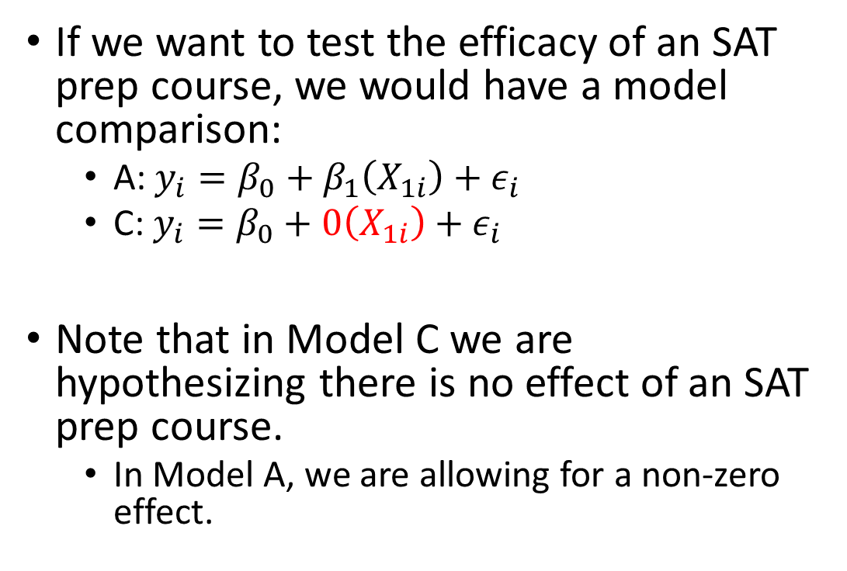
Using Contrast Codes in Practice
Student | Group | SAT
1 | Course | 580
2 | Course | 560
3 | Course | 660
4 | Course | 620
5 | Course | 600
6 | Course | 580
7 | Course | 590
8 | Course | 640
9 | Course | 620
10 | Course | 600
11 | No Course | 580
12 | No Course | 530
13 | No Course | 590
14 | No Course | 550
15 | No Course | 610
16 | No Course | 590
17 | No Course | 600
18 | No Course | 530
19 | No Course | 590
20 | No Course | 600
If we want to test the efficacy of an SAT prep course, we would have a model comparison:
A: $y_{i}=β_{0}+β_{1}\left(X_{1i}\right)+ε_{i}$
C: $y_{i}=β_{0}+0\left(X_{1i}\right)+ε_{i}$
Note that in Model C we are hypothesizing there is no effect of an SAT prep course.
In Model A, we are allowing for a non-zero effect.

Slide 3
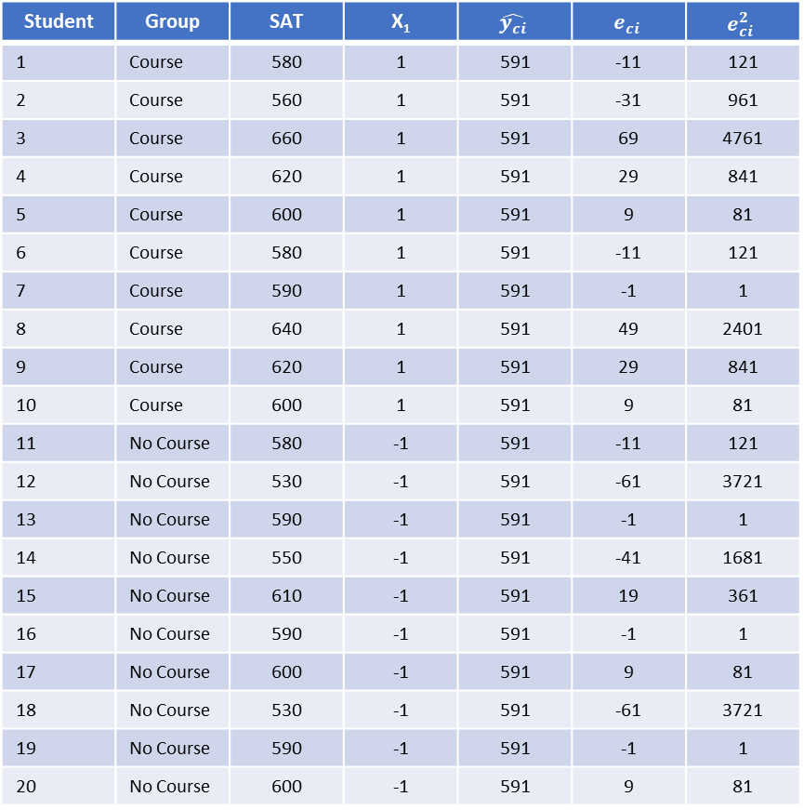
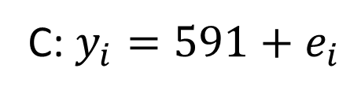
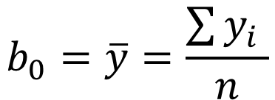
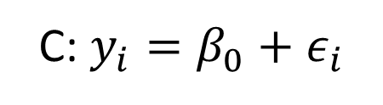
Error and ‘Fitting’ Model C
Student | Group | SAT | X₁ | $$\hat{y_{ci}}$$ | $$e_{ci}$$ | $$e_{ci}^{2}$$
1 | Course | 580 | 1 | 591 | -11 | 121
2 | Course | 560 | 1 | 591 | -31 | 961
3 | Course | 660 | 1 | 591 | 69 | 4761
4 | Course | 620 | 1 | 591 | 29 | 841
5 | Course | 600 | 1 | 591 | 9 | 81
6 | Course | 580 | 1 | 591 | -11 | 121
7 | Course | 590 | 1 | 591 | -1 | 1
8 | Course | 640 | 1 | 591 | 49 | 2401
9 | Course | 620 | 1 | 591 | 29 | 841
10 | Course | 600 | 1 | 591 | 9 | 81
11 | No Course | 580 | -1 | 591 | -11 | 121
12 | No Course | 530 | -1 | 591 | -61 | 3721
13 | No Course | 590 | -1 | 591 | -1 | 1
14 | No Course | 550 | -1 | 591 | -41 | 1681
15 | No Course | 610 | -1 | 591 | 19 | 361
16 | No Course | 590 | -1 | 591 | -1 | 1
17 | No Course | 600 | -1 | 591 | 9 | 81
18 | No Course | 530 | -1 | 591 | -61 | 3721
19 | No Course | 590 | -1 | 591 | -1 | 1
20 | No Course | 600 | -1 | 591 | 9 | 81
C: $y_{i}=β_{0}+ε_{i}$
$$b_{0}=\overline{y}=\frac{\sum{y_{i}} }{n}$$
C: $y_{i}=591+e_{i}$

Slide 4
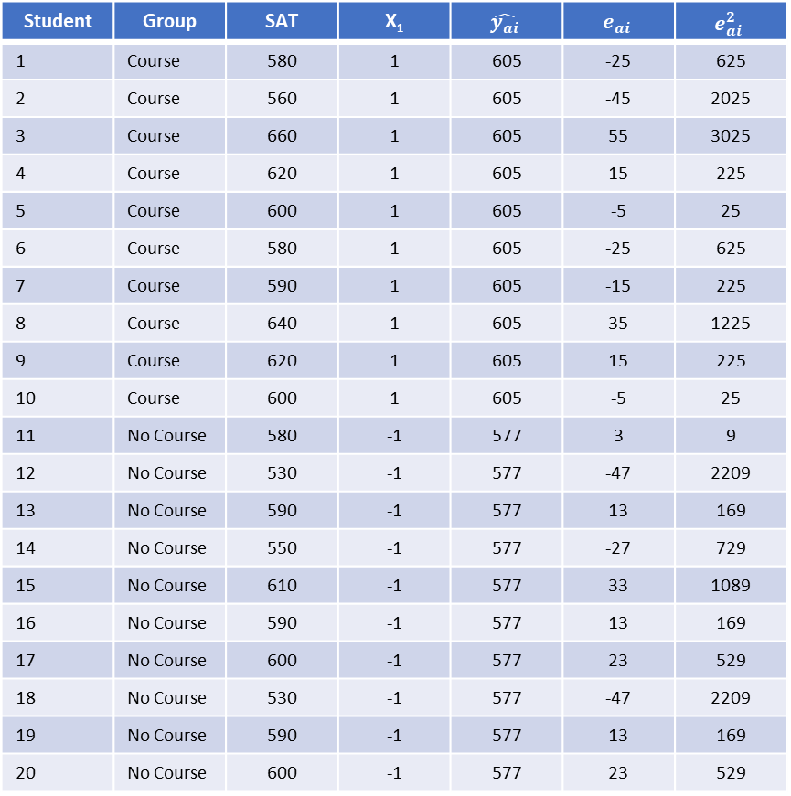
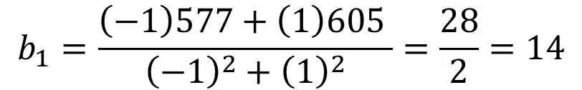
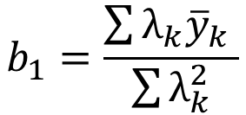
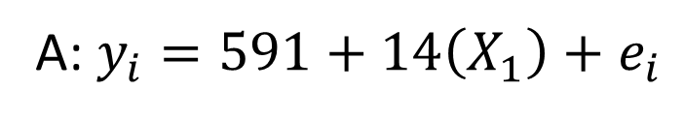
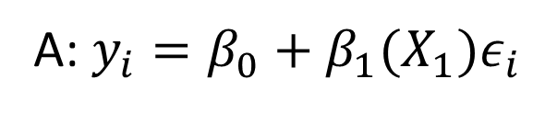
Error and ‘Fitting’ Model A
Student | Group | SAT | X₁ | $$\hat{y_{ai}}$$ | $$e_{ai}$$ | $$e_{ai}^{2}$$
1 | Course | 580 | 1 | 605 | -25 | 625
2 | Course | 560 | 1 | 605 | -45 | 2025
3 | Course | 660 | 1 | 605 | 55 | 3025
4 | Course | 620 | 1 | 605 | 15 | 225
5 | Course | 600 | 1 | 605 | -5 | 25
6 | Course | 580 | 1 | 605 | -25 | 625
7 | Course | 590 | 1 | 605 | -15 | 225
8 | Course | 640 | 1 | 605 | 35 | 1225
9 | Course | 620 | 1 | 605 | 15 | 225
10 | Course | 600 | 1 | 605 | -5 | 25
11 | No Course | 580 | -1 | 577 | 3 | 9
12 | No Course | 530 | -1 | 577 | -47 | 2209
13 | No Course | 590 | -1 | 577 | 13 | 169
14 | No Course | 550 | -1 | 577 | -27 | 729
15 | No Course | 610 | -1 | 577 | 33 | 1089
16 | No Course | 590 | -1 | 577 | 13 | 169
17 | No Course | 600 | -1 | 577 | 23 | 529
18 | No Course | 530 | -1 | 577 | -47 | 2209
19 | No Course | 590 | -1 | 577 | 13 | 169
20 | No Course | 600 | -1 | 577 | 23 | 529
A: $y_{i}=β_{0}+β_{1}(X_{1})ε_{i}$
$$b_{1}=\frac{\sum{λ_{k}{\overline{y}}_{k}} }{\sum{λ_{k}^{2}}}$$
$$b_{1}=\frac{\left(−1\right)577+\left(1\right)605 }{{\left(−1\right)}^{2}+{\left(1\right)}^{2}}=\frac{28}{2}=14$$
A: $y_{i}=591+14\left(X_{1}\right)+e_{i}$

Slide 5
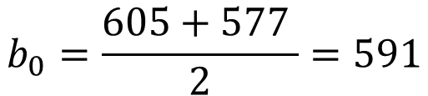
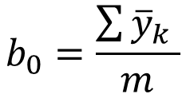
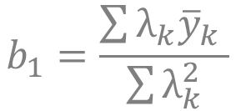
Error and ‘Fitting’ Model A
Student | Group | SAT | X₁ | $$\hat{y_{ai}}$$ | $$e_{ai}$$ | $$e_{ai}^{2}$$
1 | Course | 580 | 1 | 605 | -25 | 625
2 | Course | 560 | 1 | 605 | -45 | 2025
3 | Course | 660 | 1 | 605 | 55 | 3025
4 | Course | 620 | 1 | 605 | 15 | 225
5 | Course | 600 | 1 | 605 | -5 | 25
6 | Course | 580 | 1 | 605 | -25 | 625
7 | Course | 590 | 1 | 605 | -15 | 225
8 | Course | 640 | 1 | 605 | 35 | 1225
9 | Course | 620 | 1 | 605 | 15 | 225
10 | Course | 600 | 1 | 605 | -5 | 25
11 | No Course | 580 | -1 | 577 | 3 | 9
12 | No Course | 530 | -1 | 577 | -47 | 2209
13 | No Course | 590 | -1 | 577 | 13 | 169
14 | No Course | 550 | -1 | 577 | -27 | 729
15 | No Course | 610 | -1 | 577 | 33 | 1089
16 | No Course | 590 | -1 | 577 | 13 | 169
17 | No Course | 600 | -1 | 577 | 23 | 529
18 | No Course | 530 | -1 | 577 | -47 | 2209
19 | No Course | 590 | -1 | 577 | 13 | 169
20 | No Course | 600 | -1 | 577 | 23 | 529
A: $y_{i}=β_{0}+β_{1}(X_{1})ε_{i}$
$$b_{0}=\frac{\sum{{\overline{y}}_{k}} }{m}$$
$$b_{1}=\frac{\sum{λ_{k}{\overline{y}}_{k}} }{\sum{λ_{k}^{2}}}$$
$$b_{0}=\frac{605+577 }{2}=591$$
A: $y_{i}=591+14\left(X_{1}\right)+e_{i}$

Slide 6
Least Squares Estimates for Categorical Predictors
In practice, we get statistical programs to obtain these parameters estimates for us.
However, it is important to understand how these parameter estimates are obtained and how we should interpret them based on the coding of our variables.
Treatment/ ‘dummy’-codes are certainly valid, but contrast-codes offer a number of computational and interpretational advantages.

Slide 7
A t-test versus “the t-test”?
Often, especially in undergraduate courses, ‘ the t-test’ might be taught as a specific test *only* for comparing two group-means.
Either implicitly or explicitly, students learn that t-tests are some thing different and distinct from regression.
In the general linear modeling framework, however, we have shown that we can conduct a t-test in any situation in which we have a single degree of freedom in the numerator (i.e., PA – PC = 1).
We can conduct a t-test for an intercept,
for the slope of a continuous variable,
for the slope of a categorical variable (i.e., difference between group-means).

