Slide 1
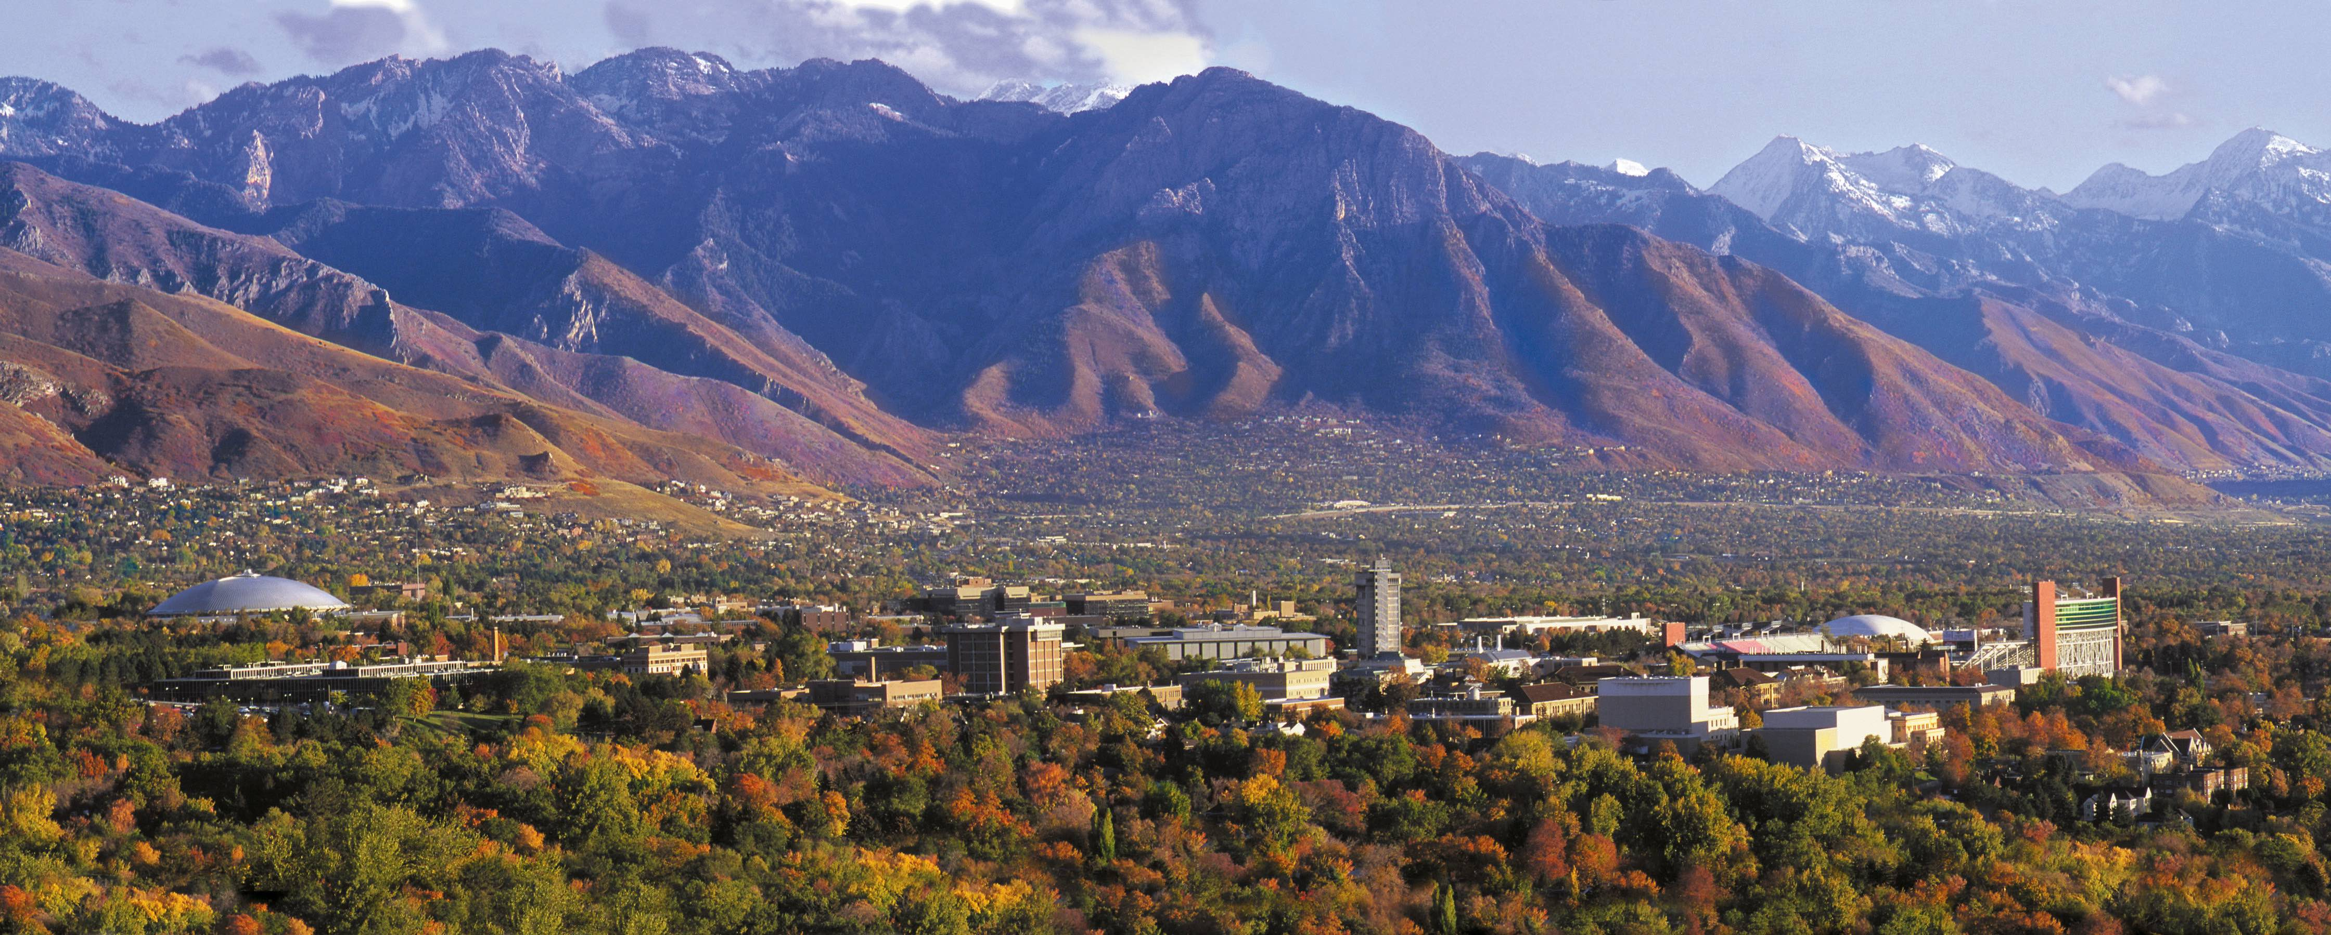



Models with a Single Categorical Predictor (One-Way ANOVA).
Keith Lohse, PhD
Assistant Professor
Department of Health, Kinesiology, and Recreation
Department of Physical Therapy and Athletic Training
University of Utah
keith.lohse@health.utah.edu
@keith_lohse

Slide 2
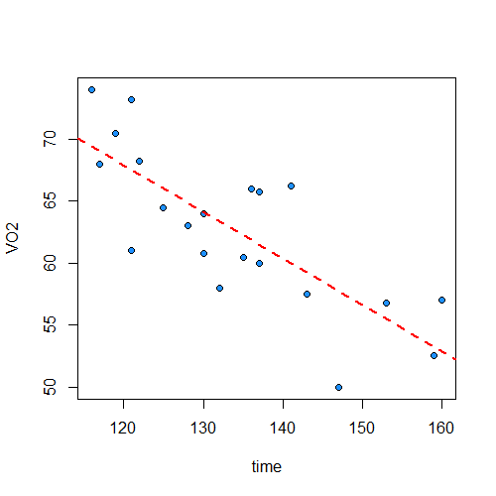
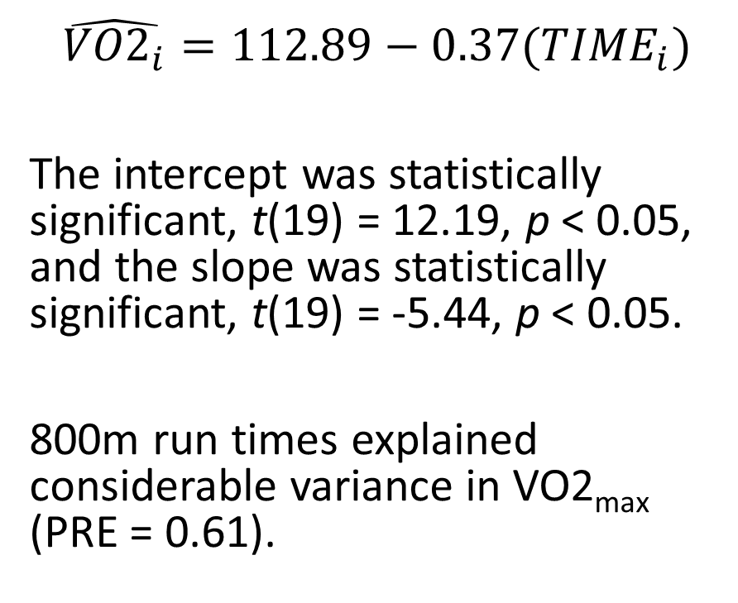
Relationship between VO2_{max} and 800 meter times.
$$\hat{{VO2}_{i}}=112.89−0.37({TIME}_{i})$$
The intercept was statistically significant, t(19) = 12.19, p < 0.05, and the slope was statistically significant, t(19) = -5.44, p < 0.05.
800m run times explained considerable variance in VO2_{max} (PRE = 0.61).

Slide 3
Relationship between VO2_{max} and 800 meter times.
sudID VO2 time faster
1 s001 74.00 116 1
2 s002 68.00 117 1
3 s003 70.50 119 1
4 s004 61.00 121 1
5 s005 73.25 121 1
6 s006 68.25 122 1
7 s007 64.50 125 1
8 s008 63.00 128 1
9 s009 60.75 130 1
10 s010 64.00 130 1
11 s011 58.00 132 1
12 s012 60.50 135 0
13 s013 66.00 136 0
14 s014 60.00 137 0
15 s015 65.75 137 0
16 s016 66.25 141 0
17 s017 57.50 143 0
18 s018 50.00 147 0
19 s019 56.75 153 0
20 s020 52.50 159 0
21 s021 57.00 160 0
But what if we had groups of runners (faster versus slower) rather than continuous run times?
Our continuous variable becomes discrete and categorical.

Slide 4
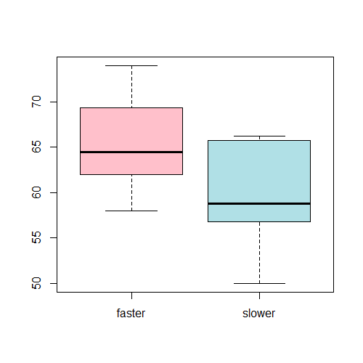
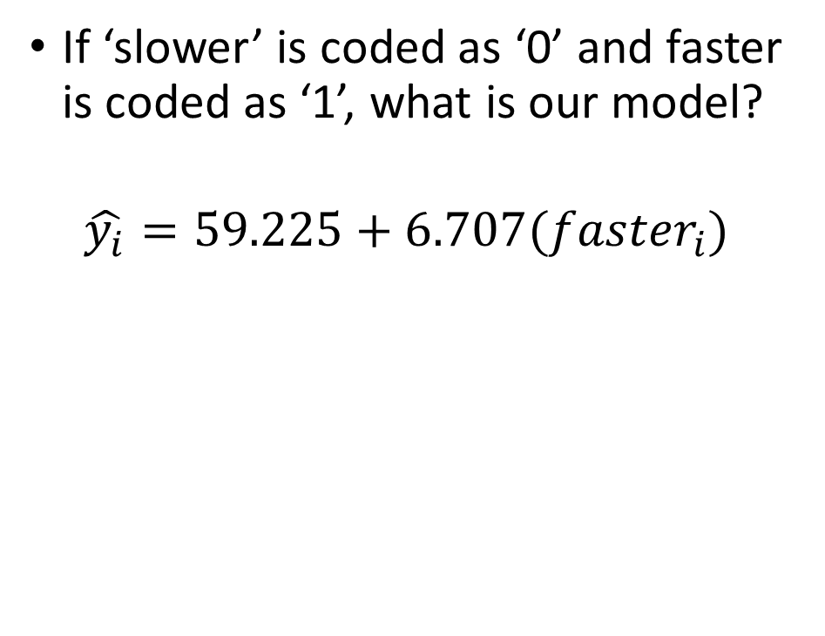
Categorical (2-level) variables in a GLM
If ‘slower’ is coded as ‘0’ and faster is coded as ‘1’, what is our model?
$$\hat{y_{i}}=59.225+6.707({faster}_{i})$$

Slide 5
Categorical (2-level) variables in a GLM
Call:
lm(formula = VO2 ~ faster, data = dat)
Residuals:
Min 1Q Median 3Q Max
-9.225 -2.932 -1.432 4.568 8.068
Coefficients:
Estimate Std. Error t value Pr(>|t|)
(Intercept) 59.225 1.720 34.434 <2e-16 ***
faster 6.707 2.376 2.822 0.0109 *
---
Signif. codes: 0 ‘***’ 0.001 ‘**’ 0.01 ‘*’ 0.05 ‘.’ 0.1 ‘ ’ 1
Residual standard error: 5.439 on 19 degrees of freedom
Multiple R-squared: 0.2954, Adjusted R-squared: 0.2583
F-statistic: 7.965 on 1 and 19 DF, p-value: 0.01088

Slide 6
What if we change how we code ‘slower’ and ‘faster’?
sudID VO2 time faster faster.c fast.cat
1 s001 74.00 116 1 1 faster
2 s002 68.00 117 1 1 faster
3 s003 70.50 119 1 1 faster
4 s004 61.00 121 1 1 faster
5 s005 73.25 121 1 1 faster
6 s006 68.25 122 1 1 faster
7 s007 64.50 125 1 1 faster
8 s008 63.00 128 1 1 faster
9 s009 60.75 130 1 1 faster
10 s010 64.00 130 1 1 faster
11 s011 58.00 132 1 1 faster
12 s012 60.50 135 0 -1 slower
13 s013 66.00 136 0 -1 slower
14 s014 60.00 137 0 -1 slower
15 s015 65.75 137 0 -1 slower
16 s016 66.25 141 0 -1 slower
17 s017 57.50 143 0 -1 slower
18 s018 50.00 147 0 -1 slower
19 s019 56.75 153 0 -1 slower
20 s020 52.50 159 0 -1 slower
21 s021 57.00 160 0 -1 slower
+1
-1

Slide 7
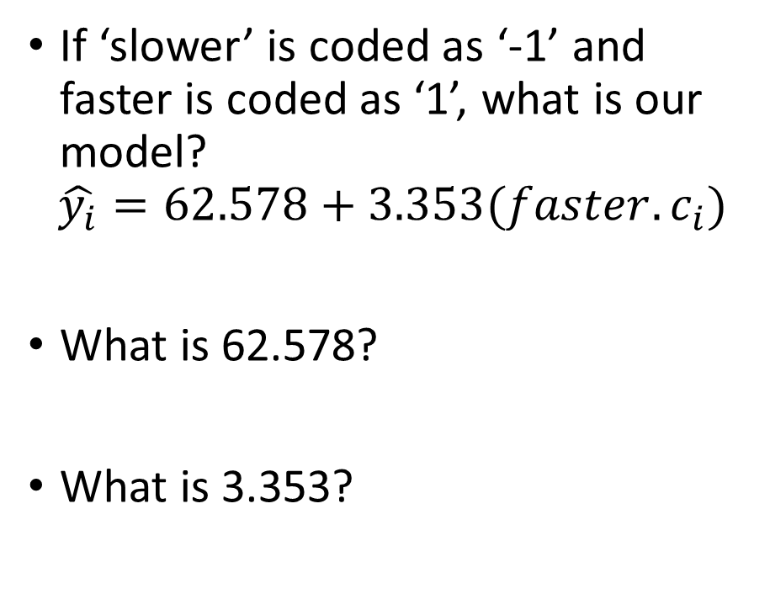
What if we change how we code ‘slower’ and ‘faster’?
If ‘slower’ is coded as ‘-1’ and faster is coded as ‘1’, what is our model?
$$\hat{y_{i}}=62.578+3.353({faster.c}_{i})$$
What is 62.578?
What is 3.353?

Slide 8
What if we change how we code ‘slower’ and ‘faster’?
The intercept is the value of ‘y’ when ‘x’ is zero. This, 62.578 is the mean of the two group means.
If ‘slower’ is coded as ‘-1’ and faster is coded as ‘1’, what is our model?
$$\hat{y_{i}}=62.578+3.353({faster.c}_{i})$$
What is 62.578?
What is 3.353?
+1
0
-1

Slide 9
What if we change how we code ‘slower’ and ‘faster’?
The intercept is the value of ‘y’ when ‘x’ is zero. This, 62.578 is the mean of the two group means.
If ‘slower’ is coded as ‘-1’ and faster is coded as ‘1’, what is our model?
$$\hat{y_{i}}=62.578+3.353({faster.c}_{i})$$
What is 62.578?
What is 3.353?
m₂=59.225
m₁=65.931
+1
0
-1

Slide 10
What if we have more than 2 groups?

Slide 11
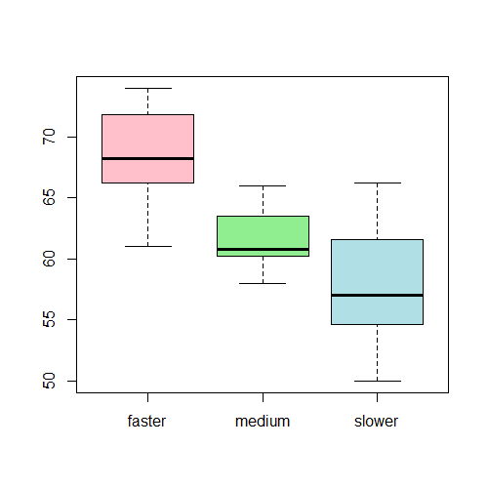
Categorical (k > 2) variables in a GLM
How do we code our variable with three groups?
0,1,2
-1,0,1
Why couldn’t we use a single code with three levels?

Slide 12
Categorical (k > 2) variables in a GLM
How do we code our variable with three groups?
0,1,2
-1,0,1
Why couldn’t we use a single code with three levels?
By default R uses ‘dummy’ codes:
λ1<-c(0,1,0)
λ2<-c(0,0,1)
What would a one unit change mean for these codes?

Slide 13
Categorical (k > 2) variables in a GLM
Residuals:
Min 1Q Median 3Q Max
-7.964 -1.750 -0.500 2.250 8.286
Coefficients:
Estimate Std. Error t value Pr(>|t|)
(Intercept) 68.500 1.779 38.497 < 2e-16 ***
groupsmedium -6.750 2.516 -2.682 0.015209 *
groupsslower -10.536 2.516 -4.187 0.000554 ***
---
Signif. codes: 0 ‘***’ 0.001 ‘**’ 0.01 ‘*’ 0.05 ‘.’ 0.1 ‘ ’ 1
Residual standard error: 4.708 on 18 degrees of freedom
Multiple R-squared: 0.4999, Adjusted R-squared: 0.4443
F-statistic: 8.996 on 2 and 18 DF, p-value: 0.001957
Group | Mean | SD
Fast | 68.5 | 4.64
Med | 61.75 | 2.71
Slow | 57.96 | 6.13

Slide 14
Categorical (k > 2) variables in a GLM
Residuals:
Min 1Q Median 3Q Max
-7.964 -1.750 -0.500 2.250 8.286
Coefficients:
Estimate Std. Error t value Pr(>|t|)
(Intercept) 68.500 1.779 38.497 < 2e-16 ***
groupsmedium -6.750 2.516 -2.682 0.015209 *
groupsslower -10.536 2.516 -4.187 0.000554 ***
---
Signif. codes: 0 ‘***’ 0.001 ‘**’ 0.01 ‘*’ 0.05 ‘.’ 0.1 ‘ ’ 1
Residual standard error: 4.708 on 18 degrees of freedom
Multiple R-squared: 0.4999, Adjusted R-squared: 0.4443
F-statistic: 8.996 on 2 and 18 DF, p-value: 0.001957
0
1
0
Group | Mean | SD
Fast | 68.5 | 4.64
Med | 61.75 | 2.71
Slow | 57.96 | 6.13

Slide 15
Categorical (k > 2) variables in a GLM
Residuals:
Min 1Q Median 3Q Max
-7.964 -1.750 -0.500 2.250 8.286
Coefficients:
Estimate Std. Error t value Pr(>|t|)
(Intercept) 68.500 1.779 38.497 < 2e-16 ***
groupsmedium -6.750 2.516 -2.682 0.015209 *
groupsslower -10.536 2.516 -4.187 0.000554 ***
---
Signif. codes: 0 ‘***’ 0.001 ‘**’ 0.01 ‘*’ 0.05 ‘.’ 0.1 ‘ ’ 1
Residual standard error: 4.708 on 18 degrees of freedom
Multiple R-squared: 0.4999, Adjusted R-squared: 0.4443
F-statistic: 8.996 on 2 and 18 DF, p-value: 0.001957
0
0
1
Group | Mean | SD
Fast | 68.5 | 4.64
Med | 61.75 | 2.71
Slow | 57.96 | 6.13

Slide 16
Contrast Coded Variables in a GLM (k > 2)
sudID VO2 time faster faster.c fast.cat lin.c quad.c groups
1 s001 74.00 116 1 1 faster 1 -1 faster
2 s002 68.00 117 1 1 faster 1 -1 faster
3 s003 70.50 119 1 1 faster 1 -1 faster
4 s004 61.00 121 1 1 faster 1 -1 faster
5 s005 73.25 121 1 1 faster 1 -1 faster
6 s006 68.25 122 1 1 faster 1 -1 faster
7 s007 64.50 125 1 1 faster 1 -1 faster
8 s008 63.00 128 1 1 faster 0 2 medium
9 s009 60.75 130 1 1 faster 0 2 medium
10 s010 64.00 130 1 1 faster 0 2 medium
11 s011 58.00 132 1 1 faster 0 2 medium
12 s012 60.50 135 0 -1 slower 0 2 medium
13 s013 66.00 136 0 -1 slower 0 2 medium
14 s014 60.00 137 0 -1 slower 0 2 medium
15 s015 65.75 137 0 -1 slower -1 -1 slower
16 s016 66.25 141 0 -1 slower -1 -1 slower
17 s017 57.50 143 0 -1 slower -1 -1 slower
18 s018 50.00 147 0 -1 slower -1 -1 slower
19 s019 56.75 153 0 -1 slower -1 -1 slower
20 s020 52.50 159 0 -1 slower -1 -1 slower
21 s021 57.00 160 0 -1 slower -1 -1 slower

Slide 17
Contrast Coded Variables in a GLM (k > 2)
sudID VO2 time faster faster.c fast.cat lin.c quad.c groups
1 s001 74.00 116 1 1 faster 1 -1 faster
2 s002 68.00 117 1 1 faster 1 -1 faster
3 s003 70.50 119 1 1 faster 1 -1 faster
4 s004 61.00 121 1 1 faster 1 -1 faster
5 s005 73.25 121 1 1 faster 1 -1 faster
6 s006 68.25 122 1 1 faster 1 -1 faster
7 s007 64.50 125 1 1 faster 1 -1 faster
8 s008 63.00 128 1 1 faster 0 2 medium
9 s009 60.75 130 1 1 faster 0 2 medium
10 s010 64.00 130 1 1 faster 0 2 medium
11 s011 58.00 132 1 1 faster 0 2 medium
12 s012 60.50 135 0 -1 slower 0 2 medium
13 s013 66.00 136 0 -1 slower 0 2 medium
14 s014 60.00 137 0 -1 slower 0 2 medium
15 s015 65.75 137 0 -1 slower -1 -1 slower
16 s016 66.25 141 0 -1 slower -1 -1 slower
17 s017 57.50 143 0 -1 slower -1 -1 slower
18 s018 50.00 147 0 -1 slower -1 -1 slower
19 s019 56.75 153 0 -1 slower -1 -1 slower
20 s020 52.50 159 0 -1 slower -1 -1 slower
21 s021 57.00 160 0 -1 slower -1 -1 slower

Slide 18
Contrast Coded Variables in a GLM (k > 2)
Residuals:
Min 1Q Median 3Q Max
-7.964 -1.750 -0.500 2.250 8.286
Coefficients:
Estimate Std. Error t value Pr(>|t|)
(Intercept) 62.7381 1.0273 61.070 < 2e-16 ***
lin.c 5.2679 1.2582 4.187 0.000554 ***
quad.c -0.4940 0.7264 -0.680 0.505086
---
Signif. codes: 0 ‘***’ 0.001 ‘**’ 0.01 ‘*’ 0.05 ‘.’ 0.1 ‘ ’ 1
Residual standard error: 4.708 on 18 degrees of freedom
Multiple R-squared: 0.4999, Adjusted R-squared: 0.4443
F-statistic: 8.996 on 2 and 18 DF, p-value: 0.001957
Group | Mean | SD
Fast | 68.5 | 4.64
Med | 61.75 | 2.71
Slow | 57.96 | 6.13

Slide 19
Contrast Coded Variables in a GLM (k > 2)
Residuals:
Min 1Q Median 3Q Max
-7.964 -1.750 -0.500 2.250 8.286
Coefficients:
Estimate Std. Error t value Pr(>|t|)
(Intercept) 62.7381 1.0273 61.070 < 2e-16 ***
lin.c 5.2679 1.2582 4.187 0.000554 ***
quad.c -0.4940 0.7264 -0.680 0.505086
---
Signif. codes: 0 ‘***’ 0.001 ‘**’ 0.01 ‘*’ 0.05 ‘.’ 0.1 ‘ ’ 1
Residual standard error: 4.708 on 18 degrees of freedom
Multiple R-squared: 0.4999, Adjusted R-squared: 0.4443
F-statistic: 8.996 on 2 and 18 DF, p-value: 0.001957
What does the intercept now represent?
Group | Mean | SD
Fast | 68.5 | 4.64
Med | 61.75 | 2.71
Slow | 57.96 | 6.13

Slide 20
Contrast Coded Variables in a GLM (k > 2)
Residuals:
Min 1Q Median 3Q Max
-7.964 -1.750 -0.500 2.250 8.286
Coefficients:
Estimate Std. Error t value Pr(>|t|)
(Intercept) 62.7381 1.0273 61.070 < 2e-16 ***
lin.c 5.2679 1.2582 4.187 0.000554 ***
quad.c -0.4940 0.7264 -0.680 0.505086
---
Signif. codes: 0 ‘***’ 0.001 ‘**’ 0.01 ‘*’ 0.05 ‘.’ 0.1 ‘ ’ 1
Residual standard error: 4.708 on 18 degrees of freedom
Multiple R-squared: 0.4999, Adjusted R-squared: 0.4443
F-statistic: 8.996 on 2 and 18 DF, p-value: 0.001957
Why is this effect not statistically significant?
Group | Mean | SD
Fast | 68.5 | 4.64
Med | 61.75 | 2.71
Slow | 57.96 | 6.13

Slide 21
Contrast Coded Variables in a GLM (k > 2)
+1
Residuals:
Min 1Q Median 3Q Max
-7.964 -1.750 -0.500 2.250 8.286
Coefficients:
Estimate Std. Error t value Pr(>|t|)
(Intercept) 62.7381 1.0273 61.070 < 2e-16 ***
lin.c 5.2679 1.2582 4.187 0.000554 ***
quad.c -0.4940 0.7264 -0.680 0.505086
---
Signif. codes: 0 ‘***’ 0.001 ‘**’ 0.01 ‘*’ 0.05 ‘.’ 0.1 ‘ ’ 1
Residual standard error: 4.708 on 18 degrees of freedom
Multiple R-squared: 0.4999, Adjusted R-squared: 0.4443
F-statistic: 8.996 on 2 and 18 DF, p-value: 0.001957
0
-1
Group | Mean | SD
Fast | 68.5 | 4.64
Med | 61.75 | 2.71
Slow | 57.96 | 6.13

Slide 22
Contrast Coded Variables in a GLM (k > 2)
Residuals:
Min 1Q Median 3Q Max
-7.964 -1.750 -0.500 2.250 8.286
Coefficients:
Estimate Std. Error t value Pr(>|t|)
(Intercept) 62.7381 1.0273 61.070 < 2e-16 ***
lin.c 5.2679 1.2582 4.187 0.000554 ***
quad.c -0.4940 0.7264 -0.680 0.505086
---
Signif. codes: 0 ‘***’ 0.001 ‘**’ 0.01 ‘*’ 0.05 ‘.’ 0.1 ‘ ’ 1
Residual standard error: 4.708 on 18 degrees of freedom
Multiple R-squared: 0.4999, Adjusted R-squared: 0.4443
F-statistic: 8.996 on 2 and 18 DF, p-value: 0.001957
-1
2
-1
Group | Mean | SD
Fast | 68.5 | 4.64
Med | 61.75 | 2.71
Slow | 57.96 | 6.13

Slide 23
Comparing our Different Codes
Treatment or ‘Dummy’ Codes
Contrast Codes
Residuals:
Min 1Q Median 3Q Max
-7.964 -1.750 -0.500 2.250 8.286
Coefficients:
Estimate Std. Error t value Pr(>|t|)
(Intercept) 68.500 1.779 38.497 < 2e-16 ***
groupsmedium -6.750 2.516 -2.682 0.015209 *
groupsslower -10.536 2.516 -4.187 0.000554 ***
---
Signif. codes: 0 ‘***’ 0.001 ‘**’ 0.01 ‘*’ 0.05 ‘.’ 0.1 ‘ ’ 1
Residual standard error: 4.708 on 18 degrees of freedom
Multiple R-squared: 0.4999, Adjusted R-squared: 0.4443
F-statistic: 8.996 on 2 and 18 DF, p-value: 0.001957
Residuals:
Min 1Q Median 3Q Max
-7.964 -1.750 -0.500 2.250 8.286
Coefficients:
Estimate Std. Error t value Pr(>|t|)
(Intercept) 62.7381 1.0273 61.070 < 2e-16 ***
lin.c 5.2679 1.2582 4.187 0.000554 ***
quad.c -0.4940 0.7264 -0.680 0.505086
---
Signif. codes: 0 ‘***’ 0.001 ‘**’ 0.01 ‘*’ 0.05 ‘.’ 0.1 ‘ ’ 1
Residual standard error: 4.708 on 18 degrees of freedom
Multiple R-squared: 0.4999, Adjusted R-squared: 0.4443
F-statistic: 8.996 on 2 and 18 DF, p-value: 0.001957

