Slide 1
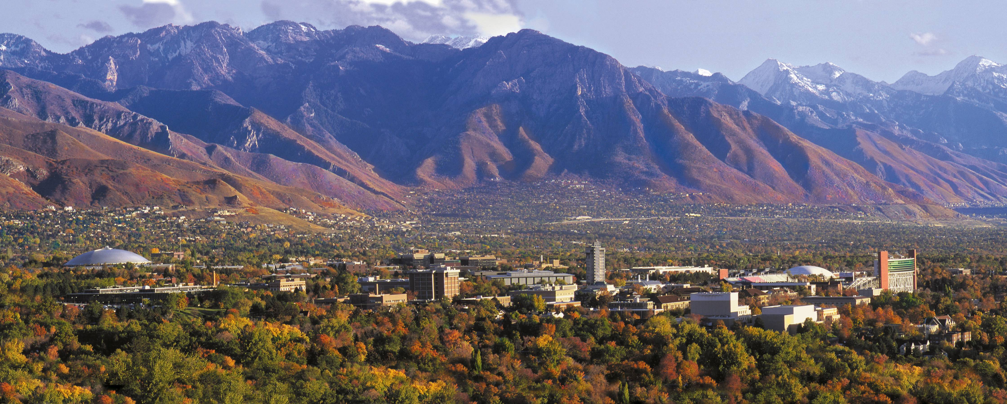



Dissecting the ANOVA Output.
Keith Lohse, PhD
Assistant Professor
Department of Health, Kinesiology, and Recreation
Department of Physical Therapy and Athletic Training
University of Utah
keith.lohse@health.utah.edu
@keith_lohse

Slide 2
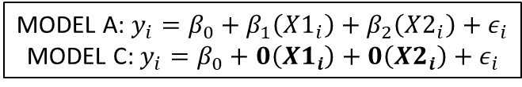
Comparing our Different Codes
Treatment or ‘Dummy’ Codes
Contrast Codes
Residuals:
Min 1Q Median 3Q Max
-7.964 -1.750 -0.500 2.250 8.286
Coefficients:
Estimate Std. Error t value Pr(>|t|)
(Intercept) 68.500 1.779 38.497 < 2e-16 ***
groupsmedium -6.750 2.516 -2.682 0.015209 *
groupsslower -10.536 2.516 -4.187 0.000554 ***
---
Signif. codes: 0 ‘***’ 0.001 ‘**’ 0.01 ‘*’ 0.05 ‘.’ 0.1 ‘ ’ 1
Residual standard error: 4.708 on 18 degrees of freedom
Multiple R-squared: 0.4999, Adjusted R-squared: 0.4443
F-statistic: 8.996 on 2 and 18 DF, p-value: 0.001957
Residuals:
Min 1Q Median 3Q Max
-7.964 -1.750 -0.500 2.250 8.286
Coefficients:
Estimate Std. Error t value Pr(>|t|)
(Intercept) 62.7381 1.0273 61.070 < 2e-16 ***
lin.c 5.2679 1.2582 4.187 0.000554 ***
quad.c -0.4940 0.7264 -0.680 0.505086
---
Signif. codes: 0 ‘***’ 0.001 ‘**’ 0.01 ‘*’ 0.05 ‘.’ 0.1 ‘ ’ 1
Residual standard error: 4.708 on 18 degrees of freedom
Multiple R-squared: 0.4999, Adjusted R-squared: 0.4443
F-statistic: 8.996 on 2 and 18 DF, p-value: 0.001957
MODEL A: $y_{i}=β_{0}+β_{1}\left(X1_{i}\right)+β_{2}\left(X2_{i}\right)+ε_{i}$
MODEL C: $y_{i}=β_{0}+0\left(X1_{i}\right)+0\left(X2_{i}\right)+ε_{i}$

Slide 3
Different models that make the same predictions:
Treatment or ‘Dummy’ Codes
$68.500−6.750\left(X1_{i}\right)−10.536\left(X2_{i}\right)=$
Contrast Codes
$62.7381+5.2679\left(X1_{i}\right)−0.4940\left(X2_{i}\right)=$

Slide 4
Different models that make the same predictions:
Treatment or ‘Dummy’ Codes
$68.500−6.750\left(X1_{i}\right)−10.536\left(X2_{i}\right)=$
$68.500−6.750\left(0\right)−10.536\left(0\right)=$ ${\hat{y}}_{fast}=68.500$
Contrast Codes
$62.7381+5.2679\left(X1_{i}\right)−0.4940\left(X2_{i}\right)=$
$$62.7381+5.2679\left(1\right)−0.4940\left(−1\right)={\hat{y}}_{fast}=68.500$$

Slide 5
Different models that make the same predictions:
Treatment or ‘Dummy’ Codes
$68.500−6.750\left(X1_{i}\right)−10.536\left(X2_{i}\right)=$
$68.500−6.750\left(0\right)−10.536\left(0\right)=$ ${\hat{y}}_{fast}=68.500$
$68.500−6.750\left(1\right)−10.536\left(0\right)=$ ${\hat{y}}_{medium}=61.750$
Contrast Codes
$62.7381+5.2679\left(X1_{i}\right)−0.4940\left(X2_{i}\right)=$
$$62.7381+5.2679\left(1\right)−0.4940\left(−1\right)={\hat{y}}_{fast}=68.500$$
$$62.7381+5.2679\left(0\right)−0.4940\left(2\right)={\hat{y}}_{medium}=61.750$$

Slide 6
Different models that make the same predictions:
Treatment or ‘Dummy’ Codes
$68.500−6.750\left(X1_{i}\right)−10.536\left(X2_{i}\right)=$
$68.500−6.750\left(0\right)−10.536\left(0\right)=$ ${\hat{y}}_{fast}=68.500$
$68.500−6.750\left(1\right)−10.536\left(0\right)=$ ${\hat{y}}_{medium}=61.750$
$68.500−6.750\left(0\right)−10.536\left(1\right)=$ ${\hat{y}}_{slow}=57.960$
Contrast Codes
$62.7381+5.2679\left(X1_{i}\right)−0.4940\left(X2_{i}\right)=$
$$62.7381+5.2679\left(1\right)−0.4940\left(−1\right)={\hat{y}}_{fast}=68.500$$
$$62.7381+5.2679\left(0\right)−0.4940\left(2\right)={\hat{y}}_{medium}=61.750$$
$62.7381+5.2679\left(−1\right)−0.4940\left(−1\right)={\hat{y}}_{slow}=57.96$0

Slide 7
Different models that make the same predictions:
Treatment or ‘Dummy’ Codes
Note that although we estimate different coefficients depending on if X’s are treatment coded or contrast coded, we arrive at the same model predictions.
This is because these coefficients are determined using least squares error estimation. Thus, the estimate we arrive at is the mean for each group.
The mean will produce the smallest SSE in each group and, as a result, the model will produce the smallest SSE overall.
$68.500−6.750\left(X1_{i}\right)−10.536\left(X2_{i}\right)=$
$68.500−6.750\left(0\right)−10.536\left(0\right)=$ ${\hat{y}}_{fast}=68.500$
$68.500−6.750\left(1\right)−10.536\left(0\right)=$ ${\hat{y}}_{medium}=61.750$
$68.500−6.750\left(0\right)−10.536\left(1\right)=$ ${\hat{y}}_{slow}=57.960$
Contrast Codes
$62.7381+5.2679\left(X1_{i}\right)−0.4940\left(X2_{i}\right)=$
$$62.7381+5.2679\left(1\right)−0.4940\left(−1\right)={\hat{y}}_{fast}=68.500$$
$$62.7381+5.2679\left(0\right)−0.4940\left(2\right)={\hat{y}}_{medium}=61.750$$
$$62.7381+5.2679\left(−1\right)−0.4940\left(−1\right)={\hat{y}}_{slow}=57.960$$

Slide 8
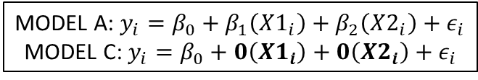
Different models that make the same predictions:
Treatment or ‘Dummy’ Codes
Note that although we estimate different coefficients depending on if X’s are treatment coded or contrast coded, we arrive at the same model predictions.
This is because these coefficients are determined using least squares error estimation. Thus, the estimate we arrive at is the mean for each group.
The mean will produce the smallest SSE in each group and, as a result, the model will produce the smallest SSE overall.
Residual standard error: 4.708 on 18 degrees of freedom
Multiple R-squared: 0.4999, Adjusted R-squared: 0.4443
F-statistic: 8.996 on 2 and 18 DF, p-value: 0.001957
Contrast Codes
Residual standard error: 4.708 on 18 degrees of freedom
Multiple R-squared: 0.4999, Adjusted R-squared: 0.4443
F-statistic: 8.996 on 2 and 18 DF, p-value: 0.001957
MODEL A: $y_{i}=β_{0}+β_{1}\left(X1_{i}\right)+β_{2}\left(X2_{i}\right)+ε_{i}$
MODEL C: $y_{i}=β_{0}+0\left(X1_{i}\right)+0\left(X2_{i}\right)+ε_{i}$
Despite different values of the coefficients, the SSE(A) for both of these models is the same and they are both being compared to the same SSE(C) to obtain the Omnibus F and PRE.

Slide 9
… but the individual contrasts are different!
Treatment or ‘Dummy’ Codes
Contrast Codes
Residuals:
Min 1Q Median 3Q Max
-7.964 -1.750 -0.500 2.250 8.286
Coefficients:
Estimate Std. Error t value Pr(>|t|)
(Intercept) 68.500 1.779 38.497 < 2e-16 ***
groupsmedium -6.750 2.516 -2.682 0.015209 *
groupsslower -10.536 2.516 -4.187 0.000554 ***
---
Signif. codes: 0 ‘***’ 0.001 ‘**’ 0.01 ‘*’ 0.05 ‘.’ 0.1 ‘ ’ 1
Residual standard error: 4.708 on 18 degrees of freedom
Multiple R-squared: 0.4999, Adjusted R-squared: 0.4443
F-statistic: 8.996 on 2 and 18 DF, p-value: 0.001957
Residuals:
Min 1Q Median 3Q Max
-7.964 -1.750 -0.500 2.250 8.286
Coefficients:
Estimate Std. Error t value Pr(>|t|)
(Intercept) 62.7381 1.0273 61.070 < 2e-16 ***
lin.c 5.2679 1.2582 4.187 0.000554 ***
quad.c -0.4940 0.7264 -0.680 0.505086
---
Signif. codes: 0 ‘***’ 0.001 ‘**’ 0.01 ‘*’ 0.05 ‘.’ 0.1 ‘ ’ 1
Residual standard error: 4.708 on 18 degrees of freedom
Multiple R-squared: 0.4999, Adjusted R-squared: 0.4443
F-statistic: 8.996 on 2 and 18 DF, p-value: 0.001957

Slide 10
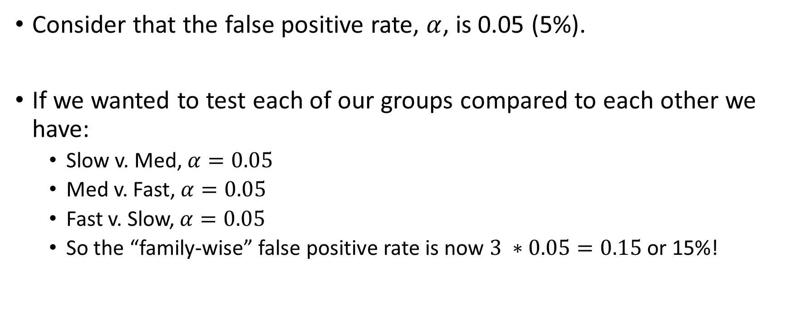
Omnibus F and “post-hoc” tests.
Consider that the false positive rate, $α$, is 0.05 (5%).
If we wanted to test each of our groups compared to each other we have:
Slow v. Med, $α=0.05$
Med v. Fast, $α=0.05$
Fast v. Slow, $α=0.05$
So the “family-wise” false positive rate is now $3 ∗0.05=0.15$ or 15%!

Slide 11
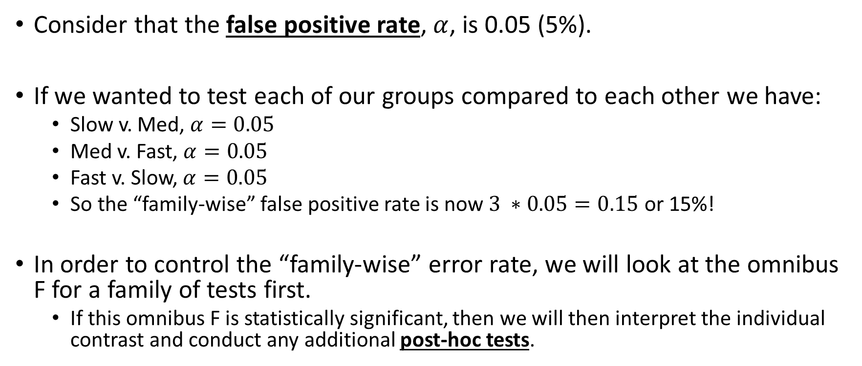
Omnibus F and “post-hoc” tests.
Consider that the false positive rate, $α$, is 0.05 (5%).
If we wanted to test each of our groups compared to each other we have:
Slow v. Med, $α=0.05$
Med v. Fast, $α=0.05$
Fast v. Slow, $α=0.05$
So the “family-wise” false positive rate is now $3 ∗0.05=0.15$ or 15%!
In order to control the “family-wise” error rate, we will look at the omnibus F for a family of tests first.
If this omnibus F is statistically significant, then we will then interpret the individual contrast and conduct any additional post-hoc tests.

