Slide 1




Models with Non-Independent Errors
Keith Lohse, PhD
Assistant Professor
Department of Health, Kinesiology, and Recreation
Department of Physical Therapy and Athletic Training
University of Utah
keith.lohse@health.utah.edu
@keith_lohse

Slide 2

Assumptions so far…
$$Data=Model+Error$$
$$y_{i}=β_{0}+β_{1}x_{1i}+β_{2}x_{2i}…+β_{n}x_{ni}+ε_{i}$$
In these models, we have made important assumptions about the residuals (ε’s).
They are normally distributed. (normality assumption)
They have a constant variance. (homoscedasticity/homogeneity of variance assumption)
They are independent of each other. (independence assumption)

Slide 3
Types of non-independence.
Positive non-independence: linked data are more alike than non-linked data.
Negative non-independence: linked data are more different than non-linked data.
School | Calculus I | College Algebra
1 | 660 | 510
2 | 740 | 560
3 | 780 | 650
4 | 650 | 500
Proficiency on a mathematical aptitude test:
School | End Term Performance | Change over the Term
1 | 585 | 100
2 | 650 | 50
3 | 715 | 30
4 | 575 | 110
Proficiency versus Growth on a mathematical aptitude test:

Slide 4
Sources of non-independence.
In practice, non-independence is likely to arise to a surfeit of factors:
E.g., time within a person, kids within schools, patients with therapists, hospitals within counties, etc.
Broadly speaking, we can think about these different sources of dependence as either grouped data or sequential data.
Team A
Team B
Team C
Year
Year
Year
Player A
1, 2, 3, 4
Player D
1, 2, 3, 4
Player G
1, 2, 3, 4
Player B
1, 2, 3, 4
Player E
1, 2, 3, 4
Player H
1, 2, 3, 4
Player C
1, 2, 3, 4
Player F
1, 2, 3, 4
Player I
1, 2, 3, 4
…
…
…

Slide 5
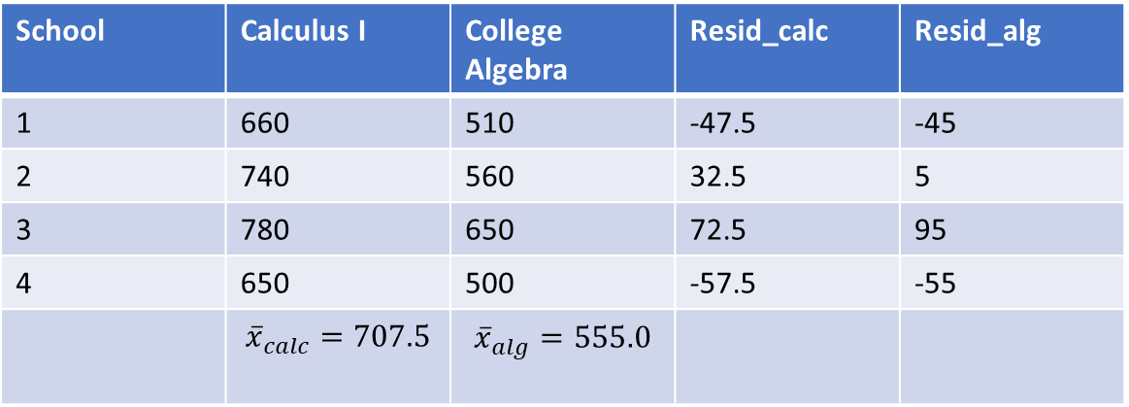

Returning to our examples…
Positive non-independence: linked data are more alike than non-linked data.
School | Calculus I | College Algebra | Resid_calc | Resid_alg
1 | 660 | 510 | -47.5 | -45
2 | 740 | 560 | 32.5 | 5
3 | 780 | 650 | 72.5 | 95
4 | 650 | 500 | -57.5 | -55
 | $${\overline{x}}_{calc}=707.5$$ | $${\overline{x}}_{alg}=555.0$$
Proficiency on a mathematical aptitude test as a function of Class:
$${\hat{y}}_{i}=β_{0}+β_{1}{class}_{i}$$

Slide 6
Returning to our examples…
Positive non-independence: linked data are more alike than non-linked data.
School | Calculus I | College Algebra | Resid_calc | Resid_alg
1 | 660 | 510 | -47.5 | -45
2 | 740 | 560 | 32.5 | 5
3 | 780 | 650 | 72.5 | 95
4 | 650 | 500 | -57.5 | -55
 | $${\overline{x}}_{calc}=707.5$$ | $${\overline{x}}_{alg}=555.0$$
Proficiency on a mathematical aptitude test as a function of Class:
$${\hat{y}}_{i}=β_{0}+β_{1}{class}_{i}$$
Clearly, the residuals of this model are not independent.

Slide 7
Returning to our examples…
Positive non-independence: linked data are more alike than non-linked data.
School | Calculus I | College Algebra | Resid_calc | Resid_alg
1 | 660 | 510 | -47.5 | -45
2 | 740 | 560 | 32.5 | 5
3 | 780 | 650 | 72.5 | 95
4 | 650 | 500 | -57.5 | -55
 | $${\overline{x}}_{calc}=707.5$$ | $${\overline{x}}_{alg}=555.0$$
Proficiency on a mathematical aptitude test as a function of Class:
$${\hat{y}}_{i}=β_{0}+β_{1}{class}_{i}$$
Clearly, the residuals of this model are not independent.
If we ignore the fact that these classes are nested within schools, we violate a major assumption!

Slide 8
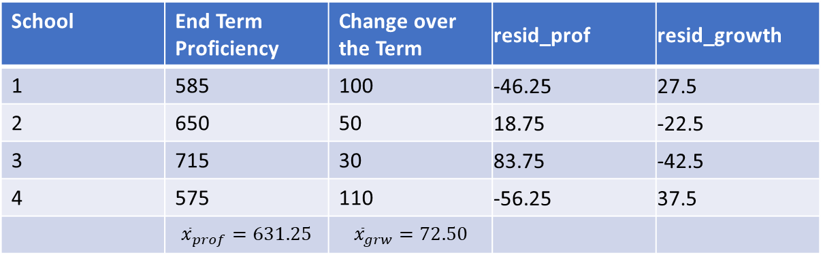

Returning to our examples…
Negative non-independence: linked data are more different than non-linked data.
School | End Term Proficiency | Change over the Term | resid_prof | resid_growth
1 | 585 | 100 | -46.25 | 27.5
2 | 650 | 50 | 18.75 | -22.5
3 | 715 | 30 | 83.75 | -42.5
4 | 575 | 110 | -56.25 | 37.5
 | $${\overline{x}}_{prof}=631.25$$ | $${\overline{x}}_{grw}=72.50$$
Proficiency versus Growth on a mathematical aptitude test:
$${\hat{y}}_{i}=β_{0}+β_{1}{prof}_{i}$$

Slide 9
Returning to our examples…
Negative non-independence: linked data are more different than non-linked data.
School | End Term Proficiency | Change over the Term | resid_prof | resid_growth
1 | 585 | 100 | -46.25 | 27.5
2 | 650 | 50 | 18.75 | -22.5
3 | 715 | 30 | 83.75 | -42.5
4 | 575 | 110 | -56.25 | 37.5
 | $${\overline{x}}_{prof}=631.25$$ | $${\overline{x}}_{grw}=72.50$$
Proficiency versus Growth on a mathematical aptitude test:
$${\hat{y}}_{i}=β_{0}+β_{1}{prof}_{i}$$
Clearly, the residuals of this model are not independent.

Slide 10
Returning to our examples…
Negative non-independence: linked data are more different than non-linked data.
School | End Term Proficiency | Change over the Term | resid_prof | resid_growth
1 | 585 | 100 | -46.25 | 27.5
2 | 650 | 50 | 18.75 | -22.5
3 | 715 | 30 | 83.75 | -42.5
4 | 575 | 110 | -56.25 | 37.5
 | $${\overline{x}}_{prof}=631.25$$ | $${\overline{x}}_{grw}=72.50$$
Proficiency versus Growth on a mathematical aptitude test:
$${\hat{y}}_{i}=β_{0}+β_{1}{prof}_{i}$$
Clearly, the residuals of this model are not independent.
If we ignore the fact that these classes are nested within schools, we violate a major assumption!

Slide 11
How do we handle the violation of this assumption?
Control the data so that we no longer dealing with non-independent observation.
I.e., if scores from the same school are more likely to be like each other, we need to remove the variation due to school, then we can get a clean look at variation due to class or proficiency versus growth.
The exact way that we do this will depend on whether our data are crossed or nested.

Slide 12
Definitions
Two factors are crossed when every level of one factor co-occurs in the design with every level of the other factor.
I.e., there is at least one observation in every combination of levels for the two factors.
A factor is nested within another factor when each category of the first factor co-occurs with only one category of the other.
I.e., an observation has to be within one level of Factor 2 in order to have a specific level of Factor 1. Not all combinations of levels are represented.

Slide 13
Definitions
In many experimental paradigms, we refer to crossed factors as “within-subject” and nested factors as “between-subjects”.
This nomenclature is valid, but understanding crossed versus nested as terms will help us understand more complicated statistical models later.
To illustrate, consider two different training paradigms for changing body composition (%BF).

Slide 14
Definitions
To illustrate, consider two different training paradigms for changing body composition (%BF)
Participants at different levels:
Time Point
Subject Pre Post
1 1 1
2 1 1
3 1 1
4 1 1
5 1 1
…
17 1 1
18 1 1
19 1 1
20 1 1
Participants at different levels:
Time Point
Group Pre Post
HIIT 10 10
Aerobic 10 10
Time and Subject are also crossed factors (every level of Subject is represented at every level of Time).
Time and Group are crossed factors (every level of group is represented at every level of time).

Slide 15
Definitions
To illustrate, consider two different training paradigms for changing body composition (%BF)
Participants at different levels:
Group
Subject HIIT Aerobic
1 2 0
2 2 0
…
9 2 0
10 2 0
11 0 2
12 0 2
…
19 0 2
20 0 2
Subject, however, is nested within group, because only some subjects are represented in the HIIT group (1-10) and some are in the Aerobic group (11-20).
(I.e., Only some levels of Subject are represented at every level of Time).

Slide 16
Moving ahead:
In the next two modules, we will demonstrate how to deal with non-independence
in nested designs (e.g., students within classrooms),
in crossed designs (e.g., participants exposed to different experimental conditions),
and then in situations where we are mixing crossed and nested variables.

