Slide 1
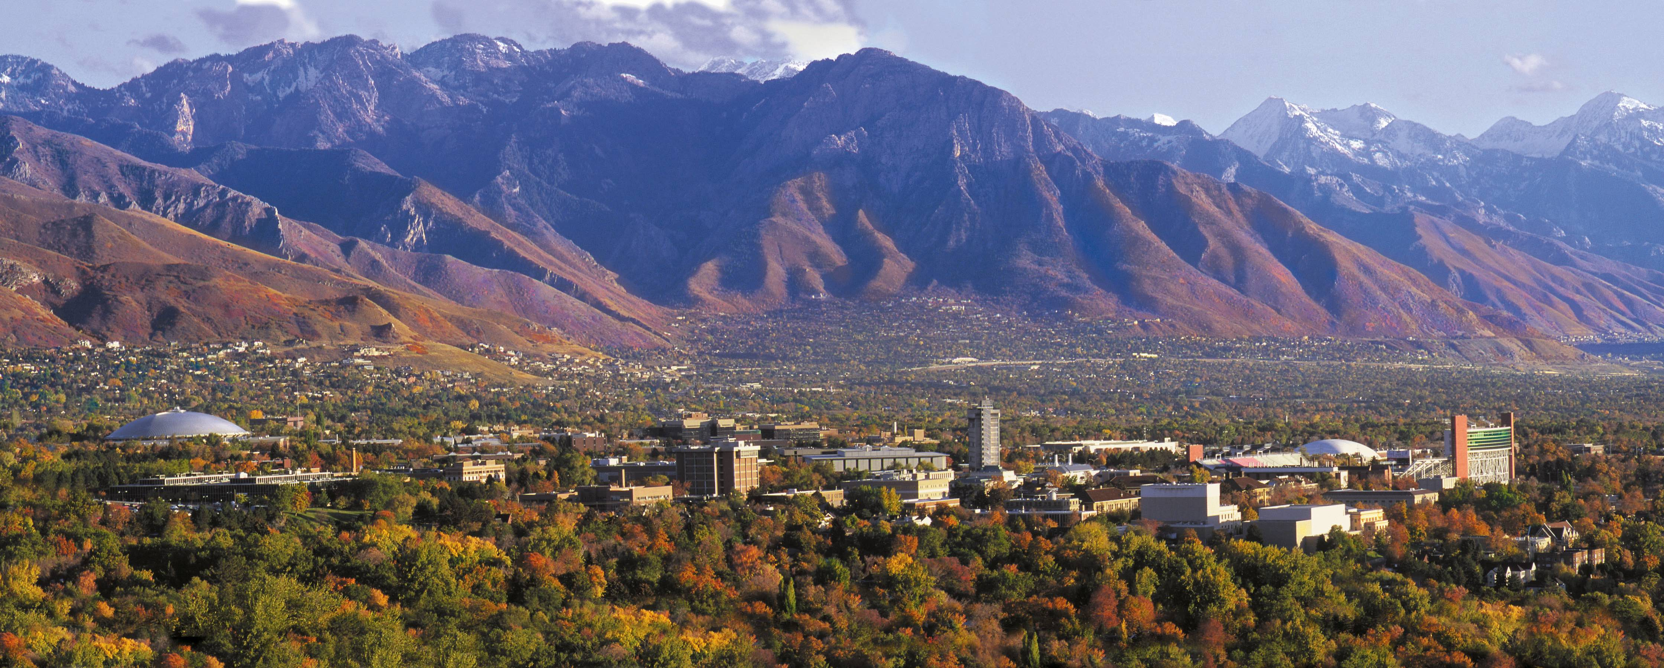



Non-Independence in Nested Designs
Keith Lohse, PhD
Assistant Professor
Department of Health, Kinesiology, and Recreation
Department of Physical Therapy and Athletic Training
University of Utah
keith.lohse@health.utah.edu
@keith_lohse

Slide 2
Non-independence in a nested example.
 | Instructions (j)
 | Competition |  |  | No Competition
 | Group 1 | Group 2 | Group 3 | Group 4 | Group 5 | Group 6
Y_{hij} | 8 | 6 | 7 | 6 | 7 | 5
Y_{hij} | 9 | 7 | 8 | 6 | 6 | 5
Y_{hij} | 7 | 6 | 8 | 5 | 7 | 4
Group Mean | 8 | 6.33 | 7.67 | 5.67 | 6.67 | 4.67
Condition Means | 7.33 |  |  | 5.67
Grand Mean | 6.50

Slide 3
Non-independence in a nested example.
 | Instructions (j)
 | Competition |  |  | No Competition
 | Group 1 | Group 2 | Group 3 | Group 4 | Group 5 | Group 6
Y_{hij} | 8 | 6 | 7 | 6 | 7 | 5
Y_{hij} | 9 | 7 | 8 | 6 | 6 | 5
Y_{hij} | 7 | 6 | 8 | 5 | 7 | 4
Group Mean | 8 | 6.33 | 7.67 | 5.67 | 6.67 | 4.67
Condition Means | 7.33 |  |  | 5.67
Grand Mean | 6.50
Source | SS | df
Condition | 12.50 | 1
Error Between Groups | 10.67 | 4
Total Between Groups | 23.17 | 5
Total Within Group | 5.33 | 12
Total | 28.50 | 17
Remember, h = individual, i = group.

Slide 4
Non-independence in a nested example.
 | Instructions (j)
 | Competition |  |  | No Competition
 | Group 1 | Group 2 | Group 3 | Group 4 | Group 5 | Group 6
Y_{hij} | 8 | 6 | 7 | 6 | 7 | 5
Y_{hij} | 9 | 7 | 8 | 6 | 6 | 5
Y_{hij} | 7 | 6 | 8 | 5 | 7 | 4
Group Mean | 8 | 6.33 | 7.67 | 5.67 | 6.67 | 4.67
Condition Means | 7.33 |  |  | 5.67
Grand Mean | 6.50
Source | SS | df
Condition
Error Between Groups
Total Between Groups
Total Within Group
Total | 28.50 | 17
$$\sum{\left(Y_{hij}−\overset{̿}{Y}\right)}$$
2
Remember, h = individual, i = group, j = instructions.

Slide 5
Non-independence in a nested example.
 | Instructions (j)
 | Competition |  |  | No Competition
 | Group 1 | Group 2 | Group 3 | Group 4 | Group 5 | Group 6
Y_{hij} | 8 | 6 | 7 | 6 | 7 | 5
Y_{hij} | 9 | 7 | 8 | 6 | 6 | 5
Y_{hij} | 7 | 6 | 8 | 5 | 7 | 4
Group Mean | 8 | 6.33 | 7.67 | 5.67 | 6.67 | 4.67
Condition Means | 7.33 |  |  | 5.67
Grand Mean | 6.50
Source | SS | df
Condition
Error Between Groups
Total Between Groups
Total Within Group | 5.33 | 12
Total | 28.50 | 17
$$\sum{\left(Y_{hij}−{\overline{Y}}_{i}\right)}$$
2
Remember, h = individual, i = group, j = instructions.

Slide 6
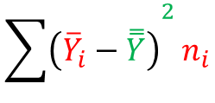
Non-independence in a nested example.
 | Instructions (j)
 | Competition |  |  | No Competition
 | Group 1 | Group 2 | Group 3 | Group 4 | Group 5 | Group 6
Y_{hij} | 8 | 6 | 7 | 6 | 7 | 5
Y_{hij} | 9 | 7 | 8 | 6 | 6 | 5
Y_{hij} | 7 | 6 | 8 | 5 | 7 | 4
Group Mean | 8 | 6.33 | 7.67 | 5.67 | 6.67 | 4.67
Condition Means | 7.33 |  |  | 5.67
Grand Mean | 6.50
Source | SS | df
Condition
Error Between Groups
Total Between Groups | 23.17 | 5
Total Within Group | 5.33 | 12
Total | 28.50 | 17
$${\sum{\left({\overline{Y}}_{i}−\overset{̿}{Y}\right)}}^{2}n_{i}$$
Remember, h = individual, i = group, j = instructions.

Slide 7
Non-independence in a nested example.
 | Instructions (j)
 | Competition |  |  | No Competition
 | Group 1 | Group 2 | Group 3 | Group 4 | Group 5 | Group 6
Y_{hij} | 8 | 6 | 7 | 6 | 7 | 5
Y_{hij} | 9 | 7 | 8 | 6 | 6 | 5
Y_{hij} | 7 | 6 | 8 | 5 | 7 | 4
Group Mean | 8 | 6.33 | 7.67 | 5.67 | 6.67 | 4.67
Condition Means | 7.33 |  |  | 5.67
Grand Mean | 6.50
Source | SS | df
Condition
Error Between Groups
Total Between Groups | 23.17 | 5
Total Within Group | 5.33 | 12
Total | 28.50 | 17
$${\sum{\left({\overline{Y}}_{i}−\overset{̿}{Y}\right)}}^{2}n_{i}$$
NOTE THAT I ACCIDENTALLY LEFT “n” OUT OF THE SLIDES IN THE VIDEO.

Slide 8
Non-independence in a nested example.
 | Instructions (j)
 | Competition |  |  | No Competition
 | Group 1 | Group 2 | Group 3 | Group 4 | Group 5 | Group 6
Y_{hij} | 8 | 6 | 7 | 6 | 7 | 5
Y_{hij} | 9 | 7 | 8 | 6 | 6 | 5
Y_{hij} | 7 | 6 | 8 | 5 | 7 | 4
Group Mean | 8 | 6.33 | 7.67 | 5.67 | 6.67 | 4.67
Condition Means | 7.33 |  |  | 5.67
Grand Mean | 6.50
Source | SS | df
Condition
Error Between Groups | 10.67 | 4
Total Between Groups | 23.17 | 5
Total Within Group | 5.33 | 12
Total | 28.50 | 17
2
2
$$\sum{\left({\hat{Y}}_{hij}−Y_{hij}\right)−\sum{\left(Y_{hij}−{\overline{Y}}_{i}\right)}}$$
Our classic SSE(A), but we have to take SSwithin out of the calculation.
Remember, h = individual, i = group, j = instructions.

Slide 9
Non-independence in a nested example.
 | Instructions (j)
 | Competition |  |  | No Competition
 | Group 1 | Group 2 | Group 3 | Group 4 | Group 5 | Group 6
Y_{hij} | 8 | 6 | 7 | 6 | 7 | 5
Y_{hij} | 9 | 7 | 8 | 6 | 6 | 5
Y_{hij} | 7 | 6 | 8 | 5 | 7 | 4
Group Mean | 8 | 6.33 | 7.67 | 5.67 | 6.67 | 4.67
Condition Means | 7.33 |  |  | 5.67
Grand Mean | 6.50
Source | SS | df
Condition | 12.50 | 1
Error Between Groups | 10.67 | 4
Total Between Groups | 23.17 | 5
Total Within Group | 5.33 | 12
Total | 28.50 | 17
$$\sum{\left({\hat{Y}}_{hij}− \overset{̿}{Y}\right)}$$
2
Our classic SSE(A), but we have to take SSwithin out of the calculation.
Remember, h = individual, i = group, j = instructions.

Slide 10
Non-independence in a nested example.
 | Instructions (j)
 | Competition |  |  | No Competition
 | Group 1 | Group 2 | Group 3 | Group 4 | Group 5 | Group 6
Y_{hij} | 8 | 6 | 7 | 6 | 7 | 5
Y_{hij} | 9 | 7 | 8 | 6 | 6 | 5
Y_{hij} | 7 | 6 | 8 | 5 | 7 | 4
Group Mean | 8 | 6.33 | 7.67 | 5.67 | 6.67 | 4.67
Condition Means | 7.33 |  |  | 5.67
Grand Mean | 6.50
Source | SS | df
Condition | 12.50 | 1
Error Between Groups | 10.67 | 4
Total Between Groups | 23.17 | 5
Total Within Group | 5.33 | 12
Total | 28.50 | 17
Our calculation of the MSR and MSE, and subsequently the F_observed, now relies on this SSE(A) with the within group variation removed.

Slide 11
The magic of squares!
SS_{total} = Σ(X – M)²
SS_{within} = Σ_{i}(Σ(X_{i} – M_{i})²)
SS_{effect} = Σ_{i}(n_{i}(M_{i} – M)²)

