Slide 1




Models with Non-Independent Errors
Keith Lohse, PhD
Assistant Professor
Department of Health, Kinesiology, and Recreation
Department of Physical Therapy and Athletic Training
University of Utah
keith.lohse@health.utah.edu
@keith_lohse

Slide 2

Assumptions so far…
$$Data=Model+Error$$
$$y_{i}=β_{0}+β_{1}x_{1i}+β_{2}x_{2i}…+β_{n}x_{ni}+ε_{i}$$
In these models, we have made important assumptions about the residuals (ε’s).
They are normally distributed. (normality assumption)
They have a constant variance. (homoscedasticity/homogeneity of variance assumption)
They are independent of each other. (independence assumption)

Slide 3
However…
We are going to run into situations in which data are not independent of each other and there are statistical dependencies in our data.
Measuring data from partners in the same couple;
Children in the same classroom;
Patients assessed at different times;
Animal measured repeatedly under different conditions.

Slide 4
Different “levels” of the data.
Because manipulations happen at different levels of the data, we will need to partition the variance into different sources.
As the person is usually the unit of analysis in an experiment, we refer to variables as between-subjects or within-subject depending on the level at which the manipulation happens.
This also means that we need to partition the total variance into both between-subject sources and within-subject sources to understand the effect of our manipulation.

Slide 5
Partitioning Variance (Conceptual Illustration)
Drug A
Drug B
y
x

Slide 6
Partitioning Variance (Conceptual Illustration)
Drug A
Drug B
y
x

Slide 7
Partitioning Variance (Conceptual Illustration)
Drug A
Drug B
y
x
First we need to recognize that these data come from the same people at different times.
Our manipulation happens at the within-subjects level.

Slide 8

Partitioning Variance (Conceptual Illustration)
$$y_{c}= y_{hi}−{\overline{y}}_{i}$$
Drug A
Drug B
y_{c}
0
x
Second, we need to account for individual differences.
Removing this between-subjects variance will isolate the within-subjects’ variance.

Slide 9
Partitioning Variance (Conceptual Illustration)
$$y_{c}= y_{hi}−{\overline{y}}_{i}$$
Drug A
Drug B
y_{c}
0
x
By removing the between-subject variance, we can see the treatment effect clearly.
Our treatment explains variance at the within-subject level.

Slide 10
Partitioning Variance in an ANOVA
Label | SS | df | MS | F-obs | P-value
Reduced (Between)
X1 (Between)
X2 (Between)
Error (Between)
Total (Between)
Reduced (Within)
X3 (Within)
Error (Within)
Total (Within)
Total

Slide 11
Partitioning Variance in an ANOVA
Label | SS | df | MS | F-obs | P-value
Reduced (Between)
X1 (Between)
X2 (Between)
Error (Between)
Total (Between)
Reduced (Within)
X3 (Within)
Error (Within)
Total (Within)
Total

Slide 12
Partitioning Variance in an ANOVA
Label | SS | df | MS | F-obs | P-value
Reduced (Between)
X1 (Between)
X2 (Between)
Error (Between)
Total (Between)
Reduced (Within)
X3 (Within)
Error (Within)
Total (Within)
Total

Slide 13
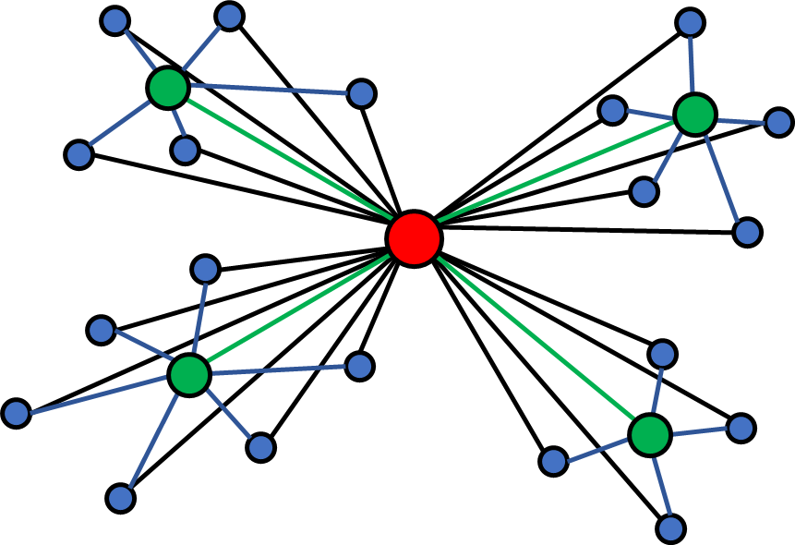
Partitioning Variance in an ANOVA
We need to account for statistical dependencies in our data to isolate the “level” at which our different effects occur.
The book does this by calculating within-subject “weights” as a transformation of the outcome measure.
An equivalent method, that I will use, is accounting for the mean of each person/condition/etc. in our different analyses.
I will walk through several examples from the book.

Slide 14
Partitioning Variance in an ANOVA
In our first lab, I will ask you to walk through these calculations by hand so that you can perform them on your own.
In general though, it is more important that you have a conceptual understanding of your study design, partitioning variance, and how to interpret the results you get from a statistical program.
In the second lab, we will use R to run statistical models with multiple repeated measures and for mixed designs. Our focus in that lab will be on interpreting statistical outputs.

