Slide 1
Research Design and Analysis: Measurement and Types of Data.
Keith Lohse, PhD, PStat
Department of Health and Kinesiology
Department of Physical Therapy and Athletic Training
University of Utah
e: rehabinformatics@gmail.com

Slide 2
Measurement and Data
Measurement is the comparison of a value to a standard.
e.g., P units of K
i.e., we can only have 0.5 inches, if know what 1 inch means.
Data are the result of measurement.
In statistics, we want to measure variables in samples of data.
Describe the sample.
Infer something about the population based on the sample.

Slide 3

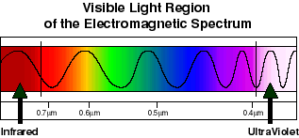
Types of variables
Color as a discrete nominal variable:
Red Yellow Green Blue Purple
Aubergine?
Color as a continuous interval variable

Slide 4
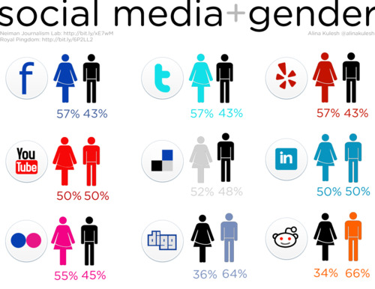

Classification of Data
Nonparametric
Nominal: mutually exclusive, qualitatively different.
Political affiliation megbeth.deviantart.com
Gender communicationcorner.blogpsot.com

Slide 5
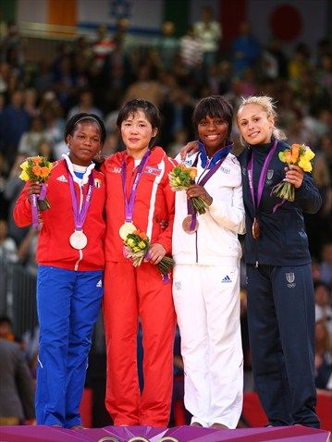
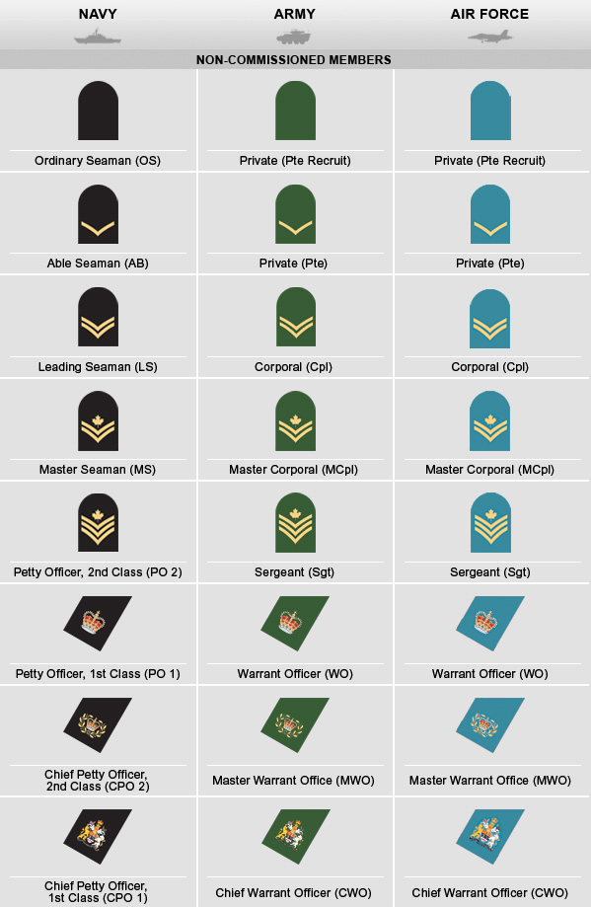
Classification of Data
Nonparametric
Nominal: mutually exclusive, qualitatively different.
Ordinal: quantitative differences, but no fixed intervals.
Rankings/Grades

Slide 6
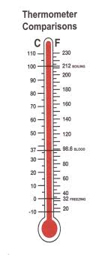

Classification of Data
Nonparametric
Nominal: mutually exclusive, qualitative different.
Ordinal: quantitative differences, but no fixed intervals.
Parametric
Interval: fixed intervals, but no true zero point.
Temperature

Slide 7
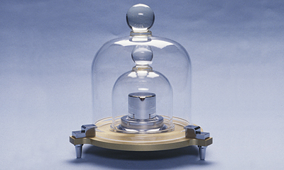

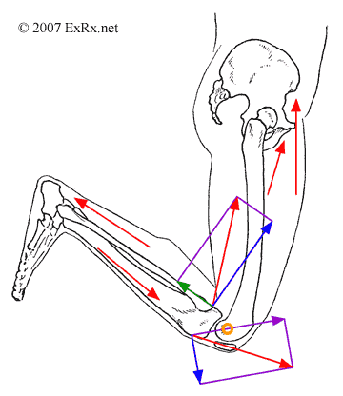
Classification of Data
Mass
Nonparametric
Nominal: mutually exclusive, qualitative different.
Ordinal: quantitative differences, but no fixed intervals.
Parametric
Interval: fixed intervals, but no true zero point.
Ratio: fixed intervals and a true zero point that indicates the absence of a quality.
The International Prototype Kilogram
Force

Slide 8

Natural constants...
Historically, measurements were often regional and idiosyncratic, decided by particular ruler or institution.
These measures were often used for economic purposes such as trade and taxation.
How many hands tall is a horse?
... It depends on whose hands (distance from thumb to extended little finger.
How many pounds does a horse weigh?
Avoirdupois pounds are 7,200 grains. If it was a rainy season and the grains were heavier, the horse weighed less. (???)

Slide 9
Natural constants...
Clearly, older arbitrary definitions are flawed, because they are either not stable over time, not consistent place to place, etc.
Modern definitions for standard units are ideally based on natural constants:
Distance: Meters are defined by the path travelled by light in a vacuum (speed of light).
Time: Seconds are based electron transitions in cesium (Plancks’ law).
Mass: The kilogram is the only unit still without definition by a natural constant... Which is why we have a standard prototype kilogram.

Slide 10
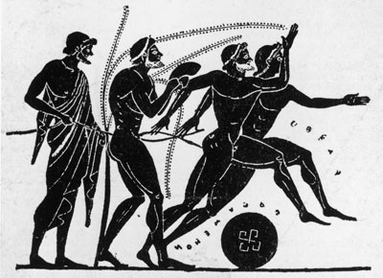
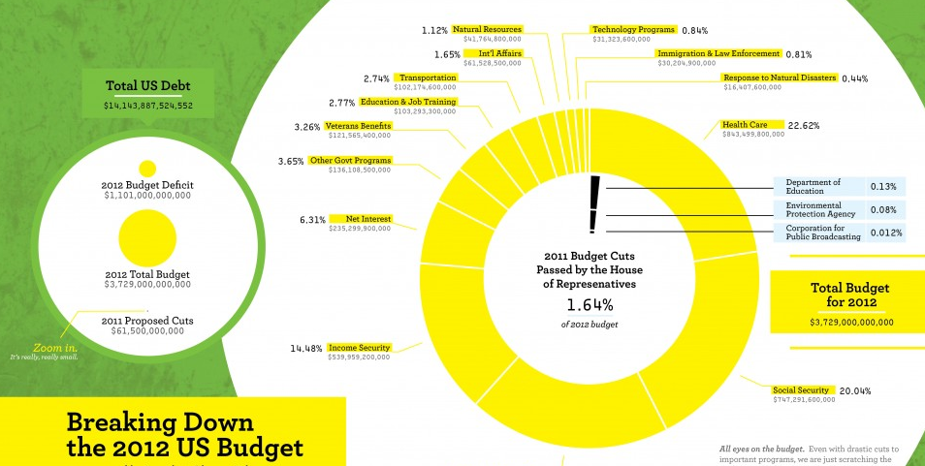
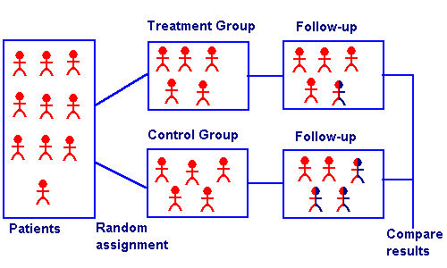
Research design and analysis
Historical Research
Descriptive Research
Experimental Research

Slide 11
Types of Data Matter.
We usually use numbers to represent values of variables
Numbers are just a model (or analogy) for real world
Some properties relevant, some superfluous
Sex
Males = 1; females = 2
Females not twice males
Numbers have many properties
Which are relevant for a given variable?
Determines what kinds of statistics make sense
Scale of a variable
Summarizes what numerical properties are meaningful
4 types of scales: Nominal, Ordinal, Interval, Ratio

Slide 12
Nominal Scale: Which stat is appropriate?
Values are just labels
Sex: {male, female}
Color: {red, green, blue, …}
No structure or relationships between values
Essentially non-numeric
Can use numbers for “coding” but just as placeholders
Red = 1; green = 2; blue = 3
Only mathematical notion is equality (=)
Two scores are equal, or they’re not
Few meaningful statistics
Frequencies: Number of scores of a given value
Mode: Value with greatest frequency

Slide 13
Ordinal Scale: Which stat is appropriate?
Values are ordered, but differences aren’t meaningful
Preferences, contest placings, years of education
1st - 2nd ≠ 2nd - 3rd
Mathematical notion of greater-than (>, =)
Additional meaningful statistics
Median, quantiles
Range, interquartile range

Slide 14
Interval Scale: Which stat is appropriate?
Differences between scores are meaningful
Today 4° warmer than yesterday
Ratios of scores can be misleading
20C is not twice as hot as 10C
20C = 293K; 10C = 183K
Also consider IQ tests
No real zero point
Mathematical notion of subtraction (–, >, =)
Additional meaningful statistics
Mean
Variance, standard deviation

Slide 15
Ratio Scale: Which stat is appropriate?
Zero is meaningful
Physical properties.
Weight, time, etc.
Ratios between scores make sense
Twice as heavy, twice as long
Mathematical notion of division (/, –, >, =)
No notable new statistics
0

Slide 16

Summary of Scale Types
Scale | Meaningful Operations | Mode | Median | Mean
Nominal | =
Ordinal | > =
Interval | – > =
Ratio | / – > =
0

