Slide 1
Research Design and Analysis: Fundamentals of Inference.
Keith Lohse, PhD, PStat
Department of Health and Kinesiology
Department of Physical Therapy and Athletic Training
University of Utah
e: rehabinformatics@gmail.com

Slide 2


Populations versus Samples
If you like the sample, do you order a full beer?
Does your sample represent the population (i.e., likelihood you will get the same result)?

Slide 3
Parameter
Characteristic of the population
Usually theoretically meaningful
Could be a mean, variance, proportion, rate, or correlation
What's the average height of college students?
How many attempts does it take a healthy rat to learn a maze?
What's the correlation between height and stroke power for rowers?

Slide 4
Statistic
Mathematical value computed from the data
Difference between statistic and its value
E.g., mean is a statistic (arithmetic average)
Usually serves one of two functions
Descriptive statistic: Summarizes some aspect of the sample data
Inferential statistic: Aids testing of some hypothesis, or making some estimate about the population

Slide 5
Descriptive Statistic
Summarizes some aspect of the data
Mean, median, maximum, quartiles, standard deviation, etc.
Used only for describing sample data
Not for making inferences about population
Can be first step of data analysis
Also useful if sample is all you’re interested in
E.g. average age of students in class

Slide 6
Inferential Statistic
Aids testing of some hypothesis about the population
Indicates how reliable an effect in the sample is
That is, how likely is an effect to be observed in the population.
Value generally has no physical meaning
Not like inches, time, or even psychological variables
Examples: t, F, χ², η, τ, β

Slide 7
Basic Logic of Inferential Statistics
Start with two hypotheses:
Null hypothesis – there is no effect of IV
Alternative hypothesis – there is some effect of IV
We pretend that the null is true.
We then ask, “how likely is our observed statistic if the null is true?”
If our observation is unlikely (given the null), then we reject the null and say there is an effect.

Slide 8

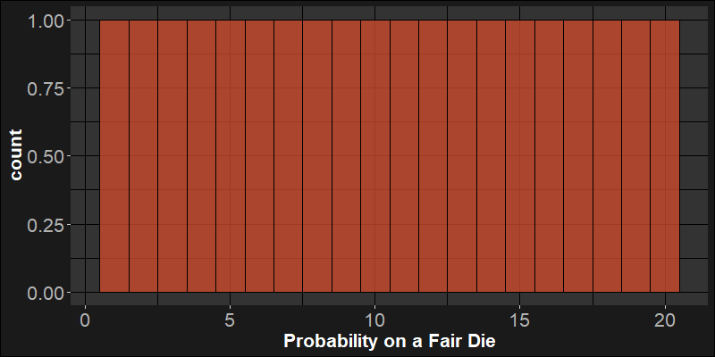
Do I have a fair die?
For a single value, this is hard to determine.
Getting a 20 on single die roll has the same probability as any other value.

Slide 9
Do I have a fair die?
Let’s assume I’m a pretty cagey cheater. It won’t come up 20 every time, but it is biased to come up with higher numbers more often.
You’ve watched me roll my die 10 times and the average value on those rolls was 14.
You go home and roll your die 10 times (observations) for 1,000 samples (10,000 total rolls).
Each time, you record the mean of your 10 rolls.

Slide 10
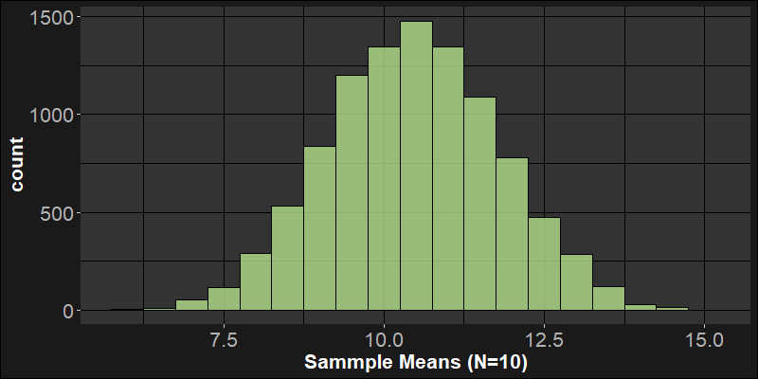
Do I have a fair die?
For a sample of 10 rolls, how likely is it to get an average of 14?
It’s unlikely to get an average of 14 on 10 rolls.
It’s not impossible, but pretty unlikely.

Slide 11
Do I have a fair die?
What if I am a very careful cheater and I rig my die to be more subtle, in ten rolls, the average value is 12?
It is more likely to get an average of 12 on 10 rolls.
Is it worth the risk of calling me a cheater?

Slide 12
Drawing inferences from distributions
If we know something about how the sample statistics should be distributed, then we can make inferential judgments about our sample statistic.
“We should expect X number of heads in K coin flips.”
“We should expect a mean this large or larger X% of the time.”

Slide 13
Descriptive Statistics
Means, medians
Standard deviations, ranges
Effect Size
Variance
Sample Size
Math!
Inferential Statistics

