Slide 1
Research Design and Analysis: Organizing and Displaying Data.
Keith Lohse, PhD, PStat
Department of Health and Kinesiology
Department of Physical Therapy and Athletic Training
University of Utah
e: rehabinformatics@gmail.com

Slide 2
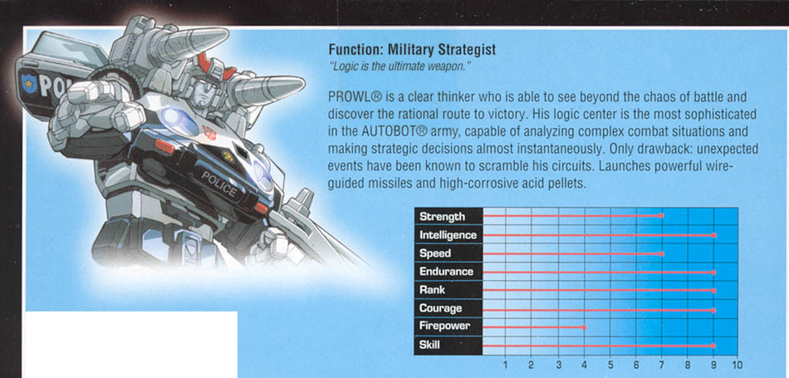

Slide 4
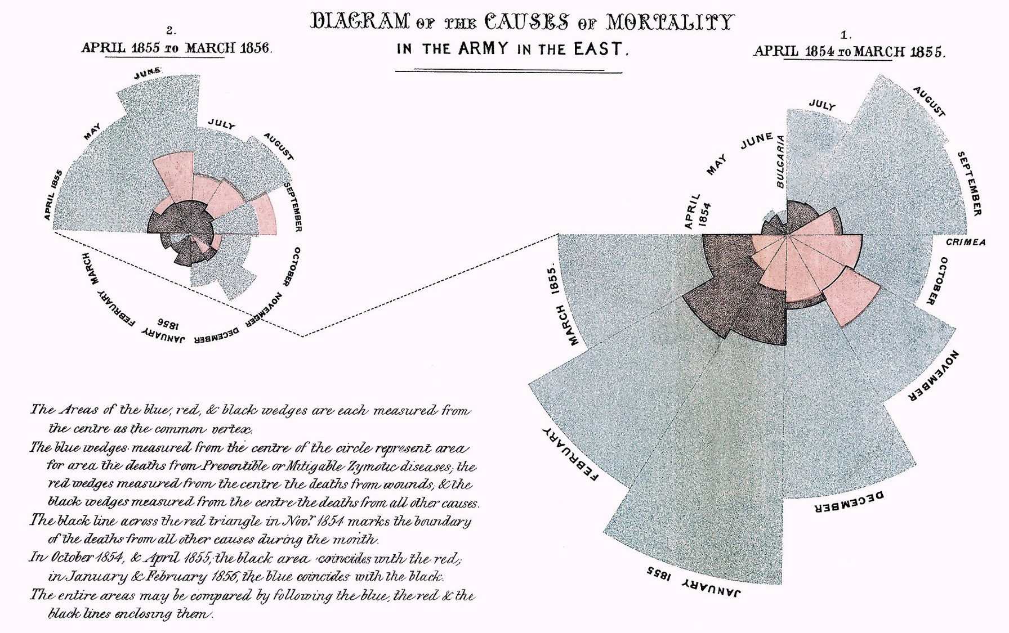
[Caused of Mortality in the Army in the East – Florence Nightengale]

Slide 5
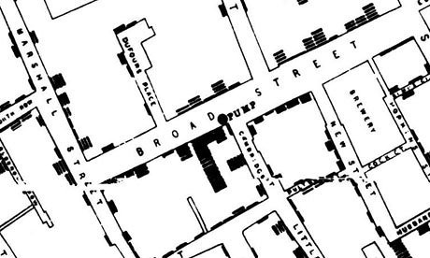
[Death’s in the Broad Street Area during the 1854 London cholera epidemic – John Snow]

Slide 6
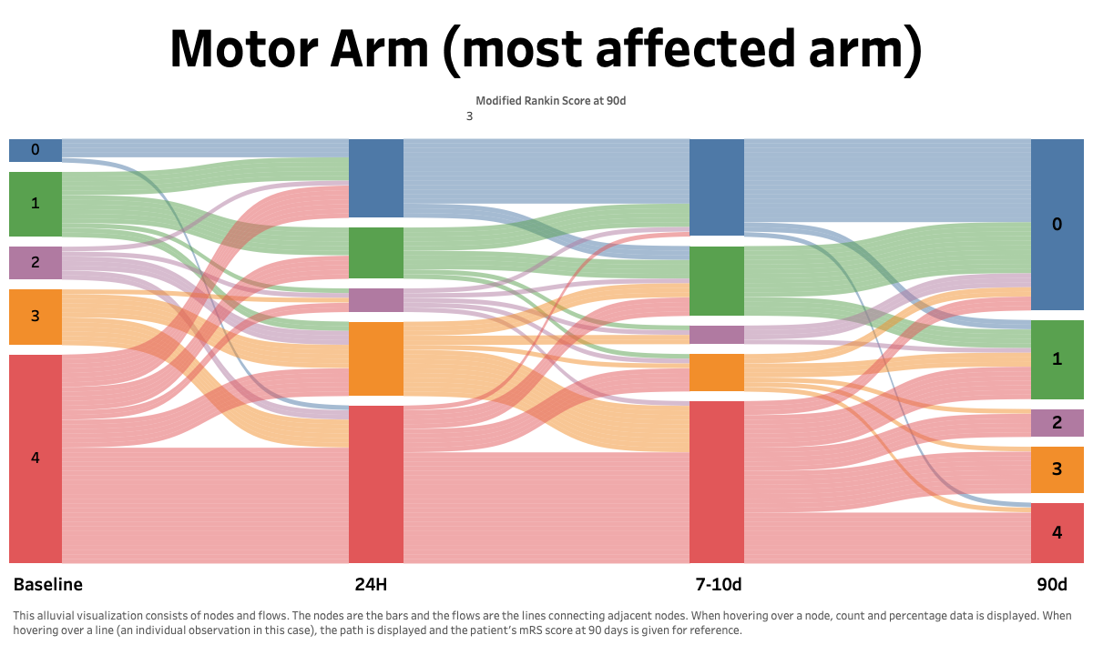
[Braun et al., Neurology, 2020 – An illustration of a Sankey Diagram named for Matthew Sankey]

Slide 7
Visualizing Data
Provide a summary of the data that is accurate.
Provide a summary of the data that is efficient.
What is some important information that we would want to convey?
The typical value.
The spread of the scores.
Are scores symmetrically or asymmetrically distributed.

Slide 8
Distribution
The set of values present in a sample or population.
Which values occur and how often.
Starting point for statistics.
Every statistic is computed from sample distribution.
Every parameter is a property of population distribution.
Need ways of visualizing distributions.
In particular, we tend to focus on the center, the spread, and the shape of distributions.

Slide 9
Scales of Measurement
Ratio: ordered scores with known interval and fixed zero (height, mass, Kelvin)
Interval: ordered scores with known interval (SAT; GPA;IQ, Celsius, Fahrenheit)
Ordinal: different ordered scores (finishers in a race; preferences)
Nominal: different scores (gender, categories, depressed/not, etc.)
As we ascend, our scales contain more information

Slide 10
Frequency Table
Easy way to characterize distribution, but not as easily interpretable as graphs
How often each value occurs
f(x) = frequency of value x
Sample: {1, 6, 3, 8, 6, 4}. f(6) = ?
Frequency table
Shows frequencies of all values
1st column for value, 2nd column for frequency
x f(x)
2
1
3
4
{5,7,3,7,2,5,5,3,7,5,3,11,7,5,3,5}
5
6
7
4
11
1

Slide 11
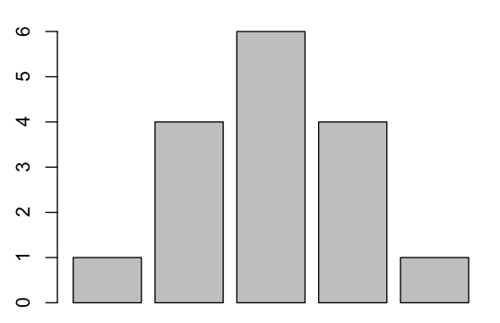
Barplot
x f(x)
Shows frequencies of all values by height of each bar
red
1
green
4
blue
6
yellow
4
orange
1
red gr bl ye or
Good for nominal data because the order of the x-axis is arbitrary.

Slide 12
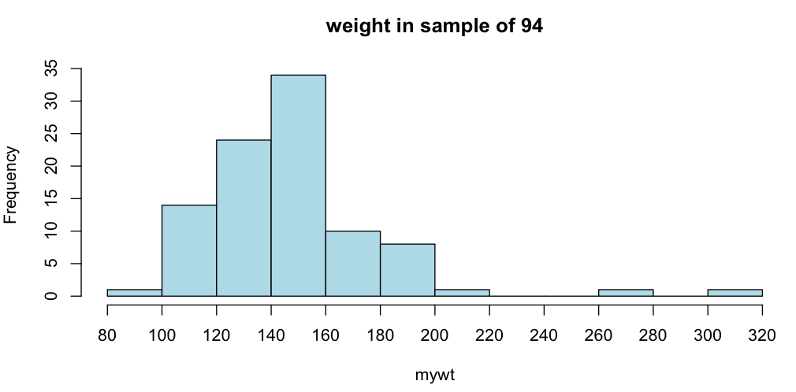
Histograms
Misleading for ordinal data because we assume equal spacing of the x-axis.

Slide 13
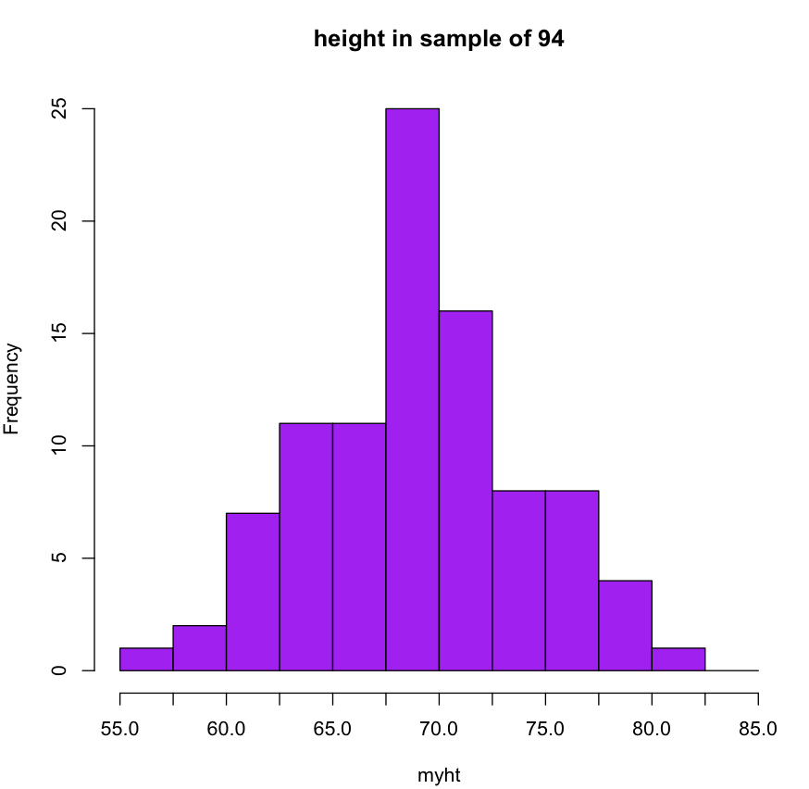
Histograms

Slide 14
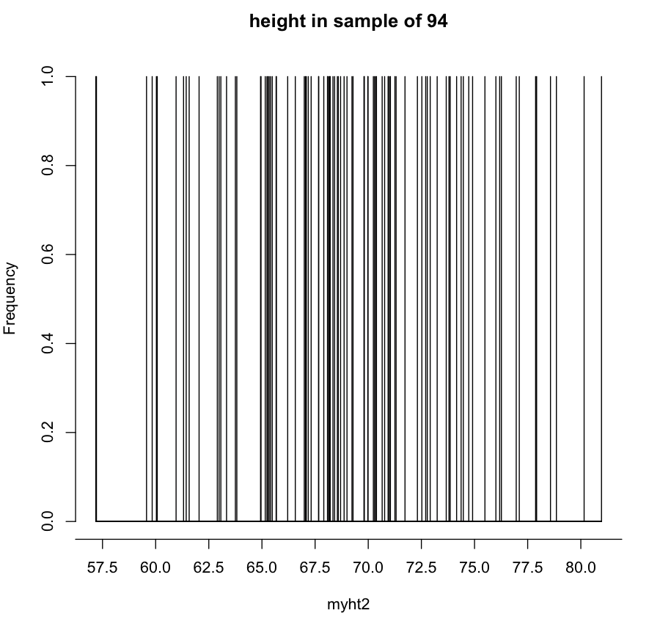
Uninformative Histogram – bins too small

Slide 15
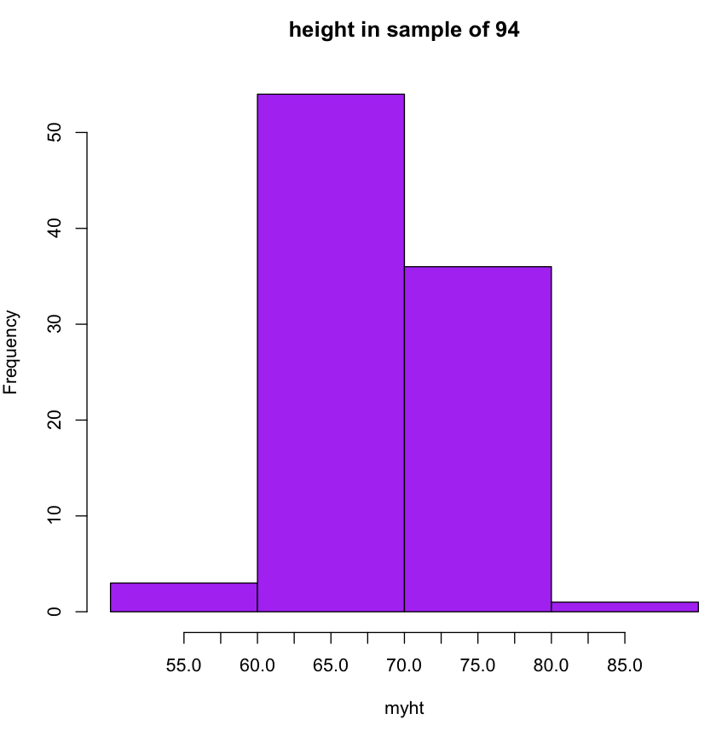
Uninformative Histogram – bins too big

Slide 16
Histograms – just right

Slide 17
Too small to be informative.
Accurate and efficient presentation of the data.
Too big to be informative.

Slide 18
Histograms – just right
The book gives “formula” for interval size.
This is more a rule of thumb, but in general, a good interval size is
I = range/15

Slide 19
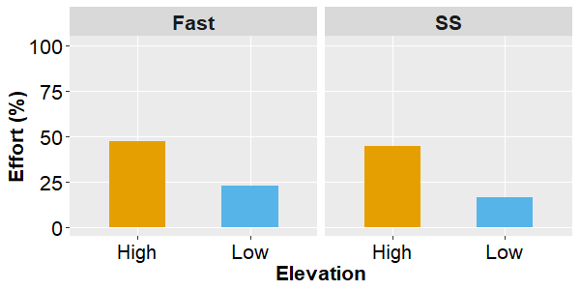
Consider a 2 x 2 factorial design.
Participants walked at fast or selected speeds at virtual high or low heights.
Among other things, we collected psychological perceptions of effort across the different trials.
No measure of central tendency.
No measures of spread.
No information about sample size.
No information about the correlation between measures.
[Raffegeau et al., 2020]

Slide 20
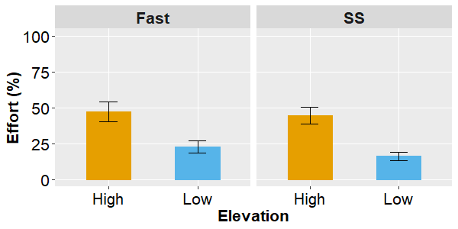
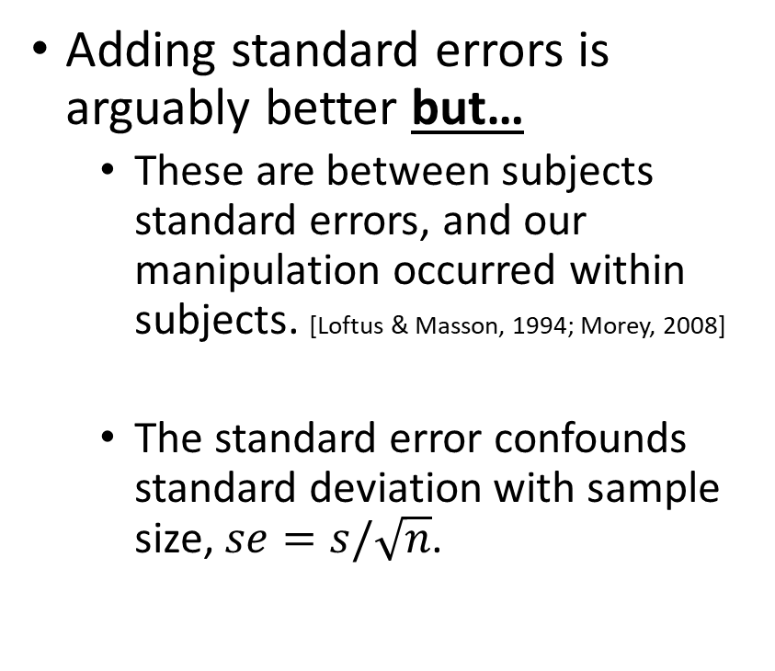
Consider a 2 x 2 factorial design.
Adding standard errors is arguably better but…
These are between subjects standard errors, and our manipulation occurred within subjects. [Loftus & Masson, 1994; Morey, 2008]
The standard error confounds standard deviation with sample size, $se=s/\sqrt{n}$.
No measure of central tendency.
No measures of spread.
No information about sample size.
No information about the correlation between measures.
[Raffegeau et al., 2020]

Slide 21
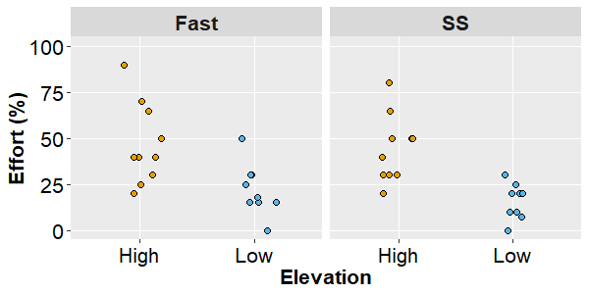
Consider a 2 x 2 factorial design.
What if we just plot all of the data?
To paraphrase Karl Pearson, we have now put our “data on the table”, but something has also been lost. [Stigler, 2002]
Measures of central tendency are critical to our statistical inference.
We have gained a rich description of our sample, but lost the correspondence to our analysis.
No measure of central tendency.
No measures of spread.
No information about sample size.
No information about the correlation between measures.
[Raffegeau et al., 2020]

Slide 22
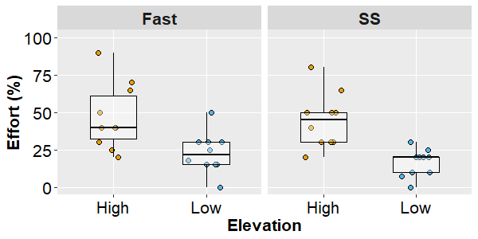
Consider a 2 x 2 factorial design.
Now this is good! By playing with overlay and transparency, group-level statistics are emphasized (for inference).
But all of the participant-level data are also visible (for description/assumptions).
One issue is that boxplots show medians, but most of our inferential statistics are based on means.
This isn’t bad, but potentially lacks correspondence between visualization and analysis.
In a within-subject design, we might want to know which points belong to whom.
No measure of central tendency.
No measures of spread.
No information about sample size.
No information about the correlation between measures.
[Raffegeau et al., 2020]

Slide 23
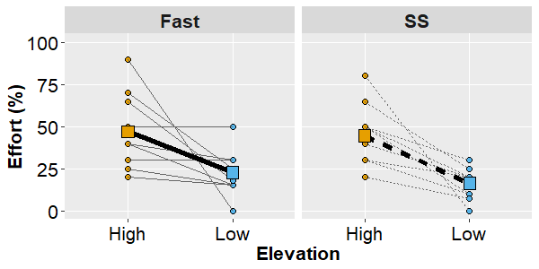
Consider a 2 x 2 factorial design.
We can overlay the means for each condition on top of the data for each condition.
By connecting the dots, we can also provide information about the correlation between conditions.
No measure of central tendency.
No measures of spread.
No information about sample size.
No information about the correlation between measures.
[Raffegeau et al., 2020]

