Slide 1
Research Design and Analysis: Measures of Central Tendency.
Keith Lohse, PhD, PStat
Department of Health and Kinesiology
Department of Physical Therapy and Athletic Training
University of Utah
e: rehabinformatics@gmail.com

Slide 2
Refresher: What are “statistics”?
Numerical summaries that characterize the shapes of distributions, allowing efficient comparisons between distributions.
At the population level, we call these parameters.
Broadly, we interested in a few different statistics in our sample in order to make inferences about parameters in the population.
Central tendency (typical value)
Variability (spread or disagreement)
Skew (long-tail one direction or other)

Slide 3

Central Tendency Statistics
Mean (m or $\overline{x}$): Average Value
Median (median or Med): Value of score in the middlemost location (or median location)
Value of score in (n + 1)/2 location
Mode (mode): Most frequent value

Slide 4

I have a two part mathematics test:
9 arithmetic question
9 algebraic questions
114 students took the test.
How do we measure students performance on the exam?
How did the “typical” student do?

Slide 5
Computing the Mean of 9 arithmetic questions.

Slide 6
Computing the Mean of 9 algebra questions.

Slide 7
Computing the Median of 9 arithmetic questions
Location of Median = (114+1)/2 = 57.5
Median = 8

Slide 8
Computing the Median 9 algebra questions
Location of Median = (114+1)/2 = 57.5
Median = 5

Slide 9
Finding the median if n is an even number
Finding the median if n is an odd number
5,6,6,7,7,9,10,11,11,13
5,6,6,7,7,9,10,11,11

Slide 10
Arithmetic
Mean = 7.54
Median = 8
Mode = 8
Algebra
Mean = 5.43
Median = 5
Mode = 5

Slide 11
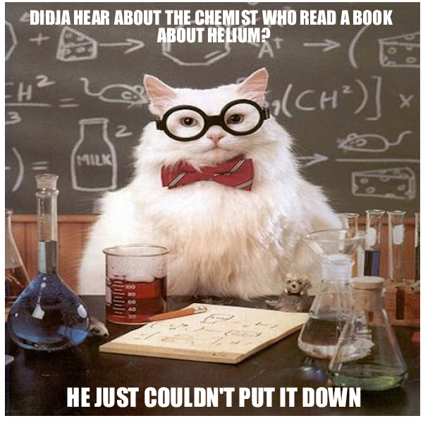
If the median is the “most central” point in a distribution, then what is the mean?
Hint: The median cuts the data in half. There are as many scores above the median as below.
Answer: the mean creates a symmetrical distribution of errors. That is, the magnitude of scores above the mean is equal to the magnitude below.

Slide 12
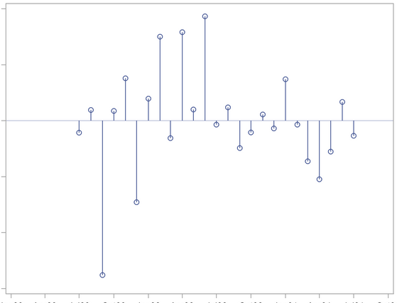
Mean
Error
Or
“Residual”
Because the mean divides the mass of scores into equal parts, the mean has a special property of making the sum of these errors = 0.

Slide 13
Desirable Properties of Sample Statistics
Unbiased: On average the sample statistic equals the population parameter.
Both mean and median unbiased.
Efficient: A more efficient statistic is one that varies less from sample to sample; on average it is closer to the population parameter
In general, mean is more efficient than the median.
Consistent: A consistent statistic is one where efficiency increases as the sample size increases. (We will understand this better later.)
Both the mean and the median are consistent.

Slide 14
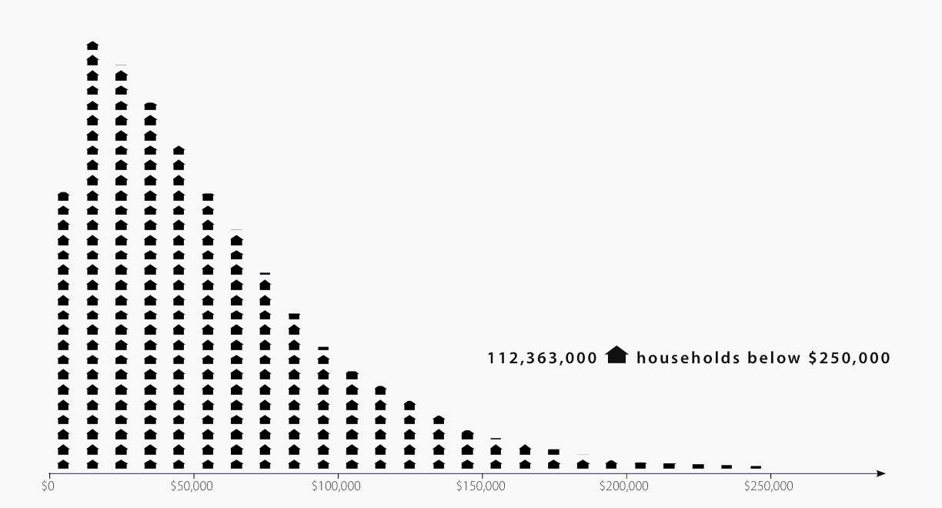
Mean vs. Median
Both based on a notion of balance
Mean sensitive to each datum's distance from middle
Median better for irregular distributions
Skew
Outliers
Median
Mean
Mean
Median ($46k)
Mean excluding outlier
Mean
Mean ($63k)
Frequency (.5 M households)
Household Income

Slide 15
Mode
Most common value
Peak in the distribution for continuous variables
Simple and insensitive
Most useful when mean, median not definable
College majors, sex, favorite color

Slide 16
Different stats for different scale types.
We usually use numbers to represent values of variables
Numbers are just a model or analogy for real world
Some properties relevant, some superfluous
Sex
Males = 1; females = 2
Females not twice males
Numbers have many properties
Which are relevant for a given variable?
Determines what kinds of statistics make sense
Scale of a variable
Summarizes what numerical properties are meaningful
4 types of scales: Nominal, Ordinal, Interval, Ratio

Slide 17
Nominal Scale: Which stat is appropriate?
Values are just labels
Sex: {male, female}
Color: {red, green, blue, …}
No structure or relationships between values
Essentially non-numeric
Can use numbers for “coding” but just as placeholders
Red = 1; green = 2; blue = 3
Only mathematical notion is equality (=)
Two scores are equal, or they’re not
Few meaningful statistics
Frequencies: Number of scores of a given value
Mode: Value with greatest frequency

Slide 18
Ordinal Scale: Which stat is appropriate?
Values are ordered, but differences aren’t meaningful
Preferences, contest placings, years of education
1st - 2nd ≠ 2nd - 3rd
Mathematical notion of greater-than (>, =)
Additional meaningful statistics
Median, quantiles
Range, interquartile range

Slide 19
Interval Scale: Which stat is appropriate?
Differences between scores are meaningful
Today 4° warmer than yesterday
Ratios of scores can be misleading
20C is not twice as hot as 10C
20C = 293K; 10C = 183K
Also consider IQ tests
No real zero point
Mathematical notion of subtraction (–, >, =)
Additional meaningful statistics
Mean
Variance, standard deviation

Slide 20
Ratio Scale: Which stat is appropriate?
Zero is meaningful
Physical properties.
Weight, time, etc.
Ratios between scores make sense
Twice as heavy, twice as long
Mathematical notion of division (/, –, >, =)
No notable new statistics
0

Slide 21

Summary of Scale Types
Scale | Meaningful Operations | Mode | Median | Mean
Nominal | =
Ordinal | > =
Interval | – > =
Ratio | / – > =
0

