Slide 1
Research Design and Analysis: Measures of Variability.
Keith Lohse, PhD, PStat
Department of Health and Kinesiology
Department of Physical Therapy and Athletic Training
University of Utah
e: rehabinformatics@gmail.com

Slide 2


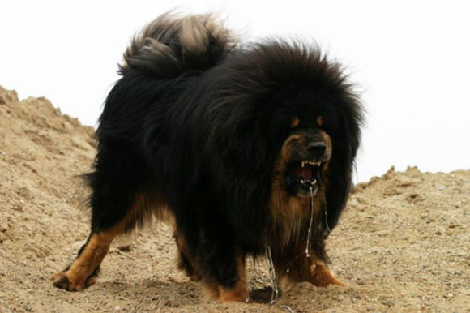
What first comes into your mind when I mention a dog?
What is the average dog?
These are all dogs, but dogs are all very different from each other.
How different are they?

Slide 3
Variability
Central tendency locates the middle of distribution,
But how are scores distributed around that point?
Low variability vs. high variability
Ways to measure variability
Range
Interquartile range
Sum of squared errors
Variance
Standard deviation

Slide 4
Why Variability is Important
Inference
Reliability of estimators
For its own sake
Consistency (manufacturing, sports, etc.)
Diversity (attitudes, strategies)
61
97
31
105
104
105
100
108
108
99
97
97
55
100
97
106
106
55
31
31
52
52
52
13
13
13
43
43
49
43
100
108
108
99
106
104
106
49
49
58
58
58
100
100
100
61
61
97
55
100
178
178
94
181
109
46
93
108
96
105
104
178
154
104
109
93
97
100
104
154
154
136
136
136
103
103
103
94
94
181
181
91
91
91
109
109
46
46
28
28
28
93
108
96
105
109
93
97
100
104
175
92
103
175
99
34
99
96
105
95
93
100
103
97
34
34
175
37
37
37
139
139
139
106
106
106
19
19
19
184
184
184
88
88
88
112
112
112
64
64
64
96
105
95
93
92
100
103
103
97
22
16
85
130
67
102
92
94
96
108
98
99
94
76
99
101
106
94
76
76
172
172
172
157
157
157
22
22
16
16
85
85
142
142
142
130
130
151
151
151
67
67
102
92
94
96
108
98
101
106
124
95
124
124
127
169
102
94
93
121
93
121
121
160
160
160
40
40
40
145
145
145
127
127
100
100
100
82
82
82
133
133
133
169
169
95
102
94
99
101
102
107
92
97
166
148
25
73
102
166
166
163
163
163
118
118
118
148
148
79
79
79
25
25
115
115
115
73
73
187
187
187
70
70
70
105
95
96
107
101
107
92
103
98
Average = 111.63
Average = 87.25
Average = 121
Average = 99.13

Slide 5
Range
Distance from minimum to maximum
Sample range depends on n
More useful as population parameter
Theoretical property of measurement variable
E.g. clinical measure of function: min and max possible
Rough guidelines, e.g. height
Measurement unit or precision
X = [66.2, 78.6, 69.6, 65.3, 62.7]
78.6 – 62.7 + .1 = 16.0
78.65 – 62.65 = 16.0

Slide 6
Interquartile range
Quartiles
Values of X based on dividing data into quarters
1st quartile: greater than 1/4 of data
3rd quartile: greater than 3/4 of data
2nd quartile = median
Interquartile range
Difference between 1st and 3rd quartiles
Like range, but for middle half of distribution
Not sensitive to n → more stable
6 – 3 = 3
X = [1,1,2,2,2,3,3,4,4,4,4,5,5,5,5,6,6,6,6,6,7,7,7,8]
1st quartile = 3
3rd quartile = 6

Slide 7
Sum of Squared Errors
Based on deviation of each datum from the mean: (X – μ)
Square each deviation and add them up
μ
115
88
94
108
122
133
145
729 = 27²
441 = 21²
49 = 7²
27
21
7
7
18
30
² = 49
² = 324
² = 900

Slide 8
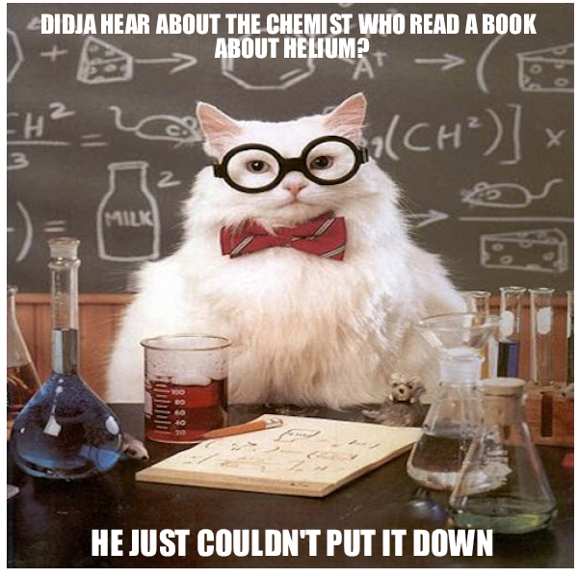
Recall that “errors” or “residuals” are the difference between a score and the mean of scores. What is a squared error?
What does the sum of squared errors tell us?
Answer: A squared error is the difference between a score and the mean multiplied by itself.
The sum of squared errors tells us how much variability is in a set of scores. Closer to the mean = less variable; Farther from the mean = more variable.

Slide 9
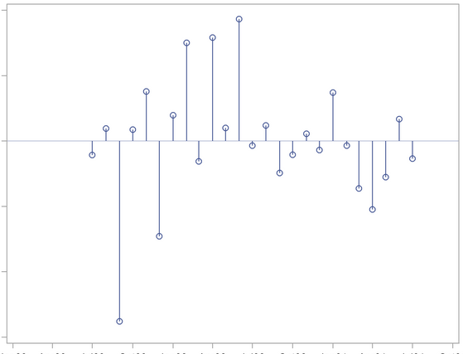
Recall that the sum of errors around the mean is equal to zero.
Now we are talking about the sum of squared errors.
(Often shortened to the “sum of squares”.)
We could take squared errors around any given value (e.g., around the median), but the mean produces the smallest SSE.

Slide 10
Variance
Most sophisticated statistic for variability
Sum of squares divided by N
Mean Square: average squared deviation
μ
115
88
94
108
122
133
145
729 = 27²
441 = 21²
49 = 7²
27
21
7
7
18
30
² = 49
² = 324
² = 900

Slide 11
Why square the difference?
Could use absolute distances, |X - µ|
Would be more intuitive: average distance from the mean
Squares have special mathematical properties
Can be broken into different parts
Sum of Squares:
Differences among scores
Central Tendency:
Common to all scores

Slide 12
Standard deviation
Conceptually, SD = the typical difference between X and μ
Again, based on (X – μ)²
Variance is average squared deviation, so sqrt(variance) is standard deviation
X = [5, 3, 7, 6, 4, 6, 8, 7, 4, 2, 3, 5]
μ = 5
Average
X – μ = [0, -2, 2, 1, -1, 1, 3, 2, -1, -3, -2, 0]
Square
Square-root
Average
(X – μ)² = [0, 4, 4, 1, 1, 1, 9, 4, 1, 9, 4, 0]

