Slide 1
Research Design and Analysis: Degrees of Freedom.
Keith Lohse, PhD, PStat
Department of Health and Kinesiology
Department of Physical Therapy and Athletic Training
University of Utah
e: rehabinformatics@gmail.com

Slide 2
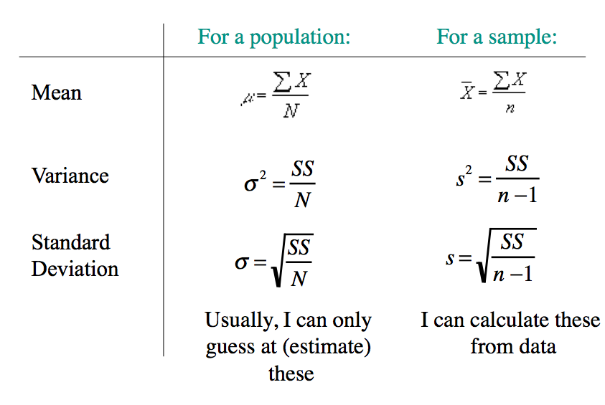
Comparing Mean, Variance, and SD for populations and samples

Slide 3
Degrees of freedom (df)
Degrees of freedom are independent bits of information.
A conceptual example – You hear that John is a jerk.
Are you more inclined to believe this if you hear it from one person or from ten people?
What if you hear it from ten people who all met him at one party?
The more independent information (df) we have, the more certainty we have about our subjective impressions.
It’s the same in stats!

Slide 4









Degrees of freedom (df) in statistics
In statistics, it is crucial to know how many independent bits of information (df) are being used to estimate a parameter.
We want to estimate the standard deviation in the population:
df = number of observations minus the number of estimated parameters.
$$σ^{2}=\sqrt{\frac{{\left(x−μ\right)}^{2}}{n}}$$
$$σ^{2}\sim s^{2}=\sqrt{\frac{{\left(x−\overline{x}\right)}^{2}}{n−1}}$$
$$\{x_{1},x_{2},x_{3}\}$$
$$\overline{x}$$
$$μ$$
$$\overline{x}$$
$$\{x_{1},x_{2},x_{3}\}$$
$$\overline{x}$$
$$\{x_{1},x_{2},x_{3}\}$$

Slide 5







Degrees of freedom (df) in statistics
In statistics, it is crucial to know how many independent bits of information (df) are being used to estimate a parameter.
We want to estimate the standard deviation in the population:
df = number of observations minus the number of estimated parameters.
$$σ^{2}=\sqrt{\frac{{\left(x−μ\right)}^{2}}{n}}$$
$$σ^{2}\sim s^{2}=\sqrt{\frac{{\left(x−\overline{x}\right)}^{2}}{n−1}}$$
df=2
$$\{x_{1},x_{2},x_{3}\}$$
df=99
$$\overline{x}$$
$$\overline{x}$$
$$\{x_{1},x_{2},x_{3},…x_{100}\}$$
$$μ$$
$$μ$$
$$\overline{x}$$
$$\{x_{1},x_{2},x_{3}, …x_{100}\}$$
$$\overline{x}$$
$$\{x_{1},x_{2},x_{3}\}$$
$$\overline{x}$$
$$\{x_{1},x_{2},x_{3}, …x_{100}\}$$
$$\overline{x}$$
$$\{x_{1},x_{2},x_{3}\}$$

Slide 6
How many df for deviations from the sample mean?
Why is it N-1?
Imagine I collect two data points. If I tell you the mean, and then give you one of the data points, you can figure out the second. E.g.:
mean = 10 X1 = 5 X2 = ?
Given the mean and one data point, the other is not free to vary.
For deviations from the mean, only n-1 df exist for what those deviations could be (one of them is determined by virtue of knowing the mean):
With 2 data points, there are 2 - 1 independent deviations
With 3 data points, there are 3 - 1 independent deviations
With 4 data points, there are 4 - 1 independent deviations

Slide 7
Variance given the population mean
Given a single data point X and given the population mean μ we could get an estimate of the variance (albeit not a reliable one):
μ
115
94
-21
We have a single bit of information about the variance. Said another way, we have 1 df in this situation.

Slide 8
Variance when we don’t know the population mean
Given a single data point X and when we DON’T know the population mean, we CANNOT get an estimate of the variance
X
94
Because we had to use our sample to estimate the mean, we have a NO information about the variance (a point cannot deviate from the mean when n=1). I.e., we have 0 df in this situation.
df = n-1 = 0

Slide 9
Variance of a sample
Given 2 data points, we can estimate the mean and have one bit of information “left over” (read 1 df) to estimate the variance!
X
101
108
94
-7
7
Did the amount of information we have magically jump from 0 to 2 by adding a single data point?
We added one bit more information, and thus we increase from 0 df to 1.
df = n-1 = 1

Slide 10
Variance of a sample
X
101
108
μ
115
94
-7
-21
7
-7
Note: together the deviations are closer to the sample mean than to μ. This must be so: the sum of squared deviations from the sample mean ≤ sum squared deviations from any other #, including μ.
Thus, if we simply average the two squared deviations, it would always be less than or equal to variance we’d get if we had known the population mean.
I.e., it would be a biased estimate of the true variance in the population

Slide 11
Unbiased estimate of population variance derived from a sample:
X
112
86
94
108
122
128
133
-26
-18
-4
10
16
21

Slide 12
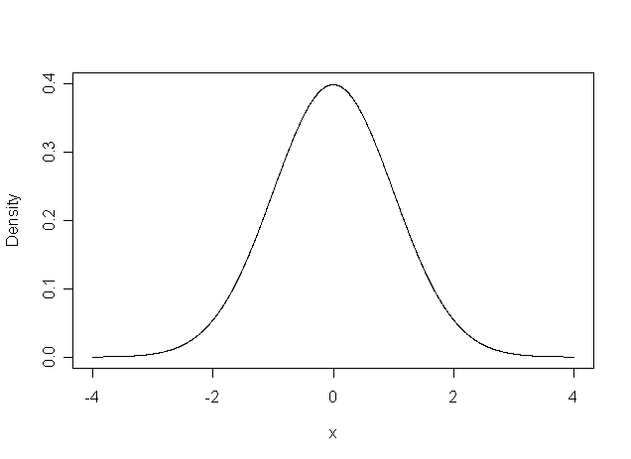
Biased Estimators: The Example of Variance
Population variance
(X-μ)² is unbiased estimator of σ²
Many observations:
Problem: We don't know μ
Sample mean always shifted toward sample
is biased estimate of σ²
Not a good definition for sample variance
μ
(X – μ)²
M

Slide 13
Sample Variance
Goal: Define sample variance to be unbiased estimator of population variance
E(s²) = σ²
Problem: Obvious answer is biased
M is always closer to X than μ is
Solution:
.
Unbiased: E(s²) = σ²
Sample standard deviation

Slide 14
Comparing Mean, Variance, and SD for populations and samples

