Slide 1
Research Design and Analysis: Fundamentals of Sampling.
Keith Lohse, PhD, PStat
Department of Health and Kinesiology
Department of Physical Therapy and Athletic Training
University of Utah
e: rehabinformatics@gmail.com

Slide 2
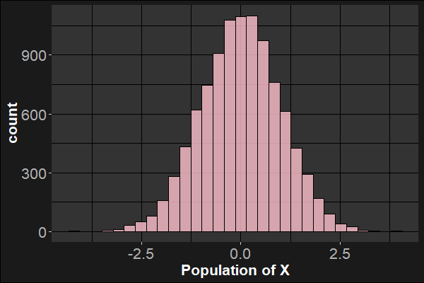
Relating Samples to the Population
μ=0, σ=1

Slide 3
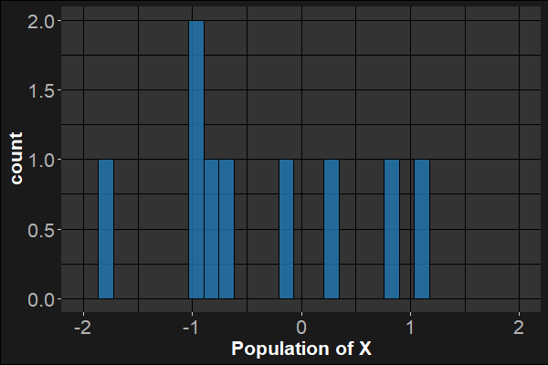

Relating Samples to the Population
$\overline{x}$=-0.13, s=1.14
N=10
μ=0, σ=1

Slide 4
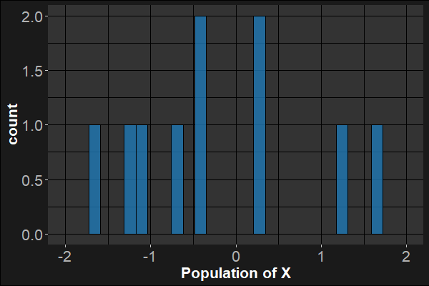

Relating Samples to the Population
$\overline{x}$=-0.13, s=1.14
N=10
μ=0, σ=1
$\overline{x}$=-0.21, s=1.11

Slide 5
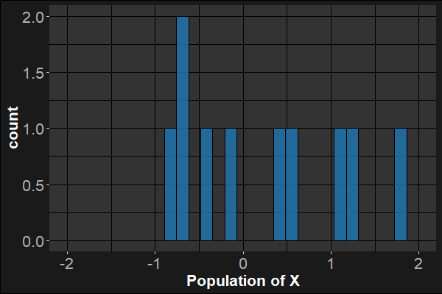

Relating Samples to the Population
$\overline{x}$=-0.13, s=1.14
N=10
μ=0, σ=1
$\overline{x}$=0.25, s=0.92
$\overline{x}$=-0.21, s=1.11

Slide 6
What if we increase the sample size?
μ=0, σ=1

Slide 7
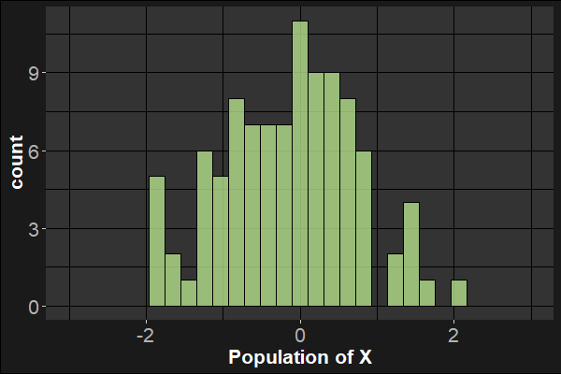

What if we increase the sample size?
N=100
$\overline{x}$=-0.11, s=0.90
μ=0, σ=1

Slide 8
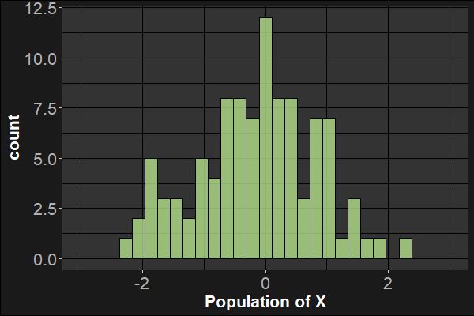

What if we increase the sample size?
N=100
$\overline{x}$=-0.11, s=0.90
μ=0, σ=1
$\overline{x}$=-0.15, s=0.97

Slide 9
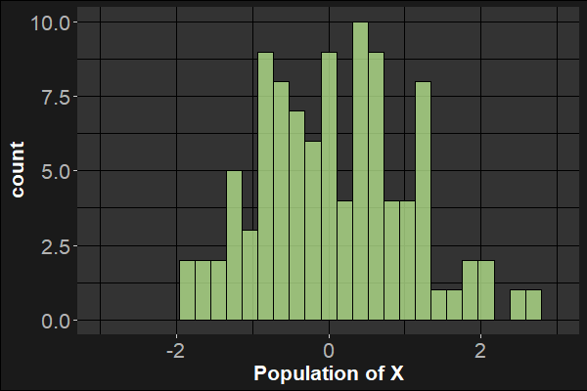

What if we increase the sample size?
N=100
$\overline{x}$=-0.11, s=0.90
μ=0, σ=1
$\overline{x}$=0.07, s=0.98
$\overline{x}$=-0.15, s=0.97

Slide 10
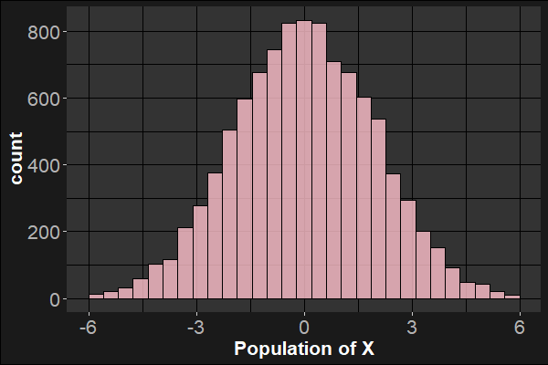
What if we change the variance?
μ=0, σ=2

Slide 11
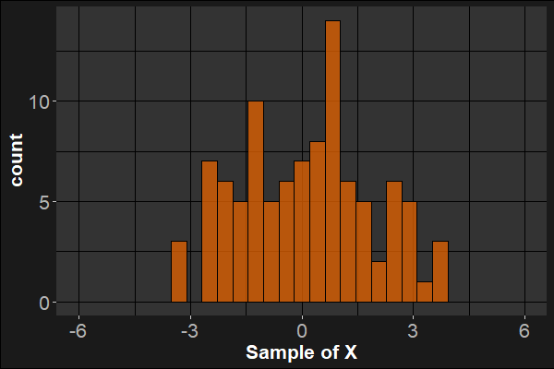

What if we change the variance?
N=100
$\overline{x}$=0.19, s=1.87
μ=0, σ=2

Slide 12
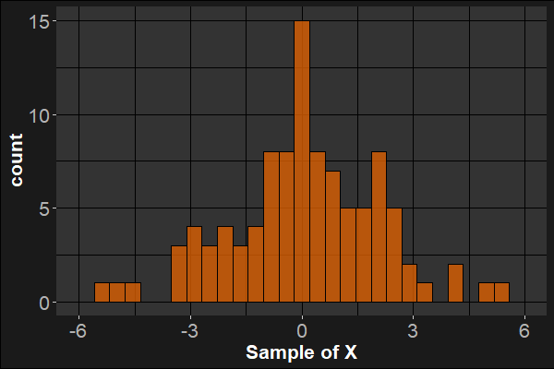

What if we change the variance?
N=100
$\overline{x}$=0.19, s=1.87
μ=0, σ=2
$\overline{x}$=0.09, s=2.04

Slide 13
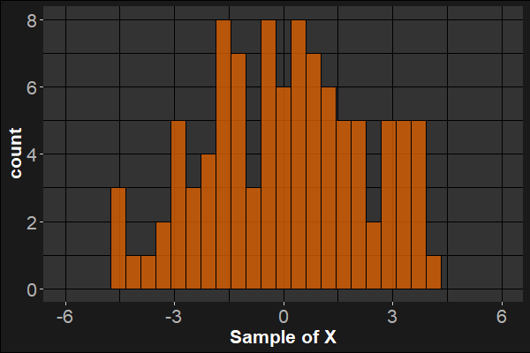

What if we change the variance?
N=100
$\overline{x}$=0.19, s=1.87
μ=0, σ=2
$\overline{x}$=0.06, s=2.18
$\overline{x}$=0.09, s=2.04

Slide 14
Populations → Samples
As we can see, statistics in the sample are similar to the parameters of the population, but they vary from sample to sample.
We can better understand how these statistics vary, by looking at the distribution of sample means.

Slide 15
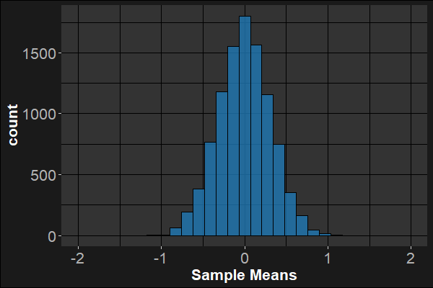

Distribution of Sample Means
N=10
k=10,000 samples
μ=0, σ=1
…
$μ_{\overline{x}}$=0.005, $σ_{\overline{x}}$=0.313

Slide 16
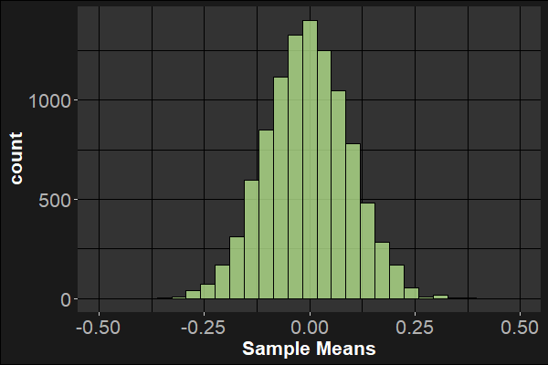

Distribution of Sample Means
N=100
k=10,000 samples
μ=0, σ=1
…
$μ_{\overline{x}}$=-0.004, $σ_{\overline{x}}$=0.098

Slide 17



Distribution of Sample Means
N=10
Notice that these distributions are symmetrical. This makes any single sample mean an unbiased estimate of the population mean.
This also makes the mean of sample means ($μ_{\overline{x}}$) approximately equal to the population mean ($μ$).
μ=0, σ=1
$μ_{\overline{x}}$=0.005, $σ_{\overline{x}}$=0.313
N=100
$μ_{\overline{x}}$=-0.004, $σ_{\overline{x}}$=0.098

Slide 18

Distribution of Sample Means
N=10
However, these sample means do vary and the amount they vary depends on the sample size.
More specifically, the standard error of the mean is
$σ_{\overline{x}}=σ/\sqrt{N}$
The standard error tells how much a sample of a given size should vary from $μ$.
μ=0, σ=1
$μ_{\overline{x}}$=0.005, $σ_{\overline{x}}$=0.313
N=100
$μ_{\overline{x}}$=-0.004, $σ_{\overline{x}}$=0.098

Slide 19

Distribution of Sample Means
N=10
However, these sample means do vary and the amount they vary depends on the sample size.
More specifically, the standard error of the mean is
$σ_{\overline{x}}=σ/\sqrt{N}$
$\frac{1}{\sqrt{10}}=0.316\sim 0.313$
$\frac{1}{\sqrt{100}}=0.100\sim 0.098$
μ=0, σ=1
$μ_{\overline{x}}$=0.005, $σ_{\overline{x}}$=0.313
N=100
$μ_{\overline{x}}$=-0.004, $σ_{\overline{x}}$=0.098

Slide 20

What should we expect from samples?
In summary then, most sample means will fall within $σ/\sqrt{N}$of the population mean.
In practice, however, we don’t know the population standard deviation, $σ$, nor the population mean, $μ$.
Thus, we need to estimate $σ$ using the sample standard deviation, s.
$s/\sqrt{N}$ is our unbiased estimate of the true standard error.

Slide 21
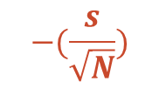



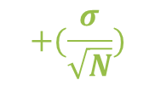

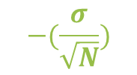


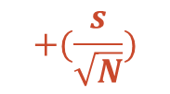
Working both ways.
If we know $μ$, then we know where sample means will likely fall:
If we know $\overline{x}$ and $s$, then we can make an estimate of where the true mean is:
$$μ$$
$$−(\frac{σ}{\sqrt{N}})$$
$$+(\frac{σ}{\sqrt{N}})$$
$μ$?
In subsequent modules, we will explain these confidence intervals in more detail.
$μ$?
$μ$?
$$\overline{x}$$
$$−(\frac{s}{\sqrt{N}})$$
$$+(\frac{s}{\sqrt{N}})$$

