Slide 1
Research Design and Analysis: The Central Limit Theorem.
Keith Lohse, PhD, PStat
Department of Health and Kinesiology
Department of Physical Therapy and Athletic Training
University of Utah
e: rehabinformatics@gmail.com

Slide 2

The Central Limit Theorem
Given a distribution with a mean μ and variance σ², the sampling distribution of the mean approaches a normal distribution with a mean (μ) and a standard error of $σ/(√N)$as N increases.
Recall that the standard error of the mean is really just a special case of standard deviation used for sampling distributions.

Slide 3
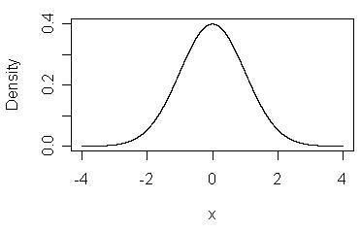


Sampling Distributions
Sampling distribution
The probability distribution of some statistic over repeated replication of an experiment
Distribution of sample means: the probability distribution for $\overline{x}$
Sampling
Distribution
Population
Sample(s)
X = [ -.70 1.10 -.36 -.68 -.08], $\overline{x}$ = -.144
X = [ .09 -.88 1.16 -1.72 .40], $\overline{x}$ = -.019
X = [ -.99 .47 .65 1.52 .20], $\overline{x}$ = .370
X = [ -.84 -2.06 1.06 -.24 2.49], $\overline{x}$ = .082
X = [ 1.88 .57 .38 .16 .85], $\overline{x}$ = .768

Slide 4
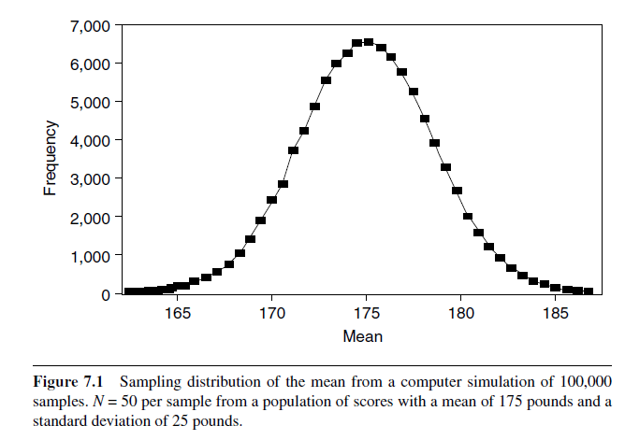
These show the relative frequency of sample means (m)
The standard error of the mean gives average deviation of sample means (SEM).
The mean of means gives an estimate of the population mean (μ).

Slide 5
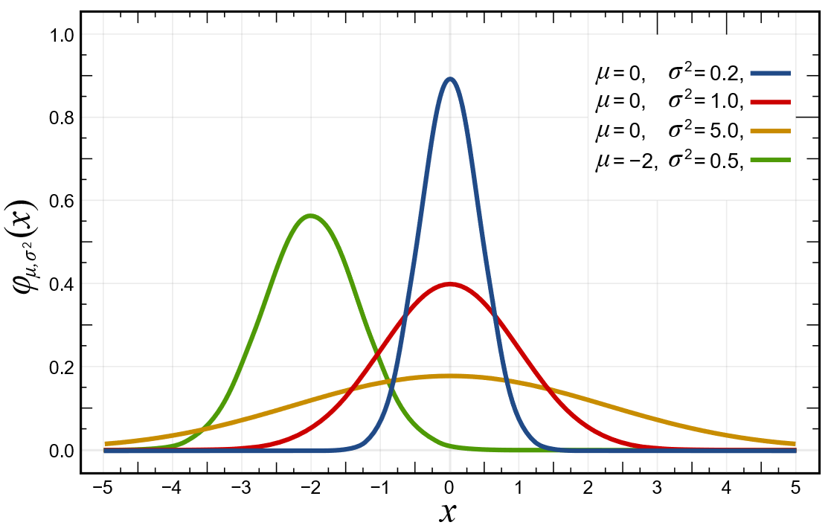

What is normal?
Probability Density Function:
$$f\left(x\right)=\frac{1}{σ\sqrt{2π}}e^{−\frac{1}{2}{\left(\frac{z−μ}{σ}\right)}^{2}}$$

Slide 6
What is normal?
Conceptually, if can define the distribution mathematically, we can calculate the probability of certain events:
p(-1 < x < +1)?
p(x >= +2)?
In practice, applied researchers let computers do these calculations, but it is very important to understand the concepts.

Slide 7
The Power of the Central Limit Theorem
Given any distribution with mean μ and variance σ², the sampling distribution of the mean approaches a normal distribution with a mean (μ) and a SEM = σ/(√N) as N increases.

Slide 8
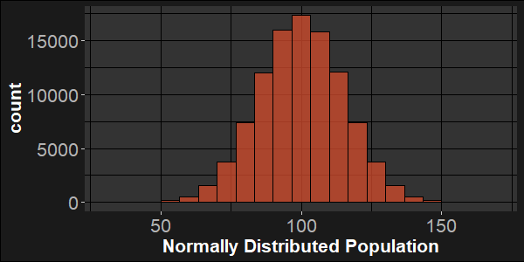
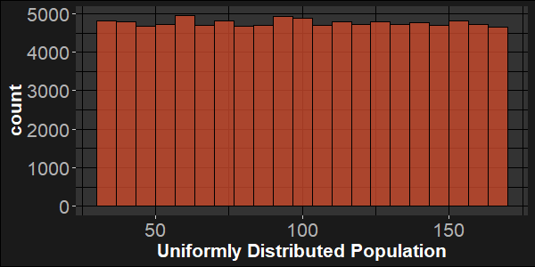


The Power of the Central Limit Theorem
Given any distribution with mean μ and variance σ², the sampling distribution of the mean approaches a normal distribution with a mean (μ) and a SEM = σ/(√N) as N increases.
$$μ=100, σ=15$$
$$μ=100, σ=40$$

Slide 9


$$μ=100, σ=15$$
$$μ=100, σ=40$$
Take 10,000 samples of n=10 from each population.

Slide 10
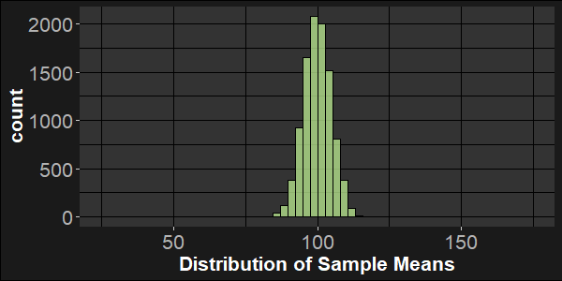
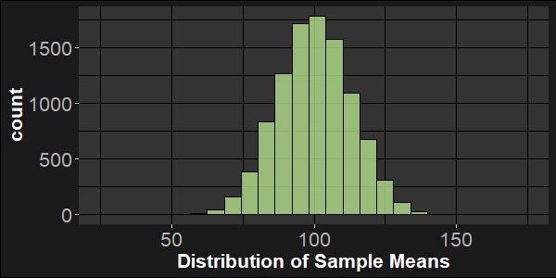
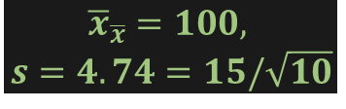
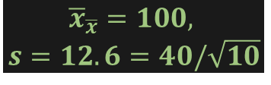
$$μ=100, σ=15$$
$$μ=100, σ=40$$
Individuals
Take 10,000 samples of n=10 from each population.
$${\overline{x}}_{\overline{x}}=100,$$
$$s=4.74=15/\sqrt{10}$$
$${\overline{x}}_{\overline{x}}=100,$$
$$s=12.6=40/\sqrt{10}$$
Sample Means

Slide 11
$$μ=100, σ=15$$
$$μ=100, σ=40$$
Take 10,000 samples of n=150 from each population.

Slide 12
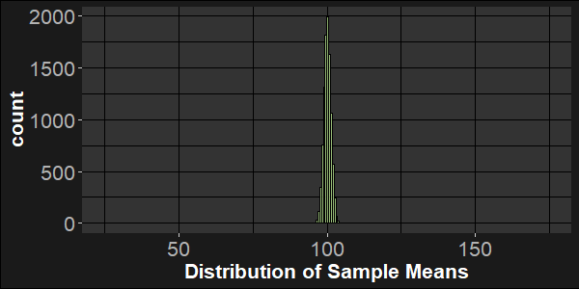
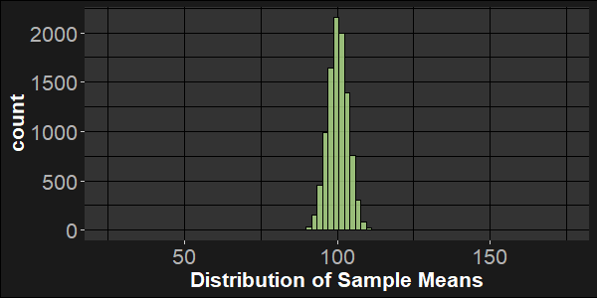
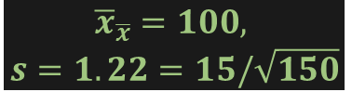

$$μ=100, σ=15$$
$$μ=100, σ=40$$
Individuals
Take 10,000 samples of n=150 from each population.
$${\overline{x}}_{\overline{x}}=100,$$
$$s=1.22=15/\sqrt{150}$$
$${\overline{x}}_{\overline{x}}=100,$$
$$s=3.26=40/\sqrt{150}$$
Sample Means

Slide 13
The Power of the Central Limit Theorem
The closer our population is to normal, the more normal the distribution of sample means will be.
Regardless of the population distribution, however, the sample distribution of means will approach normality in large samples.
Thus, we will be able to use normal or approximately normal distributions a lot when we are working with samples in the future.

Slide 14

Sampling Distributions as a function of n
Assume IQ: $μ=100;σ=15$
Sampling Distribution of Sample Means if n = 25
Normal
Sampling Distribution of Sample Means if n = 100
Normal
Sampling Distribution of Sample Means if n = 400
Normal

Slide 15
Sampling Distributions of the Mean
$$μ=100;σ=15;n=25, 100, 400$$

Slide 16
How likely is a Sample Mean IQ of 103 or greater?
Sampling Distributions of the Mean
ANSWER: It depends on how big the sample is. Larger samples make a 3 point deviation less likely.

Slide 17

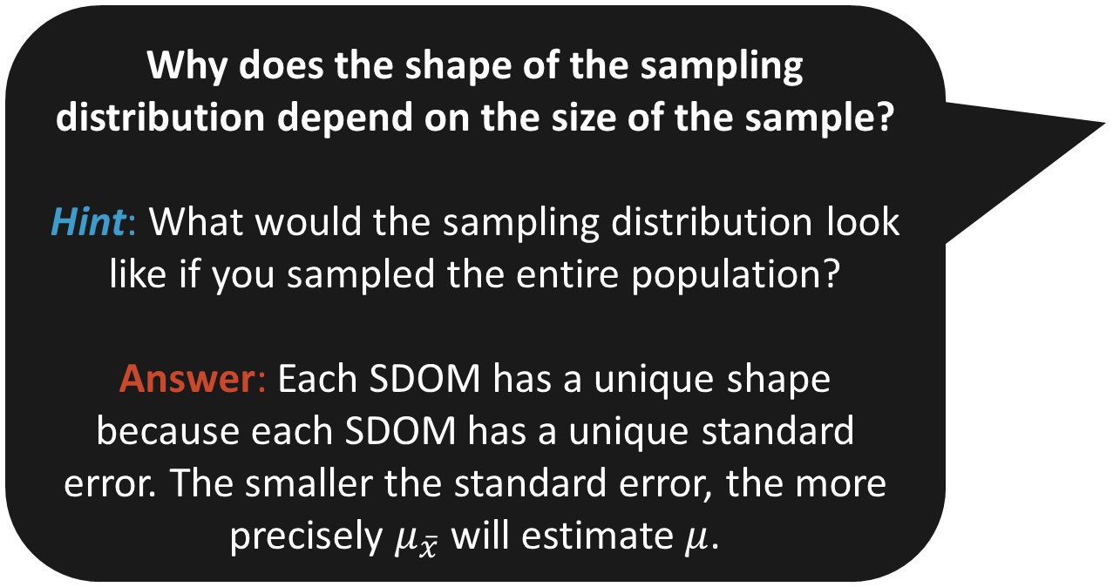
Why does the shape of the sampling distribution depend on the size of the sample?
Hint: What would the sampling distribution look like if you sampled the entire population?
Answer: Each SDOM has a unique shape because each SDOM has a unique standard error. The smaller the standard error, the more precisely $μ_{\overline{x}}$ will estimate $μ$.

