Slide 1
Research Design and Analysis: Z-Scores and Probability
Keith Lohse, PhD, PStat
Department of Health and Kinesiology
Department of Physical Therapy and Athletic Training
University of Utah
e: rehabinformatics@gmail.com

Slide 2
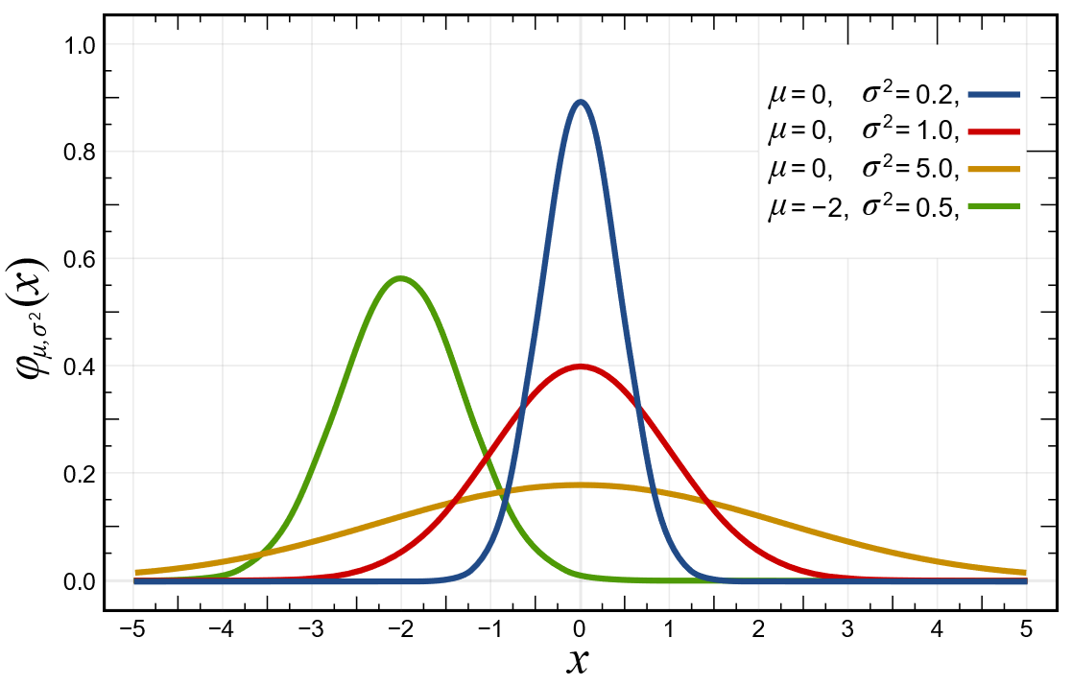

What is normal?
Probability Density Function:
$$f\left(x\right)=\frac{1}{σ\sqrt{2π}}e^{−\frac{1}{2}{\left(\frac{z−μ}{σ}\right)}^{2}}$$

Slide 3
What is normal?
Conceptually, if can define the distribution mathematically, we can calculate the probability of certain events:
p(-1 < x < +1)?
p(x >= +2)?
In practice, applied researchers let computes do these calculations, but it is very important to understand the concepts.

Slide 4

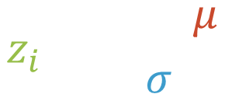

Z-Scores
$$z_{i}=\frac{x_{i}−μ}{σ}$$
Z-scores are a way for standardizing the relative positions of scores (X’s) in distributions that have different means (μ) and standard deviations (σ).
Score or 15, with a mean of 10 and a standard deviation of 2.5?
Score or 130, with a mean of 100 and a standard deviation of 15?
$$z_{15}= \frac{15−10}{2.5}=\frac{5}{2.5}=2$$
$$z_{130}= \frac{130−100}{15}=\frac{30}{15}=2$$

Slide 5
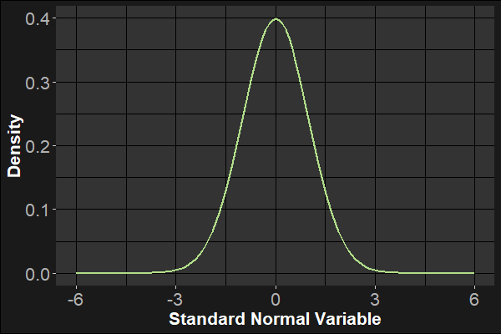

Z-Scores
Z-scores are a way for standardizing the relative positions of scores (X’s) in distributions that have different means (μ) and standard deviations (σ).
$$z=\frac{x−μ}{σ}$$
How many standard deviations above or below the mean are you?

Slide 6
How likely is a Sample Mean IQ of 103 or greater?
Sampling Distributions of the Mean
ANSWER: It depends on how big the sample is. Larger samples make a 3 point deviation less likely.

Slide 7
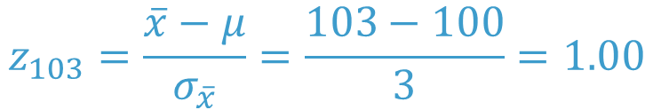
How likely is a Sample Mean IQ of 103 or greater?
Sampling Distributions of the Mean
μ = 100
σ = 15
n = 25
Z = 1.0
P(z>=1) = .1587
$$z_{103}=\frac{\overline{x}−μ}{σ_{\overline{x}}}=\frac{103−100}{3}=1.00$$

Slide 8
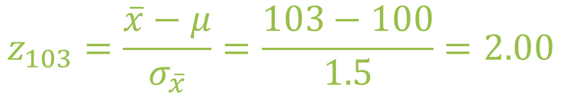
How likely is a Sample Mean IQ of 103 or greater?
Sampling Distributions of the Mean
μ = 100
σ = 15
n = 100
Z = 2.0
P(z>=2) = .0228
$$z_{103}=\frac{\overline{x}−μ}{σ_{\overline{x}}}=\frac{103−100}{1.5}=2.00$$

Slide 9
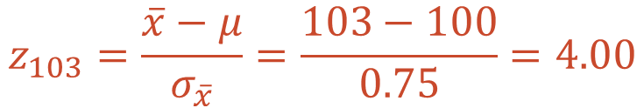
How likely is a Sample Mean IQ of 103 or greater?
Sampling Distributions of the Mean
μ = 100
σ = 15
n = 400
Z = 4.0
P(z>=2) < .0001
$$z_{103}=\frac{\overline{x}−μ}{σ_{\overline{x}}}=\frac{103−100}{0.75}=4.00$$

Slide 10
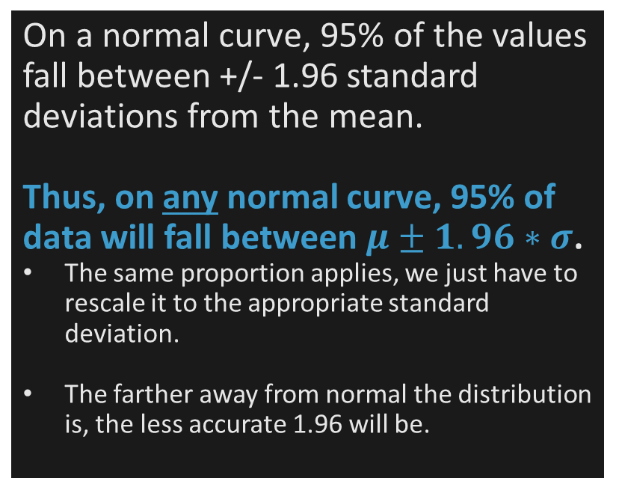
What Values of the Mean would occur 95% of the time?
Confidence Intervals
On a normal curve, 95% of the values fall between +/- 1.96 standard deviations from the mean.
Thus, on any normal curve, 95% of data will fall between $μ±1.96∗σ$.
The same proportion applies, we just have to rescale it to the appropriate standard deviation.
The farther away from normal the distribution is, the less accurate 1.96 will be.

Slide 11

What Values of the Mean would occur 95% of the time?
Confidence Intervals
What Z score in a normal distribution separates the most extreme 5% of the scores from the middle-most 95% of the scores? But how do we get from the critical z-score (1.96) back to values?
±1.96
n = 25; standard error of the mean = 3.00
$±1.96= \frac{\overline{x}−μ}{σ_{\overline{x}}}=$ $\frac{\overline{x}−100}{3}$
$$LL=100−1.96\left(3\right)=94.12$$
$$UL=100+1.96\left(3\right)=105.88$$

Slide 12
What Values of the Mean would occur 95% of the time?
Confidence Intervals
$$LL=100−1.96\left(3\right)=94.12$$
$$UL=100+1.96\left(3\right)=105.88$$

Slide 13

What Values of the Mean would occur 95% of the time?
Confidence Intervals
What Z score in a normal distribution separates the most extreme 5% of the scores from the middle-most 95% of the scores?
±1.96
n = 100, standard error of the Mean = 1.50
$±1.96= \frac{\overline{x}−μ}{σ_{\overline{x}}}=$ $\frac{\overline{x}−100}{1.5}$
$$LL=100−1.96\left(1.5\right)=97.06$$
$$UL=100+1.96\left(1.5\right)=102.94$$

Slide 14
What Values of the Mean would occur 95% of the time?
Confidence Intervals
$$LL=100−1.96\left(1.5\right)=97.06$$
$$UL=100+1.96\left(1.5\right)=102.94$$

Slide 15

What Values of the Mean would occur 95% of the time?
Confidence Intervals
What Z score in a normal distribution separates the most extreme 5% of the scores from the middle-most 95% of the scores?
±1.96
n = 400 , standard error of the Mean = 0.75
$±1.96= \frac{\overline{x}−μ}{σ_{\overline{x}}}=$ $\frac{\overline{x}−100}{0.75}$
$$LL=100−1.96\left(1.5\right)=98.53$$
$$UL=100+1.96\left(1.5\right)=101.47$$

Slide 16
What Values of the Mean would occur 95% of the time?
Sampling Distributions of the Mean
$$LL=100−1.96\left(1.5\right)=98.53$$
$$UL=100+1.96\left(1.5\right)=101.47$$

Slide 17

In this video, we’ve talked about calculating a 95% confidence interval.
Which one do you think will be wider:
A 95% CI or a 90%CI?
A 95% CI or a 99%CI?
Answer: The 95% CI is wider than the 90% CI and the 99% CI is wider than the 95%.
90
95
99

Slide 18
Sample Statistics
Means, medians
Standard deviations, ranges
Effect Size
Variance
Sample Size
What kind of statistics would we expect due to sampling variability alone?
Math!
Inferential Statistics

