Slide 1
Research Design and Analysis: t-Scores and the t-Distribution.
Keith Lohse, PhD, PStat
Department of Health and Kinesiology
Department of Physical Therapy and Athletic Training
University of Utah
e: rehabinformatics@gmail.com

Slide 2
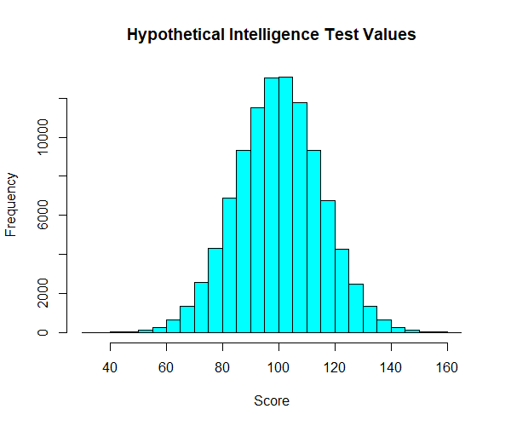
Finding the probability of an event in the normal distribution.
μ = 100
σ = 15

Slide 3

Finding the probability of an event in the normal distribution.
What is p(x ≥ 130)?
μ = 100
σ = 15
x = 130
Empirical (if we have data): count the number of observations ≥ 130, divide by total number.
Theoretical (if we know the distribution): integrate to find the area under the curve ≥ 130, divide by total area.

Slide 4
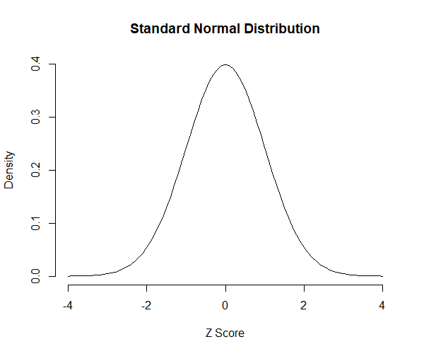
Finding the probability of an event in the normal distribution.
What is p(x ≥ 130)?
μ = 100
σ = 15
x = 130
Theoretical (if we know the distribution): integrate to find the area under the curve ≥ 130, divide by total area.
$$z= \frac{(x−μ)}{σ}$$
Solve for pnorm(z)

Slide 5
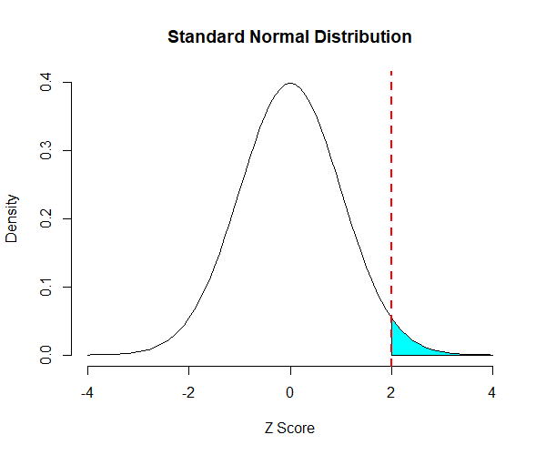
Finding the probability of an event in the normal distribution.
What is p(x ≥ 130)?
μ = 100
σ = 15
x = 130
z = 2.0
Theoretical (if we know the distribution): integrate to find the area under the curve ≥ 130, divide by total area.
$$z= \frac{(130−100)}{15}=2.0$$
Solve for pnorm(2.0)
p(z ≥ 2.0) = 0.023

Slide 6
What about a sample mean?
Recall from our previous video lectures that the distribution of sample means is approximately normal.
This is true even if the parent distribution is not normally distributed.
And as we showed, this distribution becomes more normal the larger our sample size gets.
This allows us to calculate the probability of observing a sample mean in a very useful way!

Slide 7
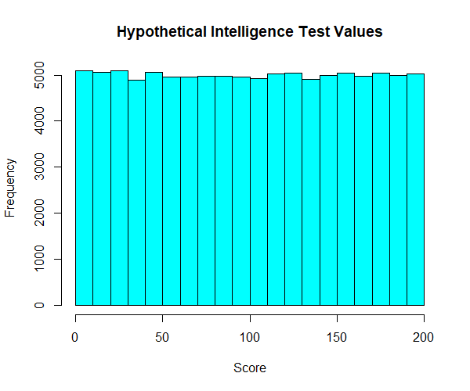
What about a sample mean?
Parent Population

Slide 8
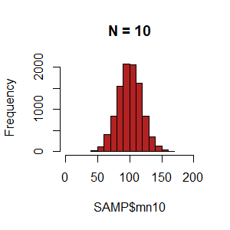
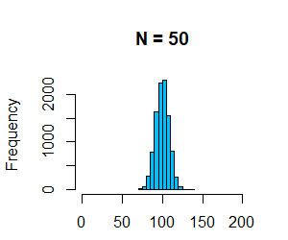
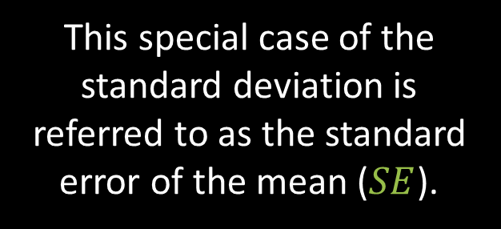
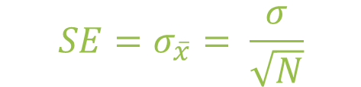
What about a sample mean?
Distributions of Sample Means
$$z= \frac{(x−μ)}{σ}$$
Parent Population
The problem is that σ for the sampling distribution varies as a function sample size.
Specifically,
$$SE=σ_{\overline{x}}= \frac{σ}{\sqrt{N}}$$
This special case of the standard deviation is referred to as the standard error of the mean ($SE$).

Slide 9
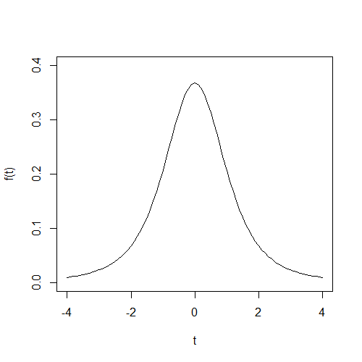
What about a sample mean?
Recall from our previous video lectures that the distribution of sample means is approximately normal.
N = 3

Slide 10
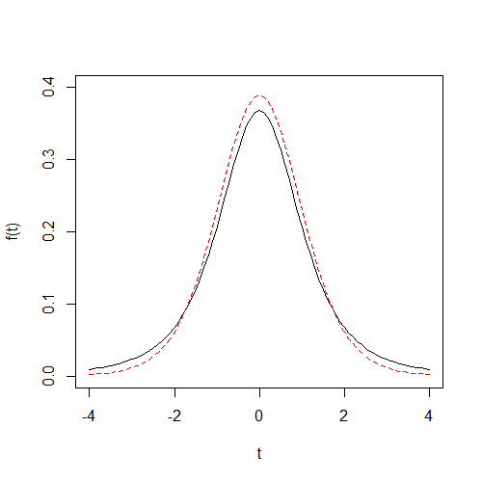
What about a sample mean?
Recall from our previous video lectures that the distribution of sample means is approximately normal.
N = 10
N = 3

Slide 11
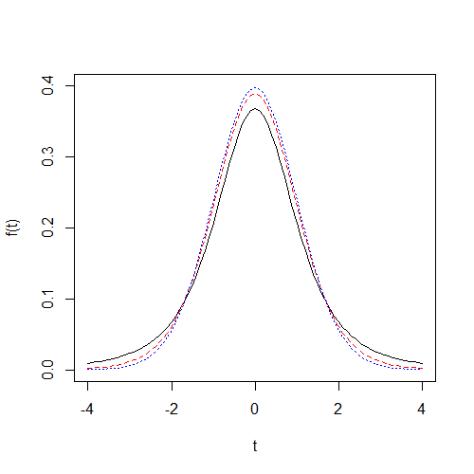
What about a sample mean?
Recall from our previous video lectures that the distribution of sample means is approximately normal.
N = 50
N = 10
N = 3

Slide 12
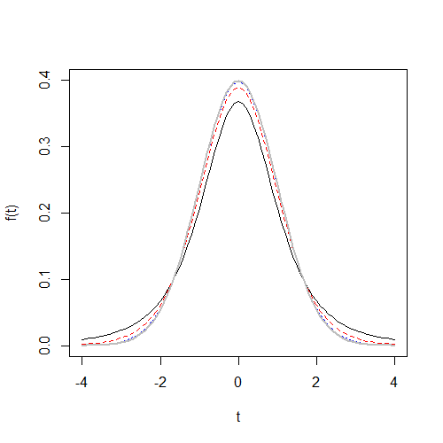
What about a sample mean?
Recall from our previous video lectures that the distribution of sample means is approximately normal.
N = ∞
N = 50
N = 10
N = 3

Slide 13
What about a sample mean?
Recall from our previous video lectures that the distribution of sample means is approximately normal.
N = ∞
This new distribution is the t-distribution.
It’s shape is similar to the normal distribution, but varies based on number of observations.
As we calculated z-values, we can also calculate t-values, that tell us how far the sample mean is from the true mean in units of standard error.
N = 50
N = 10
N = 3

Slide 14

Calculating t-values.
As we calculated z-values, we can also calculate t-values, that tell us how far the sample mean is from the true mean in units of standard error.
If σ is known:
$$t= \frac{(x−μ)}{σ/\sqrt{N}}$$

Slide 15

Calculating t-values.
As we calculated z-values, we can also calculate t-values, that tell us how far the sample mean is from the true mean in units of standard error.
The major issue we will face, however, is that the population standard deviation (σ) is often unknown.
In those cases, we need to estimate σ using the standard deviation we observe in the sample (s).
If σ is known:
$$t= \frac{(x−μ)}{σ/\sqrt{N}}$$
$$t=\frac{(x−μ)}{SE}=\frac{(x−μ)}{s/\sqrt{N}}$$

Slide 16
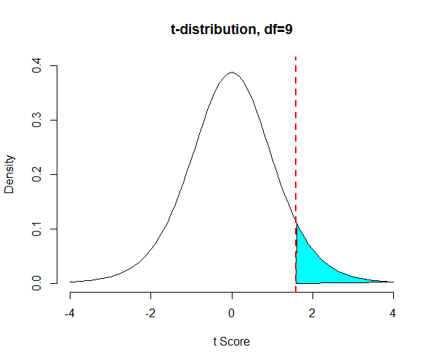
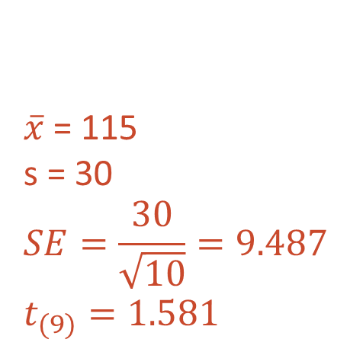
What is probability of observing a sample mean in a t-distribution, N = 10.
μ = 100
σ = ???
$\overline{x}$ = 115
s = 30
$$SE=\frac{30}{\sqrt{10}}=9.487$$
$$t_{(9)}=1.581$$
Solve for pt(1.581, df=9)
p = 0.074
We would expect to observe a t-value of this size or greater about 7.4% of the time due to sampling variability alone, when the sample size is N=10.

Slide 17
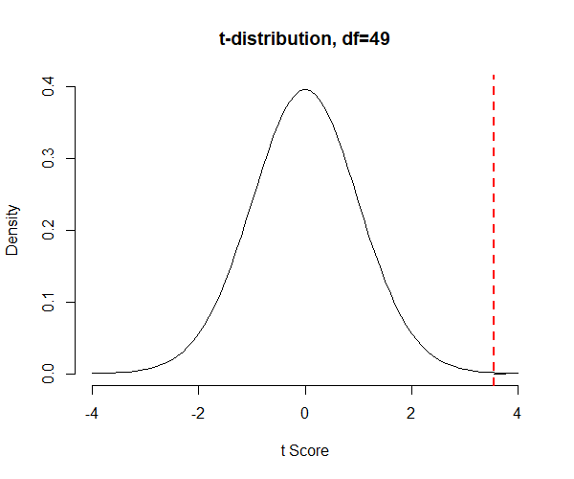
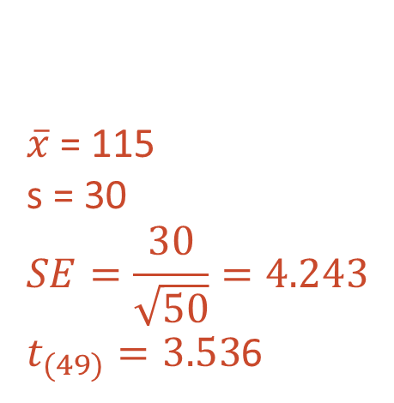
What is probability of observing a sample mean in a t-distribution, N = 50.
μ = 100
σ = ???
$\overline{x}$ = 115
s = 30
$$SE=\frac{30}{\sqrt{50}}=4.243$$
$t_{(49)}=3.53$6
Solve for pt(3.536, df=49)
p = 0.00045
We would expect to observe a t-value of this size or greater < 0.1% of the time due to sampling variability alone, when the sample size is N=50.

Slide 18

A generalized form of the t-statistic.
$$t_{obs}= \frac{(\hat{b}−β_{H})}{SE_{β}}$$
The t-value we observe in our sample (because it would be different in a different sample), tells us how far our estimated value is away from a hypothetical value, in units of standard error.
For instance, we might assume that the mean resting heart rate is 68 bpm for healthy young adults.
If we observe a mean heart rate of 60 bpm in a random sample of young adults, how likely is it that result occurred due to sampling variability alone?

Slide 19
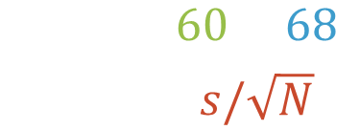
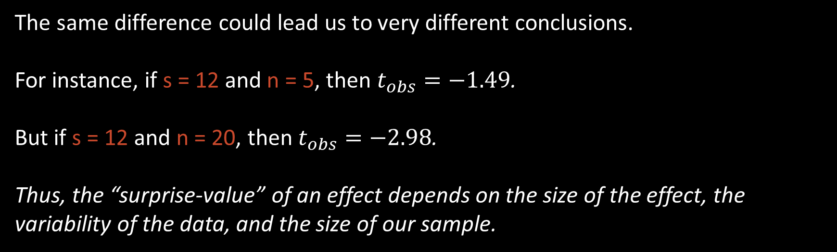
A generalized form of the t-statistic.
$$t_{obs}= \frac{(60−68)}{s/\sqrt{N}}$$
It depends! ¯\_(ツ)_/¯
How large is our sample? How variable is our sample?
The same difference could lead us to very different conclusions.
For instance, if s = 12 and n = 5, then $t_{obs}=−1.49$.
But if s = 12 and n = 20, then $t_{obs}=−2.98$.
Thus, the “surprise-value” of an effect depends on the size of the effect, the variability of the data, and the size of our sample.

Slide 20

$$t_{obs}= \frac{(\overline{x}−μ_{H})}{s/\sqrt{N}}$$
Effect Size
Variance
Sample Size
What kind of statistics would we expect due to sampling variability alone?
Math!

