Slide 1
Research Design and Analysis: The Null Hypothesis Significance Test.
Keith Lohse, PhD, PStat
Department of Health and Kinesiology
Department of Physical Therapy and Athletic Training
University of Utah
e: rehabinformatics@gmail.com

Slide 2

$$t_{obs}= \frac{(\overline{x}−μ_{H})}{s/\sqrt{N}}$$
Effect Size
Variance
Sample Size
What kind of statistics would we expect due to sampling variability alone?
Math!

Slide 3
Hypothesis Testing
Did I leave my oven on?
H0: my oven is off
HA: my oven not off
Do freshman KIN students have a higher IQ than the general population?
H0: μ = 100
HA: μ does not equal 100
Does muscimol act as an agonist of GABA_{A} receptors?
H0: μ_{treatment} = μ_{control}
HA: μ_{treatment} ≠ μ_{control}

Slide 4
What is a null hypothesis?
The null-hypothesis is the hypothesis “to be nullified”.
We want to make a set of assumptions (our null hypothesis).
If our data strongly conflict with those assumptions, then we would reject the hypothesis.

Slide 5
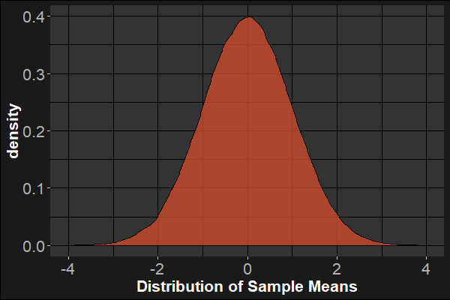

What is a null hypothesis?
Often, we make an assumption that there is no effect.
$μ_{H}=0$
Assuming that the true mean is zero, the distribution of sample means will look like the figure on the right.
Note that under the central limit theorem, it doesn’t matter what the population distribution looks like.
The distribution of sample means will be “approximately” normal at sufficiently large N.
The Null-Distribution

Slide 6
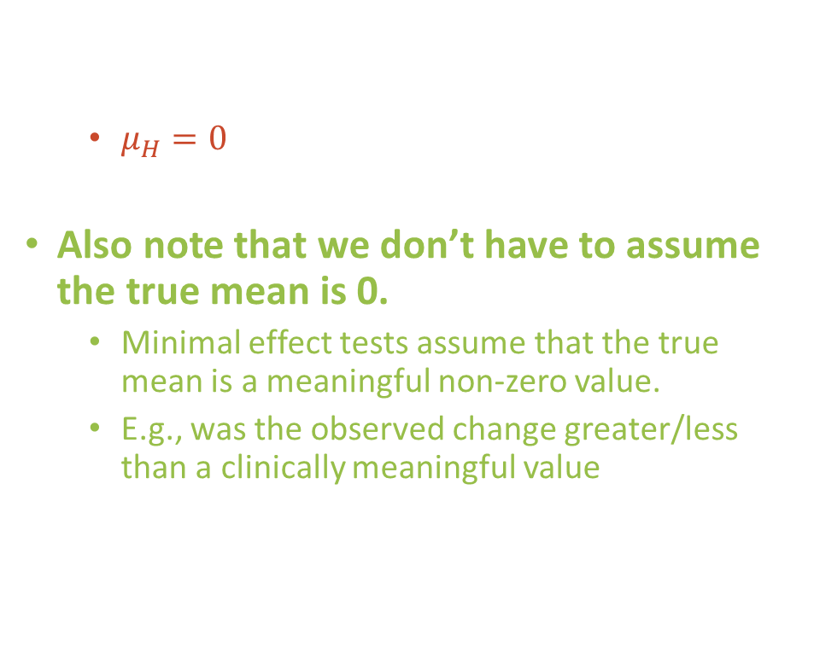
What is a null hypothesis?
Often, we make an assumption that there is no effect.
$μ_{H}=0$
Also note that we don’t have to assume the true mean is 0.
Minimal effect tests assume that the true mean is a meaningful non-zero value.
E.g., was the observed change greater/less than a clinically meaningful value
The Null-Distribution

Slide 7

Null Hypothesis Significance Testing
The null-hypothesis significance test (NHST): $p(≥\overline{x}|H_{0})$
Assuming the null is true, what is the probability of observing data this extreme or more extreme?
$H_{O}:μ=0$
$H_{A}:μ≠0$
We call this a two-sided hypothesis test.
They are the most common tests in scientific research.
The Null-Distribution

Slide 8

Null Hypothesis Significance Testing
The null-hypothesis significance test (NHST): $p(≥\overline{x}|H_{0})$
We can also set these thresholds in a direction way (if we have a really strong hypothesis)?
$H_{O}:μ≤0$
$H_{A}:μ>0$
The Null-Distribution

Slide 9
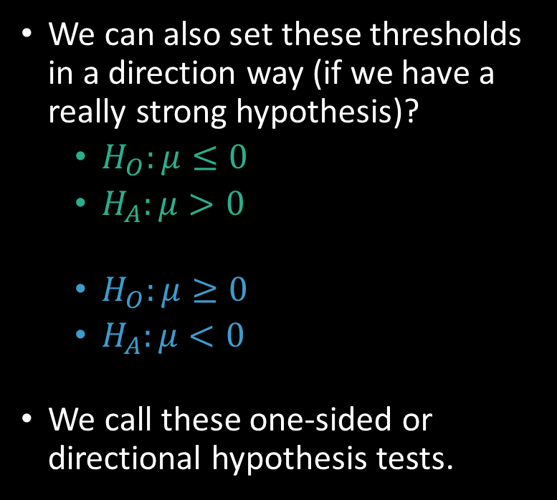
Null Hypothesis Significance Testing
The null-hypothesis significance test (NHST): $p(≥\overline{x}|H_{0})$
We can also set these thresholds in a direction way (if we have a really strong hypothesis)?
$H_{O}:μ≤0$
$H_{A}:μ>0$
$H_{O}:μ≥0$
$H_{A}:μ<0$
We call these one-sided or directional hypothesis tests.
The Null-Distribution

Slide 10
So what makes a result “significant”?
“Significance” in this case, is really just short hand for “statistically interesting”.
So, let’s say that observed a mean 0.1. Is that statistically interesting?
No, under the null hypothesis, a mean of 0.1 is well within the bounds of what we would expect due to sampling variability alone.
The Null-Distribution

Slide 11
So what makes a result “significant”?
“Significance” in this case, is really just short hand for “statistically interesting”.
What about a mean of 4.0?
Yes, under the null hypothesis, a mean very unlikely to arise.
Thus we would reject the null hypothesis as an explanation for these data.
Something systematic > sampling variability.
The Null-Distribution

Slide 12
So what makes a result “significant”?
“Significance” in this case, is really just short hand for “statistically interesting”.
What about a mean of 2.0?
This is harder to say… under the null hypothesis, a 2 is unlikely, but how unlikely does it need to be?
The Null-Distribution

Slide 13

So what makes a result “significant”?
Setting the Type 1 (false positive) error rate, $α$.
In practice, we often set alpha to 0.05.
95%
2.5%
2.5%
The Null-Distribution

Slide 14
So what makes a result “significant”?
Thus, when the null-hypothesis is true, we would only erroneously reject it about 5% of the time.
95%
2.5%
2.5%
The Null-Distribution

Slide 15
α (alpha) = the Type 1 Error Rate
By changing the alpha level we can change the threshold for what we find statistically interesting. This has costs:
Claiming a research “finding”,
Doing more research in this area,
Affecting clinical practice.
So, why is alpha .05 and no 0.001?
Errors are bad, so why not reduce the risk of Type 1 Errors?

Slide 16
α (alpha) = the significance criterion
What we decide:
 | Reject the Null | Fail to Reject the Null
Null is False | True Positive | False Negative (Miss!)
Null is True | False Positive (False alarm!) | True Negative
In reality:
What we decide:
 | There is a fire | The is no fire
There is a fire | True Positive | False Negative (Miss!)
There is no fire | False Positive (False alarm!) | True Negative
In reality:

Slide 17
Setting α = 0.05.
What we decide:
 | Reject the Null | Fail to Reject the Null
Null is False | True Positive | False Negative (Miss!)
Null is True | False Positive (False alarm!) | True Negative
In reality:
Alpha = .05
When the null is true, we will only falsely reject it 5% of the time.

Slide 18
What if we set a more liberal criterion?
What we decide:
Rejection rate goes up, but so does false alarm rate!
What we decide:
 | Reject the Null | Fail to Reject the Null
Null is False | True Positive | False Negative (Miss!)
Null is True | False Positive (False alarm!) | True Negative
In reality:
Alpha = .15

Slide 19
What if we’re more conservative?
What we decide:
What we decide:
 | Reject the Null | Fail to Reject the Null
Null is False | True Positive | False Negative (Miss!)
Null is True | False Positive (False alarm!) | True Negative
In reality:
Alpha = .001
False positives go down, but then the rate of false negative goes up!

Slide 20
So why .05?
Type 2 Error
β = probability of type 2 error
What we decide:
 | Reject the Null | Fail to Reject the Null
Null is False | True Positive | False Negative (Miss!)
Null is True | False Positive (False alarm!) | True Negative
In reality:
Type 1 Error
α = .05 = the probability of making a type 1 error.
Null hypothesis tests are only one of many statistical tools.
They have many limitations, but their real strength is Type 1 Error control.
Other types of statistical analyses can be very informative, but require more assumptions about the state of the world.
Our analysis are only as good as the assumptions they rest on.

Slide 21
Interpretation of p-values
Used correctly, frequentist p-values can be a very useful tool in science.
Unfortunately, it is also very easy to misinterpret a p-value and this can lead to many misunderstandings.

Slide 22

Interpretation of p-values
Used correctly, frequentist p-values can be a very useful tool in science.
Correct interpretation: The p-value is probability of observing data these extreme or more extreme under the null hypothesis, $p(\overline{x}|H_{0})$, and assuming that all of our assumptions hold (e.g., sampling variability is the only factor affecting our data).
P-values can indicate how incompatible the data are with a specified statistical model (i.e., null hypothesis and all other assumptions)
Thus, if p<0.05, that is unusual under the null hypothesis and suggests that something systematic might be going on.

Slide 23
Interpretation of p-values
Unfortunately, it is also very easy to misinterpret a p-value and this can lead to many misunderstandings.
Incorrect interpretations:
P < 0.05 means that an effect is “real”.
Recall that false positives can happen 5% of the time on each and every (independent) test when the null is true.

Slide 24
Interpretation of p-values
Unfortunately, it is also very easy to misinterpret a p-value and this can lead to many misunderstandings.
Incorrect interpretations:
P < 0.05 means that an effect is “real”.
P > 0.05 means that there was no effect/no difference.
If the difference between too means in your sample was 5 mL/kg and p = 0.6, the difference was still 5 mL/kg.

Slide 25
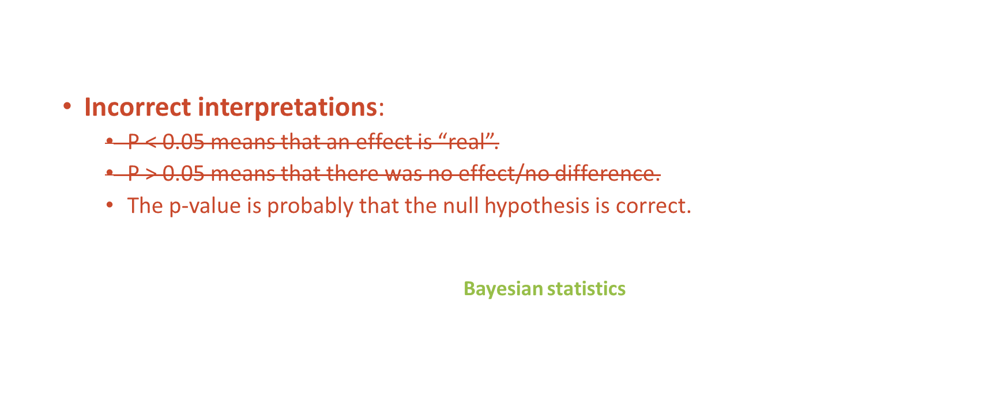
Interpretation of p-values
Unfortunately, it is also very easy to misinterpret a p-value and this can lead to many misunderstandings.
Incorrect interpretations:
P < 0.05 means that an effect is “real”.
P > 0.05 means that there was no effect/no difference.
The p-value is probably that the null hypothesis is correct.
Recall that we can only calculate the p-value assuming the null is true: $p(\overline{x}|H_{0})$.
If we want to know the probability of a hypothesis given the data $p(H_{0}|\overline{x})$ this would require a different set of statistical tools (Bayesian statistics) and more model assumptions.

Slide 26
Interpretation of p-values
Unfortunately, it is also very easy to misinterpret a p-value and this can lead to many misunderstandings.
Incorrect interpretations:
P < 0.05 means that an effect is “real”.
P > 0.05 means that there was no effect/no difference.
The p-value is probably that the null hypothesis is correct.
The p-value is the probability that these results occurred due to chance.
This kind of works as a lay-person short hand, but it is technically incorrect. The p-value reflects the compatibility of the observed data with a specific null hypothesis.
If the null hypothesis were different, than the p-value would be different, but the same chance (i.e., sampling variability) would still be a factor both times.

Slide 27
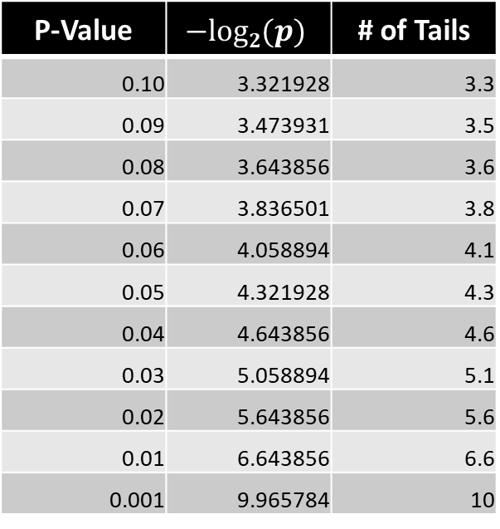


P-values as coin flips
A helpful way to think about p-values is in terms of coin flips.
That is, what is the probability of getting tails $X$ times in a row?
P-Value | $$−log2(p)$$ | # of Tails
0.10 | 3.321928 | 3.3
0.09 | 3.473931 | 3.5
0.08 | 3.643856 | 3.6
0.07 | 3.836501 | 3.8
0.06 | 4.058894 | 4.1
0.05 | 4.321928 | 4.3
0.04 | 4.643856 | 4.6
0.03 | 5.058894 | 5.1
0.02 | 5.643856 | 5.6
0.01 | 6.643856 | 6.6
0.001 | 9.965784 | 10
This helps to illustrate that there is nothing magic about 0.05.
In fact, it is not even a super high degree of evidence (about as unusual as 4 coin flips).
But remember that Type 1 and Type 2 errors trade off, so we don’t necessarily want α=0.001 either!
$$α$$

