Slide 1
Research Design and Analysis: Interpreting P-Values.
Keith Lohse, PhD, PStat
Department of Health and Kinesiology
Department of Physical Therapy and Athletic Training
University of Utah
e: rehabinformatics@gmail.com

Slide 2
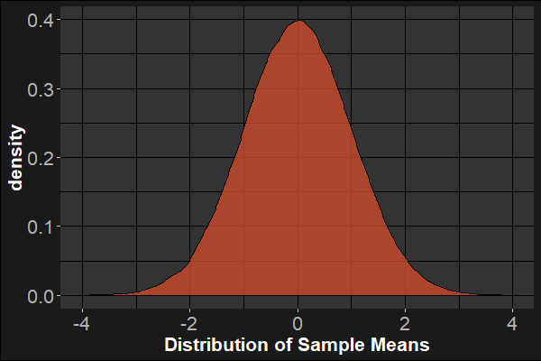

Null Hypothesis Significance Testing
The null-hypothesis significance test (NHST): $p(≥\overline{x}|H_{0})$
Assuming the null is true, what is the probability of observing data this extreme or more extreme?
$H_{O}:μ=0$
$H_{A}:μ≠0$
We call this a two-sided hypothesis test.
They are the most common tests in scientific research.
The Null-Distribution

Slide 3
Interpretation of p-values
Used correctly, frequentist p-values can be a very useful tool in science.
Unfortunately, it is also very easy to misinterpret a p-value and this can lead to many misunderstandings.

Slide 4

Interpretation of p-values
Used correctly, frequentist p-values can be a very useful tool in science.
Correct interpretation: The p-value is probability of observing data these extreme or more extreme under the null hypothesis, $p(\overline{x}|H_{0})$, and assuming that all of our assumptions hold (e.g., sampling variability is the only factor affecting our data).
P-values can indicate how incompatible the data are with a specified statistical model (i.e., null hypothesis and all other assumptions)
Thus, if p<0.05, then that is unusual under the null hypothesis and suggests that something systematic might be going on.

Slide 5
Interpretation of p-values
Unfortunately, it is also very easy to misinterpret a p-value and this can lead to many misunderstandings.
Incorrect interpretations:
P < 0.05 means that an effect is “real”.
Recall that false positives can happen 5% of the time on each and every (independent) test when the null is true.

Slide 6
Interpretation of p-values
Unfortunately, it is also very easy to misinterpret a p-value and this can lead to many misunderstandings.
Incorrect interpretations:
P < 0.05 means that an effect is “real”.
P > 0.05 means that there was no effect/no difference.
If the difference between two means in your sample was 5 mL/kg and p = 0.6, the difference was still 5 mL/kg.

Slide 7
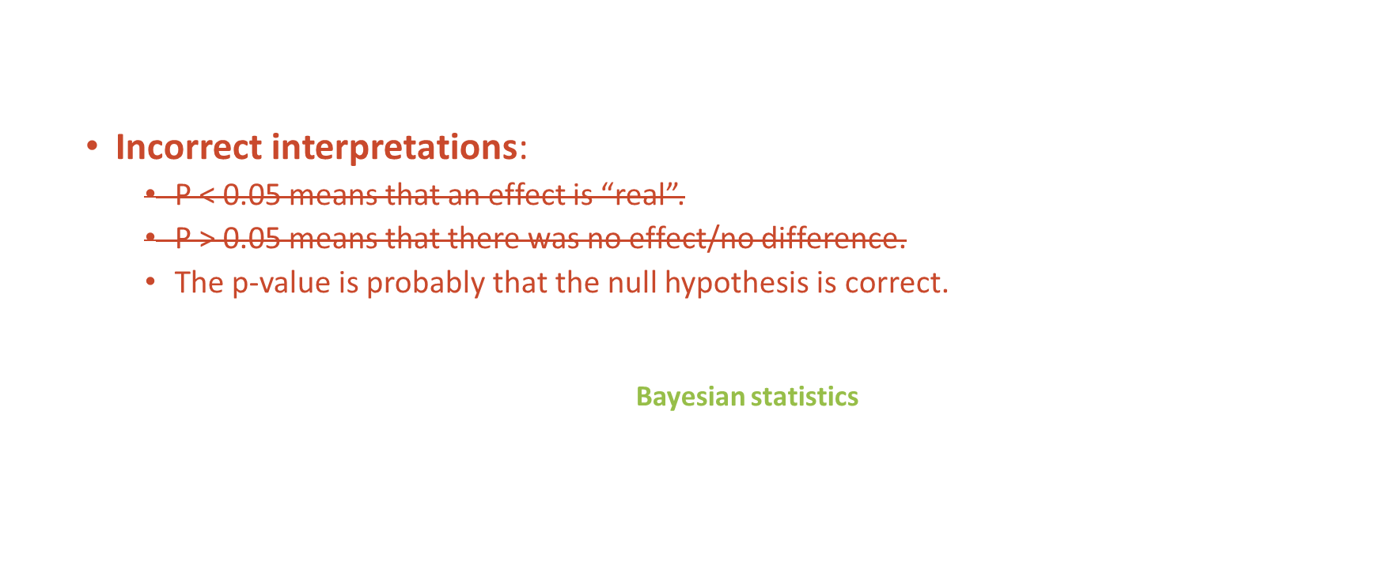
Interpretation of p-values
Unfortunately, it is also very easy to misinterpret a p-value and this can lead to many misunderstandings.
Incorrect interpretations:
P < 0.05 means that an effect is “real”.
P > 0.05 means that there was no effect/no difference.
The p-value is probably that the null hypothesis is correct.
Recall that we can only calculate the p-value assuming the null is true: $p(\overline{x}|H_{0})$.
If we want to know the probability of a hypothesis given the data $p(H_{0}|\overline{x})$ this would require a different set of statistical tools (Bayesian statistics) and more model assumptions.

Slide 8
Interpretation of p-values
Unfortunately, it is also very easy to misinterpret a p-value and this can lead to many misunderstandings.
Incorrect interpretations:
P < 0.05 means that an effect is “real”.
P > 0.05 means that there was no effect/no difference.
The p-value is probably that the null hypothesis is correct.
The p-value is the probability that these results occurred due to chance.
This kind of works as a lay-person short hand, but it is technically incorrect. The p-value reflects the compatibility of the observed data with a specific null hypothesis.
If the null hypothesis were different, than the p-value would be different, but the same chance (i.e., sampling variability) would still be a factor both times.

Slide 9
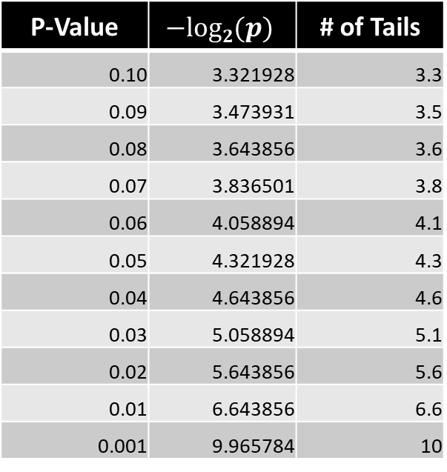


P-values as coin flips
A helpful way to think about p-values is in terms of coin flips.
That is, what is the probability of getting tails $X$ times in a row?
P-Value | $$−log2(p)$$ | # of Tails
0.10 | 3.321928 | 3.3
0.09 | 3.473931 | 3.5
0.08 | 3.643856 | 3.6
0.07 | 3.836501 | 3.8
0.06 | 4.058894 | 4.1
0.05 | 4.321928 | 4.3
0.04 | 4.643856 | 4.6
0.03 | 5.058894 | 5.1
0.02 | 5.643856 | 5.6
0.01 | 6.643856 | 6.6
0.001 | 9.965784 | 10
This helps to illustrate that there is nothing magic about 0.05.
In fact, it is not even a super high degree of evidence (about as unusual as 4 coin flips).
But remember that Type 1 and Type 2 errors trade off, so we don’t necessarily want α=0.001 either!
$$α$$

