Slide 1
Research Design and Analysis: Introduction to Statistical Power.
Keith Lohse, PhD, PStat
Department of Health and Kinesiology
Department of Physical Therapy and Athletic Training
University of Utah
e: rehabinformatics@gmail.com

Slide 2
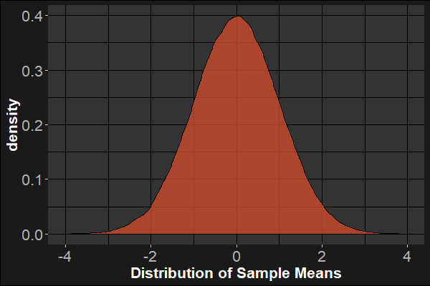
What is power?
The null-hypothesis significance test (NHST): $p(≥\overline{x}|H_{0})$
The Null-Distribution

Slide 3

What is power?
The null-hypothesis significance test (NHST): $p(≥\overline{x}|H_{0})$
One sample t-test:
One-tailed test, p = 0.023
Two-tailed test, p = 0.046
The Null-Distribution

Slide 4
What is power?
Power is the probability of detecting an effect, given that the effect is really there.
But “the real effect” is usually an approximation, informed by past work.
Our power analysis is only as good as the underlying assumptions.

Slide 5
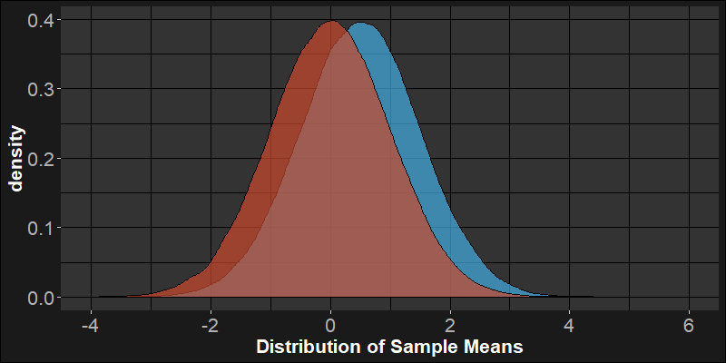
What is power?
H0 is true: assumes μ=0, need to make some estimate of SE.
Alternatively, let’s assume that μ is 0.5.
We can now contrast our two sampling distributions: assuming H0 is true and a specific case assuming H0 is false.
The Null-Distribution
Estimated Distribution

Slide 6
What is power?
For a one-sided test, the common critical value is at the 95%ile of the null distribution.
One advantage of the NHST is that we can make our Type 1 error rate always be a specific %.
$$α=0.05$$
FP
The Null-Distribution
Estimated Distribution

Slide 7
What is power?
TN
FN
Assuming that the true mean is 0.5, we have a pretty big chance of making a Type 2 error (a false negative).
In this case:
$$β=0.927$$
FP
The Null-Distribution
Estimated Distribution

Slide 8
What is power?
TN
FN
Assuming that the true mean is 0.5, we have a pretty small chance of correctly identifying the real effect as statistically significant.
In this case:
$$(1−β)=0.073$$
TP
FP
The Null-Distribution
Estimated Distribution

Slide 9
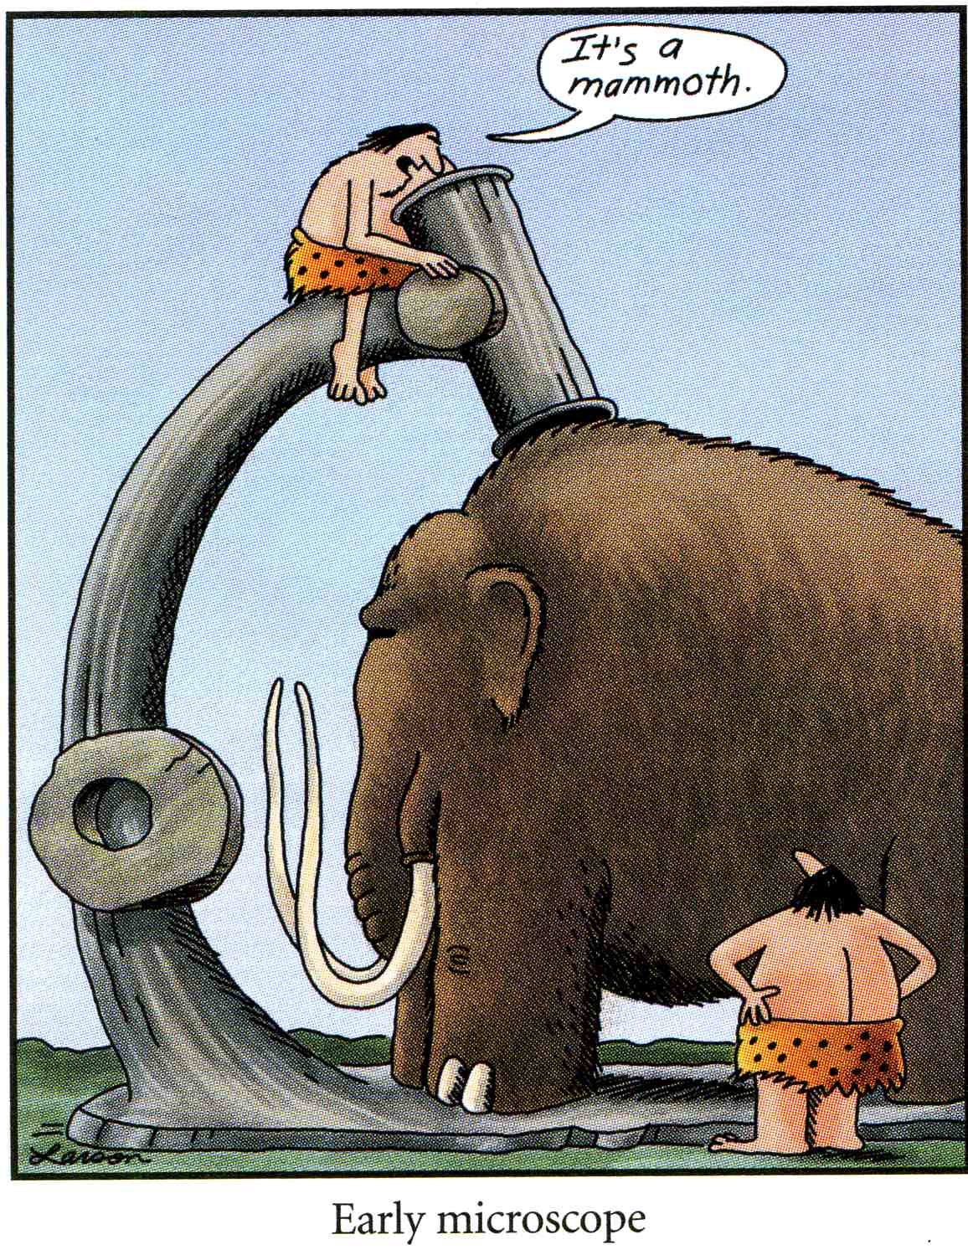
Why power analysis?
Analogy: How much magnification do you need to study the following?
A mammoth.
A flatworm.
An animal cell.
A virus.
If we know something about the object we are trying to study, we can choose the appropriate magnification.

Slide 10
What affects power?
Effect Size
Variance
Sample Size
More Certain
Less Certain
Math!

Slide 11
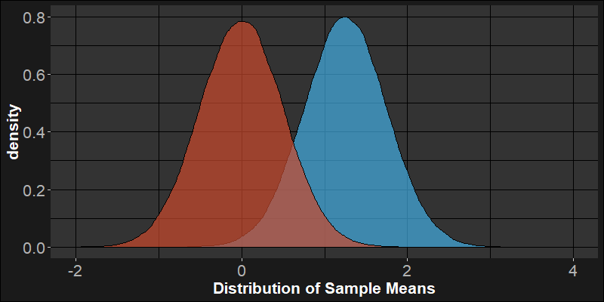
Effect size affects power.
If we increase the effect size, that will increase power.
76%
5%
0
1.25

Slide 12
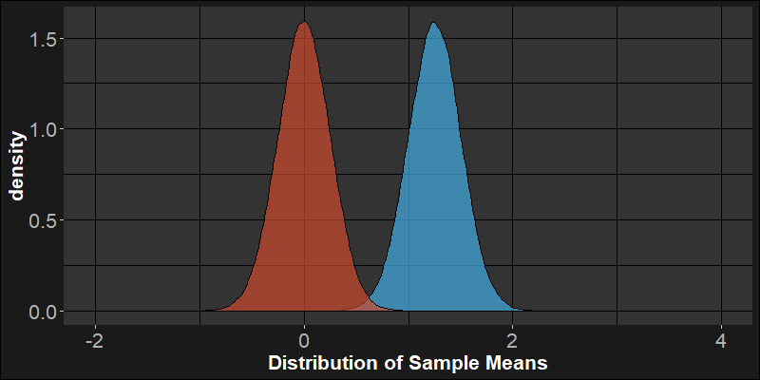

Variance affects power.
If we can increase the sample size or decrease the standard deviation, that will decrease the standard error:
$σ_{μ}=\frac{σ}{\sqrt{N}}\sim SE=\frac{s}{\sqrt{N}}$, increasing power.
99%
5%
0
1.25

Slide 13
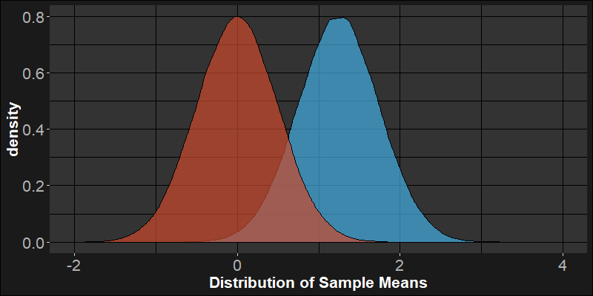
α affects power.
If we change α, we can increase the Type 1 error rate in order to reduce the Type II error rate (increasing power).
76%
86%
5%
10%
0
1.25

Slide 14
Classic a priori power analysis.
Assume:
Assume:
Effect Size
Variance
“We need ## people to reliably find…”
Sample Size
Choose:
α=0.05
β=0.20

