Slide 1
Research Design and Analysis: Confidence Intervals.
Keith Lohse, PhD, PStat
Department of Health and Kinesiology
Department of Physical Therapy and Athletic Training
University of Utah
e: rehabinformatics@gmail.com

Slide 2

Confidence intervals (“95% CI”)
If I aim at this point,
95% of my shots fall in this region.
Do you let your son sign up???

Slide 3
Confidence intervals (“95% CI”)
If I aim at this point,
95% of my shots fall in this region.
Looks better, but I am still not sure...

Slide 4
Confidence intervals (“95% CI”)
If I aim at this point,
(Population Mean)
95% of my shots fall in this region.
(95% CI)
Which is based on the standard error.

Slide 5

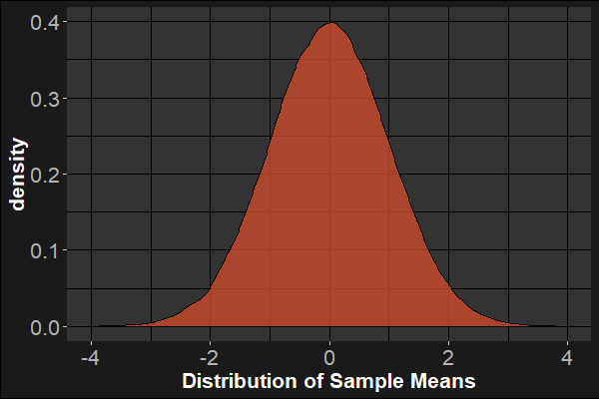



Confidence intervals (“95% CI”)
$$UL={μ_{H}}_{0}+t_{α/2}^{∗}(SE)$$
$$t_{obs}= \frac{\overline{x}−{μ_{H}}_{0}}{(\frac{s}{\sqrt{n}})}= \frac{\overline{x}−{μ_{H}}_{0}}{SE}$$
$$LL={μ_{H}}_{0}−t_{α/2}^{∗}(SE)$$
We’re talking about sample means rather than arrows of course, but I hope that analogy works.

Slide 6




Estimation
Thus, if we know $μ$ and σ then we can define were most sample means will fall:
$$μ$$
$$−\left(\frac{σ}{\sqrt{N}}\right)t_{α/2}^{∗}$$
$$+\left(\frac{σ}{\sqrt{N}}\right)t_{α/2}^{∗}$$

Slide 7







Estimation
However, we usually don’t know $μ$ and σ, so we need to work backwards from the statistics in the sample to estimate the parameters in the population.
$μ$?
$μ$?
$μ$?
$μ$?
$$\overline{x}$$
$$−\left(\frac{s}{\sqrt{N}}\right)t_{α/2}^{∗}$$
$$+\left(\frac{s}{\sqrt{N}}\right)t_{α/2}^{∗}$$

Slide 8
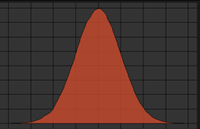



Estimation
The upper and lower limits of the CI represent the most extreme population means (μ’s) that are compatible with the mean ($\overline{x}$) we observed in the sample (to the given % confidence).
$$μ$$
$$μ$$
$$\overline{x}$$
$$−\left(\frac{s}{\sqrt{N}}\right)t_{α/2}^{∗}$$
$$+\left(\frac{s}{\sqrt{N}}\right)t_{α/2}^{∗}$$

Slide 9

Estimation
The upper and lower limits of the CI represent the most extreme population means (μ’s) that are compatible with the mean ($\overline{x}$) we observed in the sample (to the given % confidence).
Unfortunately, this means that the frequentist confidence interval has a slightly tricky interpretation.
In the long run, 95% of CIs drawn to these limits will contain the population mean.
All values inside the interval are compatible estimates of μ that could have produced $\overline{x}$.
$≠$we are 95% confident the true mean lies inside any single interval.
To do this would require Bayesian statistics and more specific model assumptions!
Again, $p(≥\overline{x}|H_{0})≠p(H_{0}|≥\overline{x})$

