Slide 1
Research Design and Analysis:
Bivariate Correlation
Keith Lohse, PhD, PStat
Department of Health and Kinesiology
Department of Physical Therapy and Athletic Training
University of Utah
e: rehabinformatics@gmail.com

Slide 2

Bivariate Correlation
How are two variables related to each other?
  Correlation $≅$ Association.
Height and weight?
Self-Esteem and relapse?
Stress and performance?

Slide 3
Consider this….
On the Pacific Coast, there is a strong negative correlation between # of shark attacks and water depth.

Slide 4


Water Depth
Negative
There are fewer attacks at greater depth.
# of Attacks
So, does shallow water cause shark attacks?
Happy, man loving shark.
Angry, man eating shark.

Slide 5

A correlation is merely a statistic, causation is established through experimental design!!!

Slide 6
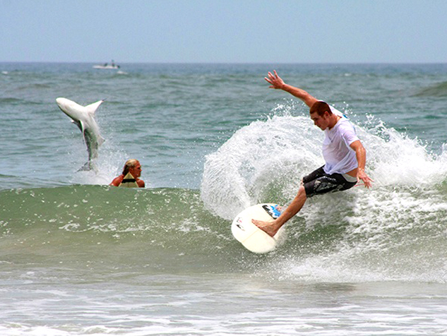
Water Depth
Negative
There are fewer attacks at greater depth.
# of Attacks
-
+
Number of people in water.
So, does shallow water cause shark attacks?
The relationship between water depth and # of attacks can be explained by an underlying third variable. In this case, the number of people in the water.
NO.

Slide 7
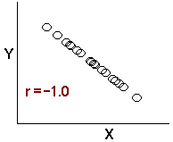
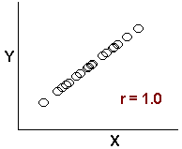
What is a correlation?
Correlation coefficients are a family of related statistics that measure the strength and direction of an association.
  Ranges from +1 to -1
  Negative Correlation Positive Correlation

Slide 8
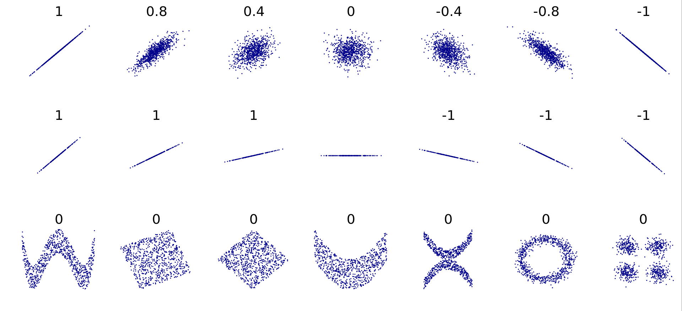
What is a correlation?
We will focus on the Pearson correlation coefficient, but know that there are other coefficients, appropriate for different types of data and relationships.

Slide 9
VO₂ Max Example.
VO2 Max | 800m Time
52.5 | 159
50 | 147
56.75 | 153
57 | 160
57.5 | 143
58 | 132
60.75 | 130
60.5 | 135
60 | 137
63 | 128
61 | 121
64.5 | 125
64 | 130
65.75 | 137
66.25 | 141
66 | 136
68.25 | 122
68 | 117
70.5 | 119
73.25 | 121
74 | 116
Is your VO₂ Max related to your time in the 800 meter sprint?
  What does “related” mean?
    Do people who with a higher VO2 run faster times?
    What about running time is not explained by VO2?

Slide 10
VO₂ Max Example.
VO2 Max | 800m Time
52.5 | 159
50 | 147
56.75 | 153
57 | 160
57.5 | 143
58 | 132
60.75 | 130
60.5 | 135
60 | 137
63 | 128
61 | 121
64.5 | 125
64 | 130
65.75 | 137
66.25 | 141
66 | 136
68.25 | 122
68 | 117
70.5 | 119
73.25 | 121
74 | 116
[From Camus et al., 1992]

Slide 11

What is a correlation?
A broad class of statistical relationships between two or more random variables or observed data values.
Computationally: the sum of all Z_{x} times Z_{y} divided by the number of pairs minus one.

Slide 12
What is a correlation?
Conceptually: the degree to which X and Y vary together divided by the degree to which X and Y vary separately.
If “r” is big then X and Y vary together more than they vary separately
If “r” is small then X and Y vary together less than they vary separately

Slide 13
VO2 Max | 800m Time | Z_VO2 | Z_time | Z*Z
52.5 | 159 | -1.62 | 1.92 | -3.11
50 | 147 | -2.02 | 1.01 | -2.03
56.75 | 153 | -0.95 | 1.46 | -1.39
57 | 160 | -0.91 | 2.00 | -1.81
57.5 | 143 | -0.83 | 0.70 | -0.58
58 | 132 | -0.75 | -0.13 | 0.10
60.75 | 130 | -0.31 | -0.29 | 0.09
60.5 | 135 | -0.35 | 0.09 | -0.03
60 | 137 | -0.43 | 0.25 | -0.11
63 | 128 | 0.04 | -0.44 | -0.02
61 | 121 | -0.28 | -0.97 | 0.27
64.5 | 125 | 0.28 | -0.67 | -0.19
64 | 130 | 0.20 | -0.29 | -0.06
65.75 | 137 | 0.48 | 0.25 | 0.12
66.25 | 141 | 0.56 | 0.55 | 0.31
66 | 136 | 0.52 | 0.17 | 0.09
68.25 | 122 | 0.87 | -0.89 | -0.78
68 | 117 | 0.83 | -1.28 | -1.06
70.5 | 119 | 1.23 | -1.12 | -1.38
73.25 | 121 | 1.66 | -0.97 | -1.62
74 | 116 | 1.78 | -1.35 | -2.41
 | VO2 Max | 800m Time
Mean | 62.7381 | 133.7619
SD | 6.315396 | 13.14498
Sum of Z*Z = -15.609
r = -0.780
r² = 0.609

