Slide 1
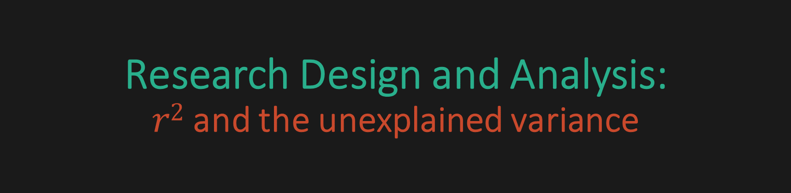
Research Design and Analysis: $r2$ and the unexplained variance
Keith Lohse, PhD, PStat
Department of Health and Kinesiology
Department of Physical Therapy and Athletic Training
University of Utah
e: rehabinformatics@gmail.com

Slide 2
Understanding r²
r², R², also sometimes called the “coefficient of determination” is a measure of the variance in Y that is explained by X.
Computationally, it is the square of the Pearson correlation coefficient (r).
Conceptually, however, it is more important than a simple exponent.
Understanding how r² relates to the sum of squared errors is important for regression.
It will also make understanding future concepts much simpler.

Slide 3

SSE and sources of variance
r² reflects the variance in Y that is accounted for by X.
(explained variance)
(1 – r²) reflects the variance in Y that is not accounted for by X.
(unexplained variance)
How do we measure variance and where does it come from?
Sum of squared errors – total:
The total variance of Y in squared units.
This is the type of SSE we have calculated in the past.
$$SS_{total}=\sum{{\left(y_{i}−\overline{y}\right)}^{2}}$$

Slide 4
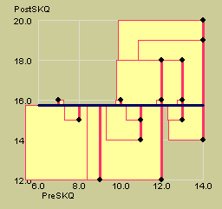
The mean gives us the smallest sum of squared errors if we predict a flat line.
SS_{Total}
That is, if we do not estimate a slope, the mean gives us the best prediction of the data.
(Because most scores should be near the mean).

Slide 5

SSE and sources of variance
Similarly, we can calculate an SSE based on the difference between each predicted score and the mean of Y.
If X does not predict Y well (i.e., X and Y are independent), we expect this value to be small.
$$SS_{regression}=\sum{{\left({\hat{y}}_{i}−\overline{y}\right)}^{2}}$$
Sum of squared errors – Regression:
The deviation between our predicted Y values and the average value of Y.

Slide 6


SSE and sources of variance
We can make a prediction ($\hat{y_{i}}$) about each y value based on x.
If X does not predict Y well, we expect the difference between y and our prediction ($y_{i}−\hat{y_{i}}$) to be large.
Sum of squared errors - error:
The difference between our predictions and the observed values.
When X makes good predictions, this value is smaller.
$$SS_{residuals}=\sum{{\left(y_{i}−\hat{y_{i}}\right)}^{2}}$$

Slide 7

SSE and sources of variance
$$SS_{total}=SS_{regression}+SS_{residuals}$$
r² is the proportion of variance in Y that is explained by X
-EQUIVALENTLY-
The proportion of squared errors for our predicted values compared to the proportion of squared errors in our original data.
If these values were identical, the explained variance would be 1, meaning we explained 100% of the variation.
$$r^{2}=\frac{SS_{regression}}{SS_{total}}$$

Slide 8
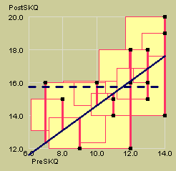

By estimating a slope, we can improve our prediction of each data point, reducing the SS_{Error}.
SS_{Regression}
SS_{Error}
SS_{Total}
SS_{Total} stays the same, but SS_{Error} is reduced, because our $\hat{y_{i}}$ starts to be a better prediction.

Slide 9
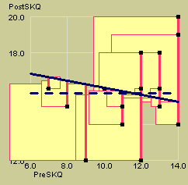
If we predict a slope in the wrong direction (not that we ever would) SS_{Error} and thus SS_{Total} can actually increase beyond the original SS_{Total}.
SS_{Error}
SS_{Total}
This means that a regression with wrong slope actually produces worse predictions than the mean by itself.

Slide 10
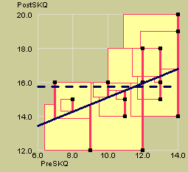
Fortunately, we have the tools to find the one intercept and the one slope that gives us the smallest SS_{Error}.
SS_{Regression}
SS_{Error}
SS_{Total}
Thus, we can find the slope and intercept that give us the best fit, but two questions remain:
Is the intercept significantly different from zero?
Is the slope significantly different from zero?

