Slide 1
Research Design and Analysis: Causation and Association
Keith Lohse, PhD, PStat
Department of Health and Kinesiology
Department of Physical Therapy and Athletic Training
University of Utah
e: rehabinformatics@gmail.com

Slide 2
Correlation and Causation
You’ve probably heard, “correlation is not causation”.
Think about our example with water depth and shark attacks.
However, we also need to remember that “correlation is not NOT causation”.
Not all associations are causal.
But all causally related phenomena have an association.

Slide 3

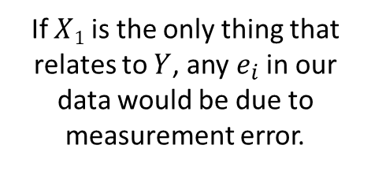

Different Types of Associations
Usually, conditioning our predictions on a single variable won’t be enough.
This is because most variables we might measure (height, academic achievement, probability of winning a match) are caused by multiple factors or at least associated with multiple factors.
$$X1$$
$$Y$$
If $X1$ is the only thing that relates to $Y$, any $e_{i}$ in our data would be due to measurement error.

Slide 4



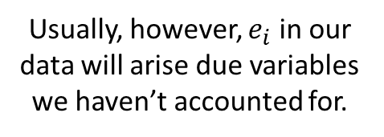

Multi-variable Regression
Usually, conditioning our predictions on a single variable won’t be enough.
This is because most variables we might measure (height, academic achievement, probability of winning a match) are caused by multiple factors or at least associated with multiple factors.
$$X_{3}$$
$$X1$$
$$Y$$
$$X1$$
$$Y$$
If $X1$ is the only thing that relates to $Y$, any $e_{i}$ in our data would be due to measurement error.
$$X_{2}$$
Usually, however, $e_{i}$ in our data will arise due variables we haven’t accounted for.

Slide 5
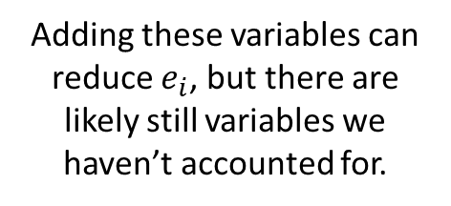






Multi-variable Regression
Usually, conditioning our predictions on a single variable won’t be enough.
This is because most variables we might measure (height, academic achievement, probability of winning a match) are caused by multiple factors or at least associated with multiple factors.
$$X_{4}$$
$$X_{3}$$
$$X_{3}$$
$$X1$$
$$Y$$
$$X1$$
$$Y$$
$$X1$$
$$Y$$
If $X1$ is the only thing that relates to $Y$, any $e_{i}$ in our data would be due to measurement error.
$$X_{2}$$
$$X_{2}$$
Usually, however, $e_{i}$ in our data will arise due variables we haven’t accounted for.
Adding these variables can reduce $e_{i}$, but there are likely still variables we haven’t accounted for.

Slide 6

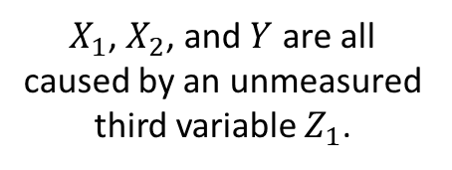











Multi-variable Regression
Further, causation is not established by the statistical relationship but by logical analysis/experimental design.
Some example associations:
$$X1$$
$$X1$$
$$X1$$
$$Y$$
$$Y$$
$$Z_{1}$$
$$X_{2}$$
$$X_{2}$$
$$X_{2}$$
$$Y$$
$X_{1}$ and $X_{2}$ both cause $Y$.
$X_{1}$ causes$X_{2}$, which in turn causes $Y$.
$X_{1}$, $X_{2}$, and $Y$ are all caused by an unmeasured third variable $Z_{1}$.

Slide 7
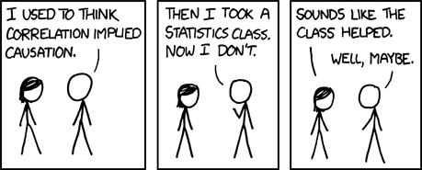
[xkcd.com]

Slide 8
Correlation and Causation
In general, we want to be careful to avoid a causal interpretation of observational data.
E.g., variables X and Y are “associated”.
Don’t assume that adding more X will yield more Y.
Causality is never established the by the choice of a statistic or the significance of an effect, it depends on the research design and adequately controlling confounding factors.
Which is why we like randomized clinical trials so much!
But RCTs are also not the only tool for establishing causal relationships.
And RCTs can be very incorrect/misleading if poorly designed.

