Slide 1
Research Design and Analysis: Regression with a Categorical Predictor
Keith Lohse, PhD, PStat
Department of Health and Kinesiology
Department of Physical Therapy and Athletic Training
University of Utah
e: rehabinformatics@gmail.com

Slide 2
Categorical Predictors
Thus far, we have looked at the relationships between continuous predictor variables (X’s) and continuous outcome variables (Y’s).
Now, we will shift our focus to categorical predictors (X’s) and continuous outcome variables (Y’s).
Categorical predictors can be “natural” groupings (e.g., a cohort study) or could be experimental groupings (e.g., a randomized controlled trial).
Categorical variables can also be “made” by breaking continuous variables into groups. However, breaking a continuous variable into a categorical variable is generally a bad practice and has a negative effect on statistical power.

Slide 3
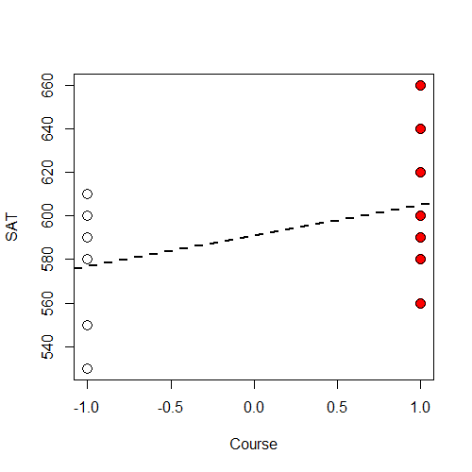
Regression with Categorical Predictors
Student | Group | SAT
1 | Course | 580
2 | Course | 560
3 | Course | 660
4 | Course | 620
5 | Course | 600
6 | Course | 580
7 | Course | 590
8 | Course | 640
9 | Course | 620
10 | Course | 600
11 | No Course | 580
12 | No Course | 530
13 | No Course | 590
14 | No Course | 550
15 | No Course | 610
16 | No Course | 590
17 | No Course | 600
18 | No Course | 530
19 | No Course | 590
20 | No Course | 600
No Course
Course

Slide 4

Regression with Categorical Predictors
Student | Group | SAT
1 | Course | 580
2 | Course | 560
3 | Course | 660
4 | Course | 620
5 | Course | 600
6 | Course | 580
7 | Course | 590
8 | Course | 640
9 | Course | 620
10 | Course | 600
11 | No Course | 580
12 | No Course | 530
13 | No Course | 590
14 | No Course | 550
15 | No Course | 610
16 | No Course | 590
17 | No Course | 600
18 | No Course | 530
19 | No Course | 590
20 | No Course | 600
If we want to test the efficacy of an SAT prep course, we would have a model comparison:
Alternative: $y_{i}=β_{0}+β_{1}\left(X_{1i}\right)+ε_{i}$
Null: $y_{i}=β_{0}+0\left(X_{1i}\right)+ε_{i}$

Slide 5

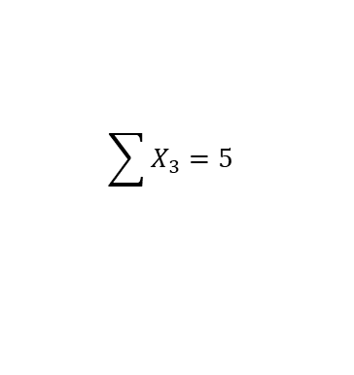
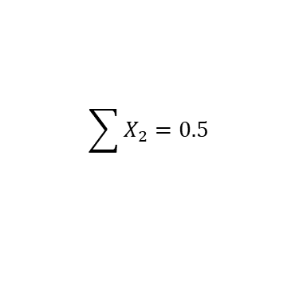
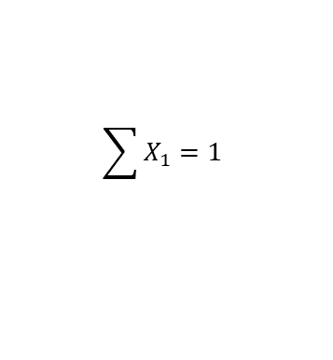
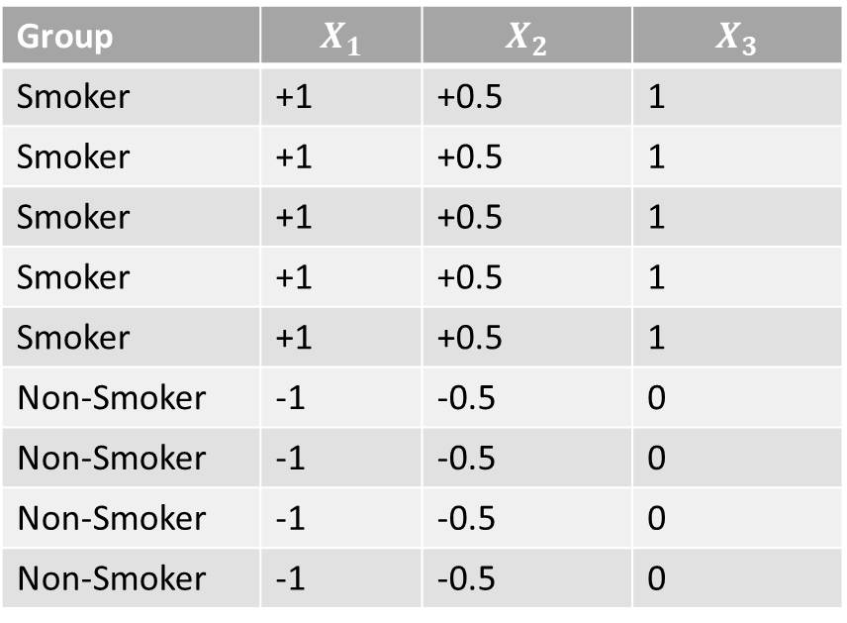
How do we represent a categorical variable?
Contrast codes:
$\sum{λ_{k}=0}$
Note this is the sum of $λ_{k}$(the code) not the sum of $X_{i}$ (the data).
$\sum{{λ1}_{k}=0}$
$\sum{{λ2}_{k}=0}$
$\sum{{λ3}_{k}=1}$
Group | $$X_{1}$$ | $$X_{2}$$ | $$X_{3}$$
Smoker | +1 | +0.5 | 1
Smoker | +1 | +0.5 | 1
Smoker | +1 | +0.5 | 1
Smoker | +1 | +0.5 | 1
Smoker | +1 | +0.5 | 1
Non-Smoker | -1 | -0.5 | 0
Non-Smoker | -1 | -0.5 | 0
Non-Smoker | -1 | -0.5 | 0
Non-Smoker | -1 | -0.5 | 0
$$\sum{X_{1}=1}$$
$$\sum{X_{2}=0.5}$$
$$\sum{X_{3}=5}$$

Slide 6
How do we represent a categorical variable?
Contrast codes: the levels of our code sum to zero.
Equivalent to mean-centering of continuous variables.
Treatment/ ‘Dummy’ codes: levels of the code do not sum to zero. One group is coded as zero across all levels of the code.
Analogous to having an interpretable 0 in your continuous variable.
Group | $$X_{1}$$ | $$X_{2}$$ | $$X_{3}$$
Smoker | +1 | +0.5 | 1
Smoker | +1 | +0.5 | 1
Smoker | +1 | +0.5 | 1
Smoker | +1 | +0.5 | 1
Smoker | +1 | +0.5 | 1
Non-Smoker | -1 | -0.5 | 0
Non-Smoker | -1 | -0.5 | 0
Non-Smoker | -1 | -0.5 | 0
Non-Smoker | -1 | -0.5 | 0

Slide 7

Using Contrast Codes in Practice
Let’s say that we will contrast code our x-variable
+1 = you took the course
-1 = you did not take the course
Note that in the null model we are hypothesizing there is no effect of an SAT prep course.
From the data will get an estimate of $β$ called $b$ or $\hat{β}$.
Then we can calculate $p(≥b|H0)$

Slide 8
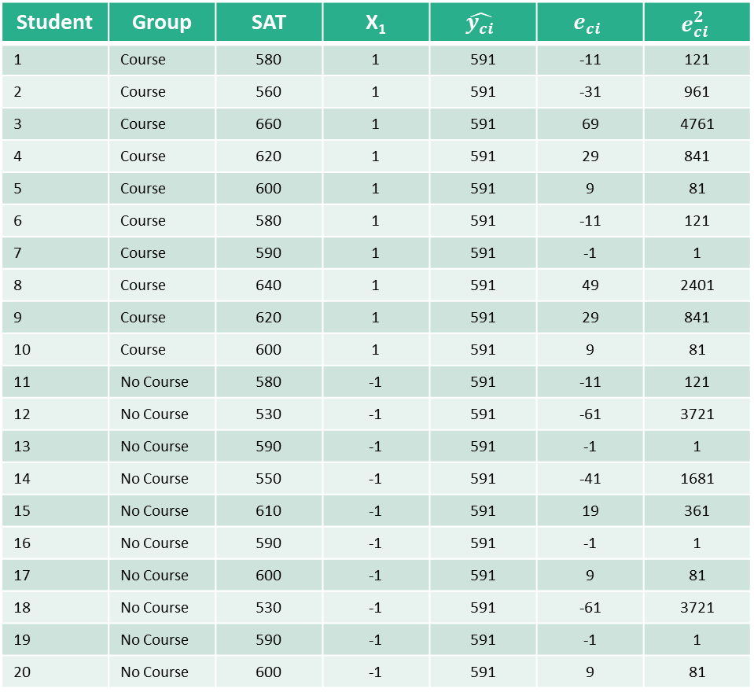

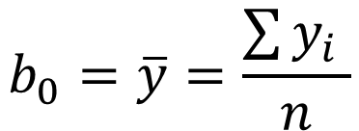

Error Under the Null Model
Student | Group | SAT | X₁ | $$\hat{y_{ci}}$$ | $$e_{ci}$$ | $$e_{ci}^{2}$$
1 | Course | 580 | 1 | 591 | -11 | 121
2 | Course | 560 | 1 | 591 | -31 | 961
3 | Course | 660 | 1 | 591 | 69 | 4761
4 | Course | 620 | 1 | 591 | 29 | 841
5 | Course | 600 | 1 | 591 | 9 | 81
6 | Course | 580 | 1 | 591 | -11 | 121
7 | Course | 590 | 1 | 591 | -1 | 1
8 | Course | 640 | 1 | 591 | 49 | 2401
9 | Course | 620 | 1 | 591 | 29 | 841
10 | Course | 600 | 1 | 591 | 9 | 81
11 | No Course | 580 | -1 | 591 | -11 | 121
12 | No Course | 530 | -1 | 591 | -61 | 3721
13 | No Course | 590 | -1 | 591 | -1 | 1
14 | No Course | 550 | -1 | 591 | -41 | 1681
15 | No Course | 610 | -1 | 591 | 19 | 361
16 | No Course | 590 | -1 | 591 | -1 | 1
17 | No Course | 600 | -1 | 591 | 9 | 81
18 | No Course | 530 | -1 | 591 | -61 | 3721
19 | No Course | 590 | -1 | 591 | -1 | 1
20 | No Course | 600 | -1 | 591 | 9 | 81
$$y_{i}=β_{0}+0\left(X_{1i}\right)+ε_{i}$$
$$y_{i}=β_{0}+ε_{i}$$
$$b_{0}=\overline{y}=\frac{\sum{y_{i}} }{n}$$
$$y_{i}=591+e_{i}$$

Slide 9
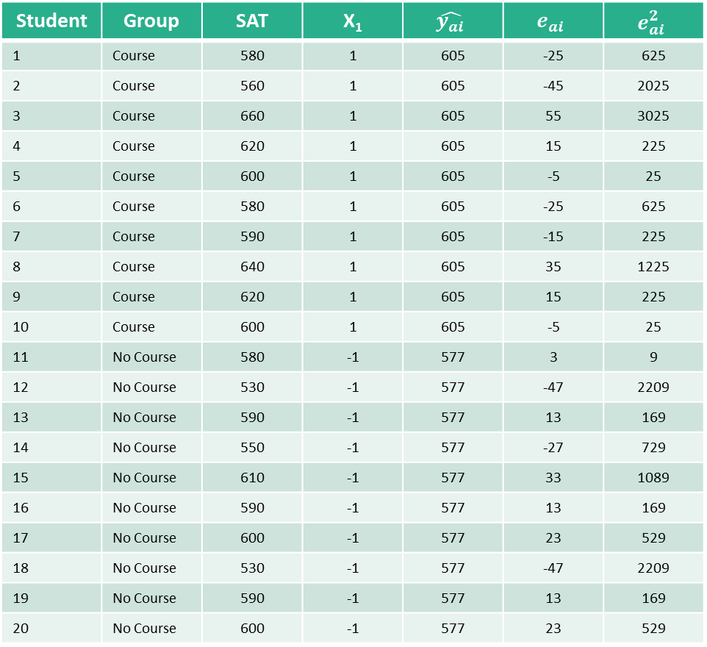
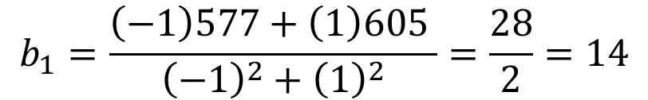
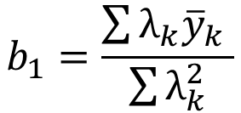


Error Under the Alternative Model
Student | Group | SAT | X₁ | $$\hat{y_{ai}}$$ | $$e_{ai}$$ | $$e_{ai}^{2}$$
1 | Course | 580 | 1 | 605 | -25 | 625
2 | Course | 560 | 1 | 605 | -45 | 2025
3 | Course | 660 | 1 | 605 | 55 | 3025
4 | Course | 620 | 1 | 605 | 15 | 225
5 | Course | 600 | 1 | 605 | -5 | 25
6 | Course | 580 | 1 | 605 | -25 | 625
7 | Course | 590 | 1 | 605 | -15 | 225
8 | Course | 640 | 1 | 605 | 35 | 1225
9 | Course | 620 | 1 | 605 | 15 | 225
10 | Course | 600 | 1 | 605 | -5 | 25
11 | No Course | 580 | -1 | 577 | 3 | 9
12 | No Course | 530 | -1 | 577 | -47 | 2209
13 | No Course | 590 | -1 | 577 | 13 | 169
14 | No Course | 550 | -1 | 577 | -27 | 729
15 | No Course | 610 | -1 | 577 | 33 | 1089
16 | No Course | 590 | -1 | 577 | 13 | 169
17 | No Course | 600 | -1 | 577 | 23 | 529
18 | No Course | 530 | -1 | 577 | -47 | 2209
19 | No Course | 590 | -1 | 577 | 13 | 169
20 | No Course | 600 | -1 | 577 | 23 | 529
$$y_{i}=β_{0}+β_{1}(X_{1})ε_{i}$$
$$b_{1}=\frac{\sum{λ_{k}{\overline{y}}_{k}} }{\sum{λ_{k}^{2}}}$$
$$b_{1}=\frac{\left(−1\right)577+\left(1\right)605 }{{\left(−1\right)}^{2}+{\left(1\right)}^{2}}=\frac{28}{2}=14$$
$y_{i}=591+14\left(X_{1}\right)+e_{i}$

Slide 10
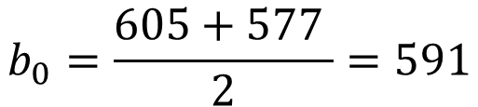

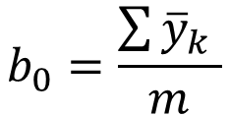


Error Under the Alternative Model
Student | Group | SAT | X₁ | $$\hat{y_{ai}}$$ | $$e_{ai}$$ | $$e_{ai}^{2}$$
1 | Course | 580 | 1 | 605 | -25 | 625
2 | Course | 560 | 1 | 605 | -45 | 2025
3 | Course | 660 | 1 | 605 | 55 | 3025
4 | Course | 620 | 1 | 605 | 15 | 225
5 | Course | 600 | 1 | 605 | -5 | 25
6 | Course | 580 | 1 | 605 | -25 | 625
7 | Course | 590 | 1 | 605 | -15 | 225
8 | Course | 640 | 1 | 605 | 35 | 1225
9 | Course | 620 | 1 | 605 | 15 | 225
10 | Course | 600 | 1 | 605 | -5 | 25
11 | No Course | 580 | -1 | 577 | 3 | 9
12 | No Course | 530 | -1 | 577 | -47 | 2209
13 | No Course | 590 | -1 | 577 | 13 | 169
14 | No Course | 550 | -1 | 577 | -27 | 729
15 | No Course | 610 | -1 | 577 | 33 | 1089
16 | No Course | 590 | -1 | 577 | 13 | 169
17 | No Course | 600 | -1 | 577 | 23 | 529
18 | No Course | 530 | -1 | 577 | -47 | 2209
19 | No Course | 590 | -1 | 577 | 13 | 169
20 | No Course | 600 | -1 | 577 | 23 | 529
$y_{i}=β_{0}+β_{1}(X_{1})ε_{i}$
$$b_{0}=\frac{\sum{{\overline{y}}_{k}} }{m}$$
$$b_{1}=\frac{\sum{λ_{k}{\overline{y}}_{k}} }{\sum{λ_{k}^{2}}}$$
$$b_{0}=\frac{605+577 }{2}=591$$
$$y_{i}=591+14\left(X_{1}\right)+e_{i}$$

Slide 11

Our Best Fit Regression Line
Contrast Codes
$$y_{i}=591+14\left(X_{1}\right)+e_{i}$$
$$r^{2}=0.196$$

Slide 12


Our Best Fit Regression Line
Contrast Codes
$$y_{i}=591+14\left(X_{1}\right)+e_{i}$$
$$r^{2}=0.196$$
Treatment Codes
$$y_{i}=577+28\left(X_{1}\right)+e_{i}$$
$$r^{2}=0.196$$
*Note that the parameter estimates change, but the $r^{2}$values stay the same.*
0
0.5
1.0

Slide 13

Statistical Inferences about Parameters
In practice, we get statistical programs to obtain these parameters estimates for us.
However, it is important to understand how these parameter estimates are obtained and how we should interpret them based on the coding of our variables.
$$t_{obs}=\frac{\hat{β}−{β_{H}}_{0}}{σ_{β}}=\frac{b−0}{{SE}_{β}}\sim \frac{Effect Size}{Sampling Variability}$$
We will get a t-value for the slope and the intercept.

Slide 14
A t-test versus “the t-test”?
Often, especially in undergraduate courses, ‘ the t-test’ might be taught as a specific test *only* for comparing two group-means.
Either implicitly or explicitly, students learn that t-tests are some thing different and distinct from regression.
In reality, the “independent samples t-test” is just a special case general linear model.
We can conduct a t-test for an intercept,
for the slope of a continuous variable,
for the slope of a categorical variable (i.e., difference between group-means).

Slide 15
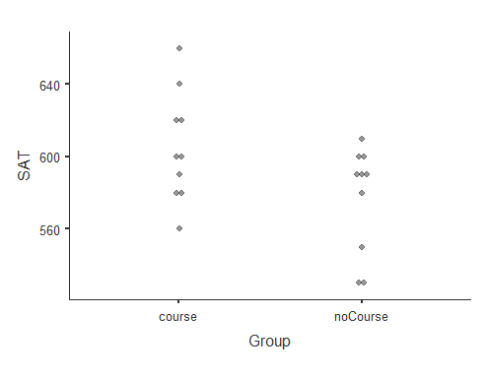
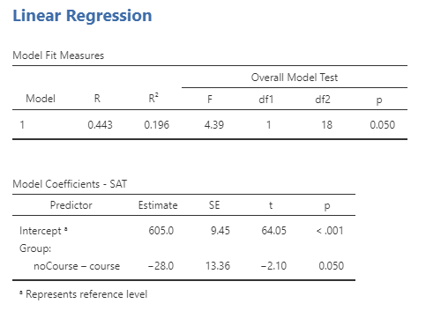
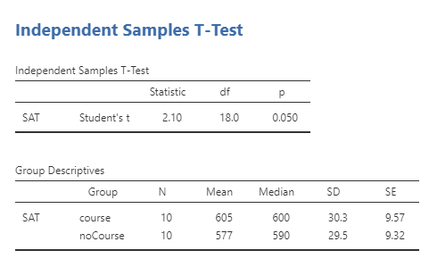
Independent Samples t-Test
Given the same data in Jamovi, we can test this hypothesis the same way in two different menus:
Under the Regression tab:
Under the T-Test tab:

