Slide 1
Research Design and Analysis: Model Fit and R-Squared
Keith Lohse, PhD, PStat
Department of Health and Kinesiology
Department of Physical Therapy and Athletic Training
University of Utah
e: rehabinformatics@gmail.com

Slide 2
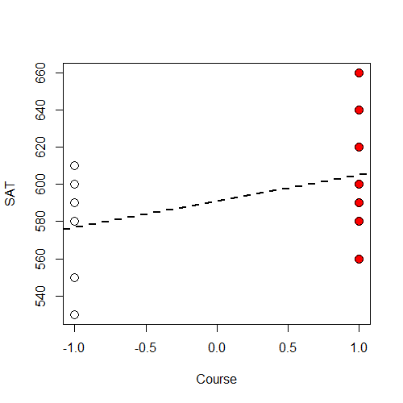
SAT Prep Course Example
Student | Group | SAT
1 | Course | 580
2 | Course | 560
3 | Course | 660
4 | Course | 620
5 | Course | 600
6 | Course | 580
7 | Course | 590
8 | Course | 640
9 | Course | 620
10 | Course | 600
11 | No Course | 580
12 | No Course | 530
13 | No Course | 590
14 | No Course | 550
15 | No Course | 610
16 | No Course | 590
17 | No Course | 600
18 | No Course | 530
19 | No Course | 590
20 | No Course | 600

Slide 3

SAT Prep Course Example
If we want to test the efficacy of an SAT prep course, we would have a model comparison:
Alternative: $y_{i}=β_{0}+β_{1}\left(X_{1i}\right)+ε_{i}$
Null: $y_{i}=β_{0}+0\left(X_{1i}\right)+ε_{i}$
Here we are contrast coding the x-variable, you can refer back to our previous video if that feels a little fuzzy.

Slide 4
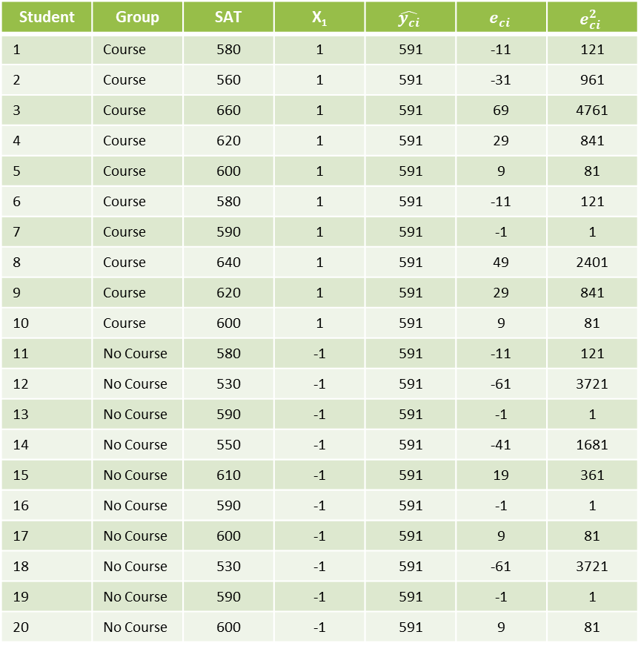

Error and ‘Fitting’ the Null Model
Student | Group | SAT | X₁ | $$\hat{y_{ci}}$$ | $$e_{ci}$$ | $$e_{ci}^{2}$$
1 | Course | 580 | 1 | 591 | -11 | 121
2 | Course | 560 | 1 | 591 | -31 | 961
3 | Course | 660 | 1 | 591 | 69 | 4761
4 | Course | 620 | 1 | 591 | 29 | 841
5 | Course | 600 | 1 | 591 | 9 | 81
6 | Course | 580 | 1 | 591 | -11 | 121
7 | Course | 590 | 1 | 591 | -1 | 1
8 | Course | 640 | 1 | 591 | 49 | 2401
9 | Course | 620 | 1 | 591 | 29 | 841
10 | Course | 600 | 1 | 591 | 9 | 81
11 | No Course | 580 | -1 | 591 | -11 | 121
12 | No Course | 530 | -1 | 591 | -61 | 3721
13 | No Course | 590 | -1 | 591 | -1 | 1
14 | No Course | 550 | -1 | 591 | -41 | 1681
15 | No Course | 610 | -1 | 591 | 19 | 361
16 | No Course | 590 | -1 | 591 | -1 | 1
17 | No Course | 600 | -1 | 591 | 9 | 81
18 | No Course | 530 | -1 | 591 | -61 | 3721
19 | No Course | 590 | -1 | 591 | -1 | 1
20 | No Course | 600 | -1 | 591 | 9 | 81
$y_{i}=β_{0}+ε_{i}$
$y_{i}=591+e_{i}$
$SSE_{total}=\sum{{\left(y_{i}−\hat{y_{ci}}\right)}^{2}=}\sum{{\left(e_{ci}\right)}^{2}}$
$SSE_{total}=19,980$

Slide 5
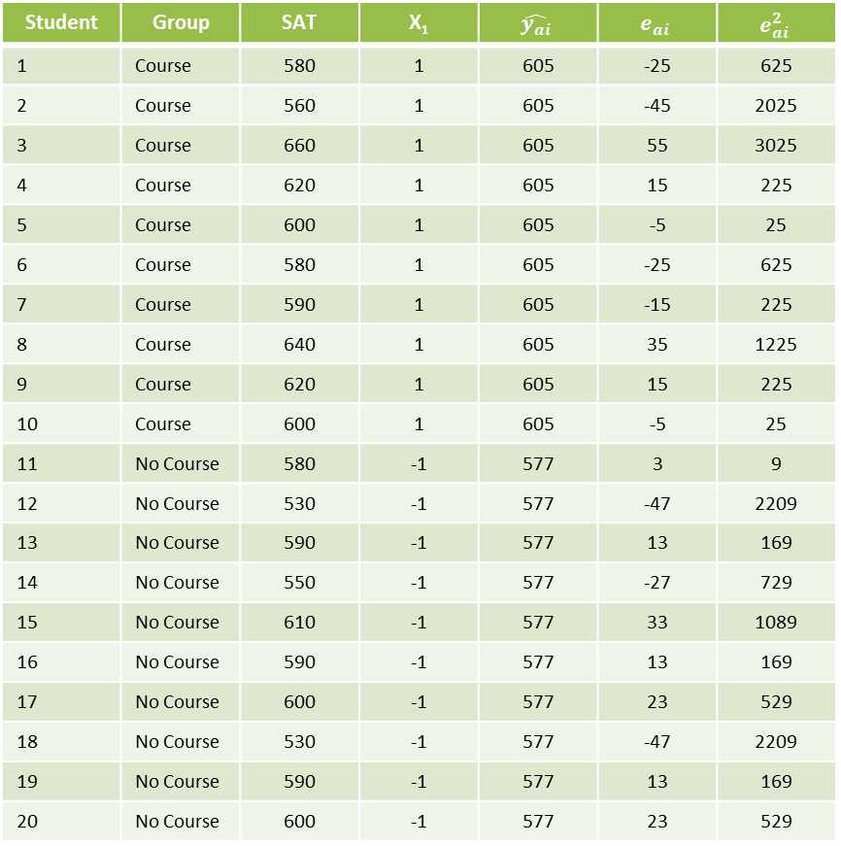

Error and ‘Fitting’ the Alternative Model
Student | Group | SAT | X₁ | $$\hat{y_{ai}}$$ | $$e_{ai}$$ | $$e_{ai}^{2}$$
1 | Course | 580 | 1 | 605 | -25 | 625
2 | Course | 560 | 1 | 605 | -45 | 2025
3 | Course | 660 | 1 | 605 | 55 | 3025
4 | Course | 620 | 1 | 605 | 15 | 225
5 | Course | 600 | 1 | 605 | -5 | 25
6 | Course | 580 | 1 | 605 | -25 | 625
7 | Course | 590 | 1 | 605 | -15 | 225
8 | Course | 640 | 1 | 605 | 35 | 1225
9 | Course | 620 | 1 | 605 | 15 | 225
10 | Course | 600 | 1 | 605 | -5 | 25
11 | No Course | 580 | -1 | 577 | 3 | 9
12 | No Course | 530 | -1 | 577 | -47 | 2209
13 | No Course | 590 | -1 | 577 | 13 | 169
14 | No Course | 550 | -1 | 577 | -27 | 729
15 | No Course | 610 | -1 | 577 | 33 | 1089
16 | No Course | 590 | -1 | 577 | 13 | 169
17 | No Course | 600 | -1 | 577 | 23 | 529
18 | No Course | 530 | -1 | 577 | -47 | 2209
19 | No Course | 590 | -1 | 577 | 13 | 169
20 | No Course | 600 | -1 | 577 | 23 | 529
$y_{i}=β_{0}+β_{1}(X_{1})ε_{i}$
$y_{i}=591+14\left(X_{1}\right)+e_{i}$
$SSE_{residual}=\sum{{\left(y_{i}−\hat{y_{ai}}\right)}^{2}=}\sum{{\left(e_{ai}\right)}^{2}}$
$SSE_{residual}=16,060$

Slide 6
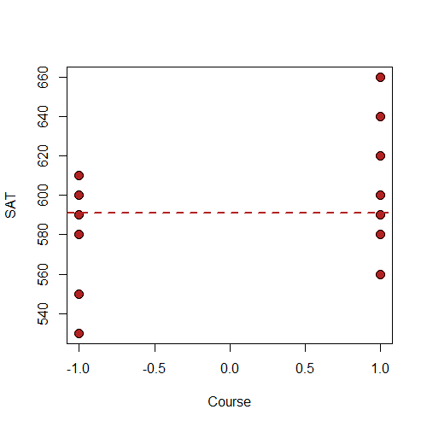




Comparing the Two Models
Fitted Model C: $y_{i}=591+e_{i}$
$$SSE_{total}=19,980$$
Fitted Model A: $y_{i}=591+14\left(X_{1}\right)+e_{i}$
$$SSE_{residual}=16,060$$
$$X_{1}=−1$$
$$X_{1}=1$$

Slide 7
ANOVA Table Testing the Null Hypothesis
Source | SSE | Df | MSE | F_obs | Pr(>F_obs)
Regression | 3,920.00 | 1 | 3,920.00 | 4.39 | 0.0505
Residual | 16,060.00 | 18 | 892.22
Total | 19,980.00 | 19
ANOVA = ANalysis Of VAriance.
We are chopping up the variance (sum of squared errors) into different sources to analyze which variables “explain” the most variance.

Slide 8
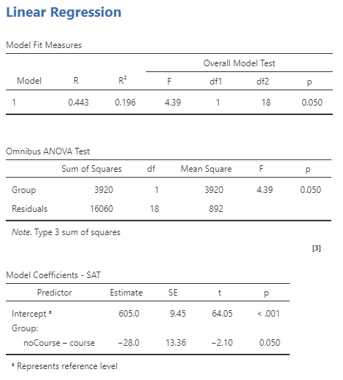
ANOVA Table Testing the Null Hypothesis
Jamovi Regression Output
Our “by hand” calculations
Source | SSE
Regression | 3,920.00
Residual | 16,060.00
Total | 19,980.00
3920/1980=0.196

Slide 9
ANOVA Table Testing the Null Hypothesis
Jamovi Regression Output
We have not yet discussed the f-statistic and it’s distribution.
The f-statistic provides a formal test of the explained variance.
Nor have we discussed the different types of Sum of Squares (1-3).
We will cover these topics in detail when we discuss multiple regression, where you have ≥2 predictors.

Slide 10
Analysis of Variance
Jamovi Regression Output
Much like the t-test, it is important we learn Analysis of Variance is not a type of test separate from regression.
We can analyze the variance of any regression!
Thus, it doesn’t really make sense to say, “I did an ANOVA”, what matters is the kind of ANOVA you did.

