Slide 1
Research Design and Analysis: Regression Assumptions
Keith Lohse, PhD, PStat
Department of Health and Kinesiology
Department of Physical Therapy and Athletic Training
University of Utah
e: rehabinformatics@gmail.com

Slide 2

What are assumptions?
In past videos, we often talked about how “the p-value is $p(data|H_{0})$ assuming that all of the other assumptions are true”.
Thus, a low p-value suggests that the data we observed are unlikely under the null or that one of our other assumptions is violated.
But what are those other assumptions?
These will vary a little bit from situation to situation, but we have some general regression assumptions that will apply broadly.

Slide 3
General Linear Regression Assumptions
Linearity - The true relationship is linear.
Independence – The errors are independent of each other (e.g., no repeated measures from the same person).
Normality - Errors are normally distributed.
Constant error variance – Errors are equally distributed around predicted values (i.e., the regression line).
This is also called homoscedasticity.
Broadly speaking, linearity and independence are big assumptions.
We get a bit more “wiggle room” with normality and homoscedasticity.

Slide 4
Continuous Predictor

Slide 5
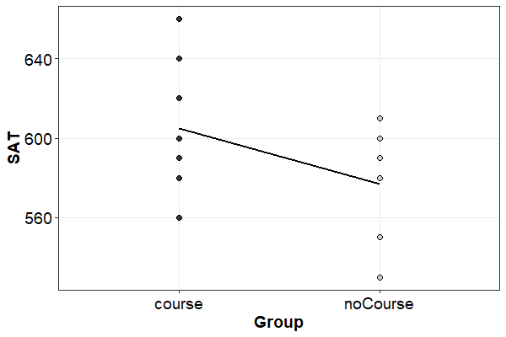
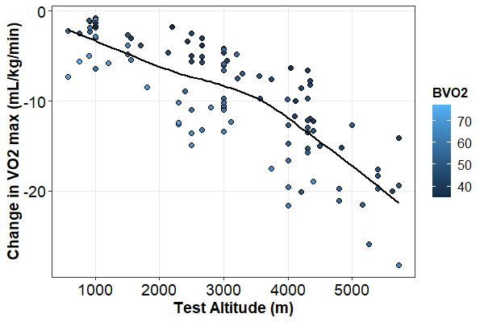
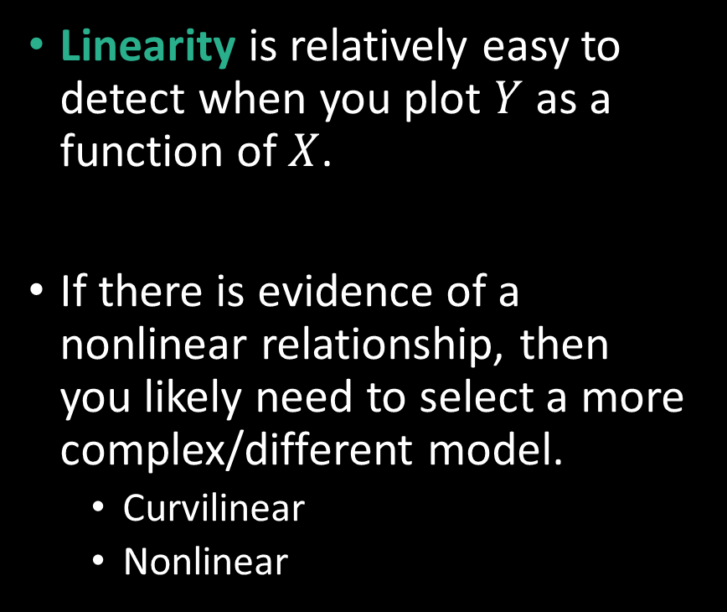
Linearity
Linearity is relatively easy to detect when you plot $Y$ as a function of $X$.
If there is evidence of a nonlinear relationship, then you likely need to select a more complex/different model.
Curvilinear
Nonlinear

Slide 6
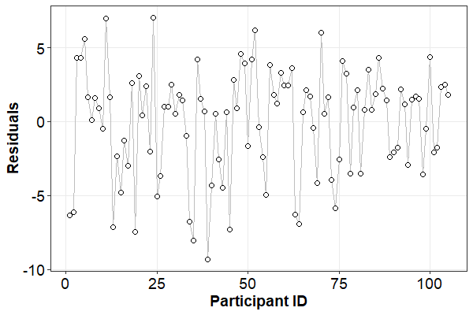
Independence
Independence is a little harder to see visually, and often comes down to what you know about your study design.
How are your data points clustered? (Over time, within families, within a person)
You may need to account for these repeated measures by changing your analytical approach.

Slide 7
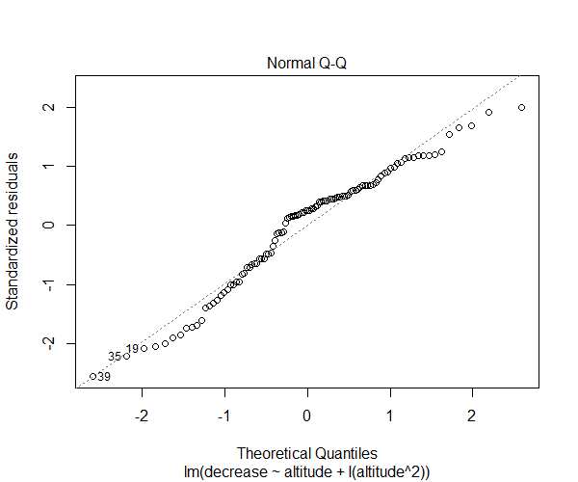
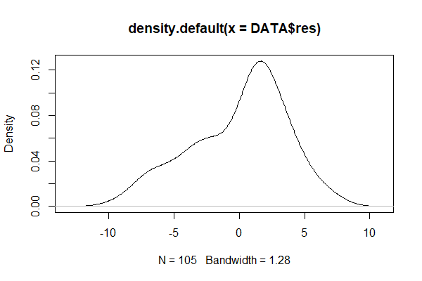
Normality
Normality can be seen in the quantile-quantile normal plot.

Slide 8
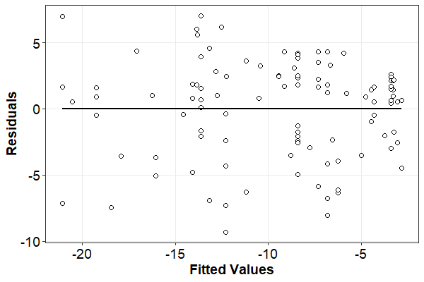
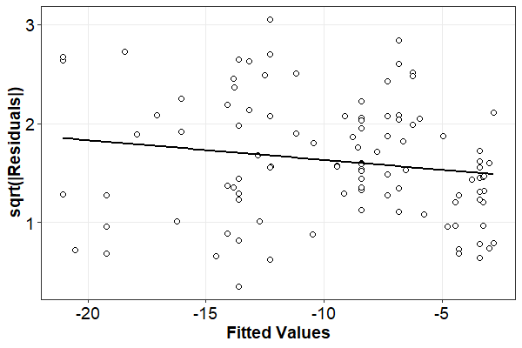
Constant Error Variance
Constant error variance (homoscedasticity) can by plotting the residuals as a function of the models predictions (also called fitted values).

Slide 9
Categorical Predictor

Slide 10
Linearity
Linearity is relatively easy to detect when you plot $Y$ as a function of $X$.
If there is evidence of a nonlinear relationship, then you likely need to select a more complex/different model.
Curvilinear
Nonlinear

Slide 11
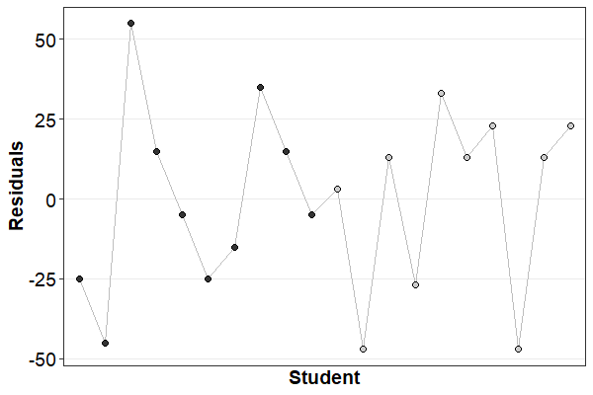
Independence
Independence is a little harder to see visually, and often comes down to what you know about your study design.
How are your data points clustered? (Over time, within families, within a person)
You may need to account for these repeated measures by changing your analytical approach.

Slide 12
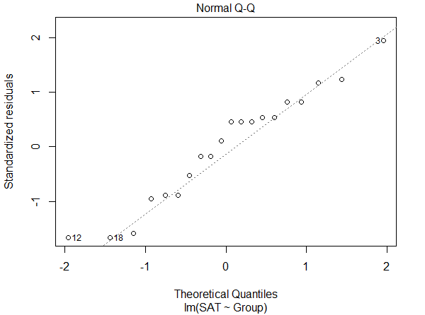
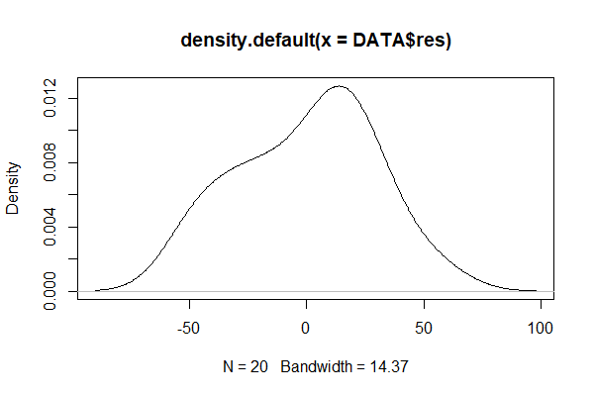
Normality
Normality can be seen in the quantile-quantile normal plot.

Slide 13
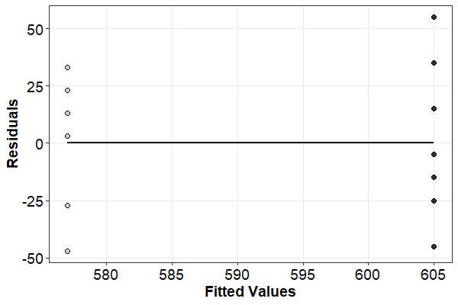
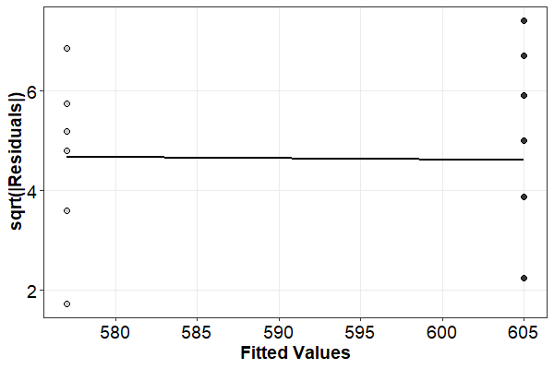
Constant Error Variance
Constant error variance (homoscedasticity) can by plotting the residuals as a function of the models predictions (also called fitted values).

Slide 14

General Linear Regression Assumptions
We will get into more details about these regression assumptions and explore them in different study designs as we go along.
However, keep these four assumptions in mind.
Always plot your data before you do analyses.
Do not simply trust summary statistics and p-values.
If you violate these assumptions, you are not out of luck, it just means you need a different statistical model.
E.g., if you have binary outcomes:
Linear regression assumes a continuous $Y$ with a normal distribution of errors.
You need to switch to logistic regression.

